Slide 1
Chapter 33 Mitigating Circumstances for Phone Agents

Slide 2
Overview of Today’s Training
Chapter 33 Mitigating Circumstances for Phone Agents
The purpose of this lesson is to provide Education phone agents with the knowledge to answer questions regarding changes in enrollments involving Mitigating Circumstances (MITCs), occurring on or after November 15, 2015, in the Long Term Solutions (LTS).

Slide 3
Lesson Objectives
At the end of this lesson, you will be able to:
Using available references, identify acceptable reasons for adjustments to enrollments, including Mitigating Circumstances (MITCs), with 80% accuracy on the assessment.
Using available references, identify changes to payments as a result of MITCs, with 80% accuracy on the assessment.

Slide 4
Terminology

Slide 5
Mitigating Circumstances (MITCs)
Mitigating circumstances (MITCs) are circumstances beyond the claimant's control that prevent the continuous pursuit of a program of education.

Slide 6
Acceptable Mitigating Circumstances
Examples of acceptable MITCs include:
An illness or injury afflicting the student during the enrollment period An illness or death in the student's immediate family An unavoidable change in the student's conditions of employment An unavoidable geographical transfer resulting from the student's employment | Immediate family or financial obligations requiring suspension of training to obtain employment Discontinuance of the class by the school Unanticipated active military service, including active duty for training Unanticipated difficulties with child care arrangements the student has made for the period during which he or she is attending classes

Slide 7
Drop Period
The drop period is a reasonably brief period of time, at the beginning of a term, officially designated by a school for dropping one or more classes without penalty.
The school's last day to drop a class will be the end of the drop period, providing it does not exceed 30 days from the first day of the term.

Slide 8
Punitive Grades
A punitive grade (Passing or Failing) is a grade assigned for pursuit of a class that is used in determining overall progress toward completion of the school's requirements for graduation.
Unlike a non-punitive grade, the punitive grade imposes a penalty toward graduation, such as an adverse effect on the student's GPA.
Examples of punitive grades are: A, B, C, D, F.

Slide 9
Non-Punitive Grades
A non-punitive grade is a grade not used when determining progress for fulfillment of requirements for graduation.
Such a grade neither yields credit toward the school's requirements for graduation nor affects a student’s GPA.
The non-punitive grade causes the class to become the equivalent of an audited class for the purpose of advancement toward graduation.
Non-punitive grade examples are W, WF, WP, Incomplete.

Slide 10
VA Form 22-1999B & 22-1999 (AM1999)
Changes to enrollments may be submitted as a Notice of Change in Student Status (VA Form 22-1999B) or an Amended Enrollment Certification (VA Form 22-1999).
Corrections to enrollment information such as changes to term dates, tuition updates or any change that is effective at the beginning of the enrollment period would be reported on an VA Form 22-1999.
Changes that involve hours enrolled including; increases, reductions and terminations are reported on a VA Form 22-1999B.

Slide 11
Comprehension Check
What is the difference between punitive and non-punitive grades?

Slide 12
Adjustments to Enrollments & MITCs

Slide 13
Adjustments to Enrollments
The law prohibits payment of VA benefits for a class from which a student withdraws and receives a grade that will not be used in computing requirements for graduation and/or be factored into the student’s Grade Point Average (GPA).
Exceptions
Benefits may still be paid if the student can establish that the failure to complete the class(es) was due to:
The student being ordered to active duty, or
A withdrawal during the "drop" period, or
Punitive grades, or
MITCs

Slide 14
Adjustments to Enrollments (Continued)
The purpose of the original legislation creating these rules was to minimize the abuse of VA educational assistance programs by certain students who were using the non-punitive grading and liberal withdrawal policies of some schools to receive VA benefits for several terms without achieving progress toward program completion.

Slide 15
Comprehension Check
Question:
If a student withdraws from a class, benefits may still be paid if the student can establish that the failure to complete the class was due to what exceptions?
What are some examples of acceptable MITCs?

Slide 16
Six Credit Hour Exclusion (6X) - Defined
VA automatically issues a one-time grant of MITCs for up to 6 credit hours for the first instance of a reduction or termination which is after the drop period, and before the end of the term, for which a non-punitive grade is assigned.
This exclusion is called the Six Credit Hour Exclusion (6X) and can only be made one time for a claimant across the various VA education programs.

Slide 17
Six Credit Hour Exclusion (6X)
The Six Credit Hour Exclusion does not apply in the following situations:
Student completes a class and receives a non-punitive grade; or
Has not yet been awarded benefits for the dropped class(es).
When called to active duty
School cancelation/closure or
Other adjudication determination where it should not be applied.

Slide 18
Six Credit Hour Exclusion (6X) - Application
If more than 6 credit hours are dropped in the first instance, the additional hours will be subject to the MITCs rules.
VA will automatically cover the first 6 credits and will consider whether or not acceptable MITCs apply to the remaining credits.

Slide 19
Comprehension Check
Question:
How often can a student qualify for the Six Credit Hour Exclusion (6X)?

Slide 20
Protected Unprotected Hours
Protected hours = Payable
Unprotected hours = Not Payable
Terminations and reductions are considered “Protected” when they occur:
Before the end of the drop-period (30 day max.)
After the drop period with non-punitive grades and acceptable MITCs are received
After the drop period with non-punitive grades and the 6-credit exclusion covers dropped classes
Anytime a punitive grade is assigned

Slide 21
Effective Dates of Terminations
If the withdrawal is from all classes before the end of the institution's drop period:
Benefits are paid through the last day of attendance.
If the withdrawal is from all classes after the end of the institution's drop period and punitive grades are assigned for the classes or acceptable MITCs are available:
Benefits are paid through the last day of attendance.

Slide 22
Effective Dates of Terminations (Continued)
If the withdrawal is from all classes after the institution's drop period, with non-punitive grades assigned, and no acceptable MITCs are found:
Benefits are terminated effective the first date of the enrollment period.
If the 6X is available and only covers part of the drop:
Pay 6 credit hours through the last date of attendance, and
Reduce any remaining hours effective the first date of the term.

Slide 23
Effective Dates of Terminations (Continued)
If an individual completes a class but at the end of the term, semester, or quarter receives a non-punitive grade for the class and acceptable MITCs are not found:
Terminate benefits from the first date of the enrollment period.
Note: The 6-credit exclusion is not a factor in such cases and should not be applied.

Slide 24
Comprehension Check
Questions:
When are benefits terminated if a student withdraws from all classes before the end of the institution's drop period?
When are benefits terminated if a student withdraws from all classes after the institution's drop period, with non-punitive grades assigned, and no acceptable MITCs are found?

Slide 25
Effective Dates of Reductions
When a student reduces hours enrolled by withdrawing from fewer than all classes on or before the first day of the term, reduce payments effective the first date of the term.

Slide 26
Effective Dates of Reductions (Continued)
A reduction occurs when the student reduces hours enrolled by withdrawing from fewer than all classes under one of the following “protected” conditions:
The reduction is during the drop period, (30 day max.);
A punitive grade is assigned for the class from which the student withdraws; or
MITCs are received and accepted, the 6-credit exclusion applies to all hours, or the training is discontinued as the result of being ordered to active duty
Payments are reduced effective the end of the month or end of the term whichever occurs first.

Slide 27
Effective Dates of Reductions (Continued)
Reductions with non-punitive grades occurring after the institution’s drop period that are “unprotected” will be adjusted effective the first day of the term. All payments associated with those hours are not payable.
Chapter 33 “protected” reductions are effective and payable through the end of the month of the change.
VA cannot pay benefits when a claimant is no longer attending an enrollment period.

Slide 28
Comprehension Check
Questions:
When a student reduces hours enrolled by withdrawing from fewer than all classes on or before the first day of the term, payments are reduced effective when?
If a student reduces their hours enrolled by withdrawing from fewer than all classes and MITCs are received and approved, payments would be reduced effective when?

Slide 29
Changes to Enrollment (VA Forms 22-1999 & 1999B)
In most cases, a VCE should not need to enter information manually.
If there is missing, conflicting, or illogical information, develop with the SCO or ELR as appropriate.
Anytime “Other” is used as the reason for an adjustment and is not fully explained in the remarks, develop with the SCO for clarification and place all development documents in the TIMS folder.

Slide 30
Notification Letters
LTS generated letters have been developed to provide proper notification.
LTS generates the following MITC letters:
MITCs Required – MITC-1 letter
MITCs Received and Not Acceptable – MITC-2 letter
MITCs Received and Acceptable – MITC-3 letter
Six-Credit Hour Exclusion – MITC-4 letter

Slide 31
Mitigating Circumstances are Required (MITC-1)

Slide 32
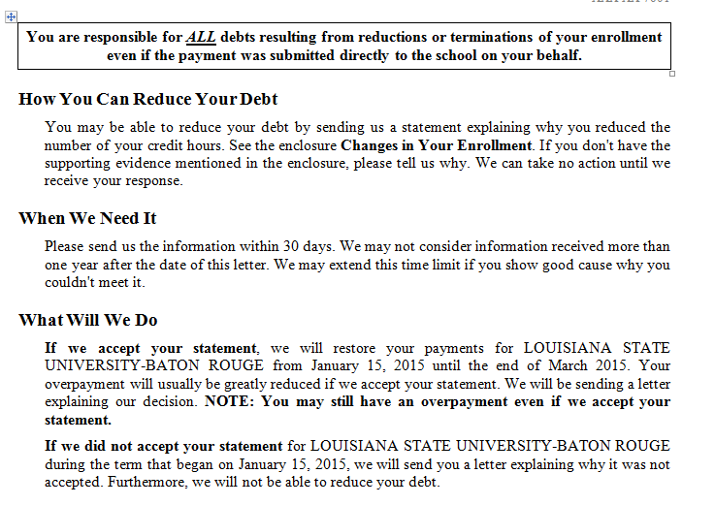
Example of a MITC-1 Letter

Slide 33
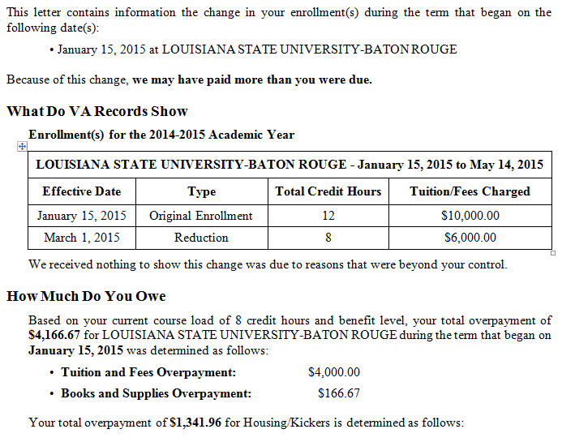
Example of a MITC-1 Letter (Continued)
Processing Mitigating Circumstances for Post-9/11 GI Bill Claims

Slide 34
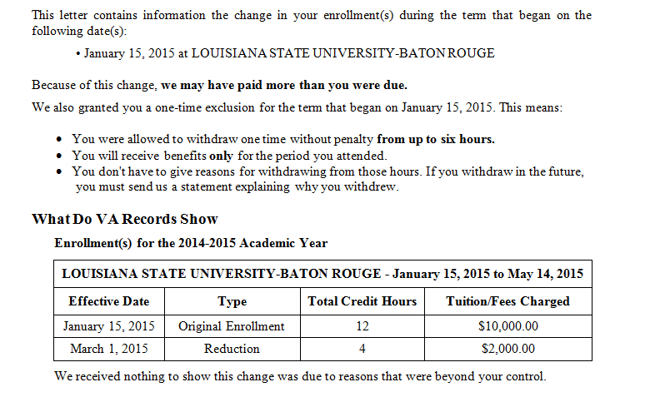
Example of a MITC-1 w/6X Letter

Slide 35
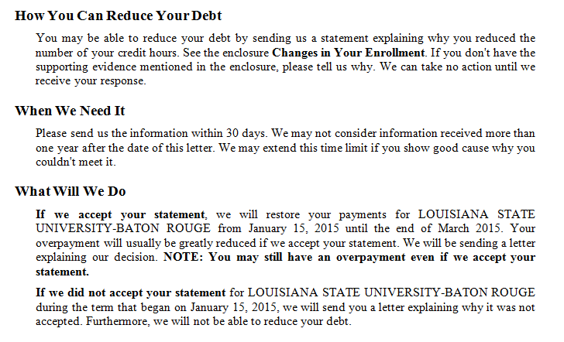
Example of a MITC-1 w/6X Letter (Continued)

Slide 36
Comprehension Check
Question:
When is the MITC-1 Letter utilized?

Slide 37
MITCs Received but Not Accepted Letter (MITC-2)

Slide 38
MITC-2 Letter Information
When necessary, MITCs are requested from the claimant. If received, claims processors must determine if they are acceptable or unacceptable.

Slide 39
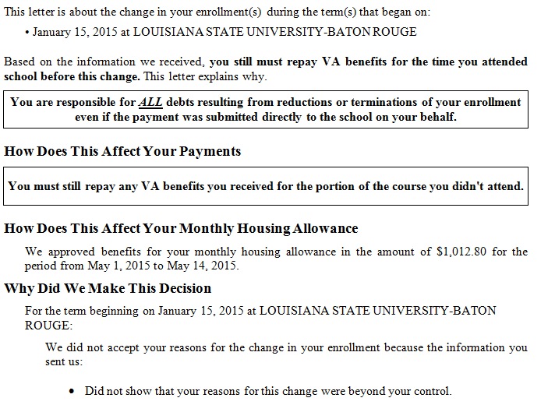
Example of a MITC-2 Letter

Slide 40
Comprehension Check
Question:
When is the MITC-2 Letter utilized?

Slide 41
Mitigating Circumstances Received and Accepted Letter (MITC-3)

Slide 42
MITC-3 Letter Information
The MITC-3 letter informs the claimant he/she withdrew from a period enrollment and the mitigating circumstance submitted was acceptable. Therefore, VA will not ask the claimant to repay benefits for the time attended school prior to the reduction/withdrawal.
Note: The claimant will still have to repay any VA benefits received for the portion of the class not attended.

Slide 43
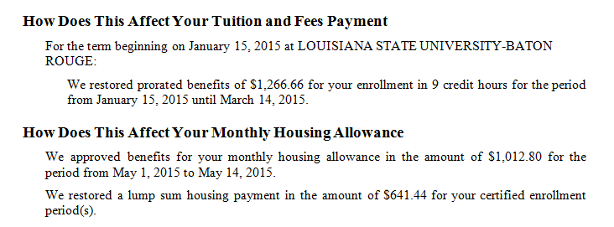
Example of a MITC-3 Letter
Indicating Tuition and Fees Payment restored.

Slide 44
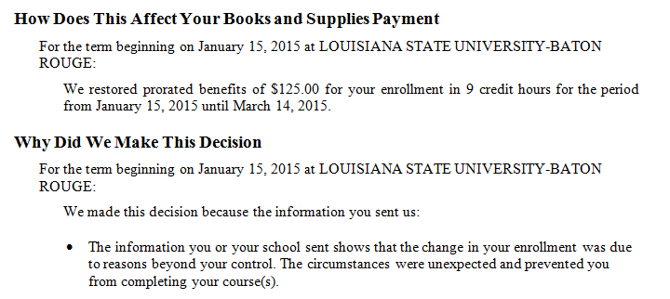
Example of a MITC-3 Letter (Continued)
Indicating Books and Supplies Payment restored.

Slide 45
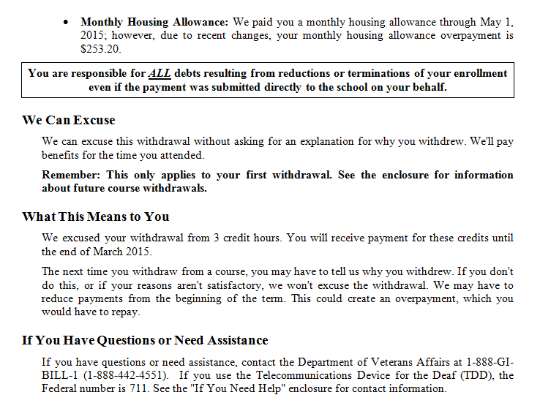
Example a MITC-3 Letter (Continued)

Slide 46
Six Credit Hours Exclusion (6X) Granted for Withdrawal/Termination (MITC-4)

Slide 47
MITC-4 Letter Information
When an amendment is added to a term and MITCs are required, LTS will automatically apply 6X if it is available.

Slide 48
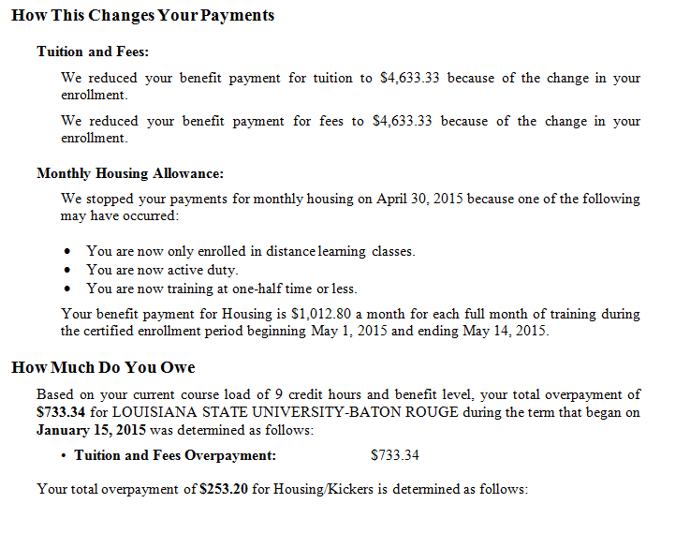
Example of a MITC-4 Letter

Slide 49
Example of a MITC-4 Letter (Continued)

Slide 50
How to Report MITCS
A student may submit Mitigating Circumstances:
In writing to the Regional Office of Jurisdiction
Through the Submit a Question Portal on GiBill Website
By phone contact to ECC
The phone tech will complete a Form 119 listing specific reasons for the mitigating circumstances

Slide 51
Summary
You have completed the Mitigating Circumstances for Post 9/11 GI Bill Claims lesson. You should be able to:
Using available references, identify acceptable reasons for adjustments to enrollments, including Mitigating Circumstances (MITCs), with 80% accuracy on the assessment.
Using available references, identify changes to payments as a result of MITCs, with 80% accuracy on the assessment.

Slide 52
Questions?
What questions do you have?

Slide 53
TMS Assessment and Survey
The assessment and survey have been assigned to you in TMS.
The assessment is comprised of multiple choice questions.
The questions are based on the information presented in this lesson.
The assessment should take you approximately 30 minutes.
Be sure to complete both the assessment and the survey in TMS to receive credit for this training.

