Slide 1
Intent to File (ITF)
Compensation Service
November 2020

Slide 2
Purpose of This Lesson
This lesson explains what an Intent to File (ITF) a claim is, why they’re important, how they can be communicated to VA, what to do if the ITF is incomplete, and how to determine the status of an ITF.
This lesson is important because ITFs may affect the amount of retroactive benefits a claimant receives. Therefore, we need to process them correctly and always check to see if an ITF was active when a claim was received.

Slide 3
Objectives
Recall the history of informal claims and ITF
Identify what kinds of claims an ITF can be applied to
List required elements of an ITF
Recognize the different ways an ITF can be communicated
Describe development actions needed for an incomplete communication of an ITF
Locate list of ITFs in VBMS and determine their status
Demonstrate how an ITF can affect possible effective dates

Slide 4
References
§38 CFR 3.155(b) - Intent to file a claim
§38 CFR 3.155(d) - Claims
M21-1 III.ii.2.C. - Informal Claims Received Prior to March 24, 2015, Communication of an Intent to File (ITF), and Requests for Application
M21-1 III.iv.5.C.2. - Impact of ITF on Effective Date

Slide 5
Topic 1: Informal Claims vs. Intent to File
Topic 1 objectives:
Recall the history of informal claims and ITF
Identify what kinds of claims an ITF can be applied to
List required elements of an ITF
Recognize the different ways an ITF can be communicated

Slide 6
Informal Claims
Prior to March 25, 2015, any communication or action that showed an intent to apply for benefits was considered an “informal claim.”
Informal claims were important because they served as an effective date placeholder, if VA received a substantially complete claim within one year of the date we notified the claimant one was needed.
VA stopped accepting informal claims on March 24, 2015
Notes:
III.ii.2.C.1.a-b

Slide 7
Intent to File (ITF)
Claimants desiring an effective date placeholder on or after March 24, 2015, must communicate to VA a formal “intent to file” a claim.
ITFs allow the claimant one year to submit a substantially complete claim and potentially maintain the date of the ITF as the effective date
Notes:
III.ii.2.C.2.a, III.ii.2.C.2.c

Slide 8
Benefits ITF Applies To
Compensation
Pension
Survivor’s Pension, and
Dependency and Indemnity Compensation (DIC)
Note: An ITF is specific to the benefit sought. When the claim received is not for the same type of benefit identified on the ITF, the ITF may not be applied to the claim for purposes of effective date assignment.
Notes:
III.ii.2.C.2.l, Note: III.ii.2.C.2.e

Slide 9
Benefits ITF Does Not Apply To
Examples of claims ITF does not apply to (not a complete list):
Dependency
Ancillary benefits
Requests for higher-level review
Supplemental claims
Duplicate claims
Requests for review based on a clear and unmistakable error
Notes:
III.ii.2.C.2.l

Slide 10
Required Elements of an ITF
A communication of an ITF is adequate if the claimant (or another authorized person):
Provides VA with enough information to identify the Veteran (and themselves if they are not the Veteran), and
Specifies the general benefit they are seeking (compensation and/or pension, or Survivors Pension and/or Dependency and Indemnity Compensation (DIC)), and
Signs VA Form 21-0966 (if that’s how ITF is communicated)
Notes:
III.ii.2.C.2.b

Slide 11
5 Ways to Communicate an ITF
1. Initiating an application for benefits online via:
eBenefits, Veterans On-Line Application (VONAPP), VONAPP Direct Connect (VDC)
Stakeholder Enterprise Portal (SEP)
Digits-to-Digits (D2D)
Online claims initiated and completed on the same day create both an ITF and a claim (which subsumes the ITF created by initiation – if an active ITF doesn’t already exist).
Notes:
III.ii.2.C.2.a

Slide 12
5 Ways to Communicate an ITF (cont.)
2. Submitting a completed VA Form 21-0966, Intent to File a Claim for Compensation and/or Pension, or Survivors Pension and/or DIC.
It must be signed by:
The claimant
The claimant’s VSO, or
A VA-recognized power of attorney (POA)
Assume the claimant is the Veteran if he/she leaves the Claimant/Veteran Identification section of the form blank.
Notes:
III.ii.2.C.2.a-b

Slide 13
5 Ways to Communicate an ITF (cont.)
3. Contacting a National Call Center (NCC)
If the claimant doesn’t have a corporate record, the call center employee must complete, sign, and submit VA Form 21-0966 on the claimant's behalf.
4. Contacting a Veterans Service Center (VSC) or Pension Management Center (PMC) employee by telephone or in person.
5. Communicating an ITF to a Field Examiner as directed in the Fiduciary Program Manual (FPM) 2.D.3.p.
Notes:
III.ii.2.C.2.a-b

Slide 14
Request for Application
Any communication received on or after March 24, 2015 that indicates the desire to submit a claim but is not an ITF (or on a prescribed form) is a “Request for Application.”
A Request for Application (RFA) letter should be sent to the claimant informing them what they need to do to submit an ITF and/or formal claim. It should be generated in VBMS using the process described in the handout.
Notes:
III.ii.2.C.6.a

Slide 15
VA Form 21-0966 Not in VBMS
A VA Form 21-0966 will NOT appear in the documents list if the ITF was communicated by:
Initiating an application online
Calling a VA call center
Speaking to a VSC or PMC employee who has immediate access to VBMS (to enter the ITF)
Notes:
III.ii.2.C.3.a

Slide 16
Topic 1 Knowledge Check
On what date did VA stop accepting informal claims?
March 24, 2015
What is the benefit of an ITF?
It acts as an effective date placeholder.
Will a VAF 21-0966 always appear in VBMS?
No

Slide 17
Topic 2: ITF Development and Status in VBMS
Topic 2 objectives:
Describe development actions needed for an incomplete communication of an ITF
Locate list of ITFs in VBMS and determine their status

Slide 18
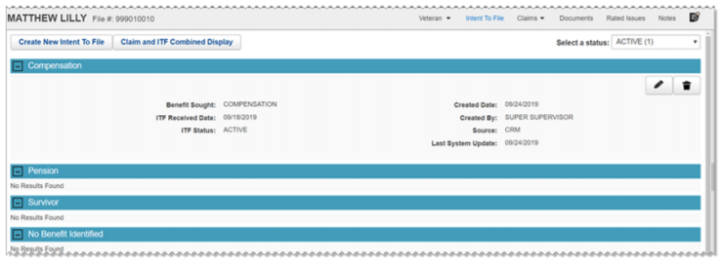
ITFs in VBMS
ITF information can be found on the “Intent To File” tab in VBMS.
Notes:
III.ii.2.C.3.d

Slide 19
Entering an ITF in VBMS
ITFs can be manually created using the “Create New Intent To File” button. A combined list of claims and ITFs can be displayed by selecting “Claim and ITF Combined Display”.

Slide 20
ITF Acknowledgement Letter
When a valid ITF is communicated online or entered in VBMS, and a substantially complete claim is NOT submitted online the same day, the Hines Information Technology Center (ITC) generates and mails to the claimant a letter
confirming
the date VA received the claimant’s communication of an ITF, and
the benefit(s) the claimant is seeking, and
informing the claimant of
the form(s) that must be completed to apply for benefits, and
the time limit for returning the completed form(s) to VA.
Notes:
III.ii.2.C.2.m

Slide 21
ITF Acknowledgement Letter (cont.)
Historically a copy of this letter was automatically uploaded to “Legacy Content Manager Documents”. Currently the letter is uploaded to the eFolder.
Sometimes, the Hines ITC is unable to generate the ITF Acknowledgement Letter. Upon receipt of notice that this has occurred, manually create the letter using the Active ITF Notification Letter from the Letter Creator tool or equivalent letter generated in Personal Computer Generated Letters (PCGL), and upload to the eFolder.
Notes:
III.ii.2.C.2.m

Slide 22
Incomplete VA Form 21-0966
If VA Form 21-0966 is missing a required element, and VA has not received a subsequent claim, telephone development should be attempted to obtain the missing information.
If telephone development is unsuccessful, an “Incomplete ITF” letter must be sent to the claimant. This letter is sent automatically when an incomplete ITF is entered in VBMS.
If a subsequent claim has been received an “Incomplete ITF – Claim Received” letter should be sent using the Letter Creator program.
Notes:
III.ii.2.C.4.a-c

Slide 23
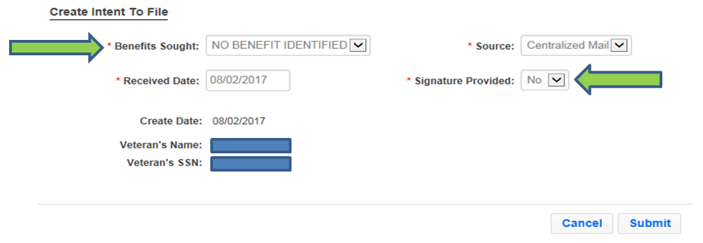
Incomplete ITF Letter in VBMS
An “Incomplete ITF” letter is automatically generated by entering an ITF in VBMS and selecting the benefit sought is unidentified and/or the signature is missing.
Notes:
III.ii.2.C.4.a

Slide 24
Status of ITFs
Active – only one ITF can be active at a time
Duplicate – an ITF received while an active one exists
Incomplete – requires development
Expired – did not receive claim within one year of ITF
Claim Received – claim received within one year of ITF
Canceled – created erroneously
Notes:
III.ii.2.C.3.e

Slide 25
Expiration of ITFs
An ITF is considered “Active” as an effective date placeholder until:
VA receives a substantially complete claim for the same benefit on a prescribed form; or
One year passes since VA received the ITF
Only one ITF can be active at a time. If another ITF is received while an active ITF exists for the same type of benefit, it is a “Duplicate” ITF.
Notes:
III.ii.2.C.2.d, One-year calculation: III.ii.2.C.5.f

Slide 26
Searching for the Status of ITFs
To search for the status of any previous or current ITFs, use the “Select a Status” drop down.

Slide 27
Topic 2 Knowledge Check
Does the procedure for handling an incomplete VA Form 21-0966 depend on whether a subsequent claim has been received?
Yes
True or False: There can be multiple active ITFs.
False
How many different ITF Status indicators are there?
6

Slide 28
Topic 3: ITF and Effective Dates
Topic 3 objective:
Demonstrate how an ITF can affect possible effective dates

Slide 29
ITF and Effective Dates
If an active ITF exists at the time a substantially complete claim is received, VA may grant entitlement to benefits from an effective date prior to the date of claim (DOC).
The status of the ITF must be “Active” when a claim is received to qualify as an effective date placeholder for that claim.
Other factors must be evaluated along with the ITF to determine the correct effective dates (multiple ITFs, RAD date, etc.)
Notes:
III.ii.2.C.2.d, III.iv.5.C.2.a-c

Slide 30
Multiple ITFs and/or Multiple Claims
Each ITF can only be associated with one substantially complete claim, though it applies to all issues within that claim
Any subsequent claims submitted will not be associated with the ITF already connected to the original claim
After an ITF and claim have been associated, a claimant may submit a subsequent ITF to serve as a new placeholder for a supplemental claim
Notes:
III.ii.2.C.2.d

Slide 31
Potential Effective Date Example 1
A Veteran communicates an ITF for compensation to a National Call Center (NCC) on June 1, 2017.
On November 1, 2017, the Veteran begins an online application for SC for a back disorder through eBenefits.
On January 1, 2018, VA receives a VA Form 21-526EZ from the Veteran with a non-original claim for SC for a knee disorder.
On February 1, 2018, the Veteran completes and submits the online application for SC for a back disorder.

Slide 32
Potential Effective Date Example 1 (cont.)
What is the status of the ITF received June 1, 2017 when the next complete claim is received?
Active
What claim is associated to the ITF received June 1, 2017?
January 1, 2018, for knee disorder
What is the status of the ITF received November 1, 2017?
Duplicate
What would be the potential earliest effective date for back disorder?
February 1, 2018, the date of claim. The November 1, 2017 ITF was not active at the time of receipt of claim for the back disorder.
Notes:
III.iv.5.C.2.c

Slide 33
ITF Within One Year of Discharge
If… | Then the earliest potential effective date of entitlement to benefits is…
VA receives communication of a Veteran’s ITF within one year of the date he/she separated from service, and VA subsequently receives a substantially complete application within one year of the date VA received the communication of an ITF | the day after the Veteran separated from service.
Notes:
III.iv.5.C.2.b

Slide 34
Potential Effective Date Example 2
A Veteran is honorably discharged from active duty on September 1, 2017.
On December 1, 2017, VA receives the Veteran’s communication of an ITF.
On November 1, 2018, VA receives VA Form 21-526EZ from the Veteran with a claim for SC for a knee disorder.
What is the earliest potential effective date?
September 2, 2017, because VA received the ITF within one year of the discharge date and received VA Form 21-526EZ, within one year of the ITF.
Notes:
III.iv.5.C.2.b-c

Slide 35
Topic 3 Knowledge Check
Does an ITF always affect the potential effective date?
No
If an ITF applies to a subsequent claim, will the effective date always be the date we received the ITF?
No
If we receive an ITF and then two subsequent claims on different days, does the ITF apply to the second claim?
No

Slide 36
Questions?

