Slide 1
Address, Electronic Funds Transfer, and Certification Standards

Slide 2
Overview of Today’s Training
The purpose of this lesson is to provide the procedures and practice for:
Various types of addresses and their standards
Change of address (CADD) requirements and procedures
Setting up, changing, and cancelling an electronic funds transfer (EFT)
Performing a certification of attendance

Slide 3
Icebreaker Activity
Answer this question:
What information do you want to learn during this training session?

Slide 4
Lesson Objectives
At the conclusion of this lesson, you will be able to:
Differentiate types of addresses and the associated standards
Identify the process for performing a change of address (CADD)
Determine the procedures required to perform an electronic funds transfer (EFT)
Identify the requirements for certification of attendance

Slide 5
Address Standards

Slide 6
BDN and USPS Requirements
Payments (checks) and letters are sent according to the address entered in the Benefits Delivery Network (BDN)
To ensure proper receipt, addresses must conform to United States Postal Service (USPS) standards
BDN’s address area contains a maximum of 6 lines, and is limited to 20 characters per line
The claims processor must know how to conform to USPS standards within the confines of BDN

Slide 7
General Address Standards
A standard address contains three lines:
Recipient Line
Delivery Line (Address Line)
Last Line
Alternate payees (fiduciary) should be put on second line (making 4 total lines)
The address should be all uppercase with no punctuation
The # symbol should only be used if apartment (Apt) or Suite (Ste.) is not available; space between # and unit.
Ex: # 100

Slide 8
Domestic Addresses
Treat all US. Territories as domestic addresses
The proper format for last line is city, space, two position state abbreviation, space, zip code
Ex: HEMPSTEAD NY 11550
If necessary, the zip code may be placed on a line below the last line
Apt or Ste. # should be placed on the delivery line. If there is no room, it should be placed on line above delivery line
A PO Box should be placed on delivery line
Abbreviate cities according to Appendix 4 of the VBA Education Services Address Standards Guide

Slide 9
Military and Department of State Addresses
Military and Department of State addresses must contain:
Location | Abbreviation
Army/Air Post Office | APO
Fleet Post Office | FPO
Diplomatic Post Office | DPO
Armed Forces Europe, Middle East, Africa, and Canada | AE
Armed forces in the Pacific | AP
Armed forces in the Americas, excluding Canada | AA

Slide 10
Military and Department of State Format
The Delivery line contains the Military Postal Center information or US Navy/Coast Guard vessel information.
The APO/FPO/DPO and AE/AP/AA state abbreviation code should be placed on the same line. For example:
JOHN P JONES
USS COCHRANE (DDG-21)
FPO AP 09001

Slide 11
Canadian Addresses
The address should contain the 2 position abbreviation for provinces and territories and the Canadian Postal Code
The City, Province/Territory Code and Canadian Postal Code should be placed on the same delivery line
Canada should be spelled out in all uppercase on the last line followed by the three position Foreign Zip (FZ) Code
Ex: HELEN SAUNDERS
1010 CLEAR STREET
OTTAWA ON K1A 0B1
CANADA FZ953

Slide 12
Foreign Addresses
For payment processing, it is critical that the correct 3-digit foreign zip is entered on a foreign address
The country name should be placed on the last line with the FZ code directly following it
If country name and FZ code do not fit on same line, place the FZ code on the following line
Ex: JOHN SMITH
CAYETANO 201
SANTO DOMINGO
DOMINICAN REPUBLIC
FZ934

Slide 13
Accepted Abbreviations – Short Endings
Substitute short endings as follows:
Short Ending | Abbreviation
AN | A
ER | R
IAL | L
AL | L
IES | S
ES | S
ED | D
ING | NG
TION | TN

Slide 14
Accepted Abbreviations – Dwellings
Accepted abbreviations for homes, offices, or other dwellings are:
Dwelling | Abbreviation
Apartment | APT
Building | BLDG
Floor | FL
Office | OFC
Suite | STE
Unit | UNIT
Room | RM
Department | DEPT

Slide 15
Additional Rules for Compressing an Address
When compressing an address line:
Do not alter the 1st or 2nd words. Exception: If the first word is “THE”, which may be removed
Remove special characters
Remove repetitive words
Vowels may be removed on a word-by-word basis, but always leave the last vowel. Do not remove the first character if it is a vowel

Slide 16
Topic Review
In this topic, the following was covered:
Differences between domestic and military addresses
Elements of a foreign address
Location of local information related to address standards
Acceptable abbreviations and rules for compressing and address

Slide 17
Resources
USPS website Publication (PUB) 28: http://pe.usps.com/cpim/ftp/pubs/pub28/pub28.pdf
VBA Education Service Address Standards (Feb 2012)

Slide 18
Comprehension Check
Question:
What is the accepted abbreviation for the following?
APARTMENT
BUILDING
ROOM
DEPARTMENT

Slide 19
Change of Address (CADD) for Phone Techs

Slide 20
Purpose of CADD
A claimant’s address is a vital piece of information needed to notify the claimant of:
Eligibility for education benefits
Request for more information
Awards and payments
Debts
Appeals process
Incorrect addresses results in returned mail to the VA, which could negatively affect time-sensitive documents and complicate the administration of benefits.

Slide 21
PII Required for CADD
Before changing an address in a claimant’s file, you must verify Personally Identifiable Information (PII) to ensure you are speaking to the claimant or an authorized individual.
PII that must be verified includes:
SSN or Claim Number
Full Name
Complete Address of Record
Date of Birth
Branch of Service (except for Ch33 FRY or Ch35)
Verify that the caller is calling from an unrestricted/unblocked phone number.

Slide 22
Verification of PII
PII should be verified using:
BDN M21 screen
BDN VID screen
LTS
Claimant’s application
VA Form 22-1995

Slide 23
Additional Sources for Verification
If the verification sources shown previously are not available or information is outdated, additional VA systems may be used for verification such as Share, VIS, TIMS documents, correspondence, etc.
If the caller cannot correctly answer PII, have them submit the requested address changes on
VA Form 20-572
***Required Education ID Protocol information can be found on the ECC’s “Green Card”

Slide 24
Role Play Activity
Verifying PII Information for CADD
Pair up! Select a “caller” and a “VA Employee”.
Using the information given to each of you by the instructor, ensure that PII has been verified.
Caller, you can either give the proper information or give incorrect, or slightly off information. Such as switching numbers, not being exactly sure of something and you think it might be…, etc.
Switch roles and use the second address provided by the instructor.

Slide 25
Potential Issues When Performing a CADD:
When verifying, the caller provides the information. The agent should not provide any information
If the address of record is incorrect due to VA error, the VA employee may verify and correct the address using additional sources
Misspelled words or transposed numbers can be corrected by the VA employee and do not require additional ID protocol by the caller
If the caller indicates possible fraud in changing an address, verify their address according to source documents, correct the address of record and notify your coach about the case.

Slide 26
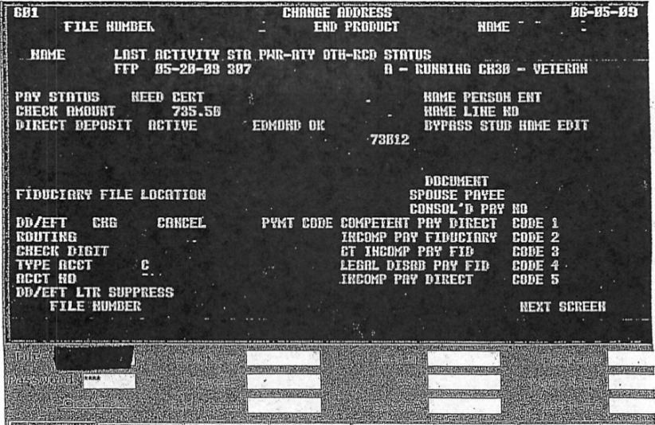
Completing the CADD in BDN
Enter the file number and payee number in BDN Shell.
Select the “CADD” button in the BDN Shell.
On the 601 screen, tab down to the address.
Type over the data to change it. Be sure to use VBA Address Standards.
Select the “Enter” key (Select twice for Ch35).
Note, if the claimant is using Chapter 33, you must change the address in LTS.

Slide 27
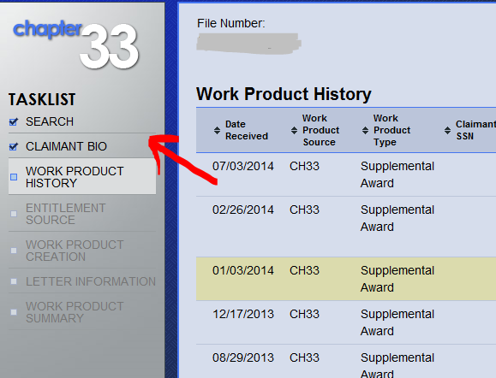
Completing the CADD in LTS – Claimant Bio
On the Work Product History Screen, select “Claimant Bio”.

Slide 28
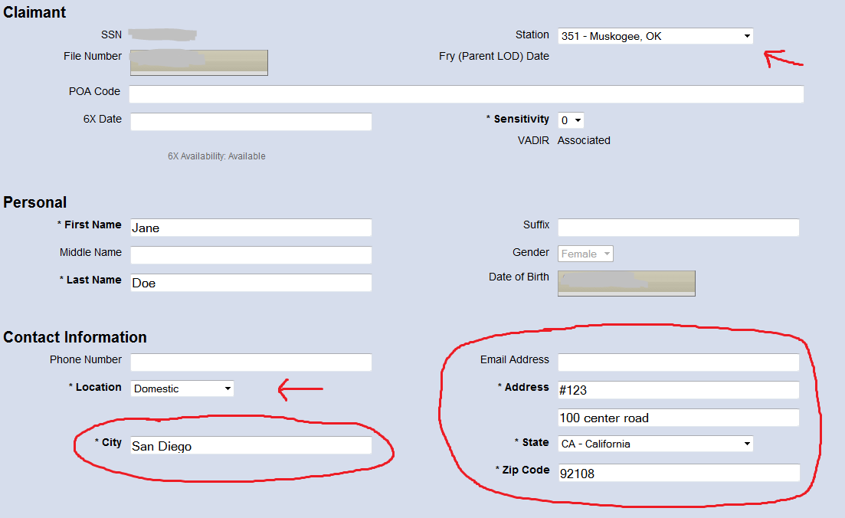
Completing the CADD in LTS – BIO SCREEN
Once on the Bio screen:
Select the correct RPO
Select Domestic, Foreign, or Military and enter the entire address per VBA Standards
Make sure the BDN and LTS addresses match
Delete any extra spaces after City (these sometimes show on letters)

Slide 29
Completing the CADD in LTS - NEXT
Choose “Next” to go back to the “Work Product History” Screen

Slide 30
Annotation of TIMS File
After completing an address change, be sure to place a “NOTE” in the TIMS file, by doing the following:
Type the complete, new address in proper format
Do not use screen captures
Annotate the NOTE (F9 key) after placing it in TIMS to indicate the source of the change:
CADD per call from Veteran
CADD per 1999
CADD per School Certifying Official

Slide 31
Comprehension Check
Why is it important to properly format a change of address?

Slide 32
Topic Review
In this topic you learned:
Why a proper change of address is important
What information is to be verified before completing the CADD
Which screens on the BDN and LTS the change of address is performed
How to annotate a change of address

Slide 33
References
VBA Education Service Address Standards (Feb 2012)
Revised Procedural Advisory: Education Call Center Identification (ID) Protocol, May 13, 2015
ECC Required Education ID Protocol (Green Card)

Slide 34
Electronic Funds Transfer (EFT)

Slide 35
Purpose of EFT
Maintaining correct electronic funds transfer (EFT) information is crucial for prompt and correct payment to claimants.
EFT information can change over time, therefore, it is important to know why and when information is changed.

Slide 36
Background
On December 21, 2010, the U.S. Treasury issued a final rule that anyone who receives a Federal benefit payment must receive those payments by Electronic Funds Transfer (EFT).
The Treasury reserves the right to automatically enroll the claimant in the Direct Express Debt Master Card program if they do not sign up for EFT.

Slide 37
Direct Deposit
Claimants may enroll in direct deposit, in one of three ways:
Contacting the VA by phone (1-888-442-4551)
Contacting the Department of Treasury Go Direct (for a Direct Express Debit MasterCard(1-800-333-1795)
Mailing in a VA Form 24-0296, Direct Deposit Enrollment Form
Accessing eBenefits

Slide 38
PII Required for New EFT
Only the claimant or their legal guardian is authorized to change EFT information
To confirm that you are speaking with the actual claimant, you must verify the following information through approved sources:
SSN or Claim Number
Full Name
Complete Address of Record
Date of Birth
Branch of Service (if Veteran or Servicemember)

Slide 39
Comprehension Check
Questions:
What is the purpose of the EFT program?
Who can change EFT information?

Slide 40
Setting Up EFT in BDN
To add new EFT information in BDN:
Enter the file number and payee number into BDN Shell
Select the CADD button in BDN Shell

Slide 41
BDN 601 Screen
On the 601 Screen:
Enter an “x” next to New.
Enter the new routing number Note: the last digit of the routing number will wrap to the Check Digit line.
Enter an “S” for savings account, or “C” for checking account type.
Enter Account number.
Select “Enter” (Select the “Enter” button twice for Ch35).

Slide 42
PII Required for Changing or Cancelling EFT
Recall the following:
Only the claimant or their legal guardian is authorized to change EFT information
To confirm that you are speaking with the actual claimant, you must verify the following information through approved sources:
SSN or claim number
Full name
Date of birth
Branch of service (if Veteran or servicemember)
Full account number of record

Slide 43
Potential Issues When Verifying PII
When verifying PII, requirements include:
The caller must provide the information. The agent should not provide the information to the caller
If the address of record is incorrect due to VA error, the phone agent may verify and correct the address using additional sources
Misspelled words or transposed numbers can be corrected by the phone agent and do not require additional ID protocol by the caller
If the caller indicates possible fraud in changing an address, verify their address according to source documents, correct the address of record, and notify your coach about the case

Slide 44
Changing EFT Information in BDN
To change EFT information in BDN:
Enter the file number and payee number into BDN Shell.
Select the CADD button in BDN Shell.
On the 601 Screen:
Enter an “x” next to “New”
Enter the new routing number
Note: the last digit of the routing number will wrap to the Check Digit line
Type an “S” for savings account, or “C” for checking account type
Enter the account number
Select Enter button. Select the button twice for Ch35

Slide 45
Cancelling EFT in BDN
To cancel EFT information into BDN:
Enter the file number and payee number into BDN Shell.
Select the CADD button in BDN Shell.
On the 601 Screen:
Enter an “x” next to “Cancel”
Select Enter button. Select the button twice for Ch35

Slide 46
Annotate the TIMS File
To place a “Note” in the TIMS file:
Type the new routing number and account number in the TIMS note and label as either a checking account or savings account
Do not copy and paste information or use screen captures inside notes, as this will slow operation and contains too much information, making the note difficult to read and interpret
Label the Note as “EFT per ______.”
EFT per claimant phone call
EFT per VA Form 22-1995
Use the F9 key to index

Slide 47
International Bank Accounts
If a claimant wants to set up or change EFT information for a bank account located at a foreign bank, they should complete the International Direct Deposit Enrollment Form (VA Form 24-0296A) and send it to:
Department of Veterans Affairs
810 Vermont Ave, NW
Washington DC 20420
Mail Stop: 241C
Fax: 202-495-6704

Slide 48
Comprehension Check
Questions:
List the PII items required to setup an EFT.
List the PII items required when cancelling and changing an account.

Slide 49
Topic Review
In this topic you learned:
Having a claimant’s correct EFT information in VA systems is critical to timely payments
An EFT account is now mandatory for VA benefit payments
The mandatory PII verification questions for setting up a new EFT account are different than those required to change or cancel an EFT account
The phone agent must annotate changes to EFT accounts by placing a Note in the TIMS file
Requests to set up EFT for a foreign account must be mailed in using VA Form 24-0296A

Slide 50
References
Revised Procedural Advisory: Education Call Center Identification (ID) Protocol, May 13, 2015
EFT Instructions (under Training Resources on the ECC Index)
Direct Deposit Script (under Scripts on the ECC Index)
Required Education ID Protocol (Green Card)

Slide 51
Certifying Enrollments and Attendance

Slide 52
Certifying Requirements
Students using Ch30, 1606, 1607, or pursuing an NCD under Ch35 and 32 must certify:
Enrollment on the last calendar day of each month in order to get paid for that month’s attendance
Attendance the day after their term ends (if there are no remaining terms during that month)
Students using Ch33 (including TOE and FRY) or pursuing an IHL degree under Ch35 or 32 do not need to certify. These payments are system generated.

Slide 53
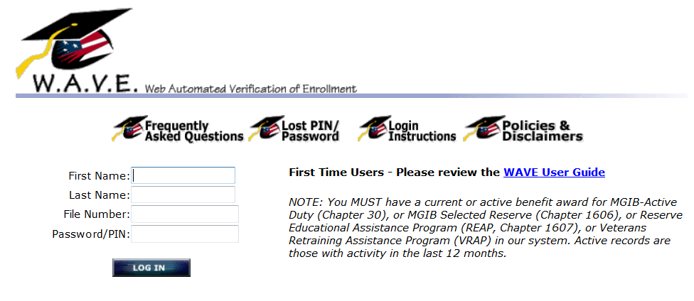
Enrollment Certification Methods
There are three ways a student can certify enrollment:
Call the Education Call Center (1-888-442-4551)
Call the automated phone line (1-877-823-2378)
Verify online at https://www.gibill.va.gov.wave/

Slide 54
Phone Certification
When a student calls the Education Call Center (ECC) to certify attendance, the VA employee performs the following:
Confirm the student’s address and EFT information
Confirm the hours of attendance for the month
If the hours are correct, certify attendance in BDN

Slide 55
Confirm the Student’s Address & EFT
Before certifying enrollment, ask the student if their address or EFT information needs to be updated
If information needs to be updated, perform the following:
Follow identification protocol instructions.
Update the information.
Place a note in the TIMS file with the updated information.
If the address or EFT cannot be updated due to a failed identification protocol, do not process the certification
The Student may send in a written request to change the address (VA Form 20-572) or EFT (VA Form 24-0296) or call back with correct information before certification

Slide 56
Confirm the Hours of Attendance
The VA employee should:
Ask specific questions to make sure the hours of attendance have not changed:
“How many hours are you attending?”
“Did you drop hours or withdraw from class?”
“Did you complete your term this month?”
Verify the student’s response with the enrollment information shown on the M21 screen

Slide 57
Certify Attendance
Certify the attendance if the:
Student confirms that there are no changes to their enrollment and the reported enrollment information matches enrollment data on the BDN M21 screen.
-or-
Only change to enrollment involves an increase in hours.

Slide 58
M21 Screen
Ensure enrollment information provided by the student matches the M21 screen.
Also note the Date Last Paid and Date Last Certified.

Slide 59
Discrepancies in Enrollment
If the stated hours of attendance do not match the enrollment in BDN, perform the following:
Do not certify as this could create debts.
Check TIMS to see if any unauthorized or pending changes, (22-1999b) are noted.
If yes, advise the student certification will be performed when the change is authorized
If no, advise the student to have SCO submit changes on a Change in Enrollment form (22-1999b)
Advise the student to submit self-reported changes through WAVE.

Slide 60
Practice Exercise
Given the records and data from your instructor:
Determine if attendance should be certified.
Explain why or why not.

Slide 61
Certify Attendance in BDN
In BDN, complete the stub name using the first initial, middle initial, and first 5 letters of the last name.
Example: J A SMITH
For Ch35 claims, use the dependent’s stub name
The stub name must match the stub name on the M21 screen
Complete the payee field.
Enter payee number (i.e. 00, 41, etc.)
Select the “CERT” button for the benefit type (this will take you to the 317 General Certification “Cert” Screen).

Slide 62
317 “CERT” Screen

Slide 63
Completing the Certification on 317 Screen.
To compete the certification, use the 317 screen and:
Place an “X” by the type of certification (Chapter 35 requires a “Y”).
Enter certification dates in MMDDYY format for:
Period Begin Date: Beginning term date or date last paid on M21
Certified Thru Date: The later of the last day of the month or the last day of the term
Select the Enter button (twice for a Ch35 claim).
NOTE: Payment information will be immediately available on the M22 screen (except for Ch35).

Slide 64
Practice Activity
Instructions:
Given an actual M21 record, determine the date for the next monthly certification of enrollment.

Slide 65
Certification Issues for Chapter 35 Claims
Chapter 35 certification issues include:
Chapter 35 transactions cycle in BDN approximately 8 times per month as compared to 20 times per month for other benefits
Additionally, only one transaction (CERT, CADD, EFT, Pending AUTH, etc.) can cycle at a time as opposed to other benefits in which multiple transactions can cycle on the same day
BDN transactions will not be visible in BDN until they cycle. Because of this, Chapter 35 transactions must be handled differently

Slide 66
Certifying Chapter 35 Claims
Check the TIMS file for notes left by other agents or processors before certifying enrollment.
If a note indicates a recent change has been made (CERT, CADD, EFT, Pending AUTH), check the schedule of operations to make sure the action has had time to cycle:
If not, do not perform certification - instead, have student call back in a couple of days
If the action has cycled, complete the certification
After certifying, place a NOTE in the TIMS file listing the beginning cert date and the certified thru date.

Slide 67
Missing Documents
If a student calls in to certify enrollment for a term and the enrollment is not reflected in their TIMS file:
Ask the student to provide:
Cert ID# and date submitted for a missing cert
Confirmation# and date submitted for a missing VONAPP
Wait at least three business days from the date the document was submitted before performing an electronic search for the document
Note: The student may have to contact their SCO for the Cert ID# and date submitted on a missing cert and call back with the information.

Slide 68
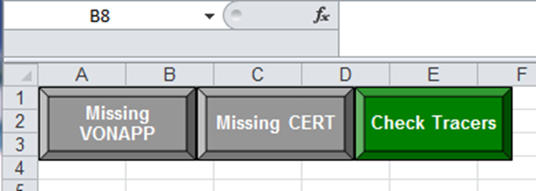
Electronic Searches for Missing Documents
Step 1 | Select the “ECC Buttons” icon on the homepage of the ECC Index.
Step 2 | Select “Missing Cert” to locate a missing VA Form 22-1991999/1999b/AM1999/E1999. or Select “Missing VONAPP” to locate a missing VA Form 22-1990 or VA Form 22-5490.

Slide 69
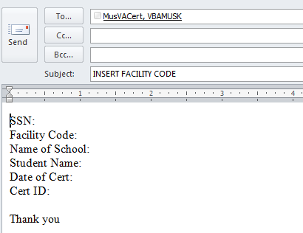
Missing Certification
To search for a missing certification:
Select the “Missing Cert” button.
When the email opens, change the subject line to the Facility Code of the School.
Fill in the appropriate information as prepopulated.
Send the email and capture a copy of the sent email in TIMS.
Label as “Missing Cert Request”.

Slide 70
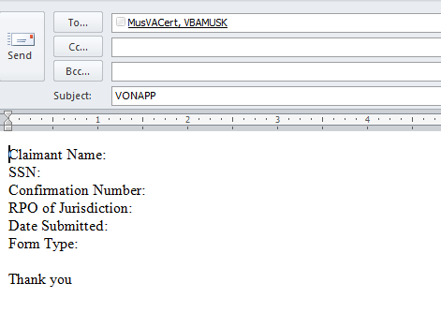
Missing VONAPP
To search for a missing VONAPP:
Select the “Missing VONAPP” button.
When the pre-populated email opens up, complete the appropriate information.
Send the email and capture a copy of the sent email in TIMS.

Slide 71
Comprehension Check
Scenario:
A Chapter 1606 student calls to certify their attendance for the month of August. You are aware you must confirm the address, EFT, enrollment, and certify attendance.
During the conversation, the student lets you know that his EFT has changed, but his address and enrollment are still correct.
Question:
Which actions would you perform and in what order?
Do Not Certify Attendance
Ask the student to call back
Complete a CADD or EFT change
Perform a Missing Cert/VONAPP action
Certify Attendance

Slide 72
Comprehension Check
Scenario:
A Chapter 35 student calls to certify attendance at their IHL. They inform you that their address, EFT, and enrollment information is correct.
Question:
Which of the following would you do and why?
Certify Attendances
Do Not Certify Attendance
Check TIMS for more information
Complete a CADD or EFT change
Perform a Missing Cert/VONAPP action

Slide 73
References
BDN Schedule of Operations
M22-4, Pt. III, ch. 8
M22-4, Pt. V, ch. 6
M22-4, Pt. VIII, ch. 6
ECC Index, Training Resources, Certifying or Verifying Enrollment
ECC Index, Training Resources, Missing Cert and VONAPP

Slide 74
Topic Review
In this topic you learned:
Benefits that require monthly certification
Three ways students can certify attendance
How to find the correct dates for certification
Three actions phone agents should perform when certifying attendance
How to locate the Date Last Certified
How to perform certification in BDN
Common issues when certifying attendance for Ch35 claims
How to request missing documents

Slide 75
Lesson Summary
You have completed the Address and Certification Standards lesson. You should be able to:
Differentiate types of addresses and the associated standards
Identify the process for performing a change of address (CADD)
Determine the procedures required to perform an electronic funds transfer (EFT)
Perform a certification of attendance

Slide 76
Questions?

Slide 77
TMS Assessment and Survey
The assessment and survey have been assigned to you in TMS
The assessment is comprised of multiple choice questions
The questions are based on the information you learned today
The assessment should take approximately 30 minutes
Be sure to complete both the assessment and the survey in TMS to receive credit for this training

