Slide 1
Pension & Fiduciary Service Quality Review Teleconference
December 16, 2014

Slide 2
Roll Call & Agenda
Hub Roll Call
Agenda
  Verifying/Documenting SSA Income
  Most Common References Cited in FY14
  Reconsideration Discussions
  FE Centralized Training
  FY15 National Training Curriculum
  Spring 2015 QR Conference
  New Training & Quality SharePoint Site
  Open Forum

Slide 3
Verifying/Documenting SSA Income
Fiduciary Program Manual 2.D.13.f.
  FE must verify and document all sources of income
  Must review all evidence received with the field examination request, and compare it to information provided, fully explaining any changes or inconsistencies
Verify Social Security:
  SHARE (gross benefit and Medicare part B)
  VA Form 21-592
  In person with SSA award letter, or bank statement
In all cases – document how SSA was verified

Slide 4
FY14 Most Common References
Top 3 most common substantive errors in FY14:
  B2, B3, B4
Top Fiduciary Program Manual and Fast Letter references:

Slide 5
Reconsideration Discussion
Case Example 1
Funds on deposit must be verified if over $5k
Bank verification by telephone
  B4 error was cited for not verifying by bank statement or by 4718a (FPM 2.D.13.e.)
  Upheld
Case Example 2
Proper account registration
  B6 error was cited because account was not properly titled to identify fiduciary relationship at time of interview, and FX report did not document need for corrective action (FPM 3.B.5.c.)
  Account was properly titled (and verified) by time WPC was cleared
  Withdrawn

Slide 6
FE Centralized Training
Next iteration: January 26 – February 6
  Student nominations due by January 9
Training Prerequisites / Locally teach and certify:
  Microsoft Office Suite (to include Lync)
  Internet Browser Navigation
  E-mail
  VA systems (SHARE, VVA, CAPRI, MAP-D, and BFFS)
Changes to instructor solicitation:
  Nominate 4 instructors per Hub for all FY15 iterations
  Available for one week only (versus entire 2-week duration)
  Act as primary and back-up for the one-week period
  Instructor nominations due by January 9

Slide 7
FY15 National Training Curriculum
Major changes to training in FY15:
  Trainees (one year and under) / Experienced (more than a year)
  Assign training by placing users into TMS Class by position/ experience level
  Technical and Developmental training are now Station-Selected
  Station-Selected can be any course from
    VBA Learning Catalog
    Skillsoft Catalog
    VALU Catalog
  List of suggested Station-Selected courses on SharePoint
  Locally developed training still must be submitted for approval
  Cross-training is encouraged

Slide 8
Spring 2015 QR Conference
Considering March or April (pending approval)
Will discuss STAR items such as consistency studies and will conduct blind reviews
Send FIDSTAR any topics/items you’d like to discuss
Would require travel card and travel card training (VA 5508)

Slide 9
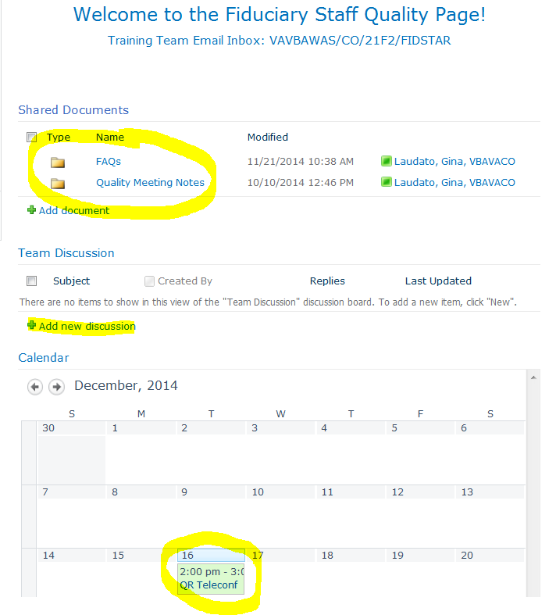
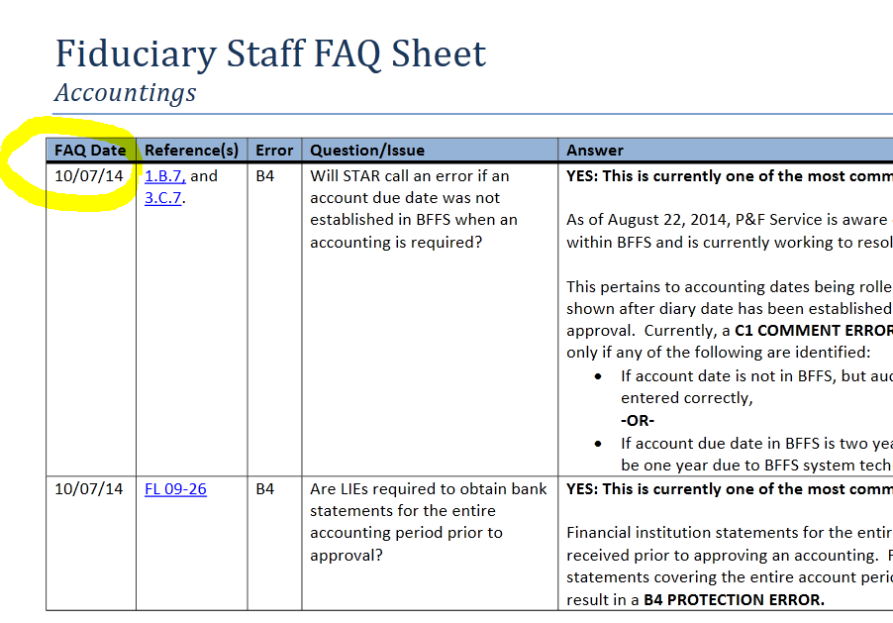
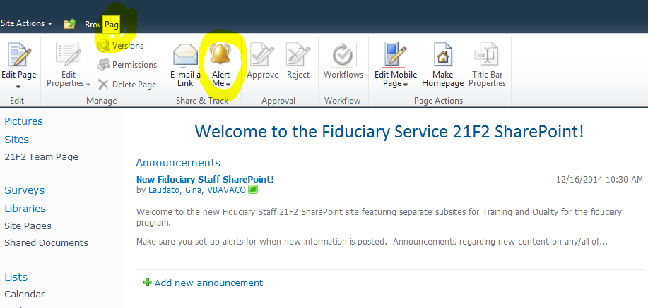
New SharePoint Site
FAQs
QR Call Notes
Calendar / Events
Training Info
Discussion Board
Set Alerts

Slide 10
Open Discussion
New SharePoint site link:
https://vaww.portal2.va.gov/sites/FiduciaryService21F2/default.aspx
Questions, Comments?

