Slide 1
Compensation Service
February 2016
Effective Dates
(Post Challenge RVSR)

Slide 2
Objectives
Demonstrate a comprehensive understanding of effective date rules and regulations.
Identify the appropriate effective date.

Slide 3
References
38 CFR 3.400, Effective Dates; General
38 CFR 3.155, How to file a claim
38 CFR 3.1(r), Definitions, Date of receipt
38 CFR 3.114, Change of law or Department of Veterans Affairs issue
38 CFR 3.816, Awards under the Nehmer Court Orders for disability or death caused by a condition presumptively associated with herbicide exposure
38 CFR 3.105, Revision of decisions
38 CFR 3.156 New and material evidence
38 CFR 3.157 historical, Report of examination or hospitalization as claim for increase or to reopen
38 CFR 3.401(a), Effective Dates; Veterans, Aid and attendance and housebound benefits
38 CFR 4.29, Ratings for service-connected disabilities requiring hospital treatment or observation
38 CFR 4.30, Convalescent ratings
M21-1 Part III, Subpart ii,2.B.1, Applications for Disability Compensation and/or Pension
M21-1 Part III, Subpart ii,2.C.1, Identification of an Informal Original Claim Received Prior to March 24, 2015, an ITF, and a Request for Application
M21-1 Part III, Subpart i,3.B.4.a, Determining the Appropriate Effective Date for a Grant of Benefits Under the FDC Program
M21-1 Part IV, Subpart ii,2.C.3.i, Date Disabilities Became Subject to Presumptive SC Under 38 CFR 3.309(e)
M21-1 Part IV, Subpart ii,2.F.1.a, Establishing Entitlement to TDIU

Slide 4
Effective Date Determination
What is the issue?
Service connection?
Increased evaluation?
Original/New/Reconsideration/Reopen?
What is the date of receipt of the claim?
Was there an intent to file?
Was the claim received before or after March 24, 2015?
What is the date basic entitlement arose?
Do any liberalizing laws or special considerations apply?
3.114? Section 506 PL 112-154?

Slide 5
§3.400 The General Rule
The effective date is the date of receipt of the claim or the date entitlement arose (whichever is later, unless otherwise provided)
CANNOT be prior to discharge.
CANNOT be prior to existence of the condition, or level of severity in the instance of an increase.
CANNOT be prior to service connection of primary condition.

Slide 6
§3.400(b)(2)
(i) Direct Service Connection
Day following separation from active service, if claimed within one year from separation
Otherwise: date of receipt of claim, or date entitlement arose, whichever is later.
(ii)–Presumptive Service Connection
Date entitlement arose, if claimed within one year from separation
Otherwise: date of receipt of claim, or date entitlement arose, whichever is later.

Slide 7
§3.400 (o)(2) – Claims for Increase
Earliest date as of which it is factually ascertainable that an increase in disability had occurred if claim is received within one year from such date
otherwise, date of receipt of claim

Slide 8
Individual Unemployability
§3.400 (o)(2) Earliest date as of which it is factually ascertainable based on all evidence of record that an increase in disability had occurred if a complete claim or intent to file a claim is received within 1 year from such date, otherwise, date of receipt of claim.
date following date last worked
the effective date of the grant of disability(ies) that first met the minimum schedular requirements
the effective date of the grant of or (increase in) disability(ies) which result in or contribute to the Veteran’s unemployability

Slide 9
§3.157 – Report of examination or hospitalization as claim for increase or to reopen
PRIOR TO MARCH 24, 2015:
The date of outpatient or hospital examination or date of admission to a VA or uniformed services hospital for a service connection condition will be accepted as the date of receipt of a claim for increase.
**There is no time limit for application of §3.157, this should continue to be applied when admission or treatment took place prior to March 24, 2015.**

Slide 10
§3.157 :Eliminated by Standard Claims and Appeals Form Rule
ON OR AFTER MARCH 24, 2015:
Hospitalization reports from VA or military treatment facilities will be accepted as a prescribed form for temporary total disability rating paragraph 29 and 30 benefits.
When … | Then make the 100-percent rating effective the date …
considering any VA hospitalizations non-VA hospitalizations, if authorized by VA on or before the date of admission unauthorized non-VA hospitalizations if the Veteran is SC at the time of admission and a claim for increase is received within one year of the date of admission, or there is a pending claim for service connection for the disability(ies) | of hospital admission.
VA receives an Intent to File (ITF) within one year of admission to a non-VA hospital, and a claim for compensation within one year of the receipt of the ITF | of hospital admission.
VA receives an ITF within one year of admission to a non-VA hospital, and a claim for compensation more than one year after receipt of the ITF | VA received the claim.
VA receives a claim showing admission to a non-VA hospital more than one year ago | VA received the claim.

Slide 11
Effective Dates of Hospitalization Ratings
§4.29 100% for hospitalization in excess of 21 days
The first day of continuous hospitalization and will be terminated effective the last day of the month of hospital discharge.
§4.30 Convalescent Ratings
This date of hospital admission or outpatient treatment and continuing for a period of 1, 2, or 3 months from the first day of the month following such hospital discharge or outpatient release.

Slide 12
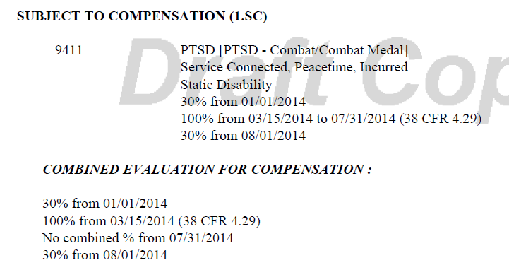
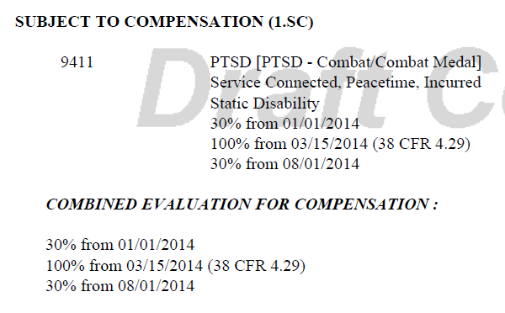
VBMS inputs

Slide 13
Secondary vs. Worsening
Secondary: One condition is caused by another, not a disease process
For effective date purposes, secondary service connection arises as a result of a specific claim
§3.400 “general rule” is governing rule
Worsening: Part of a disease process, considered an “increased” manifestation of the primary disease
For effective date purposes, treated as an increased manifestation
§3.400(o) applies
§3.157 potentially applies

Slide 14
Reconsideration vs. Reopen
Reconsideration: received within the one-year appeal period, which begins on the date the claimant was notified of the decision at issue.
A prescribed form is not required for a request for reconsideration.
§3.400(q) The effective date will be as though the former decision had not been rendered.
Reopened Claim: an application for a benefit received after final denial.
the claim must be submitted on a prescribed form.
§3.400(r) Date of receipt of claim or date entitlement arose, whichever is later.
*Both require the Veteran to submit or identify new evidence related to the previously denied/decided issue(s).

Slide 15
§3.156 (c) Service department records
At any time after VA issues a decision on a claim, if VA receives or associates with the claims file relevant official service department records that existed and had not been associated with the claims file when VA first decided the claim, VA will reconsider the claim. This includes:
(i) Service records that are related to a claimed in-service event, injury, or disease,
(ii) Additional service records forwarded by the Department of Defense or the service department to VA any time after VA's original request for service records; and
(iii) Declassified records that could not have been obtained because the records were classified when VA decided the claim.
An award made based all or in part on the records is effective on the date entitlement arose or the date VA received the previously decided claim, whichever is later.

Slide 16
Reductions
After the notice of proposed adverse action has been sent and the 60-day period following that date has passed, prepare a final rating decision to reflect a lower evaluation.
The lower evaluation is effective the first day of the month following expiration of a 60-day period of time that commences the date the Veteran is notified of the final rating decision.
*When the net result is a higher or the same combined evaluation, promulgate the rating evaluation without proposal or due process.

Slide 17
Competency
Prepare a rating decision proposing a finding of incompetency
Provide the payee notice of the proposed incompetency rating, and the opportunity for a hearing
Issue a final decision based on all the evidence of record
§3.400 (x) Effective date of determination of incompetency
Date of rating of incompetency.
§3.400 (y) Effective date of determination restoring competency
Date shown by evidence of record that competency was regained.

Slide 18
Special Considerations

Slide 19
§3.114 – Liberalizing Legislation
If criteria for eligibility for the liberalized benefit were met from the date of the law change, and
reviewed by VA or claimed by Veteran within one year of law change, effective date is date of law change.
reviewed by VA or claimed by Veteran more than one year after law change, effective date is one year prior to date of VA review/date of claim.

Slide 20
Nehmer
Nehmer class members are Vietnam Veterans who served in-country and have a covered herbicide disease, or the surviving spouse, child, or parent of a Vietnam Veteran who died from a covered herbicide disease.
The first claim of service connection for the condition at issue was received BEFORE the condition was added to the list of Agent Orange-related disabilities and the effective date for the grant of service connection will also be BEFORE the condition was added to the list of Agent Orange-related disabilities.
Effective dates
the date the original claim was filed or date entitlement arose, whichever is later
can go back as far as the date of claim that was pending on September 25, 1985

Slide 21
Public Law 112-154, Section 506
Allows up to one year retroactive effective date for fully developed original claims for compensation received between Aug. 6, 2013 – Aug. 5, 2015 for Veterans separated at least one year prior to filing claim
Retroactive date is only calculated based on date VA receives formal claim or ITF received between March 24, 2015, through August 5, 2015
The effective date may be up to one year prior to date of formalized claim depending on evidence of when the disability first manifested
A staged rating may be appropriate when assigning the evaluation using the retroactive effective date
If the claim is removed from the FDC program, then the one-year retroactive effective date cannot be granted

Slide 22
EFFECTIVE DATE TOOLS

Slide 23
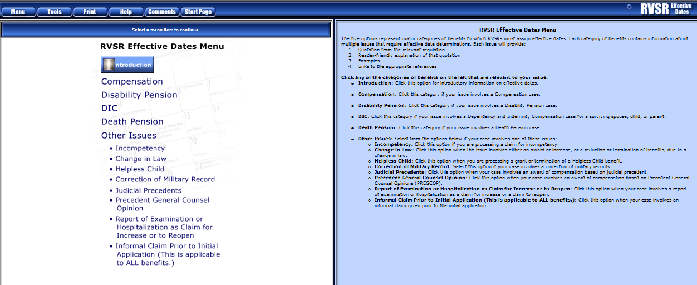
RVSR Assistant: Effective Dates EPSS

Slide 24
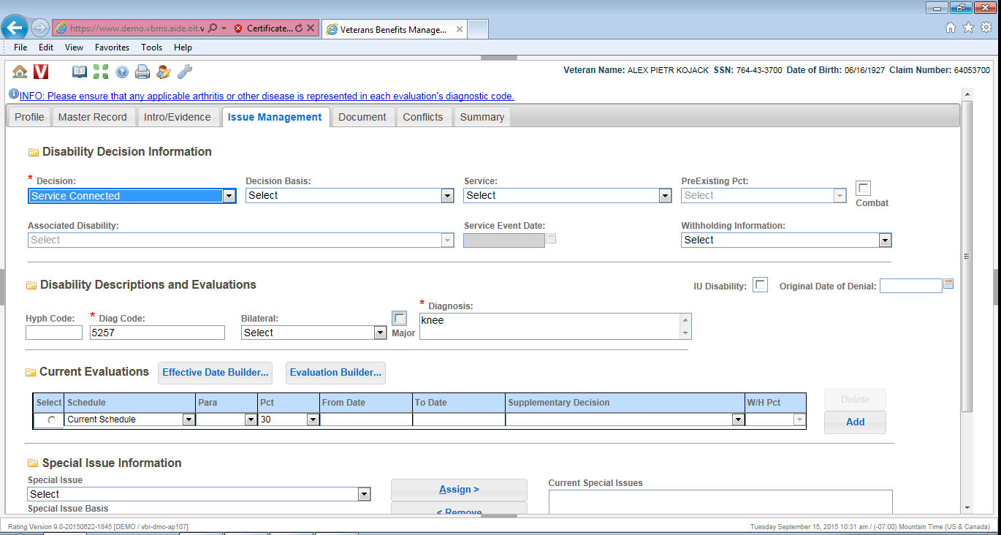
VBMS-R Effective Date Builder

Slide 25
Questions?

