Slide 1
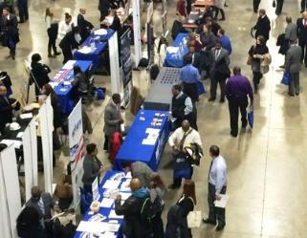
Veteran Employment Services Office (VESO)
May 2015

Slide 2
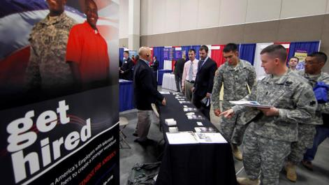
Overview
Background
Mission
VESO Business Lines

Slide 3
Background
VESO established in support of Executive Order 13518 and VA’s Strategic Plan
Major Initiative for Human Capital.
Executive Order 13518, Section 3(b):
(b) within 120 days of the date of this order, establish a Veterans Employment Program Office, or designate an agency officer or employee with full-time responsibility for its Veterans Employment Program, to be responsible for enhancing employment opportunities for veterans within the agency
VA Strategic Plan, Major Initiative 12:
HCIP: Transforming Human Capital- VA will engineer new approaches to recruiting, hiring, and retention
Notes:
VESO’s Vision is “to be the model Federal Veteran Employment SERVICE”

Slide 4
Veteran Employment Services Office
Mission
Develop and implement innovative and comprehensive programs, procedures and services to support federal Veteran recruitment, and VA (Veteran) retention and reintegration.
Functions and Tasks
Manages the VA for Vets program to facilitate the recruitment, retention, and reintegration of Veterans at VA
Develops and manages communications to build awareness and advise Veterans and hiring managers of VESO non-competitive hiring options and VA for Vets programs and services
Provides consultative services for VA and other federal agencies on Veteran employment policy, the appropriate application of Veterans preference, and the use of special hiring authorities to increase the number of Veterans in the civilian workforce
Notes:
VESO’s Focus:
Increase percentage of Vets in VA’s workforce, with our main effort currently focused on VHA
VA interim objective is 35% onboard Veteran strength; strategic objective is 40% onboard strength
Increase the number of Veterans who are employment ready for positions at VA and in the federal workforce
Increase the number of Veteran non-competitive hiring actions supported by the VESO HR team

Slide 5
Veteran Employment Services Office
Functions and Tasks (Con’t)
Manages a cadre of Regional Veteran Employment Coordinators, HR Staffing specialists, and Deployment and Reintegration managers across VA to recruit, retain, and reintegrate qualified Veteran talent at VA
Assists Veterans in preparing resumes and completing employment application packages
Develops strategies to retain the VA Veteran population
Oversees Uniformed Services Employment and Reemployment Rights Act (USERRA) compliance and case management for the Department

Slide 6
VESO Business Lines
HR Services
Provides HR support in the areas of Veteran staffing at VA and other Federal agencies/nonprofits through the Feds for Vets initiative
Consistently ensures VA’s time to hire a Veteran through the noncompetitive process is less than 25 calendar days
Field Operations
Provides a team of Regional Veteran Employment Coordinators (RVECS) nationwide to work with VESO customers to recruit Veterans to fill positions at VA and other Federal agencies
Manages VA’s Disabled Veteran Affirmative Action Program
Assists Veterans in preparing resumes and completing employment application packages and develops strategies to retain the VA Veteran population
Provides consultative services in the areas of policy, training, deployment and reintegration, and oversees USERRA case management for the Department
Develops strategies with facilities to retain current Veteran employees and support our Military Service Member employees through supportive deployment and reintegration services throughout the deployment life cycle
Notes:
HR’s staffing timeline for non-comp actions includes the following:
Staffing process briefing to stakeholders (e.g., Facility Selecting Officials, Servicing HR Office Reps).
Job Opportunity Announcements (JOA) marketed for 3-5 days.
Eligibility and qualification decisions complete within 3-5 days after JOA closes.
Automated referral process to issue certificates of eligibles begins 4-6 days after JOA closes.
VESO’s RVECs increase the supply of employable Vets for VA’s Mission Critical Occupations; conduct outreach at hiring events and assist Veterans and HR professionals with the following high level services:
Customized resume support
Job skills matching
Career Readiness Support
Follow up support and advocacy for job placement and retention

Slide 7
VESO Business Lines
Data/Program Management
Analyze and provide Veteran employment data to contribute to workforce planning initiatives; provide consultation to assist in VA for Vets program management
Build data dashboard to monitor and track VA’s performance toward meeting annual Veteran employment goals
Develop reports on Veteran workforce trends and process VESO’s customer requests for Veteran workforce data
Strategic Communications
Coordinates all marketing initiatives for VESO and the VA for Vets program
Manage media inquiries and coordinate interviews for customers seeking information on VESO and the VA for Vets program
Manage all written correspondence related to VESO and the VA for Vets program; coordinate all speaking engagements/briefings
Maintains Website and social media presence to connect with Veterans and stakeholders

Slide 8
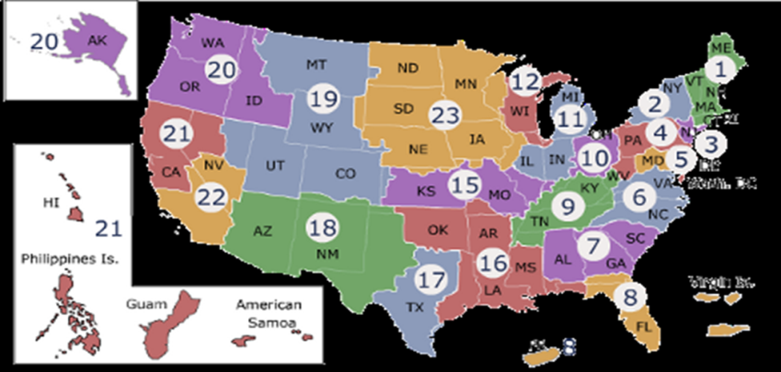
VESO Contact Information

Slide 9
Field Operations Contact Information
Andree’ M. Sutton, Ed.S., LPC, NCC
Chief Field Operations
andree.sutton@va.gov
Robert Mortenson
Supervisory RVEC, West
robert.mortenson@va.gov
Denise DeShields,
Management Analyst
denise.deshields@va.gov
RVECS
http://vaforvets.va.gov/hr/RVECS/Pages/rvecs-map.asp

Slide 10
Questions?

