Slide 1
February 11, 2015
Compensation Service Quality Call 1-855-767-1051 Conf. ID # 36041139

Slide 2
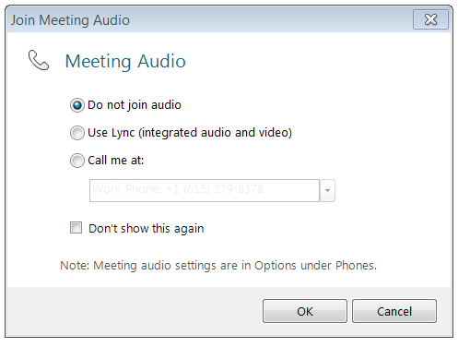
Quality Call Reminder
If you are using a USB headset connected to your computer to listen to this meeting:
Select “Use Lync (integrated audio and video)” when joining the meeting
If you are using a telephone line to listen to this meeting:
Dial 1-855-767-1051, enter the Conference ID code 36041139, press #, then select “Do not join audio” when joining the Lync meeting

Slide 3
February 2015 Quality Call Agenda
Opening Remarks
Quality Review & Consistency Topics
Common Findings
Medical Examination Request Builder (ERB) Tool
Reminders
Quality Review Team (QRT) Q-Tips
Reconsideration Request Discussion
Questions & Answers
TMS and Next Quality Call Information
Reminder – All Phone Lines Are Muted Until The End Of The Call

Slide 4
Opening Remarks
Diana Williard
Quality Assurance Officer (QAO)
Program Review

Slide 5
Quality Call Roll Call Procedures
RO’s VSCM or AVSCM or QRT Coach should type their attendance in the IM “Chat Box”
Only one person from each RO should type their RO’s attendance

Slide 6
General Quality Call Information
Quality Call consists of a visual PowerPoint presentation along with presenters talking
Thank you for completing the TMS surveys and providing your comments
Recording of today’s call, Call Notes (transcript), and a copy of this PowerPoint will be posted into TMS
Call Notes will also be posted to Intranet STAR homepage

Slide 7
Quality Review Team (QRT) Updates
George Boyd and Jamie Smith
Consultants
Quality Review and Consistency

Slide 8
Quality Review and Consistency
S1 – System Compliance Errors
System Compliance Errors vs. Other Error Categories
FAQ
S1 – System Compliance IPR’s
Changed to match list provided on in October 2014 VSCM Bulletin
Error Cascading
No development for STRs and no tracked item
FAQs from Oct 21st S1 call forwarded to field
Example – B2 error

Slide 9
Quality Review and Consistency (continued)
AQRS/VSR Consistency Studies
December and January results
Director, VSCM, QRT Mailboxes
Future consistency study information
Tuesday, February 17, 2015
Next QRT Challenge: April
Upcoming Challenge Training
QRT Mailbox

Slide 10
Common Findings
Gabrielle Mancuso
Chief, Program Operations
Quality Assurance

Slide 11
Common Findings – Review of Supplemental STRs
Review of supplemental STRs
Upon receipt of the supplemental STRs, a VSR conducts an initial review of the STRs with the claims folder to determine whether the records are duplicates
If duplicates
Send duplicate STRs to the Veteran with a cover letter
Annotate duplicate STRs reviewed, no action needed on the outside of the existing STR jacket
Initial and date the annotation and clear an EP 699
Not duplicates
Establish a future EP 699 with a 60 day suspense diary, and
Forward the claims folder to the RVSR for rating action
Reference: M21-1MR IV.ii.2.A.1.c,

Slide 12
Medical Examination Request Builder (ERB) Tool
Maruta Grean
Performance Specialist
Disability Examination Management Office (DEMO)

Slide 13
ERB Tool
ERB improves the quality of examination requests
ERB uses consistent language & standardized format to minimize insufficiency in examination reports throughout the nation
ERB clarifies opinion requests
ERB will be mandatory at the end of February 2015

Slide 14
ERB Tool (continued)
The tool
Automatically determines asbestos and noise exposure probability based on military occupation specialty
Calculates days pending based on date of claim
Automatically pulls name, date, SSN, address, Zip code, and power of attorney name from the VBMS profile screen
Automatically pulls in the contentions and service connected disabilities, to include evaluations, from the VBMS contentions screen

Slide 15
ERB Tool (continued)
The tool
Inputs Mitchell information when a musculoskeletal examination is selected
Automatically inputs ACE, IU, and insufficient examination information for applicable examination requests
Includes medical opinion formats for direct, secondary, pre-existing aggravation, and non-service connected aggravation
Sorts tabs into chronological order

Slide 16
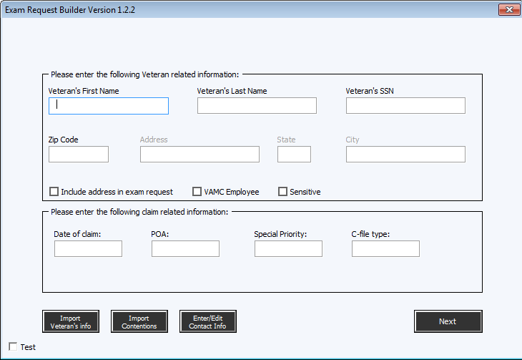
ERB Tool (continued) – Introduction Screen Key

Slide 17
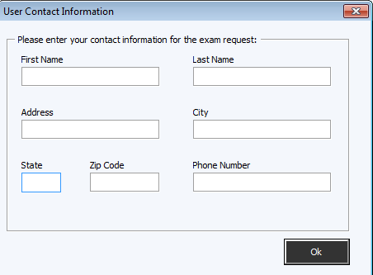
ERB Tool (continued) – Contact Information Screen

Slide 18
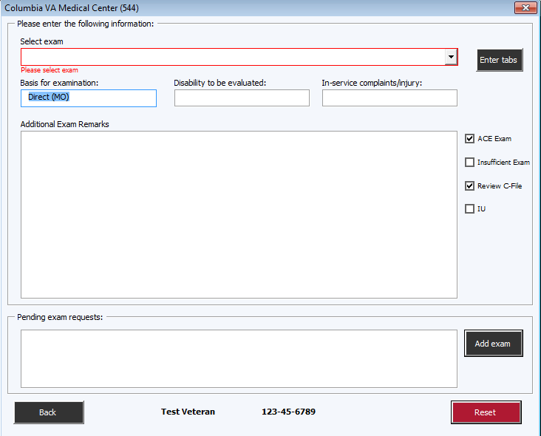
ERB Tool (continued) – Exam Request Entry Screen

Slide 19
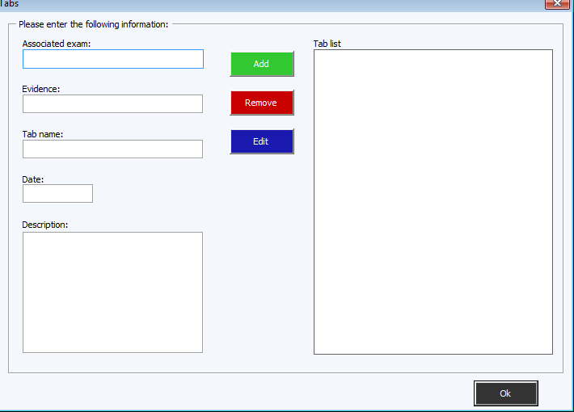
ERB Tool (continued) – Tab Screen Key

Slide 20
ERB Tool (continued)
Sample examination request:
The Veteran has filed a fully developed claim
Please expedite
Date of claim: 1/01/2011
Days pending: 165
Veteran has a power of attorney
Please send a courtesy copy of the examination notice letter to American Legion

Slide 21
ERB Tool (continued)
Sample examination request continued:
The Veteran will need to report for the following exam(s):
DBQ PSYCH Review Evaluation of PTSD
Please do not use ACE for this exam
Please review the Veteran’s electronic folder in VBMS for this examination
The Veteran is service connected for PTSD which is currently evaluated at 70%

Slide 22
ERB Tool (continued)
Sample examination request continued:
Please evaluate for the current level of severity of the Veteran’s SC disability
If the diagnosis rendered is different from the disability for which the Veteran is SC, please indicate whether the Veteran’s current diagnosis is a progression of the SC disability or the original diagnosis was in error
Please comment on the level of functional impairment resulting from the examined disability with regards to physical and sedentary employment

Slide 23
ERB Tool (continued)
Sample examination request continued:
***Addendum only***
***Veteran need not report***
Scars:
Please have (test examiner) provide an addendum to the examination he or she conducted on the Veteran on 02/01/2014 - Please provide the following clarification:
Please provide measurements of the surgical scar on the Veteran’s back
Please direct any questions regarding this request to: (Name, Address, and phone number)

Slide 24
ERB Tool (continued)
Conclusions
ERB reduces the amount of time spent developing examination requests
ERB generates the examination request into a clear, concise, and consistent format
ERB increases the quality of each examination request

Slide 25
Reminders
Cindy Windham
Senior Authorization Quality Review Specialist
Quality Review Team
Program Review

Slide 26
DOC Errors for EP 600
VBMS Release 8.0
Change on how letters are dated
Standardized to be the next business day
DOC errors not cited when DOC does not match date of due process letter
Effective December 15, 2014
M21-4 will be updated later to reflect this change

Slide 27
Removing Dependents
Loss of dependent reported via SEP
Considered 3rd party information
Check for signature of Veteran/claimant
Send due process if no signature
Compensation Service Bulletin October 2014

Slide 28
Chapter 33 Education Benefits
Concurrent receipt of compensation & Ch. 33 prohibited unless
Child is
Under age 18, or
Age 18 or older and permanently incapable of self support
Spouse or surviving spouse
MR updated October 15, 2014
FAQ has been removed

Slide 29
Correct End Product Credit
VA Form 21-0538, Status of Dependents Questionnaire
Information matches Corporate
EP 692 is proper, NOT EP 130
M21-1MR,III.iii.5.K.63 - Steps 1 - 4

Slide 30
Quality Assurance Internal Quality Review Team
David Hannigan
Chief, Quality Review Team
Program Review

Slide 31
Exciting way to share ideas in a simple tip format
Your Q-Tips are welcome and requested
We will achieve top notch Veteran service together by sharing knowledge with each other
Send your ideas to David Hannigan and Get your name on the big screen!
david.hannigan@va.gov

Slide 32
Source of This Month’s Q-Tip
The first Q-Tip comes from Jennell Lloyd, Super Senior Veterans Claims Examiner, Phoenix Regional Office
The second Q-Tip comes from the Los Angeles Regional Office
My thanks to Jennell and LARO for sharing these important reminders!
Thanks for the submissions – please keep them coming!

Slide 33
Q-Tip # 1
The plain language of PL 112-154 regarding FDC states that “an original claim is the initial formal (complete) claim filed by a Veteran for disability compensation”. Policy defines the phrase “original claims” to only disability compensation. Therefore, a Veteran who has applied for NSC pension in the past is eligible for the retroactive date upon filing an original comp disability FDC.
This means watch 020’s as they MAY qualify for the one year retro IF this is the very first disability compensation claim ever filed.

Slide 34
Q-Tip # 2
Reminders for VAMC record requests we cannot obtain via CAPRI:
You do not need continue to develop for a negative reply from the VAMCs.
You do not need a formal memorandum of unavailability for VAMC records…In lieu of sending a 10-day final attempt letter, the VSR needs to prepare a 27-0820 certifying that relevant medical records at [insert name of VAMC] for the period [insert date range of treatment] do not exist. M21-1MR III.iii.2.I.59.b

Slide 35
Q-Tip # 2 (cont’d)
You DO need:
You do need to make 3 attempts to the VAMC (30 day suspense, 15 day suspense, 10 day suspense) …The VSR should call the VAMC for both the 15-day and 10-day follow-ups (and only send the follow-up requests if we can’t make phone contact). Also, the VSR should call the Veteran at the 10-day follow-up point. M21-1MR III.iii.2.I.57.b
See M21-1MR III.iii.2.I for more in-depth guidance on the Control of and Follow-Up on Requests for Federal Records

Slide 36
Reconsideration Request
Cindy Windham
Senior Authorization Quality Review Specialist
Quality Review Team
Program Review

Slide 37
Reconsideration Request Discussion
EP 290 reviewed
H error cited
Separation pay received
EP cleared without any adjustments
Reconsideration request
Contends amount reported was same as what had been recouped
DFAS reports different net amount
Error changed to B2 as development was needed

Slide 38
Questions?
The phone lines have been unmuted 
Remember to personally unmute your phone line or USB headset microphone if you have a question
To unmute your phone line, press , then press 6

Slide 39
VA Talent Management System (TMS)
The TMS number for the December 2014 Quality Call is 3901744
The TMS number for the January 2015 Quality Call is 3897823
The TMS number for this call (February 2015 Quality Call) is 3901551 - In the near future, a Calendar Blast will be issued showing when the TMS number has been activated

Slide 40
Next Quality Call
Quality Assurance (QA) Staff conducts a Quality Call each month
Next Quality Call will be held on Wednesday, March 11th at 1:30 PM

Slide 41
Suggestions?
Please feel free to forward suggested topics to VAVBAWAS/CO/214B
Quality Call Notes can be found on the Compensation Service Intranet site at http://vbaw.vba.va.gov/bl/21/star/star_call.htm
“Nothing great was ever achieved without enthusiasm.”
~ Ralph Waldo Emerson

