Slide 1

Sound Check
New Manager Training MS Teams Session Call will begin momentarily
A facilitator is currently talking. If you cannot hear, please “raise your hand “
icon in the menu bar at the top of the screen.
Notes:
Narrator – Dale Sagotsky (15 / 7 mins)
Slide Instructions –
Open Lync/slide 15 minutes before call begins
Start Video when call begins (office start time of call)
Place all participants microphones in lecture mode (mute)
Slide Notes – Copy text “A facilitator is currently talking. If you cannot hear, please place a ‘sad face’ emoticon in the chat box.”
Slide Narration –
Hello, Welcome to the New Manager Training Lync Session Call. The call will begin in (15 /7 start time) minutes.
Please remember to mute your microphones when you are not speaking.
If you are calling in by phone, please ensure your microphone and speaker on your computer is muted. This will prevent feedback
Please do not use the Instant Message window for general discussion or commentary as it can be distracting to the audience and presenter.
Please post questions at the end of the call during the Q&A portion. Questions will be answered in the order they are received, within the remaining time of the Hotline call.
The video is currently active and you should see the presenter. If you do not see the presenter, select Video at the top of your window to activate the video. Be sure to pause your video.
(omit at start time) Please stand by until the call begins.

Slide 2
Purchase Card Management
Click here to Play Recording of NMT Purchase Card Management session
VR&E New Manager Training
Heather Becker and Chloe Freeman
THIS EVENT IS BEING RECORDED

Slide 3
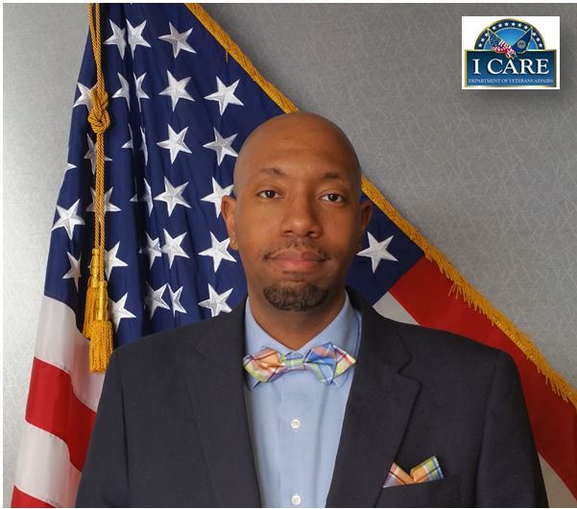

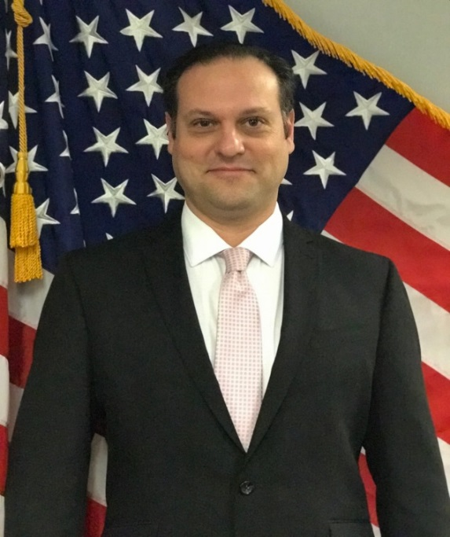
Training Team
Lamoyd Figures
VR&E Training Specialist
Orlando, FL
Dale Sagotsky
VR&E Training Specialist
Orlando, FL
Notes:
Welcome to NMT Session 1 for FY 2020. We are your facilitators with the VR&E Central Office Training Team.
Dale – intro – background info
Lamoyd – intro background info

Slide 4
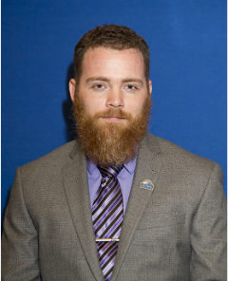
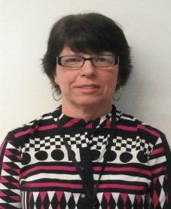
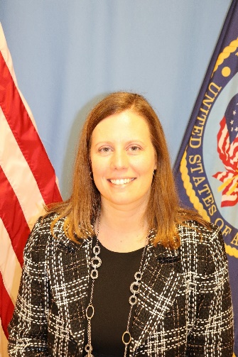



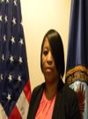

Subject Matter Experts
James Lester
Columbia VREO
Linda Steffensmeier
St. Paul VREO
Heather Becker
Buffalo AVREO
Rodney Hackney Oakland VREO
Will Bethea
Philadelphia/Wilmington VREO
Corliss De La Garza
Albuquerque VREO
Chloe Freeman
Jackson VREO
Kenneth Fisher
Muskogee AVREO
Notes:
Dale
With that being said, I would like to inform you all of our subject matter experts for the NMT Program. (Name and introduce the SMES). These SMEs help to review, develop and facilitate virtual and in-person trainings to the newly hired division leaders. In addition to this, the SMEs also serve as coaches. We greatly applaud and appreciate all their efforts and assistance as we prepare to kick off this year of NMT training.

Slide 5
Objectives
After this presentation, participants should be able to:
Identify authorized and unauthorized purchases
Identify cardholder and approving official responsibilities
Identify billing, review, and audit processes
Notes:
The objectives of this lesson are to:
Identify authorized/unauthorized purchases
Identify cardholder and approving official responsibilities
Identify billing, review, and audit processes.
Much of this information that we will cover today is contained in VBA Letter 20-18-08 and M28R.V.B.5 (LF)

Slide 6
Overview
Use of Card
Cardholder Tasks
AO Tasks
Training Duty
Delivery Proof
28-1905
Cardholder Cert.
AO Cert.
Bill Processing
Review & Audits
Dispute Officer
Authorized/Unauthorized Use of Purchase Card
Cardholder Responsibilities
Approving Official (AO) Responsibilities
Training Requirements
Proof of Delivery
Required Use of VA Form 1905m
Cardholder Statement Reconciliation & Certification
Approval Official (AO) Certification
Billing Officer Processing
Dispute Officer
Reviews/Audits
Notes:
Overview
This represents the key elements and parties involved in the VR&E Purchase Card Management Process. Today we are going to identify the staff, the responsibilities, the forms, and the documentation to make sure we are appropriately using and documenting the use of government funds.
Therefore, we will be addressing the following:
1. Authorized/Unauthorized Use of Purchase Card
What we can/can not purchase.
2. Cardholder Responsibilities
What we are responsible for ensuring, while making purchases for Veterans
3. Approving Official (AO) Responsibilities
Our second line of defense to ensure we are documenting and spending funds appropriately. Typically, the AVREO and/or VREO functions as the AO for VR&E Purchase Cardholders.
4. Training Requirements
Recurring training is mandatory for cardholders and approving officials. We will be discussing this training and frequency of completion.
5. Proof of Delivery
How can we tell if the Veteran received the purchased items?
6. Required Use of VA Form 1905m
What is the purpose of this form? What does it document?
7. Cardholder Statement Reconciliation & Certification
How to document monthly purchases? What needs to be submitted to the AO? What are the timeliness requirements?
8. Approval Official (AO) Certification
Once the Cardholder submits the monthly purchase documentation, what is the next step for the AO? What are the timeliness requirements for the AO?
9. Billing Officer Processing
What are the responsibilities of the Billing Officer?
10. Dispute Officer
What are the responsibilities of the Dispute Officer?
11. Reviews/Audits
What is the purpose of the reviews and audits?
Who is conducting the various reviews and audits?
Before moving on to the next slide ask participants to name some authorized uses of the purchase card

Slide 7

Authorized Use of VR&E Purchase Card
Books
Supplies
Computers
Adaptive Equipment
Tuition and Fees
Uniforms
Tools
Notes:
Authorized Use of Card
This is a list of the most common purchases made by VR&E Staff. Purchases are based on Veterans needs and regulations. It is a good practice to emphasize to cardholders, if they have any question or doubt, consult with the VR&E Officer and Assistant VR&E Officer prior to the purchase. Therefore, as the supervisor, you must be familiar with purchasing restrictions.
The VR&E Purchase Card is used to assist Veterans and Servicemembers with training or equipment to improve rehabilitation or increase independence in daily living.
The cost strings associated with the VR&E Purchase Card restrict it’s use to Rehabilitation Benefits. (i.e. you can’t purchase office supplies for your division)
Before moving on to the next slide ask participants to name some unauthorized uses of the purchase card

Slide 8
Unauthorized Use of Card
Cash advances
Rental/lease of land or buildings of any type
Procurement of travel or travel related expenses (employee travel cards may be used for official travel expenses)
Gifts
Meals or drinks
Paying for sales tax
Personal use of any kind
Use for fleet (GSA) management vehicles
Memberships (Requires Director’s approval)
Third-Party Merchants (Paypal, eMoney, Eaccount)
Notes:
Unauthorized Use of Card
This is a list items the purchase card may not be used for, per VBA Letter 20-18-08:
Cash advances
Rental/lease of land or buildings of any type
Procurement of travel related expenses (airline, bus, boat or train tickets)
Gifts
Meals or drinks
Paying for sales tax: The VA is a federal government agency and tax-exempt, therefore no sales tax should be paid.
Now, agencies sometimes charge a processing fee, handling fee and occupancy tax.
Personal use of any kind:
Do not use the purchase card to purchase anything that you may need or use personally. If you accidentally misuse the card, attempt to have the facility/company/organization refund the transactions. Then notify the VR&E Officer and AO immediately of the incident to begin the proper steps of rectifying the situation and determining procedures to ensure that the mishap will not happen again. There may be disciplinary actions taken for misuse of the card.
Use for fleet management vehicles:
Fleet management vehicles have their own card to utilize for gas, maintenance and other emergencies that may occur while conducting official government business. Maintenance usually has to be approved prior to the service.
Memberships (This is not banned, but Requires Director’s approval prior to procurement) An example of this might be a few months of a membership to a club for a Veteran under an IILP.
Third-Party Merchants (Paypal, eMoney, Eaccount). Check with vendors before making a purchase to ensure they do not use a third-party for the transaction.
A purchase card can be used as the procurement method on a contract, if the contract outlines this will be the method of payment. The card used must be one that has cost accounting strings that are appropriate for the type of transaction that is taking place. (i.e. can’t use the VR&E purchase card to pay for GOE contracting service, because the VR&E card has a cost accounting string that is tied to RB funds.)

Slide 9
Cardholder Responsibilities
Accountable for all transactions & procurements made with the purchase card
Required use of VA Form 28-1905m for supplies & equipment procured outside training facility
Maintain Buying Log Sheet/Purchase Card Log (Appendix BX, M28C)
Enter full transaction data in CWINRS
Verify receipt of goods/services
Reconcile transactions in US Bank Access Online and the reconciliation packet must be sent to the AO (typically the VR&E Officer) within 10 working days after the billing cycle
Notes:
Cardholder Responsibilities
VA and VR&E Purchase Cardholders are responsible for the following:
Accountable for all transactions & procurements made with the purchase card.
The purchase card is assigned to each individual user and must be secured safely when not in use.
Required use of VA Form 1905m for supplies & equipment procured outside training facility (VR&E purchase card)
This form requires a listing and price of the items purchased. It also has places for approval signatures for the following: facility/school representative, the Veteran, and VR&E staff. With VR&E Letter 28-12-26, this form has been revised and now has a section for the Veteran to sign for proof of receipt of the items/services purchased.
Maintain Buying Log Sheet/Purchase Card Log
This Purchase Card Log is required to compile monthly purchase data such as name of vendor, date of purchase/receipt, description of items purchased, and the recipient. The purchase card log is Appendix BX, M28C V B4.
Enter full transaction data in CWINRS
Dates: Purchased, Item Received, Invoice Received, Invoice Date
Vendor: Name, payment address, contact name and phone number
Invoice: Number
Item: Select appropriate BOC from the drop down
Item: Add description, quantity, amount and total
Verify receipt of goods/services: Mandatory use of 28-1905m for required supplies
Best practices:
Obtain signature or delivery confirmation from Veteran
Have veteran pick up supplies from office or mutually agreed location
Delivery to VR&E Office if Veteran lives nearby and/or has a history of not replying timely to verify receipt of goods/services
Reconcile transactions in US Bank Access Online and the reconciliation packet must be sent to the AO (typically the VR&E Officer) within 10 working days after the billing cycle
Please note that the billing cycle date is the cut-off date, also known as the “closing date”, for processing purchase card transactions for the billing cycle. The statement must be downloaded and printed from US Bank Access Online on the 24th of each month. If the 24th falls on a weekend, then the closing date is the following Monday.
Simply, when you get your monthly statement, please process your documentation-receipts, 28-1905m, Purchase Log, other proof of receipt items, and submit to AO within 10 working days after the billing cycle.

Slide 10
Approval Official (AO) Responsibilities
1:25 Maximum Ratio/ 1:10 or 1:15 is more typical
Approve, verify & review transactions
Ensure cardholders complete Purchase Card Training
Recommend single and monthly purchase limits
Ensure spending limits are honored and no split purchases are made
Ensure cardholders maintain sufficient documentation/reconciliation for all transactions and maintains documentation for 6 years and 3 months
Assist cardholders in resolving disputes
Reconcile/verify transactions by reviewing the reconciliation packets and approving in US Bank Access Online within 14 working days after the billing cycle
Notes:
AO Responsibilities:
1:25 Maximum Ratio
Usually 1 AO to 10 purchase cardholders.
Approve, verify & review transactions:
The AO approves, verifies, & reviews the transactions of the cardholder. As stated earlier it’s the second line of defense so to speak.
Ensure cardholders complete Purchase Card Training:
AOs are responsible for ensuring that the cardholders receive training and updates regarding purchasing procedures. They must also complete bi-annual purchase card training.
Recommend single and monthly purchase limits: This will depend on whether the cardholder is a warranted contracting officer or not, and if so, what level of Warrant they hold (I, II, or III). Most cardholders in VR&E have a maximum of $10,000 single purchase (micro-purchase threshold) and $50,000 per month.
Ensure spending limits are honored and no split purchases are made:
Ask the trainees, do they know: What is a split purchase?
FAR 13.003 Policy (c) (2) Do not break down requirements aggregating more than the acquisition threshold into several purchases that are less than the applicable threshold merely to (a) permit use of simplified acquisition procedures or (b) avoid any requirement that applies to purchases exceeding the micro-purchase threshold.
Ensure cardholders maintain sufficient documentation and reconciliation for all transactions
This is a checks and balances procedure, once submitted, the AO reviews all documentation to make sure the purchases are approved, purchased, and received by the appropriate personnel. Verifies cardholder performs appropriate market research and documents the same to ensure compliance with socio-economic goals.
Cardholders must maintain documentation for 6 years and 3 months.
Assist cardholders in resolving disputes:
If you have any disputes regarding miscellaneous/erroneous charges, contact the AO to develop a course of action to resolve the errors in a timely manner. The Billing Officer and/or Dispute Officer should be notified. The Billing Officer and Dispute Officer is normally someone in SSD Finance. The Billing Officer and/or Dispute Officer can NOT be a cardholder or an AO. Disputes must be handled within 30 days.
Reconcile/verify transactions by reviewing the reconciliation packets and approving in US Bank Access Online within 14 working days after the billing cycle.
AO may be a cardholder if ORM approves a waiver (i.e. small office necessitates it).
No one may be the AO for their own supervisor or for oneself.

Slide 11
Purchase Card Training
Cardholders and AOs will participate in refresher training at least once every two years
VA Form 0242 – Government Wide Purchase Card Certification Form provides written delegation to cardholders and AOs to make and certify procurements on behalf of the federal government
Notes:
Cardholders and AOs will participate in refresher training at least once every two years.
VA Online Purchase Card Training TMS # VA 5863, Unauthorized Commitments Training TMS# 1701572,
VA Directive 6008 Acquisition and Management of VA IT Resources TMS#4407221, GSA SmartPay Purchase Card Training TMS#3870979
VA Form 0242 – Government Wide Purchase Card Certification Form provides written delegation to cardholders and AOs to make and certify procurements on behalf of the federal government. This is required prior to obtaining a card or being delegated as the AO.

Slide 12
Proof of Delivery: 1905m
VAF 28-1905m
  In accordance with current guidance outlined in the VR&E manual in M28C Part V, Section B, Chapter 4
  Must be completed when supplies and equipment are purchased outside of a training facility
  Used to document each purchase
  Verify Veteran’s need and receipt of goods and services
Notes:
Proof of Delivery
VAF 28-1905m
The VA Form 28-1905m (See Appendix O, VA Forms) must be completed when supplies and equipment are purchased outside of a training facility. It is used to document each purchase and to certify that the items requested and received by the Veteran have been deemed necessary for the successful achievement of a vocational goal.
M28C. Part V, Section B, Chapter 4 details how to use VAF 28-1905m. In summary, this chapter provides guidance regarding proper documentation including Veteran’s signature and date on the purchase receipt and a proper review of the documentation by the VR&E Officer. It also provides guidance on the mandatory use of 1905m for required supplies, including proof of receipt which requires signature of Veteran on the 2nd page of the 1905m form.
Note: An email from the Veteran requesting the items and informing the cardholder that the items were received is not sufficient to meet this requirement in terms of documenting in the CER; however, to reconcile the purchase in US Bank Access Online, an email notification of receipt of the item or a CWINRS note verifying receipt of the item is sufficient. The cardholder will still need to obtain a signed VAF 28-1905m to upload into VBMS.
The VAF 28-1905m must be completed for each purchase and filed in the reconciliation packet.

Slide 13
Cardholder Statement Reconciliation & Certification
10 Days
CWINRS
Approve Purchase
Dispute
Verify Statement
Reconciliation Packet
Monthly Statement
Step 1: Print/save monthly purchase card statement (US Bank Access Online)
Step 2: Use Purchase Card Log to verify each transaction with supporting documentation
Step 3: Verify purchase card statement and purchase documentation
Step 4: Contact merchant to dispute charges in unmatched transactions
Step 5: Approve each purchase (US Bank Online)
Step 6: Update CWINRS
Step 7: Provide reconciliation packet to Approving Official (AO) within 10 business days
Notes:
What does the cardholder do as soon as he or she receives the Monthly Billing Statement from the Credit Card Company (US Bank)?
1. The monthly purchase card statement from US Bank Access Online should be printed or saved to the H Drive.
Statements are available on the 24th of each month.
2. Prepare reconciliation packet. (Monthly Purchase Card Statement, Government Purchase Card Log and Other supporting documentation such as: VAF 28-1905m, Purchase Documentation and Justification, Purchase Card Checklist (Micro-Purchase), and other Back-Up Documents. Make sure that the purchase card log is sorted to correspond with the purchase card statement and that the Veteran’s full name and case number is annotated next to the appropriate transaction on the purchase log for VR&E administrative tracking assistance.
3. Verify each transaction on the purchase card statement and compare it with purchase documentation in the reconciliation packet.
4. Identify discrepancies during the reconciliation process and ensure that they are corrected. Examples include duplicate billed, partially billed, and erroneous charges.
5. Log on to US Bank Access Online and approve each purchase.
6. Verify that purchase card transactions are entered into CWINRS. See the CWINRS User Guide, Chapter 6 for further guidance.
7. Provide reconciliation packet to Approving Official (AO) within 10 business days.

Slide 14
Approval Official (AO) Certification
14 Days
Disputes
Verify Purchases
CWINRS
Reconciliation Packet
Approve Transactions
Step 1: Log In to Approve Transactions (US Bank Access Online)
Step 2: Review Reconciliation Packet (Purchase Card Log)
Step 3: Verify CWINRS
Step 4: Verify purchased items are proper and legal
Step 5: Resolve Disputes
Step 6: Submit to Finance (Billing Official) within 14 working days after the billing cycle
Notes:
What does the AO do as soon as he or she receives the Reconciliation Packet from the card holder?
1. Log on to US Bank Access Online and approve cardholder transactions within 14 working days after the billing cycle. AOs can “approve” or “reject” the transaction based upon his/her review.
2. Review Purchase Card Log and supporting documentation for each purchase.
3. Ensure transactions are completely entered in CWINRS. Ensure Veterans Full Name and SSN is printed on the statement, as required per VBA Letter 28-18-08 (section 4.4)
4. Verify that purchased items on the purchase card statement are proper and legal. This means that purchases are for government use only and are tax-exempt. Approving purchases in US Bank Access Online certifies that goods were received and dollar amounts are correct. Ensure there is no tax charged, that purchases are appropriate and consider socio-economic goals. This includes ensuring the cardholder purchases are within the single and monthly purchase limits. This verifies compliance with FSSI OS2 contract for office supplies. Also verify purchases were not split in order to stay within the spending limits.
5. Work with cardholders to resolve problems and disputes.
6. Submit Reconciliation Package to Finance (Billing Official)

Slide 15
Approval Official (AO): What to look for?
Split transactions
Exceeding purchase limits
Duplicate/partially billed transactions
Repeat purchases from same vendors
Sales Tax
Notes:
While combing through all of the transactions and supporting documentation with a fine tooth comb or microscopic glasses, the AO is looking for the following:
Split transactions
Exceeding purchase limits
Duplicate/partially billed transactions
Repeat purchases from same vendors (this could be split purchases)
Mandatory use of FSSI OS2 contract: office supplies
Max $3500 for single purchases for supplies ($2500 services, $2000 construction) (without a contracting warrant). Requests can be made to raise the single purchase limit up to $10,000 temporarily refer to section M28C V 4 B.
Repeat purchases same vendors

Slide 16
Billing Officer
Billing Officer is normally a part of finance
File statements and supporting documentation of all cardholders at the facility
Conduct audit to review purchases, spending limits, proper costing, follow-up on disputes and credits, and timely reconciliation
Ensuring rebates are credited, and costs are charged to the correct cost strings, BOCs, etc.
Ensures monthly limits are adhered to
Notes:
Once the AO has completed their process, the information is then forwarded to the Billing Officer.
The BO will:
Notify AO if there are discrepancies with statements
Ensure purchase card transactions are charged to the appropriate fund, cost center, and budget object code
Establish default code string (cost accounting) for the card
Ensure single and monthly purchase limits are adhered to
File statements and supporting documentation of all cardholders at the facility for storage (6 years and 3 months)
Conduct audit to review purchases, spending limits, proper costing, follow-up on disputes and credits, and timely reconciliation

Slide 17
Dispute Officer
Coordinates and monitors disputed procurements, credits, and billing errors, which cannot be resolved within 30 work days of receipt of statement
Assists when a dispute cannot be handled in the normal method using the government cardholder dispute form
Notes:
The Dispute Officer can be the program coordinator also, but can NOT be a cardholder or AO.
The Dispute Officer is responsible for:
Coordinates and monitors disputed procurements, credits, and billing errors, which cannot be resolved within 30 work days of receipt of statement
Assists when a dispute cannot be handled in the normal method using the government cardholder dispute form

Slide 18
Reviews/Audits
Quarterly Focus Reviews
Annual Audit of Cardholder Account
Management Quality Assurance Service (MQAS)
VR&E Service Site Visit Protocol
VR&E SAO
Notes:
The required audits are outlined in VBA Letter 20-18-08.
Quarterly Focus Reviews
Review of both GOE and VR&E Purchase card transactions by the Director or their designee (usually SSD) to ensure the purchase card program is managed per VBA Letter 20-18-08.
Annual Audit of Cardholder Account
Mandatory for each cardholder, a minimum of 25% audit each quarter recommended. Minimum of 10% of transactions reviewed to determine cardholder compliance. The VBA organization director or designee will perform the review of each cardholder account annually.
Management Quality Assurance Service (MQAS)
Risk Assessment for internal controls
Financial Services Center (FSC) requires a random sample of purchases selected for mandatory review to ensure proper costing, fund control point, BOC, timeliness, spending limits, etc.
VR&E Service Site Visit Protocol
Reviewed at VR&E QA/STAR Site Visit to ensure compliance with VBA and VR&E policies
SAO Debt Avoidance and Fiscal Control includes a review of the purchase card program in VR&E
M28C.VIII.A.4

Slide 19

Questions/Discussion
Next NMT Teams Sessions:
Workload Management Best Practices
Tuesday, June 15, 2021 @ 11-12:30 PM ET
Human Resources Part I – TBD pending SME confirmation
Tuesday, June 22, 2021 @ 11-12:30 PM ET
Emotional Intelligence – Part II
Tuesday, June 29, 2021 @ 11-12:30 PM ET
TMS # 3898749
Purchase Card Management
19
Notes:
Any questions.
TMS Info: Please complete the feedback survey.

