Slide 1
New FY 2015 IPR
Compensation Services

Slide 2
QRT IPR Reviews
FL13-18
In-Process Reviews (IPRs) - Non-punitive IPRs conducted at strategic points in the claims process with immediate feedback provided to employees. Employees will take appropriate corrective action on identified deficiencies. These reviews are not part of the individual performance data, but may be used for training purposes. The number of IPRs completed per RO should be no less than 10% of the expected monthly production as identified on the RO’s fiscal year dashboards.

Slide 3
IPR Purpose
Identify Deficiencies
Correct Deficiencies
Pre-promulgation
Track and Trend Deficiencies
Immediate feedback
Identify Training Opportunities

Slide 4
IPR Reviews
Only review the error category noted
This is not an end to end review
Mentoring is the key to success
Local Management uses error trending to determine the appropriate IPR’s to use
10% does not change for overall
Mix and match the Rating IPR’s as needed
Use the IPR’s that meets the quality needs at your station

Slide 5
Issue Based Errors

Slide 6
B2 IPR

Slide 7
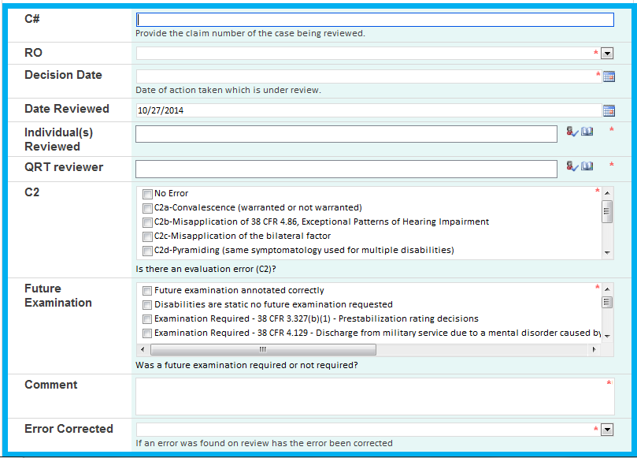
C2 IPR

Slide 8
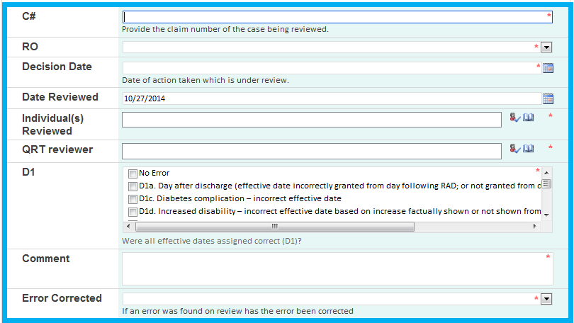
D1 IPR

Slide 9
Other findings
Each Rating IPR will have a section that will allow for identifying other errors if they are found on review.
REMEMBER IPRS are meant to be touches to focus on the type of IPR being reviewed.
DO NOT REVIEW IPRS IN THE SAME WAY YOU PERFORM AN IQR.

Slide 10
Review
Questions on the IPR process or the new IPR’s
New IPR location: QRT
Contact: VAVBAWAS/CO/QRT QRT.VBACO@va.gov

