Slide 1
Veterans Information Solution (VIS) VADIR Functionality
Compensation Service Training Staff

Slide 2
What is VIS?
VIS provides a consolidated views eligibility and benefits data from VBA and DoD.
VIS provides access to rating and award information from VBA’s corporate record for Veterans and certain dependents.
VIS enables authorized users to search records and retrieve information, request access w 8824e
2

Slide 3
Login to VIS

Slide 4
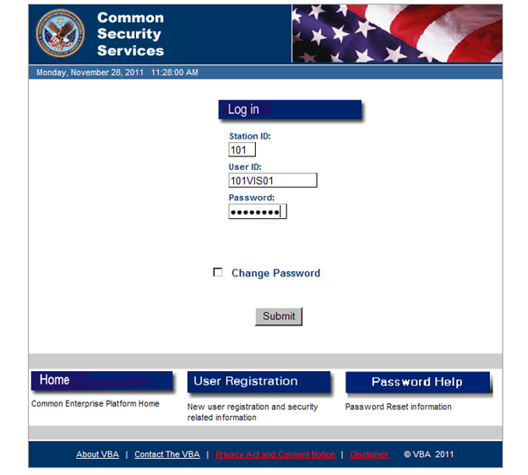
Login to VIS
A “parent” is from RBPS)

Slide 5
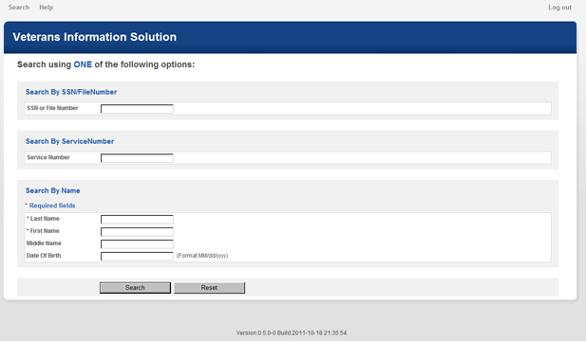
VIS Home Screen
5

Slide 6
Viewing Records
When more than one record is returned:
1. Identify the required profile by matching name and DOB; and,
2. Click on the identified record to view the individual’s profile

Slide 7
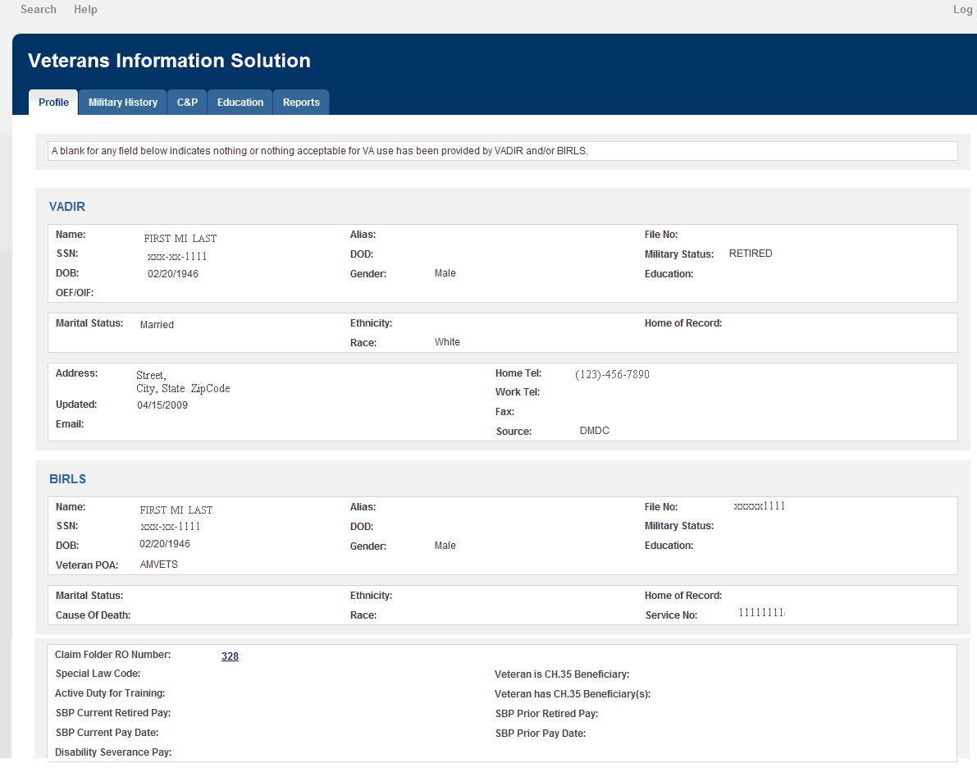
Profile Screen

Slide 8
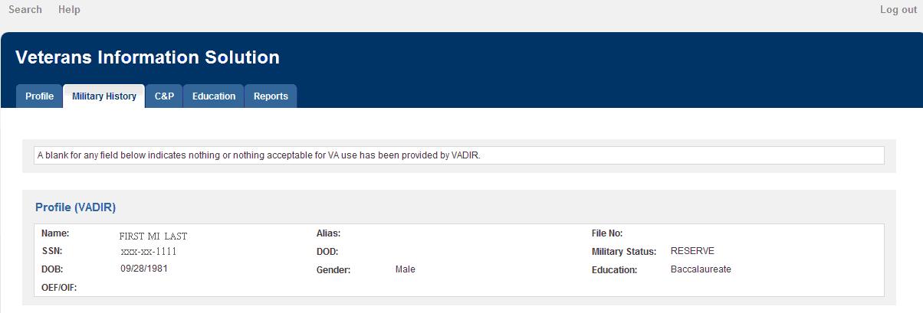
Military History
The data elements in the profile segment of this VADIR screen are generally self-explanatory and repeat a number of elements displayed in the Profile screen.

Slide 9
VADIR Screen Profile Segment
The Military History segment is divided into three categories:
service periods
deployment periods
special pay periods.
The category for service periods contains three types of service:
active duty periods
National Guard and Reserve member activation/mobilization periods
National Guard and Reserve service periods

Slide 10
VADIR Screen Profile Segment
The category for special pay periods contains two types:
combat pay and combat tax exclusion periods,
hazardous duty pay periods.
For the most part, the category labels provide an explanation of the data elements.

Slide 11
VADIR Screen- Military History Segment
Categories viewable in VADIR
Active Duty Service Periods
National Guard and Reserve Activation/Mobilization Service Periods
National Guard and Reserve Service Periods
Deployment Periods
Combat Pay & Combat Tax exclusion periods
Hazardous Duty Incentive Pay Periods

Slide 12
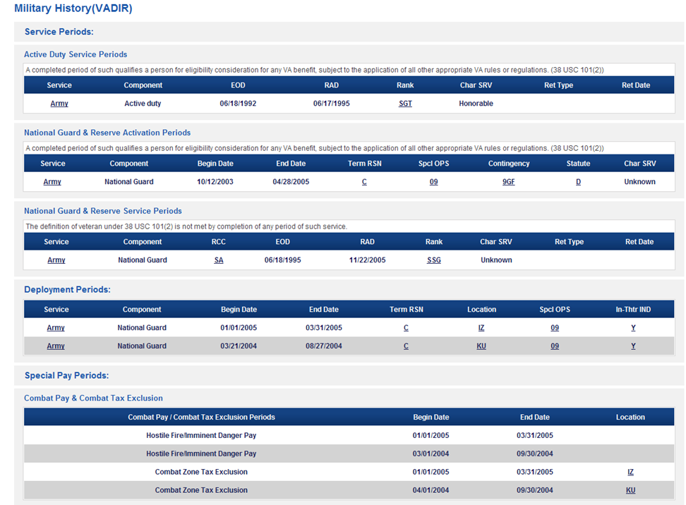
VADIR Screen

Slide 13
Special Pay Periods

Slide 14
Military History from BIRLS

Slide 15
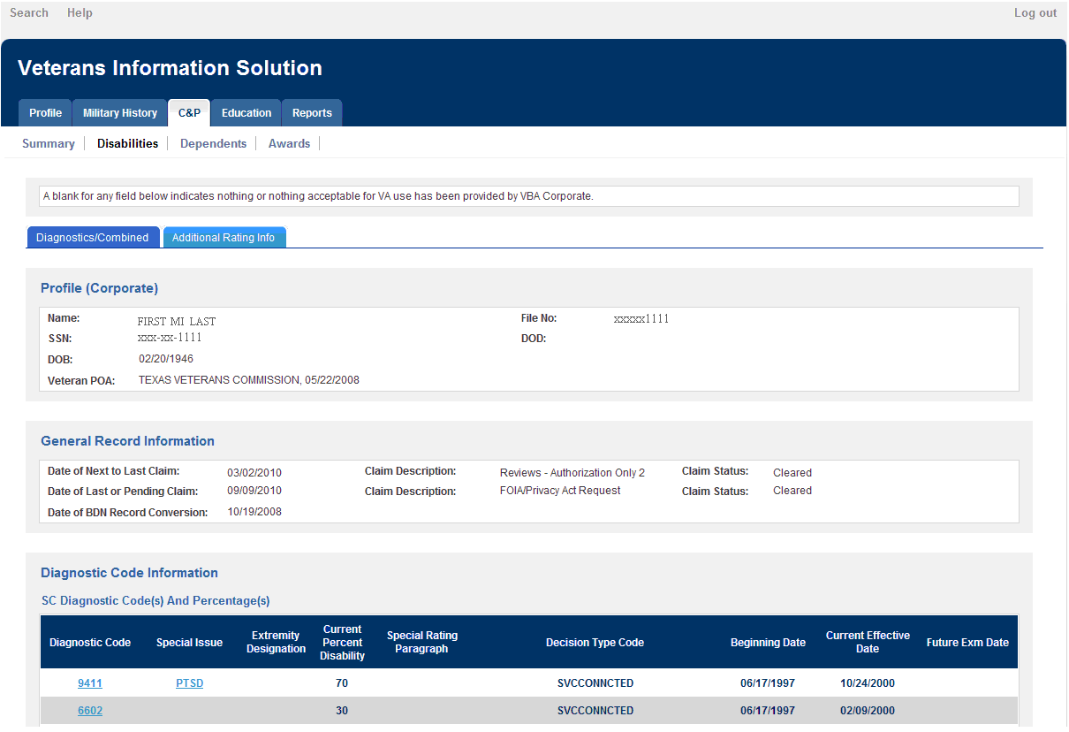
Diagnostics/ Combined Tab

Slide 16
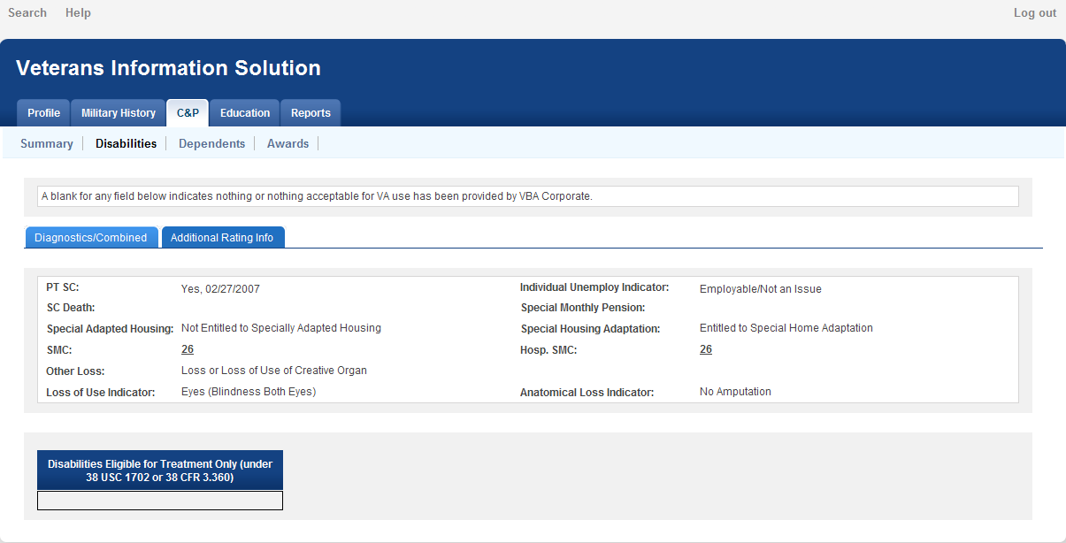
Additional Rating Information Tab

Slide 17
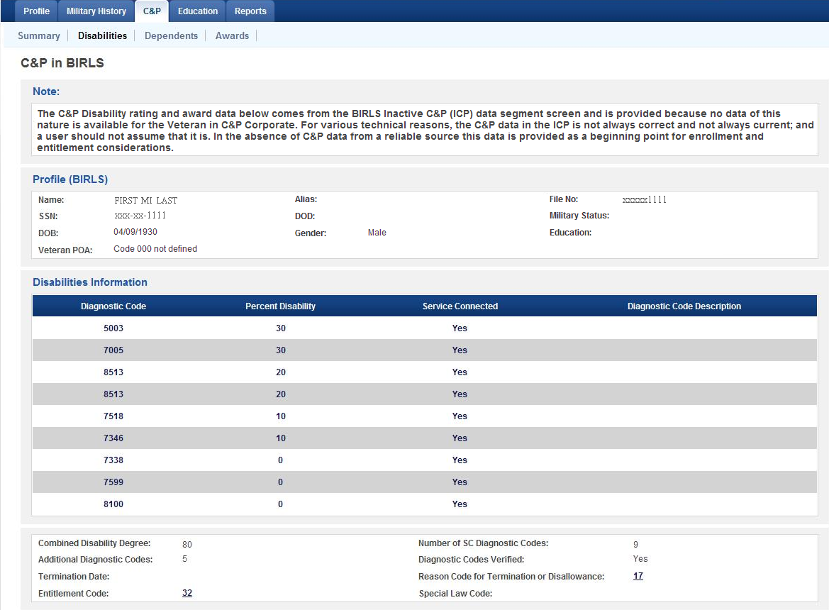
C&P in BIRLS Screen

Slide 18
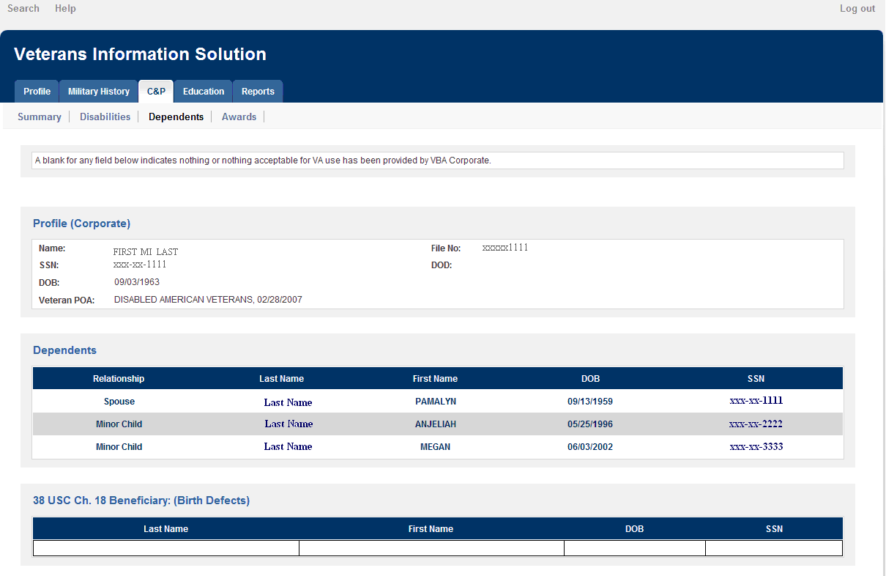
C&P Dependents Screen

Slide 19
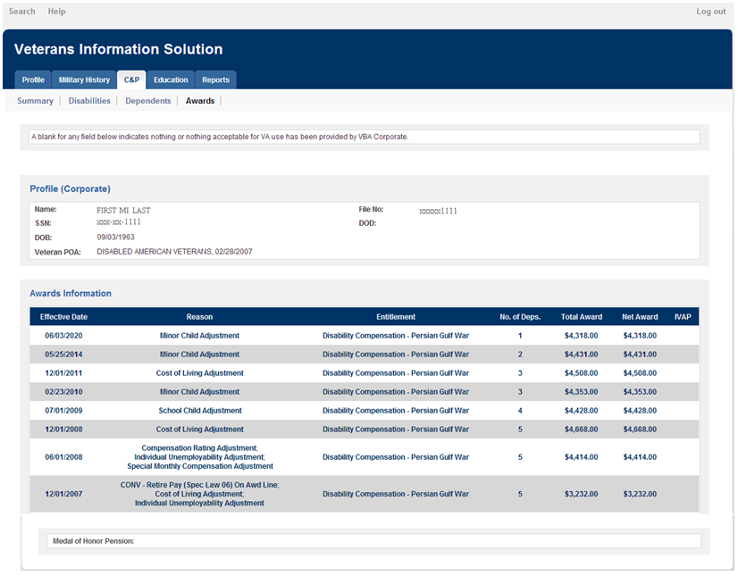
C&P Awards Screen

Slide 20
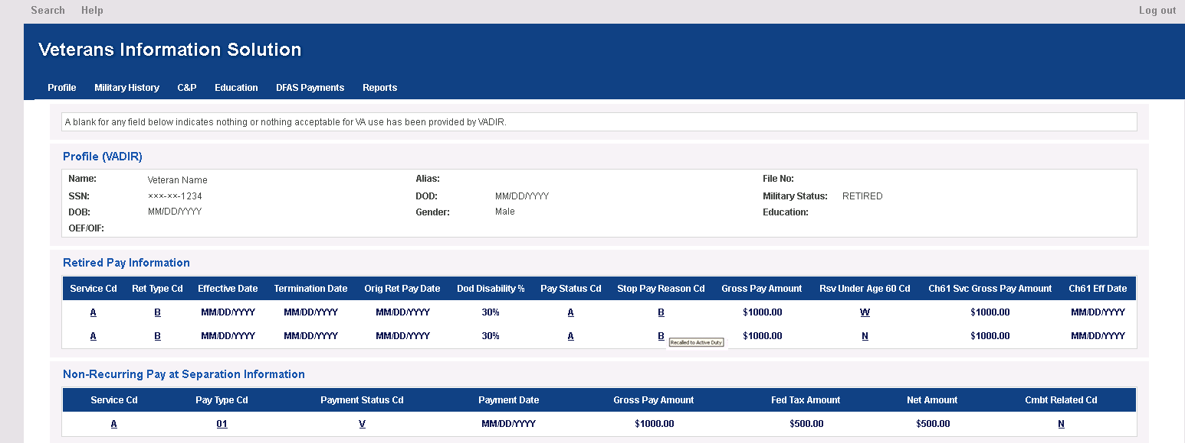
DFAS Payments Screen

Slide 21
DFAS Payments
DFAS Payment is available through VIS-R. For most cases, this information can be used to verify the following pay data, unless the information is not provided in VIS-R or not clear. This includes:
Retired pay
Non-Recurring Separation Pay
Email VAVBAWAS/CO/212A to provide feedback
21

Slide 22
DFAS Payments
Army, Navy, and Air Force:
Active Component Separation Pay Data in VADIR - January 2001 - Present
Reserve Component Separation Pay Data in VADIR - June 2007 – Present
USMC:
Active and Reserve component - October 2006 – Present
22

Slide 23
Access
Access to VIS-R is granted through the completion of an VAF 8824e, Common Security Services (CSS) User Access Request
Access to each Veterans Service Representative will be rolled out in a phased approach to ensure adequate capacity.
Work with your Information Security Officer
23

Slide 24
Review
Review

