Slide 1
Compensation Service
February 2016
Hearing Loss and Tinnitus
For VSRs

Slide 2
Objectives
Identify the types of hearing loss and tinnitus
Determine hearing loss criteria for VA purposes
Identify evidence to review for hearing loss and tinnitus
Identify hearing loss and tinnitus examination and medical opinion criteria

Slide 3
References
38 CSR 3.385 Disability due to impaired hearing
M21-1MR III.iv.4.B.12 Hearing Impairment
DAD associated with Hensley v. Brown

Slide 4
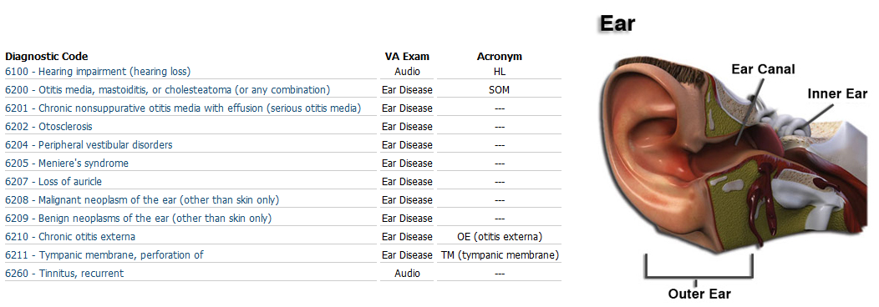
Additional Resources are found in MEPSS

Slide 5
Types of Hearing Loss
For C&P adjudication purposes, there are four types of hearing loss:
Conductive
Sensorineural,
Mixed, and
Central

Slide 6
Determining Impaired Hearing as a Disability
Per 38 CFR 3.385, impaired hearing is considered a disability for VA purposes when
the auditory threshold in any of the frequencies 500, 1000, 2000, 3000, 4000 Hertz is 40 decibels or greater, or
the auditory thresholds for at least three of the frequencies 500, 1000, 2000, 3000, or 4000 Hertz are 26 decibels or greater, or
speech recognition scores using the Maryland CNC Test are less than 94 percent.

Slide 7
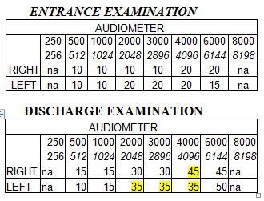
Hearing Loss in Service
Be careful when reviewing audio tests to not consider frequencies at 250, 6000, or 8000 Hertz.
This example shows hearing loss in service

Slide 8
Tinnitus Defined
Tinnitus is the subjective or objective perception of a ringing or tingling sound in one or both ears without an external stimulus.

Slide 9
Characteristics of Tinnitus
Tinnitus may sound like ringing, blowing, roaring, buzzing, hissing, humming, whistling, or sizzling. It can be either constant or intermittent. Both constant and intermittent tinnitus is considered to be recurrent, which is the requirement under diagnostic code 6260 for assigning a 10-percent evaluation.

Slide 10
Causes and Onset of Tinnitus
The etiology of tinnitus often cannot be identified, because there are so many potential causes that it is impossible to select one.
Acute noise exposure and noise-induced hearing loss.
Sensorineural hearing loss, such as from presbycusis or acoustic trauma, is the most common cause of tinnitus
The onset may be gradual or sudden, and individuals are often unable to identify when tinnitus began

Slide 11
Claim Review
Review the claim for:
sufficient evidence of a current audiological disability (including lay evidence), and
Evidence documenting
hearing loss and/or tinnitus in service, or
an in-service event, injury, disease, or symptoms of a disease potentially related to an audiological disability.

Slide 12
MOS Noise Exposure
The Duty MOS Noise Exposure Listing, which has been reviewed and endorsed by each branch of service, is available at http://vbaw.vba.va.gov/bl/21/rating/docs/dutymosnoise.xls
If the duty position is shown to have a “Highly Probable” or “Moderate” probability of hazardous noise exposure, concede exposure to hazardous noise for the purposes of establishing an event in service.

Slide 13
Examinations
Establishment of an event, injury or disease in service is fact specific. If there is no documentation of an in-service illness, injury or event involving the ears or hearing, the Duty MOS Noise Exposure listing will be considered.

Slide 14
MOS information in the Exam Request
If noise exposure is conceded based on the duty MOS Noise Exposure Listing include the level of probability conceded, such as “highly probable” or “moderate,” in the information provided to the examiner in the body of the examination request.

Slide 15
Additional Remarks
If noise exposure is not conceded but an examination and/or opinion are otherwise necessary based on another event, injury, disease provide the probable level of exposure to hazardous noise associated with the Veteran’s documented duty position in the examination request remarks.

Slide 16
Unclear findings remarks
Request a medical opinion regarding the significance of prior audiological findings if the evidence of record is unclear on any point.

Slide 17
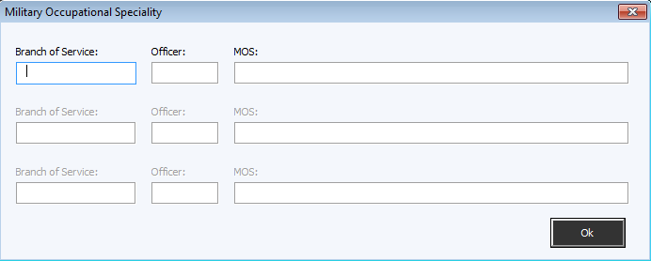
Entering the exam request

Slide 18
Entering the exam request cont’d

Slide 19
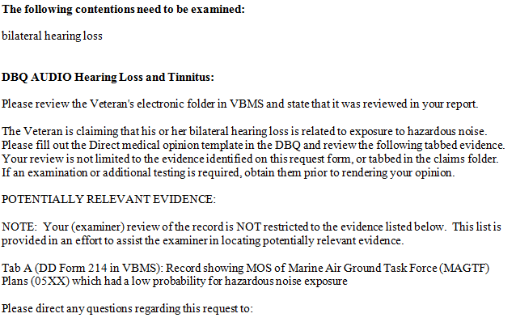
Entering the exam request cont’d

Slide 20
Tinnitus Medical Opinions Not Required
A medical opinion is not required to establish direct service connection for claimed tinnitus if
service treatment records (STRs) document the original complaints and/or diagnosis of tinnitus
there is current medical evidence of a diagnosis of tinnitus or the Veteran competently and credibly reports current tinnitus, and

Slide 21
Tinnitus Medical Opinions Not Required continued
the Veteran claims continuity of tinnitus since service or there are records or other competent and credible evidence of continuity of tinnitus diagnosis or symptomatology.

Slide 22
Review

