Slide 1
VR&E Enhanced Application Processing
For VR&E & Support Staff
TMS # 3882319
Notes:
Welcome to the VR&E Enhanced Application Processing course. My name is Ruth Comeau and I’m a Senior Program Manager in VA Central Office, VR&E Service.
The purpose of this training course is to identify and correctly perform steps for Chapter 31 application processing. It will also introduce you to BDN archiving and indexing by showing you where application processing is affected by the ongoing Chapter 31 Transition to Corporate.
Basic Eligibility is the keystone decision for a Service-member’s or Veteran’s access to Chapter 31 (Ch31) services. 38 United States Code 3102 and 3103 cover the provisions for establishing basic eligibility as well as the duration of eligibility. A timely and correct response to a Veteran from Department of Veterans Affairs (VA) allows the individual access to Ch31 resources – at minimum, a thorough assessment along with information and guidance which he/she can use to make important decisions for employment or independent living. Vocational Rehabilitation and Employment (VR&E) staff allow for sound workload management and provision of Ch31 services by using Information Technology systems, placing claims under control, processing correctly, generating data, and having correct basic eligibility information throughout.

Slide 2
Objectives
By the end of this lesson, you will be able to
Perform each step in Claim Development
Properly use AutoGED to process
Original or Re-Opened Claim
Updating Eligibility (supports CWINRS Awards Module)
Understand Data Generation and Locating
Understand Indexing & Archiving
Notes:
By the end of this lesson, you will be able to perform each step in Ch31 Application – also referred to as Claim - Development. You will be able to properly use AutoGED in Corporate WINRS to process an original claim and a reopened claim and will have an understanding of how AutoGED is used in updating eligibility for Corporate WINRS subsistence allowance award processing. You will know the points of data generation in Ch31 claims processing, and where to locate the data. You will have increased awareness of BDN Indexing and Archiving as steps in the VR&E Transition to Corporate.

Slide 3
Application Processing
Share
Corporate WINRS
BDN
Virtual VA
Claim
Development
VBMS
BIRLS
VonApp
Notes:
Let’s begin with processing an original claim using AutoGED in Corporate WINRS. Other primary Information Technology (IT) systems used by VR&E staff are: Benefits Delivery Network (BDN), Beneficiary Identification and Records Locator System (BIRLS), Share, Veterans Benefits Management System (VBMS), Virtual VA, and Veterans On-line Application (VonApp). Permissions and commands for using IT systems are processed through Common Security Employee Management (CSEM) application. See your Information Resource Manager (IRM) or Information Security Officer (ISO) for more information about how to obtain access to these systems.

Slide 4
Claim Development continued
Know the outcome BEFOREHAND: verify the type of claim
Basic Eligibility Allowed
Basic Eligibility Disallowed
Original (no CWINRS record; no BDN/Share record)
Reopened (previously Discontinued; previously Rehabilitated – EP 795)
Existing Ch36 claim in Applicant status
Notes:
Each Chapter 31 claim will be either an original or a reapplication. Know which one you are processing and the intended outcome of the claim before you engage AutoGED. Will you be processing an original or re-opened claim? Will basic eligibility be allowed or disallowed? Is there an existing Chapter 36 claim in applicant status?

Slide 5
Claim Development continued
Receiving and Processing Ch31 Applications
Centralized Mail Room delivery
VBA Regional Offices or out-based locations, including outreach location(s)
VHA facility or community-based outpatient clinics
Vet Centers
National Cemetery Administration (NCA)
Veterans Online Application (VonApp)
Military Installations
Verify qualifying military service
Very qualifying service-connected disability
Verify record exists in correct station
CWINRS – BDN
Verify if Chapter 36 claim (Ed/Voc) exists
Verify date of claim is on application
Notes:
There are basic steps necessary for Ch31 claim development. First, know the locations in your office where applications are received. Ensure that the application is properly stamped with the date of receipt in VA. Next, know where to look to verify qualifying military service and also to verify qualifying service-connected disability. Verify if an active Chapter 36 claim exists. Then, verify whether or not a CER folder exists and the folder location (request transfer from another station if necessary).
Note that VA introduced Centralized Mail within each Regional Office as of May 12, 2014. Processing time in Centralized Mail may delay receipt of a Ch31 claim in the VR&E Division. Despite any delay, stations must use the correct date of claim. Prompt processing of the claim in VR&E Divisions can help reduce the impact of processing time in Centralized Mail units. A schedule for release of Centralized Mail procedures can be found on the Compensation Service web-site at http://vbaw.vba.va.gov/OBPI/Centralized_Mail.asp. The site also contains a link to Standard Operating Procedures which includes how mail is handled for non-Compensation-related services. VR&E Service recommends that VR&E Divisions work with their local Mail Room, Veterans Service Center Manager, and/or Chief of Support Services to ensure expeditious routing of Ch31 claims.

Slide 6
Date of Claim
Date of receipt of formal or informal claim
Follows Pending End Products 095 and 295
Follows Pending End Product 719
Must equal the Applicant Effective Date in both Corporate WINRS and BDN.
Notes:
Once entered into AutoGED, the Date of Claim is attached to the pending End Product(s) 095/295 and 719 and follows them until the end product is cleared. The Date of Claim is the equivalent of “Applicant Effective Date” in calculating Days to Entitlement when EP 719 is either cleared, or used in authorizing a Disallowance for no employment handicap or for failure to pursue. The Date of Claim on the BDN M35 screen (applicant effective date) must equal the Date of Claim in Corporate WINRS History (applicant effective date).
If the date of claim is ever in question, please refer to the Date of Claim Job Aid associated with this training and consult with your VR&E Officer.

Slide 7
Basic Claim Development Steps
Before using AutoGED
Verify whether Original or Reopened claim
Use BDN MINQ command to access the M35 screen for case status
If BDN Ch31 MR found, it is a Reopened claim. If no record found, it is an Original claim.
Archived BDN records - see instructions for how to identify an Archived BDN record
May also use the Share VR&E Information tab for verify Reopened claim
Verify qualifying military service
BIRLS, DD214 (Veteran Service Center)
Use BDN BINQ command or SHARE.
Note EOD (entry onto active duty) date, RAD (release from active duty) date, and Character of Service.
Notes:
Following basic claim development steps will help ensure a smooth AutoGED process. Before using AutoGED, verify if the claim is an original claim, meaning there is no BDN Master Record. Or determine if it is a reopened claim, meaning a BDN Master Record exists and information may be retrieved from the M33 and M35 screens, or from the Share VR&E Information tab. If the Reopened claim is from a former Ch31 participant who was Rehabilitated, establish an EP 795 to control the count and timeliness until a determination is made that the prior rehabilitation declaration can be overturned.
Next, verify the qualifying military service through a BIRLS inquiry, a DD-214, or using the BDN BINQ or Share BIRLS command. Be sure to make note of the EOD (entry onto active duty) date, the RAD (release from active duty) date, and Character of Service.

Slide 8
Basic Claim Development Steps continued
Verify qualifying service-connected disability and obtain Initial Rating Notification Date (IRND)
SC compensation rating; Memo rating; NDAA
Use SHARE
Corporate Inquiries Tab
Awards/Ratings Tab
Compensation Ratings Tab
Memorandum Ratings Tab
Other sources of IRND include
VBMS (rating decision and letter)
Virtual VA (rating decision and letter)
Claims folder
Veterans Service Center
Verify that CER folder is in your station
Verify whether Ch36 (Ed/Voc) exists
Verify date of claim
Notes:
Next, confirm the individual’s qualifying service-connected disability and obtain the Initial Rating Notification Date (IRND). You can locate the IRND on the VA Disability Rating for Compensation purposes; a Memorandum rating for Ch31 purposes; or confirm receipt of Department of Defense medical statement for National Defense Authorization Act.
You can locate the IRND by using SHARE Corporate Inquiries function. Select the Awards/Ratings module, then select Ratings Tabs. Other sources of IRND include Virtual VA. Locate the original rating decision that granted 10% or higher service-connected disability and the letter that informed the Veteran of that rating. Ratings that were made prior to VA’s use of VetsNet applications may require a search of the Claims folder; or inquiring through the Veterans Service Center if assistance is needed to locate an electronic claims folder.
Next, for a reapplication, verify that the CER folder is in your station and verify date of claim. If the Veteran received Ch36 Educational-Vocational Counseling services, ensure that both the electronic and paper records are transferred to your station. When the Ch36 record is in your station, AutoGED will incorporate it into the Ch31 record.

Slide 9
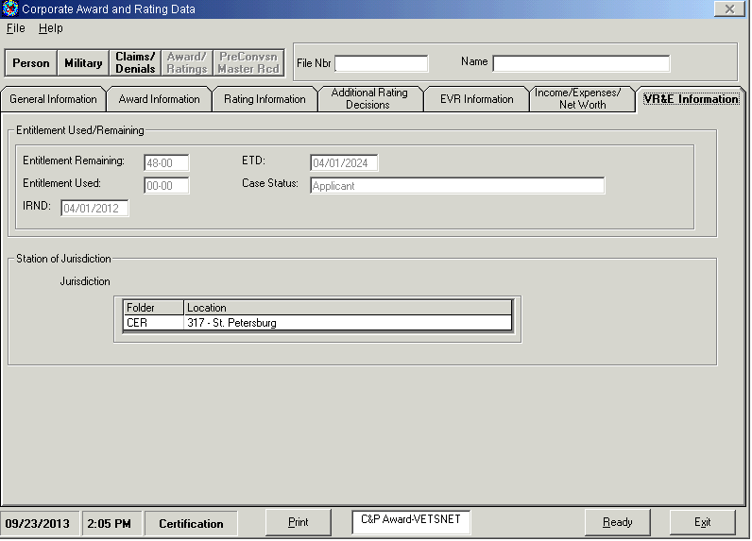
Initial Rating Notification Date
Notes:
This screen displays the Share Corporate Award and Rating Data, VR&E Information tab. The following fields are populated in Share when AutoGED is used to process basic eligibility: Entitlement Remaining; Entitlement Used; IRND; Eligibility Termination Date (ETD); Case Status; and Station of Jurisdiction of Counseling Evaluation Rehabilitation (CER) folder.
The Initial Rating Notification Date for Reopened Claims can be obtained from BDN M33 screen, using MINQ/M33 or from Share, using Corporate Inquiries – Award/Ratings function – VR&E Information tab.
When a Corporate WINRS record exists, but no BDN Ch31 Master Record exists (ex., “No Record” appears at the bottom of the BDN Ready Screen), it is most likely an Archived BDN record. The Ch31 record has been deleted from BDN, and the screen snapshots are available on the Share, Corporate Inquiries, Pre-Conversion Master Record tab where you can view the M33 screen for IRND.

Slide 10
Verifying Qualifying Military Service
Notes:
Use the BINQ command or inquiry to verify qualifying military service. BIRLS may be accessed through BDN or Share.
This screen displays a BDN Ready Screen. Minimum entries are:
Command = BINQ
Password = 4 character BDN Ready Screen password
File Number = Veteran’s file number

Slide 11
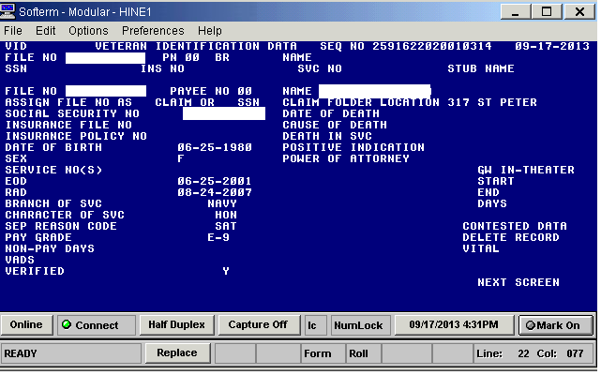
Verifying Qualifying Military Service
Notes:
Next, this BDN screen displays BIRLS Veteran Identification Data screen. No entries are allowed except in the Next Screen field.
View the veteran identification data screen to verify the following military service information:
Entry onto Active Duty (EOD)
Release from Active Duty (RAD)
Character of Service (Character of SVC)
Separation Reason Code (Sep Reason Code), and either –
VADS or Verified have a “Y” in the field.
If any of these fields are missing, and the applicant is a Veteran, then a BIRLS update is required. Corporate WINRS AutoGED will stop processing when it encounters a field with incorrect or missing data. A BIRLS update may be accomplished by the Veterans Service Center.

Slide 12
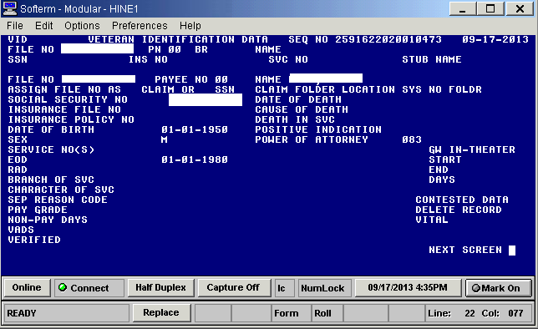
BDN BIRLS and Memo Rating or NDAA
Notes:
Here is a BDN snapshot displaying a BIRLS VID screen with minimum data requirements for in-service Memorandum Rating or National Defense Authorization Act (NDAA) AutoGED processing. The EOD field contains a valid date. You may not necessarily see an RAD date, branch of service, separation reason code and VADS or VERIFIED.
The BIRLS record must have enough data in it to confirm that the service-member has military service. If basic development reveals there is no BIRLS record or insufficient information in the record, AutoGED will set the record to Disallowance. A BIRLS update may be accomplished by the Veterans Service Center.

Slide 13
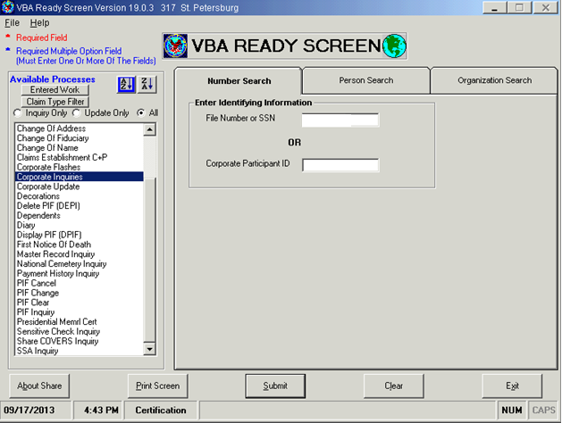
Share and Qualifying Service-Connected Disability – Locating IRND
Notes:
Use Share as the primary resource to verify qualifying service connected disability rating. Select Corporate Inquiries and enter file number or Social Security Number (SSN). Two pieces of data are retrieved from Corporate Inquiries: Initial Rating Notification Date (from Claims/Denials Tab); and verification of service-connected disability rated at 10% or higher.
Step 1 – select Corporate Inquiries and enter Veteran’s file number.

Slide 14
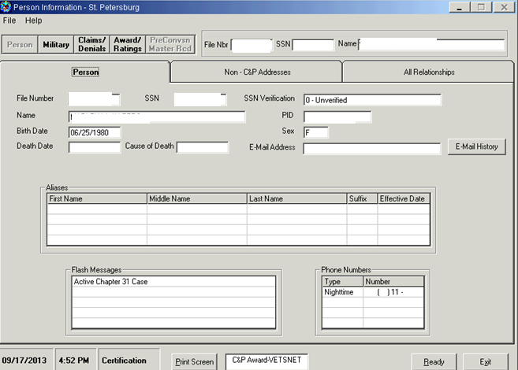
Share and Qualifying Service-Connected Disability – Locating IRND continued
Notes:
Step 2 – select the Claims/Denials function button.

Slide 15
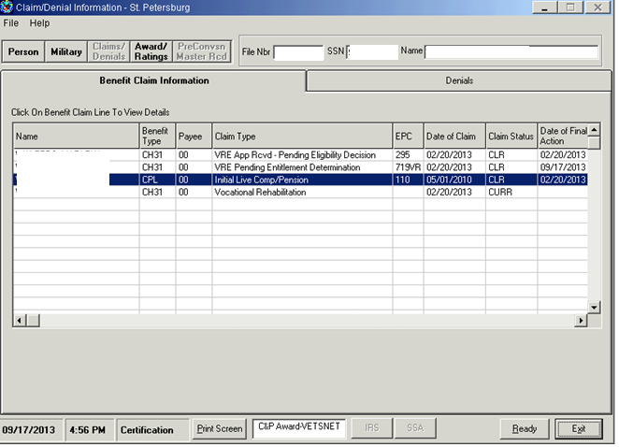
Share and Qualifying Service-Connected Disability – Locating IRND continued
Notes:
Step 3 – highlight the Initial Compensation/Pension claim type.

Slide 16
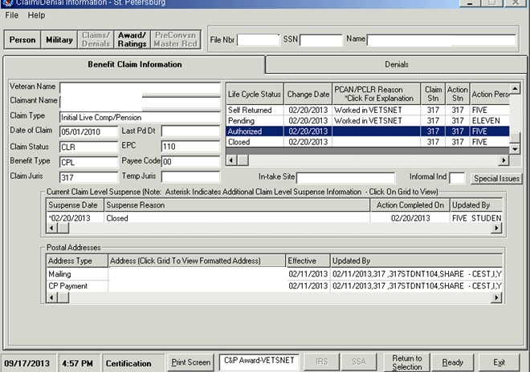
Share and Qualifying Service-Connected Disability – Locating IRND continued
Notes:
Step 4 – open the Initial Comp/Pen line for details about the date authorized. The date that a compensable (10% or higher) service-connected disability is authorized is the Initial Rating Notification Date.

Slide 17
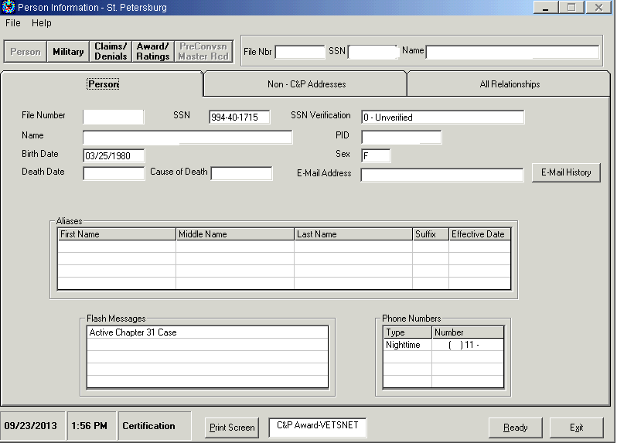
Share and Qualifying Service-Connected Disability – Locating Award/Rating
Notes:
Step 5 – select the Award/Ratings function button.

Slide 18
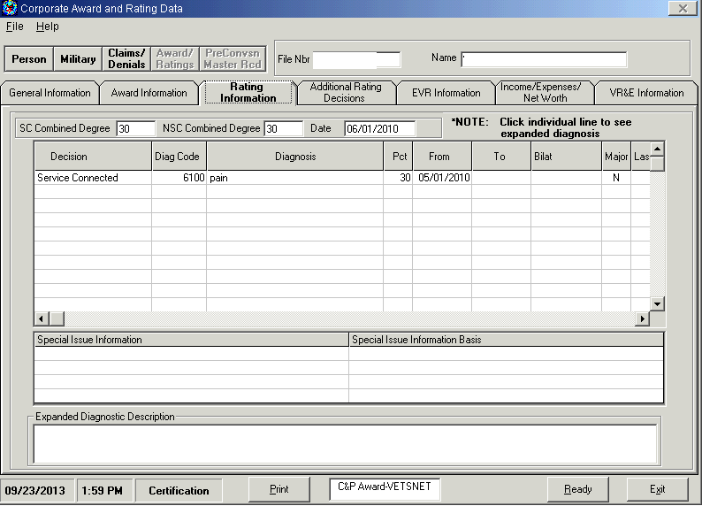
Share and Qualifying Service-Connected Disability – Locating Award/Rating continued
Notes:
Step 6 – select Rating Information tab for diagnostic code and percentage of service-connected disability condition. Other tabs may be accessed for additional information as needed for Ch31 claim processing.

Slide 19
Virtual VA and Locating IRND
Notes:
Another source to obtain an Initial Rating Notification Date is Virtual VA. Log into Virtual VA and open Veteran’s e-Folder to locate Notification Letter for the earliest claim. Note: before capturing this date as the IRND, verify that the letter specifies it is a notification of compensable rating for Original/Initial claim of service-connected disability.
The screen displayed here is a Veteran’s Virtual VA e-Folder with first notification letter line highlighted for selection.

Slide 20
Use Share Benefit Claim Information to confirm Virtual VA IRND
Notes:
This screen shows the Share Claim/Denial Benefit Claim Information tab with “Closed” date corresponding to the same date of notification shown in the Veteran’s Virtual VA e-Folder displayed in the previous slide.

Slide 21
VBMS Information – Locating IRND
Notes:
Another source of rating information is VBMS. VBMS is operational throughout VBA. New Compensation claims are entered into VBMS now. Although it will be years before all claim info is transferred into VBMS, it is good to know what it looks like for now. VR&E will continue to use Share and other Corporate applications for verifying information. This screen displays the VBMS Documents Log where one can locate the Original Rating of compensable service-connected disability and the associated correspondence to obtain IRND.

Slide 22
VBMS Information – Locating IRND continued
Notes:
This slide shows the VA Original Disability Rating Decision located in VBMS.
The SHARE, Virtual VA, and VBMS slides are intended to illustrate the different IT systems and locations for obtaining information necessary to process Chapter 31 claims.
When basic development steps are complete, proceed with AutoGED processing.
If you have not already learned how to use VBMS to locate rating and correspondence, please refer to the VBMS Training in TMS and your local training resources. The TMS course titles and numbers are listed below and in the references.
VBMS Overview and Getting Started (Online) 3725147
VBMS Conducting Searches (Online) 2073965
VBMS eFolder Read Only Access (Online) 3840573

Slide 23
CER Folder Location – Original Claims, Reopened Claims, Archived BDN Records
Notes:
So far we have reviewed the basic development steps for locating information to verify qualifying military service and verifying service connected disability rating.
Next we will discuss the CER Folder Location. This screen displays the BDN Ch31 Master Record M35 screen with Station and CER Folder Location entries highlighted.
Accuracy in the CER folder location fields in BIRLS and the BDN M35 screen are important to successful claims processing. There is a sequence of steps to follow to ensure the CER folder location is correct in BIRLS and BDN.
For Original claims – authorize AutoGED first, then use BFLD command to establish the CER location in BIRLS. BIRLS will update the BDN M35 screen. A Chapter 31 BDN record that has been Archived has been deleted from BDN. It will act like an Original when a reapplication is processed in AutoGED, and AutoGED will create a new Ch31 BDN Master Record. If a CER location exists in BIRLS for an archived Ch31 BDN Master Record, then use the BFLD command to destroy the current CER folder location in BIRLS. Upon Authorization of AutoGED, use the BFLD command again to establish a new CER folder location in BIRLS. BIRLS will update the M35 screen. Use the BFLD function on the AutoGED processing tab to record the update to BIRLS.
For Reopened claims - ensure the CER folder location in BIRLS and BDN is in your station BEFORE you start AutoGED processing. Use the BFLD command to access the transfer into your station. BIRLS will update the M35 screen. Use the BFLD function on the AutoGED processing tab to record the update to BIRLS.
When the M35 Screen CER Folder Location field is blank or incorrect, AutoGED is unable to transmit the Date of Claim and Case Status Updates; some loss of workload and performance data occurs.

Slide 24
Using EP 795 to Control Reapplication from Rehabilitated Status
EP 795 is for re-applications for Claimants who were previously rehabilitated.
Do not start AutoGED before entitlement determination and overturning/removing prior rehab
Refer to EP 795 training conducted on August 27, 2013 for procedures to establish EP 795 control
Notes:
Also, please remember, claims received from prior Ch31 participants who entered Rehabilitated or Discontinued (MRG RC 34 or 35) case status will be processed out-of-system, until there is a determination of whether or not the prior Rehabilitation or Discontinuance can be over-turned. Upon receipt of 28-1900, establish EP 795 with date of claim. Once a decision is made (allowed or disallowed), PCLR the 795. If the prior Rehabilitation or Discontinuance is over-turned, proceed with AutoGED processing.

Slide 25
Application Processing
AutoGED Processing
Notes:
We have just completed Claim Development, and AutoGED Processing is next.
The AutoGED Module of Corporate WINRS is used to process Original and Reopened claims for Ch31 services. It also interacts with Corporate WINRS Award module to validate and update basic eligibility and entitlement to subsistence allowance.

Slide 26
AutoGED Processing – Original Claim
CWINRS AutoGED
From CWINRS Navigator, click on GED PROCESSING button with AutoGED Processing showing in the drop-down list
Click on the ADD button on the right-hand side of the screen.
Enter File Number
Corporate environment and BDN will be checked to confirm claimant is a Veteran
If claimant is not a Veteran, a message will appear stating that there is no BIRLS record on file
Notes:
AutoGED is the primary tool to process Ch31 claims. A Corporate WINRS enhancement in February 2011 introduced a change to AutoGED. Prior to February 2011, AutoGED records were stored on a Regional Office server and could only be viewed by the Regional Office of jurisdiction. When Corporate WINRS introduced AutoGED to the Corporate Database, it also eliminated the ability to delete authorized GED records from the database.
To begin using AutoGED, go to the Corporate WINRS Navigator screen, click on the GED PROCESSING button with AutoGED Processing showing in the drop-down list. Click on the ADD button on the right-hand side of the screen. Enter the File Number. If the claim is an Original claim, AutoGED will check BIRLS to confirm claimant is a Veteran. If claimant is not a Veteran, a message will appear stating that there is no BIRLS record on file.
Remember, know the outcome BEFOREHAND: verify the type of claim before using AutoGED.

Slide 27
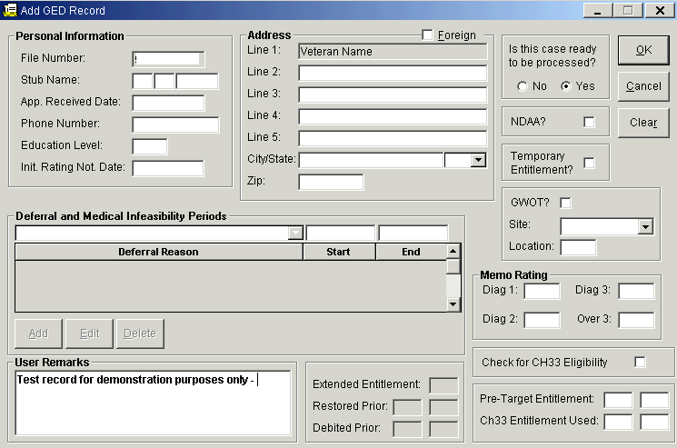
AutoGED Processing – Original Claim continued
Notes:
This is the Add GED Record screen in Corporate WINRS. It displays the Corporate WINRS Add GED Record form with the “Check for Ch33 Eligibility” and “Ch33 Entitlement Used” fields highlighted. In addition to verifying that basic eligibility criteria are met with qualifying military service and one or more service connected disability conditions rated at 10% or higher, AutoGED will handle the basic eligibility process when the Servicemember or Veteran has a memorandum rating, or has applied under NDAA. AutoGED will also obtain Education benefit usage including Ch33. Enter a check-mark in the Ch33 Eligibility box located in the lower right corner of the screen.
Corporate WINRS Version 3.2 enhanced AutoGED processing by making the Ch33 Eligibility check a manual operation. Users must place a check in the box labelled “Check for Ch33 Eligibility” before AutoGED will interface with Long Term Solutions (LTS). If there is no check-mark in the box, AutoGED will not interface with LTS. As an alternative, Users can obtain from LTS the amount of entitlement used and enter it in the Ch33 Entitlement Used fields. Use caution with this option as AutoGED will not cross-check LTS when entries are contained in these manual fields.
Any errors or verification problems will be posted on the AutoGED Processing Tab, and users will be able to retry processing once the errors or problems are resolved.

Slide 28
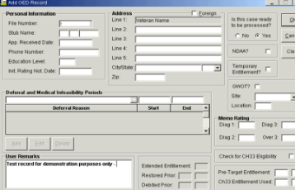
AutoGED Processing – Original Claim continued
Complete AutoGED Entries
App Received Date – This must be the date it was received in a VA facility – point of processing accuracy review
Education Level – Enter number of years with two digits
Initial Rating Notification Date (IRND) or blank if Memorandum Rating or NDAA
Case ready to be processed?
Default setting is yes – select no if there is no Memo rating or if prior Rehab and out-of-system processing is required. Remarks required.
Is this an NDAA case? If yes, check the box
5555 will automatically appear in DIAG 1 field.
Refer to VR&E Circular 28-12-01 Procedures for Implementing the Provisions of Public Law 110-181, National Defense Authorization Act of 2008 as extended by Public Law 112-56, Vow to Hire Heroes Act.
Notes:
The Corporate WINRS User’s Guide Chapter 5 for AutoGED Processing was recently updated and is available on the VR&E Service Knowledge Management Portal. https://vaww.portal.va.gov/sites/VRWKM/IT%20Systems%20%20Resources/CWINRS%20updated%20User%20Guide/Chapter%205%20AutoGED%20Processing.pdf
The Users Guide should be referenced in addition to guidance accompanying this training session for a more detailed look at each of the fields or for questions or assistance as you complete the AutoGED entries.
Now we will look at the major AutoGED fields.
The file number and stub name fields are auto-populated and no changes are allowed. Please verify that the stub name and full name are correct and request assistance from the Veteran Service Center if a name change is required.
The Application Received Date must accurately reflect the date it was received in a VA facility.
Enter the phone number provided by the Veteran.
In the Education Level field, enter number of years with two digits—for a number lower than 10, enter a leading 0.
In the Initial Rating Notification Date field, enter the date you obtained from Share, Virtual VA or VBMS during the basic development steps. Leave the Initial Rating Notification Date field blank for Memorandum Ratings and NDAA claims.
Enter the Veteran’s address. Note that the Veteran's name is auto-populated on the first line—DO NOT enter the Veteran’s name on the second address line as that will cause two lines bearing the Veteran’s name in both the Corporate WINRS address field and the BDN address field on the M32 screen.
The “Case ready to be processed?” options have a default setting of “yes”. Change to “no” if there is a reason that you cannot process immediately (i.e., a Memorandum rating is required. You must enter a remark in Notes when “not ready to process” is selected.
Use the NDAA check box ONLY when an NDAA claim is received. When you check the box, the numbers 5555 will automatically appear in DIAG 1 field for a diagnostic code.
Refer to VR&E Circular 28-12-01, Procedures for Implementing the Provisions of Public Law 110-181, National Defense Authorization Act of 2008 as extended by Public Law 112-56, Vow to Hire Heroes Act.

Slide 29
AutoGED Processing – Original Claim continued
Complete AutoGED Entries, continued
Is there temporary entitlement – use only when IRND is unavailable
Do not check for re-opened application
The IRND will be on the M33 screen if claim is re-opened
Use of Location, Site, and Priority Processing indicators
Priority processing checkbox (currently labelled GWOT)
Select site – drop-down selection of VR&E Division out-base locations
Enter Location – VOW for NDAA, Initials of the Case Manager, or other 3-character indicator for tracking purposes
Location and Priority Processing indicator remain attached to pending End Products 095/295 and 719
Notes:
Continue Completing the AutoGED Entries. The temporary entitlement box may be checked if this is an Original claim AND if the IRND is not available. NOTE: Use of temporary entitlement requires an Eligibility/Entitlement Update GED before subsistence allowance can be processed.
If the claim requires priority processing, check the box currently labelled GWOT. Underneath the check box are two additional fields: Site and Location. The Site check box operates on a drop down selection of the out-base locations for your VR&E division. In the Location field, you may enter VOW for NDAA or abbreviate out-base location, or any other 3-character indicator for tracking purposes.
The priority and location indicators will be attached to the pending End Products 095/295/719s and allow stations to track the claims through those End Products. When GWOT/Priority is checked, a “Z” indicator will accompany all of the pending 095s/295s/719s and will disappear when the end product is cleared.
AutoGED also obtains education benefit usage including Ch33. There are specific functions for retrieving Ch33 benefit usage through an interface between Corporate WINRS and Long Term Solutions (LTS).
Corporate WINRS Version 3.2 enhanced AutoGED processing by making the Ch33 eligibility check a manual operation. Users must place a check in the box labeled “Check for Ch33 eligibility” before AutoGED will interface with LTS.

Slide 30
Entitlement Look-up in LTS
.
Notes:
Here is a Long Term Solution on-line record view. The Long Term Solution, or LTS, program contains the data on available and used Ch33 entitlement. This screen displays the information available in LTS. On the first screen following log-in, read and click ACCEPT and enter the Veteran’s Social Security number. The Work Product History screen appears. Click View on the most recent work product line, and a Work Product Summary appears with the real-time Entitlement used and remaining. The Eligibility and Entitlement Banner immediately underneath the name displays the Eligibility Date, the Benefit Level for Ch33, Delimiting Date, Original Entitlement, Used Entitlement, and Remaining Entitlement.
Note: The record displayed in this and other screens are a test-version of Veteran names and file numbers – no real PII was used.

Slide 31
AutoGED Processing – Reopened Claim
EP 795
If claimant is prior Ch31 participant who was Rehabilitated, or Discontinued (MRG RC 34 or 35) establish an EP 795 and do not process in AutoGED until a determination to overturn Rehabilitation or Discontinuance is documented. PCLR the 795 when entitlement determination is made.
Reopened
From CWINRS Navigator, click on GED PROCESSING button with AutoGED Processing showing in the drop-down list
Click on Single Record and enter file number
Highlight case and select Reopen
Enter date of claim, update any fields with outdated information
Process (errors or data validation issues will appear on Process Tab – correct and retry)
Notes:
As previously stated, if a claimant is a prior Ch31 participant who was Rehabilitated or Discontinued (MRG RC 34 or 35), establish an EP 795 and do not process in AutoGED until a determination to overturn Rehabilitation or Discontinued is documented. PCLR the 795 when entitlement determination is made.
To process a Reopened claim in AutoGED, click on Single Record and enter file number. Highlight case and select Reopen. Enter date of claim, update any fields containing any outdated information. Process the claim. If errors or data validation issues appear on the Process Tab, then correct and retry.

Slide 32
Application Processing
Completed GED
Notes:
Working with completed GED records is next.

Slide 33
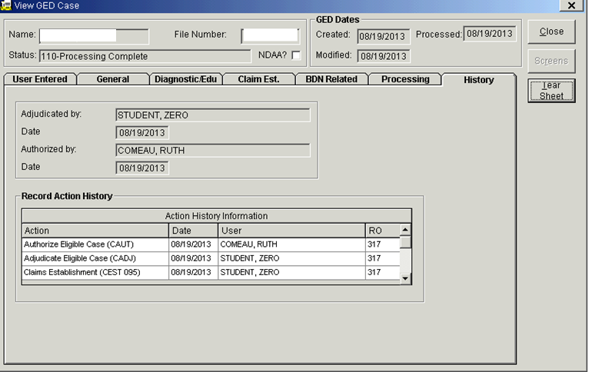
Completed GED
Notes:
This snapshot displays a Corporate WINRS View GED Case screen. The GED status is listed as 110-Processing Complete. A GED Tear Sheet can be printed at this point.
Upon authorization, the following outcomes occurred:
End Product 095/295 were cleared and End Product 719 was established.
For Original claims, a BDN Ch31 Master Record was created with Applicant status effective date equal to the date of claim; a BDN Index Record was created with the indicator pointing to Corporate WINRS; and a Corporate WINRS record was created with Applicant status effective date equal to the date of claim.
For Reopened claims, the BDN Ch31 Master Record was updated to close Rehabilitated or Discontinued status and open Applicant status with effective date equal to the date of claim; and the Corporate WINRS record was updated to close Rehabilitated or Discontinued status and open Applicant status with effective date equal to the date of claim.

Slide 34
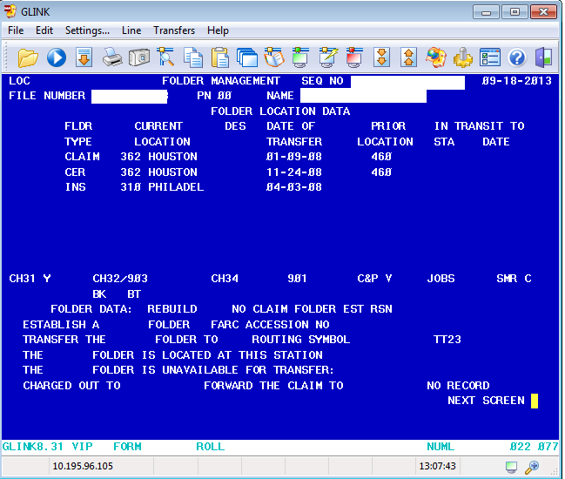
CER Folder Location
Create using BFLD (BIRLS Folder) Command
Original GED – BFLD after Authorization
Reopened GED – BFLD before Establishment
Handling Archived Records
Screen displays BDN BIRLS Location screen.
Notes:
The sequence of establishing a new, or updating an existing, CER folder location in BIRLS is essential for many data integrity issues.
If the claim is an Original (no Ch31 Master Record in BDN), perform the BFLD command AFTER authorizing the GED and update AutoGED Process Tab.
If the claim is a Reopened/Reapplication (Ch31 Master Record exists in BDN), perform the BFLD command BEFORE initiating the GED and update AutoGED Process Tab.
The CER folder location allows Corporate WINRS to accurately update the BDN Master Record with Date of Claim (i.e., the “effective” date) which is the beginning period for Days to Entitlement measure. A CER folder location allows BDN to refresh (when necessary) the Corporate WINRS record.
When processing a reapplication from a Veteran whose BDN Ch31 Master Record has been Archived, it is necessary to reestablish the CER folder location in the NEW BDN Ch31 Master Record. Use BFLD command to: 1) destroy the existing CER folder location; 2) establish new CER folder location after the GED is authorized. When the second BFLD transaction is complete, the M35 screen will reflect your station number in the CER folder location field.

Slide 35
Disallowance
Application Processing
Notes:
Now we’ll move on to disallowance processing in AutoGED when the Veteran has no Basic Eligibility to Ch31.

Slide 36
Disallowance – Basic Eligibility
AutoGED processes disallowance for Basic Eligibility
No qualifying military service
No qualifying service connected disability
Compensation; memo rating; NDAA
Processing Tab allows for corrections and re-try processing
Notes:
AutoGED processes basic eligibility Disallowance and creates a Corporate WINRS and BDN record documenting that the claim was disallowed. If any basic eligibility criteria are missing or erroneous, AutoGED cannot validate the claim and will set it for disallowance. The AutoGED Processing Tab allows a VR&E user to retry processing after corrections to the record are made (may involve BIRLS update by Veterans Service Center). If basic eligibility cannot be verified, the disallowance processing will be completed on the Processing tab.

Slide 37
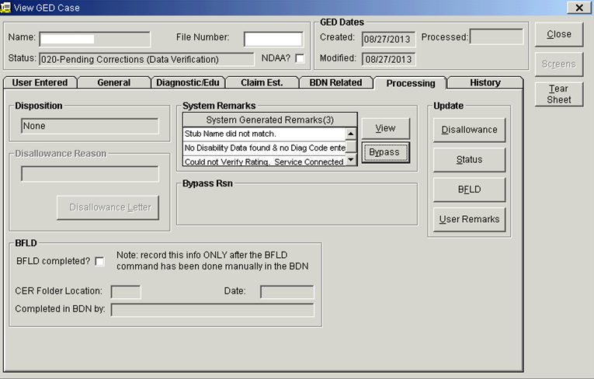
AutoGED Corrections on Processing Tab
Notes:
AutoGED Processing Tab displays the system generated remarks which list one or more reasons for stopping the process and/or Disallowance. Sometimes the Stub Name does not match; or no disability data is found and no diagnostic code was entered in the Memorandum Rating diagnostic code fields; or the NDAA field was not checked. Sometimes, it cannot verify service-connected disability rating. This snapshot illustrates Corporate WINRS View GED Case Processing Tab with System Remarks. Use the Disallowance function on the Processing Tab to complete a disallowance transaction for no Basic Eligibility. Please refer to the AutoGED User’s Guide for additional information in the use of the functions for correcting the issues displayed in the “System Remarks” field.

Slide 38
Data
Application Processing
Notes:
The next section provides a more detailed look at Ch31 claims processing system-generated data and how to locate it.

Slide 39
Data Generation – BDN and Corporate
Performance Analysis and Integrity (PA&I)
Types of VR&E Performance Measures Reports
VOR 2.0
Pending Full Detail
Pending Awaiting Authorization
Detail Cancelled EPs
Completed Detail
Detailed-Pending Message Work Items
VR&E Reports on PA&I
CWINRS Intranet Reports
Notes:
Chapter 31 data is generated throughout the entire claims processing procedure. There are various reports to run and track the data, such as reports available in Performance Analysis and Integrity (PA&I) VR&E Reports, VOR 2.0, and also those from the Corporate WINRS Intranet Reports.
AutoGED CEST establishes a BDN pending End Product 095/295 and a VRE basic eligibility corporate claim status controlled by the same end product. EP 095/295 created through AutoGED is “Ch31 type”.
AutoGED CAUT clears the pending BDN 095/295 and closes the VR&E basic eligibility corporate claim status. It concurrently establishes EP 719 in BDN and establishes a VR&E entitlement corporate claim. To view the VRE eligibility and entitlement EP’s in BDN, use a PINQ command. To view the VR&E eligibility and entitlement corporate claims use Share/Corporate Inquiries, Claims/Denials tab or view in MAP-D.
EP 795 is manually established by a VR&E employee when a reopened claim from Rehabilitated Ch31 participant is received.
Data sources/reports are available on the PA&I website: http://vbaw.vba.va.gov/bl/20/opai/pai/wkld/2010/files/pai.htm

Slide 40
Share Display of VR&E Data
Corporate Inquiries Module – Awards
SAM Award details (limited to SAM Beta participants)
Contains enrollment dates, benefit amount
VR&E Info tab (all Ch31 participants)
Contains Initial Rating Notification Date; Eligibility Termination Date; CER folder location; Case Status; Entitlement Used; Entitlement Remaining.
Will be available to Veterans through eBenefits log-on
BDN screens on Pre-Conversion tab (currently limited to archived records)
Payment History
Module
Subsistence Allowance
payments
Notes:
Share Corporate Inquiries displays VR&E information. The Awards Module displays details of subsistence allowance awards processed in Corporate WINRS SAM—SAM awards are NOT displayed in BDN. The screen snapshot illustrates Share Corporate Award and Rating Data.
The Share Corporate Inquiries Awards VR&E Info tab provides information for ALL Ch31 participants. It contains the Initial Rating Notification Date; the Eligibility Termination Date; the CER folder location; the Case Status; the amount of Ch31 Entitlement Used; and the amount of Ch31 Entitlement Remaining. Veterans may soon be able to view this information through their eBenefits log-on as well.
Also, in Share, you can view old BDN screens through the Share Corporate Inquiries Pre-Conversion tab. The BDN screens contained in this module are currently limited to the records that have been already archived/deleted from BDN through June 2013.
Lastly, the Share Payment History Module displays subsistence allowance payments made to Veterans from either SAM or BDN.

Slide 41
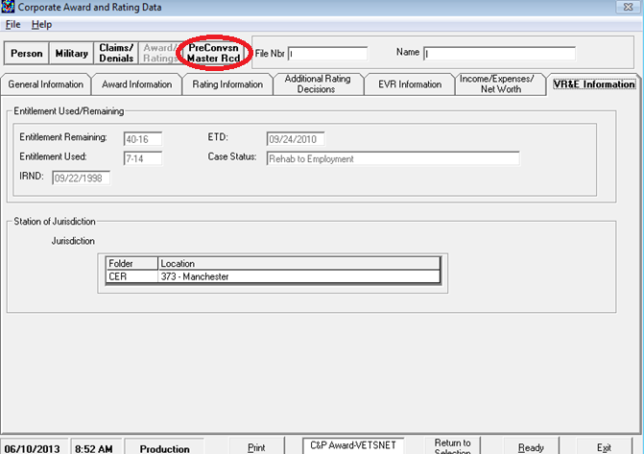
Share display of Ch31 eligibility/entitlement
Notes:
This screen displays Share Corporate Award and Rating Data with the BDN Pre-conversion Master Record tab highlighted.
In this view you can see Share Corporate Award and Rating Data on the VR&E Information tab with Entitlement Used and Remaining fields highlighted, as well as the Share tab containing Pre-Conversion BDN Master Record screens highlighted.

Slide 42
Eligibility Entitlement Update
Application Processing
Notes:
Basic eligibility processing at the time of application for Ch31 services records the eligibility and entitlement at a static point in time. It is often necessary to update eligibility and entitlement during the Evaluation/Planning phase; prior to and during a plan of rehabilitation services; and at any point that a correction/restoration/extension of entitlement is necessary.
For stations who process subsistence allowance payments in SAM, eligibility and entitlement updates for those records will be processed in AutoGED.
For stations who process subsistence allowance payments in BDN, eligibility and entitlement updates for those records will be processed in BDN.

Slide 43
Eligibility/Entitlement Update - charging entitlement to Ch31 (< ½ time or Ch33 TOE)
Notes:
Here is a screen of the BDN Chapter 31 Basic Eligibility Data, or the 431 screen for use in updating eligibility or entitlement.
Let’s discuss charging entitlement to a record where a Veteran is attending at less than ½ time. When it is not possible to charge entitlement through subsistence allowance award processing, an eligibility/entitlement update GED is required to charge entitlement to the BDN Master Record (same functionality applies to SAM). You will need the award and enrollment certification just like with a BDN award for payment. Calculate the number of months and days. Use BDN Eligibility/Entitlement Update functionality to process this GED type.
Enter “X” in the Elig/Entitlement update field. Enter mm-dd in the “Other” field. Validate or enter Initial Rating Notification Date if applicable. Proceed to the 432 screen. Here is where a recalculation of creditable Ch31 entitlement occurs.
The same steps apply to transfer of entitlement (TOE) under Ch33 from the Veteran to a family member.
The provisions for computing and charging entitlement to Ch31 participants who are specifically barred from receiving subsistence allowance are as follows from the CFR 21.79, Determining Entitlement Usage under Chapter 31:
CFR 21.79-2 addresses participants such as IDES or others who are specifically barred from receiving subsistence allowance while receiving training services under Chapter 31.
CFR 21.310 – “Rate of Pursuit of a Rehabilitation Program” covers the Rate of Pursuit charged under different programs (note – since the publication date of the regulation, there have been changes to the rate of pursuit allowed for independent study).
CFR 21.314, “Pursuit of Training Under Special Conditions” discusses the approval of pursuit at less than ½ time.
Instructions to field offices were released by VR&E Service in M28R, Part V, Chapter 8.

Slide 44
Eligibility/Entitlement Update - charging entitlement to Ch31 (<1/2 time or Ch33 TOE) continued
Notes:
Continuing on, this screen displays the BDN Chapter 31 Basic Eligibility Data – 432 screen in updating eligibility or entitlement.
Enter a facility name or facility code in the “Facility Name” field. Enter applicable type of training (i.e., A=graduate; B=undergraduate). Enter course name (example Ch31Lessthanhalf). Enter amount of entitlement used (from 431 screen). Enter “OTH” in Benefit Type. Enter “S” or “U” (Satisfactory or Unsatisfactory) in Training Status field.
For Transfer of Entitlement, enter the words TOE-Spouse or TOE-Child under Facility Name and then the number of months under “entitlement used” Enter person’s name under Course Name.
In Next Screen field, type GED. Authorize and sign the GED tear sheet. File in CER folder.

Slide 45
Ch31 Transition to Corporate:
Indexing/Archiving
Application Processing
Notes:
This section provides updated information about the steps VR&E is taking in the Ch31 Transition to Corporate – how to identify and work with Indexed and Archived BDN Ch31 Master Records.

Slide 46
Ch31 Transition to Corporate- Background
VR&E Service is transitioning from BDN to the use of Corporate WINRS as a single system to:
Create Ch31 records
Manage Ch31 services
To pay subsistence allowance benefits
Corporate WINRS has been enhanced with:
Robust eligibility/entitlement module (AutoGED)
Fully functioning subsistence allowance module (SAM)
CWINRS releases and the ongoing BDN Archiving project are both driving the Ch31 transition from BDN to the Corporate environment.
Notes:
VR&E Service is transitioning from BDN to the use of Corporate WINRS as a single system to Create Ch31 records, manage Ch31 records and eventually pay all subsistence allowance benefits. Corporate WINRS has been enhanced with a robust eligibility/entitlement module (AutoGED) and a fully functioning subsistence allowance module (SAM).
On November 2, 2013, Corporate WINRS Version 3.1 was deployed. This version installed several enhancements that enable Corporate WINRS and BDN to interface with Index records. Please refer to VR&E e-mail dated November 1, 2013 and reissued July 10, 2014 for additional information.
Index records reside in BDN and indicate which system will allow payment of subsistence allowance. The Index indicators are “V” (VetsNet/CWINRS) and “B” (BDN). All Ch31 Master Records in existence as of November 1, 2013 were automatically set to “B” during a Batch process by Hines. All new Ch31 Master Records established using AutoGED processing after November 1, 2013 are automatically set to “V” upon authorization of the GED. When the record is set to “B”, users can access BDN with all commands and pay subsistence. When the record is set to “V” users are prevented from entering BDN, but can access Corporate WINRS and use all functions including case updates to BDN. Users can continue to use BFLD, PINQ, PCLR, PCAN, BINQ – and MINQ/M21 commands while the record is set to “V.”

Slide 47
Ch31 Transition to Corporate– Archive Records
What happens when a BDN record is archived?
BDN record is deleted
BDN data segments are stored in the Corporate data base for future use by CWINRS (AutoGED will access this data for reopened claims)
BDN screen series M32 – M38, M01 and M39 are stored in Share (Pre-Conversion Tab in Corporate Inquiries Module) for reference
Notes:
Next, we’ll recap what happens when a BDN record is archived.
The BDN record is deleted by Hines Information Technology Center – there is “No Record” in BDN.
Here is a helpful note to identify an Archived record: If a Corporate WINRS record exists, and BIRLS shows a CER folder location, but BDN responds “No Record”, it is most likely that the Ch31 BDN Master Record has been archived/deleted. Use Share/Corporate Inquiries/Pre-Conversion Master Record tab to locate archived Ch31 BDN screens.

Slide 48
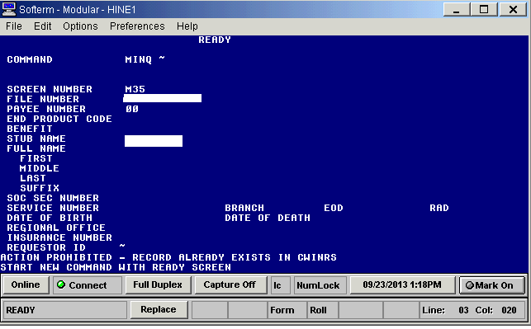
Ch31 Transition to Corporate – Index Records
BDN Ready screen will post “ACTION PROHIBITED–RECORD ALEADY EXISTS IN CWINRS”
Notes:
And, next, we’ll recap how to recognize an Indexed record.
This screen displays the BDN message located at the bottom of the Ready Screen when the Index is set to “V” (VetsNet or Corporate WINRS). The message reads: “Action prohibited – record already exists in CWINRS. Start new command with ready screen”.
When a Ch31 record is Indexed to “V” (VetsNet/Corporate), the BDN Ready Screen will display this message when any of the following commands are entered: MINQ/M32-M38/M01 and M39, CEST, CADJ, CAUT, CADD, CORR, FIST, or FAUT. Education and Ch18 BDN Master Records are accessible, as well as pending end products using SINQ and/or PINQ command. PCLR/PCAN will continue to work on pre-existing BDN Ch31 EPs.
In any instance where it is necessary for VR&E or Finance to access the BDN Master Record, submit a request by encrypted e-mail to VAVBAWAS/CO/VRE/CORPWINRS to re-set the Index to be set to “B” (BDN).
Reminder—Refer to VR&E Service e-mail announcement of 11/2/2013, reissued 7/10/2014 for additional information about Index Records.

Slide 49
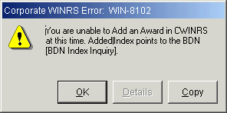
AutoGED - Indexing/Archiving Impact
CWINRS AutoGED – Index/Archiving Impact
No screen changes to AutoGED
All changes are to background processes to check or create Index record, synchronize entitlement, etc.
Warning messages displayed, processing stopped
Sample warning message below is displayed when you try to add an award in SAM when the Index points to BDN.
Notes:
The slide displays a Corporate WINRS screen snapshot displaying Error Message WIN-8102. At present, only the SAM Beta sites where Corporate WINRS Subsistence Allowance Module is currently in use will encounter this message when the Index record is set to “B” (BDN). Notify VR&E by encrypted e-mail request to VAVBAWAS/CO/VRE/CORPWINRS that the Index needs to be re-set to V.

Slide 50
Common Errors in Ch31 Claims Processing
Problem – VOR 2.0 shows pending Ch31 095, 295, or 719, but there is no Pending Issue File
Cause: Starting a claim process in AutoGED and authorizing it in BDN increases the likelihood of “abandoning” a Corporate claim that will display as “pending” in VOR 2.0
Avoid the problem by using AutoGED to authorize all claims pending CAUT – if a processing error occurs, fix the error, then return to AutoGED Processing Tab to mark the correction made and retry processing. Do not delete the AutoGED record nor leave it in pending status.
Fix: The problem can be fixed by using Share/Corporate Inquiries/Claims-Denials to determine the Claim Status for the EP. If the Corporate Claim status is Open, and the EP is no longer pending, then use MAP-D to change the Claim Status from “Open” to “Closed”
Notes:
Now we’re going to look at some common errors in Ch. 31 claims processing.
First example: VOR 2.0 shows pending Ch31 095, 295 or 719 but there is no Pending Issue File
Cause:
Starting a claim process in AutoGED and Authorizing it in BDN increases the likelihood of “abandoning” a Corporate claim that will remain open with an “095” or “295” that appears to be pending
Avoid:
Avoid the problem by using AutoGED to authorize all claims pending CAUT – if a processing error occurs, fix the error then return to AutoGED Processing tab to mark the correction made and retry processing
Fix:
The problem can be fixed by using Share/Corporate Inquiries/Claims-Denials to first determine the Claim Status for the EP. If the Corporate Claim Status is Open, and the EP is no longer pending, then use MAP-D to change the Claim Status from “Open” to “Closed”.

Slide 51
Common Errors in Ch31 Claims Processing
Problem: I authorized the AutoGED, but neither the CWINRS nor the BDN Index record were created
Cause: Multiple issues cause this, including processing errors (technical) or user errors
Avoid the problem by authorizing AutoGED during VBA business hours. If the authorization is processed during Hines ITC overnight processing time when BDN is taken off-line (usually 2 – 4 hours commencing at 9:00 p.m. CT) the normal transmission of data from CWINRS to BDN is disrupted and the CWINRS and BDN Index records are not created
Report technical errors to the National Service Desk – itsc@va.gov or 1-855-NSD-HELP (1-855-673-4357)
Fix: The problem can be fixed by using BDN/MINQ to determine that the Ch31 BDN record was created, and/or PINQ (BDN or Share inquiry) to determine that EP 095/295 was closed and that EP 719 was established. Create the CER folder location in BIRLS. Use CWINRS Record manual creation function. These steps will create both a CWINRS and a BDN Index record.
Notes:
In this example, I authorized the AutoGED, but neither the Corporate WINRS nor the BDN Index record were created.
Cause:
The cause may be Multiple to include processing errors (technical) or user errors.
Avoid:
Avoid the problem by authorizing AutoGED during VBA business hours. If the authorization is processed during Hines ITC overnight processing time when BDN is taken off-line (2 – 4 hours commencing at 9:00 p.m. CT every evening) the normal transmission of data from CWINRS to BDN is disrupted and the CWINRS and BDN Index record are not created
Report technical errors to the National Service Desk – itsc@va.gov or 1-855-NSD-HELP (1-855-673-4357)
Fix:
The problem can be fixed by using BDN/MINQ to determine that the Ch31 BDN record was created and/or PINQ (BDN or Share inquiry) to determine that EP 095/295 was closed and that EP 719 was established. Create the CER folder location in BIRLS. Use Corporate WINRS Record manual creation function. When these steps are completed, a Corporate WINRS record will be available and a BDN Index record will have been created.

Slide 52
Common Errors in Ch31 Claims Processing
Problem: My Pending End Products are older than the claim
Cause: Most likely cause is an error in the entry of the date of claim on Add/Reopened GED record.
Avoid the problem with point-of-processing accuracy review
Fix:
Use CAST command (this may require that the Ch31 Index record is re-set to “B” in order to use CAST command in BDN), to correct the date of claim
Submit a trouble ticket to the National Service Desk – itsc@va.gov or 1-855-NSD-HELP (1-855-673-4357)
(NOTE: the date of claim on the EP will remain incorrect – however days to entitlement determination data will be correct)
Notes:
Next problem: My Pending End Products are older than the claim.
Cause:
The most likely cause is an error in the entry of the date of claim on Add/Reopened GED record.
Avoid:
Avoid this problem with point-of-processing accuracy review in the entry of the date of claim on the Add/Reopened GED record.
Fix:
Use CAST command (this may require that the Ch31 Index record is re-set to “B” in order to use CAST command in BDN), to correct the date of claim in BDN
Submit a trouble ticket to the National Service Desk to request the Corporate WINRS date of claim field be corrected– itsc@va.gov or 1-855-NSD-HELP (1-855-673-4357).

Slide 53
Common Errors in Ch31 Claims Processing
Problem – My Days to Entitlement calculation is incorrect
Cause: Most likely cause is that an error in the entry of the date of claim on Add/Reopened GED record was not corrected on either an original or reopened claim – or, CWINRS was unable to update the BDN Ch31 Master Record on a reopened claim
Avoid the problem by following basic development steps and ensure that the CER folder location is in your station before starting the reopened claim process
Fix: None – once the monthly Master Record data is calculated, correction of the historic record details will not correct the performance score
Notes:
And in our final example: My Days to Entitlement calculation is incorrect
Cause:
Most likely cause is that an error in the entry of the date of claim on Add/Reopened GED record was not corrected on either an original or reopened claim – or, CWINRS was unable to update the BDN Ch31 Master Record on a reopened claim
Avoid:
Avoid the problem by following basic development steps and ensure that the CER folder is located in your station before starting the reopened claim process
Fix:
None – once the monthly Master Record data is calculated, correction of the history record details will not correct the performance score

Slide 54
References
M28R.PIV.A.2, Receiving and Processing Chapter 31 Applications
M28R.PV.B.8, Authorizing and Processing Subsistence Allowance
VR&E Letter 28-13-21 (Revised)
“AutoGED Overview,” August 27, 2013 by Ruth Comeau
VR&E Job Support Tools Portal for BDN http://epss.vba.va.gov/vre_jst/default.html
Centralized Mail Info 5/12/14
Compensation Service website http://vbaw.vba.va.gov/OBPI/Centralized_Mail.asp
VBMS Overview and Getting Started (Online) TMS ID# VA 3725147
VBMS Conducting Searches (Online) TMS ID# VA 2073965
VBMS eFolder Read Only Access (Online) TMS ID# VA 3840573
VR&E Service Date of Claim Job Aid, attached to June 2014 Hotline Bulletin
VR&E Service Indexing Job Aid 11/1/13; reissued 7/10/2014
Performance Analysis and Integrity (PA&I) website: http://vbaw.vba.va.gov/bl/20/opai/pai/wkld/2010/files/pai.htm
Notes:
We have detailed many aspects of application processing.
Basic development steps; correct sequence of BIRLS updates to ensure the CER folder location is correctly entered in the BDN Master Record;
Primary use of AutoGED to process original and reopened claims;
Updating eligibility and entitlement;
Working with Archived and Indexed records;
And understanding how and when data is generated from the claims processing workflow.
Attention to these procedures along with requesting assistance with “problem” records will help ensure a successful Ch31 transition to corporate.
Here is a list of references that were used to create this training module. Please refer to these references if further clarification is needed.

Slide 55
Questions?
Email Field Liaisons
AREA | E-MAIL
Eastern | VAVBAWAS/CO/VRE/EA
Southern | VAVBAWAS/CO/VRE/SA
Central | VAVBAWAS/CO/VRE/CA
Western | VAVBAWAS/CO/VRE/WA
CRC CEUs are available for this training, please submit CRC Request to the Corporate VR&E Mailbox Thanks for Your Participation!
Notes:
We encourage you to utilize your local resources, such as your colleagues and VR&E Officers to assist you with any questions regarding Application Processing. If further guidance is needed, VR&E Officers and Assistants will send all inquiries from the Regional Office staff to the Field Liaisons. A list of the VR&E Field Liaisons email addresses is referenced on this slide.
CRC CEU Credits are available for this training. Please remember to return to the TMS content screen and take the Feedback Survey. Your feedback regarding this training is greatly appreciated.
This concludes the presentation on Enhanced Application Processing. We hope that this training has been beneficial in educating you. Thanks for participating and for your dedicated service to our Nation’s Veterans and Servicemembers.

