Slide 1
Introduction to SMS Centralized Mail (CM) Portal
Compensation Service
January 2015

Slide 2
Lesson Objectives
Identify the general features and functions of the CM Portal
Describe process for accessing the CM Portal
Discuss procedures for viewing the mail in the CM Portal
Describe the Basic User and Super User functions
Describe method for uploading mail into VBMS

Slide 3
References
Centralized Mail (CM) Processing Portal User Manual
Centralized Mail (CM) Processing Portal Super User Manual
Centralized Mail Standard Operating Procedure

Slide 4
Centralized Mail
About Centralized Mail (CM):
Centralizing mail operations for the entire country
Paperless, electronic process
Virtual analysis concept
Currently only processing mail for Compensation Service
Routing processes for adding mail directly to VBMS eFolder
Future of CM
Add other Business Lines
Auto-CEST capabilities

Slide 5
Features and Functions
Log In
Home Page/Work Queues
Processing Queues
View Buttons and Tools

Slide 6
User Functions
Basic User
Reviews mail packets
Uploads mail packet to VBMS
Requests mail packet for Rescan, Split, or Unidentified
Restricted to Regional Office mail packets assigned to User
Super User
Assigns mail packets to Basic Users within their own Regional Office
Final approval for Split and Unidentified requests
Reassign mail packets to different Regional Offices
Super Users have the ability to perform all actions of a Basic User
View all mail packets assigned to their Regional Office
National User
Views mail packets across Regional Offices
Final approval for Rescan requests
National Users have the ability to perform all actions of a Super User and Basic User
Nationwide access

Slide 7
Access to the CM Portal
Email notification will provide:
User name
Password
Link/URL address https://cmp-prodc.datadimensions.com/CMP/web/core/account/logon

Slide 8
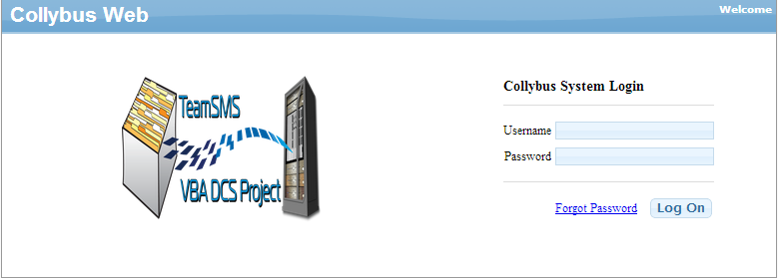
Login

Slide 9
Login Continued
Recover Password
Click on the “Forgot password” link
A temporary password will be sent to user email
Copy and Past temporary password into “Password”
Left click “Log On”
System will prompt user to create a new password

Slide 10
Home/Landing Page

Slide 11
Home Page Options
Search – allows the user to filter on document index values for document retrieval
Upload – allows the user to upload a new document directly into the workflow. This feature is currently not available.
Workflow – allows the User to return to main work queues for document processing and routing

Slide 12
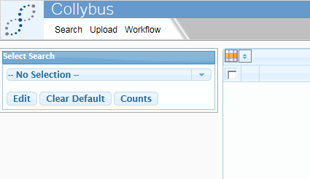
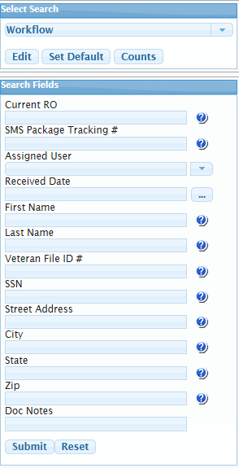
Search Function
Allows user to filter on document index values for document retrieval

Slide 13
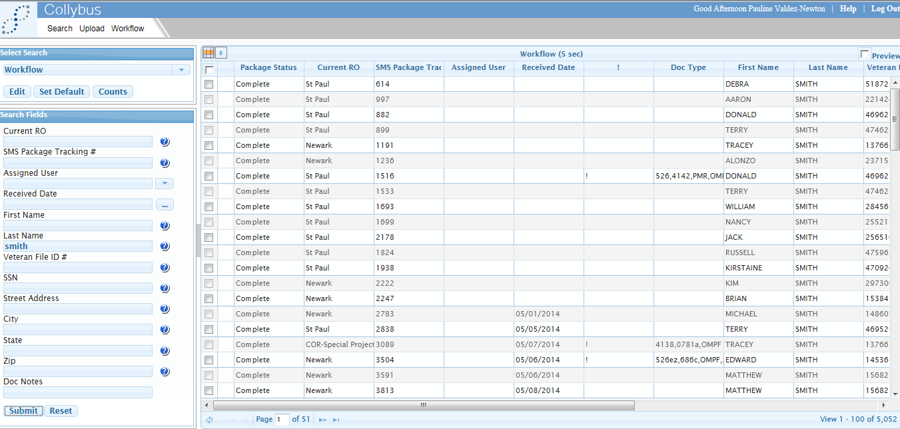
Search Selections

Slide 14
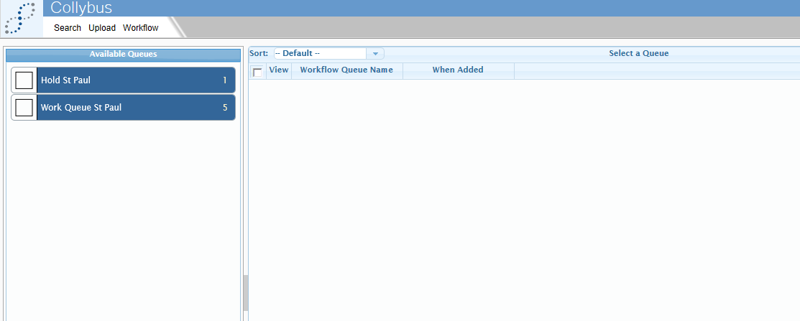
Home Page – Work Queues
User View – 2 Queues
Loading
Each work queue will have the total number of documents available for processing

Slide 15
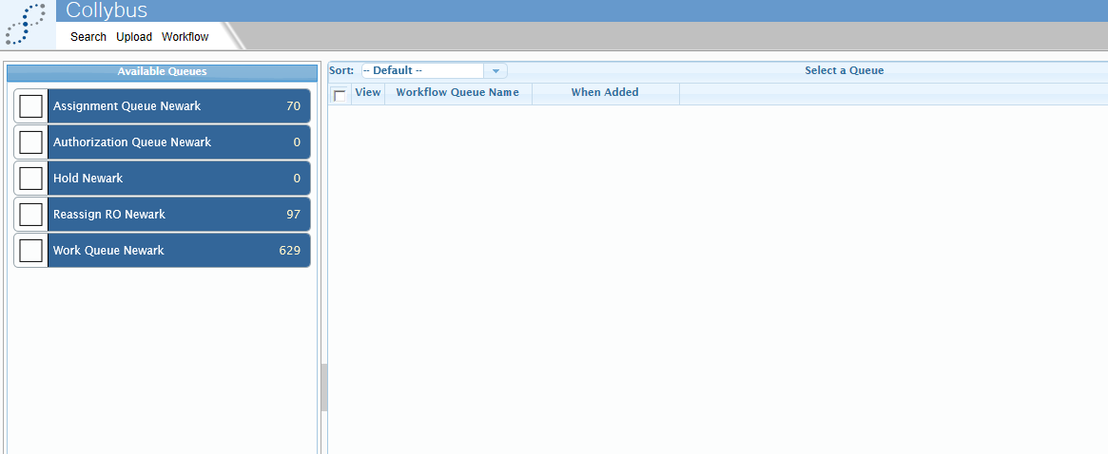
Home Page – Work Queues
Super User View – 5 Queues
Each work queue will have the total number of documents available for processing

Slide 16
Home Page Available Queues
WORK Queue – mail packets assigned to Users and pending processing
HOLD Queue – mail packets that are put on hold because they require additional information in order to continue processing
ASSIGNMENT Queue – mail packets that need to be assigned to a User (Only Super Users have access)
AUTHORIZATION Queue – mail packets a User has returned for rescan or split approval (Only Super Users have access)
REASSIGN Queue – mail packets to be re-assigned to another RO (Only Super Users have access)

Slide 17
Workflow Queue

Slide 18
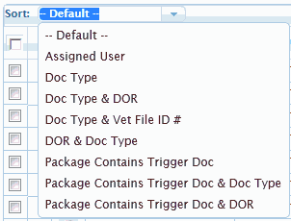
Workflow Queue Sorting
Users and Super Users have the ability to sort
Sorting allows for quick package identification
Sort button at the top of the Package List page contains several options
Sorting preference will be removed if user selects another queue

Slide 19
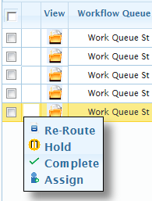
Workflow Page Actions
Each queue has a quick Actions dropdown from the main queue screen
Each Action that is available within the package is also available as a quick Action from the main queue
Multiple packets can be selected to perform the same Action on all selected packets
The Actions selections (re-route, hold, complete, assign) are discussed in detail on a later slide

Slide 20
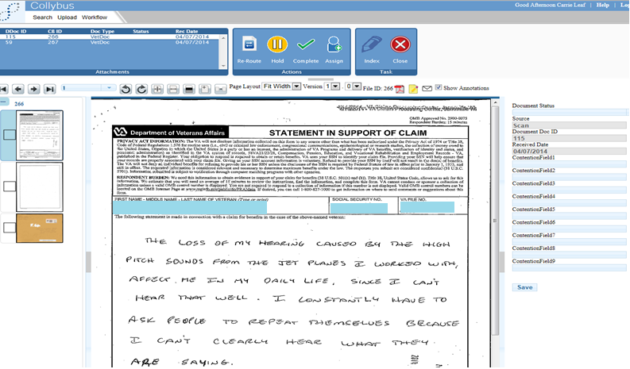
Workflow Processing Page

Slide 21
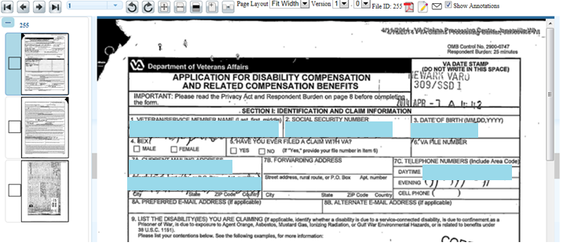
Workflow Page Package Level Processing
Mail Package Grid
Document View
Thumbnail View
Grey Bar

Slide 22
Workflow Page Actions & Tasks
Work Processing Queue
(User & Super User)
Re-route – Allows User and Super User to reroute mail package to the Reassign queue
Hold – Allows User and Super User to hold and process mail at a later time
Complete – Allows User and Super User to complete mail package by sending to VBMS or to Authorization Queue
Assign – Allows Super User to assign to another user
Index – Allows User and Super User to update index values associated to mail package
Close – Allows User or Super User to close out current package and return to main menu

Slide 23
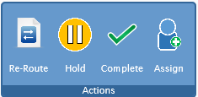
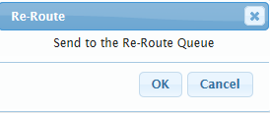
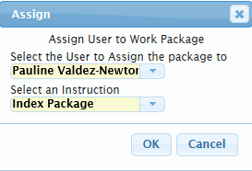
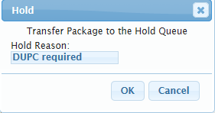
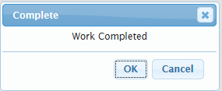
Actions Buttons

Slide 24
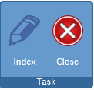
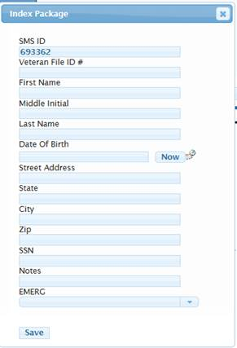
Index Button
Required data,
Veteran File #
Veteran First Name
Veteran Last Name
All other data optional

Slide 25
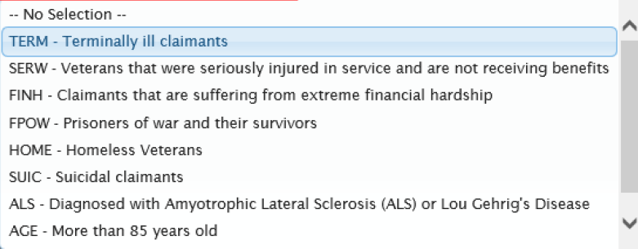
Index Button Emergent Claims
Users can designate claim as 'Emergent’ by assigning an Emergent code to the index package
Click the down arrow and select a category from the list.
Code will display at the top of the dropdown list.

Slide 26
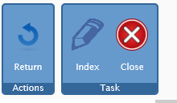
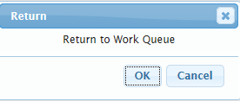
Actions & Tasks
Hold Queue
(User & Super User)
Return – Allows the User to move mail package back into work processing queue

Slide 27
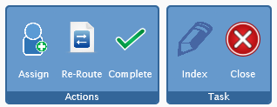
Actions & Tasks
Assignment Queue
(Super User Only)
Assign – Send mail package to designated User
Re-route – Move mail package to the Re-Assign Work Queue
Complete – Super User can work a mail package from this queue
Index – Can Index at any time
Close – Will take Super User back to main menu

Slide 28
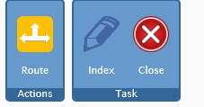
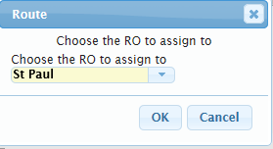
Actions & Tasks
Reassign Queue
(Super User Only)
Route – Super User can route mail package to another RO
Index – Can Index at any time
Close – Will take Super User back to main menu

Slide 29
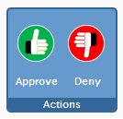
Actions & Tasks
Authorization Queue
(Super User Only)
Super User has the ability to Approve or Deny a Rescan or Split request by a User
If Approved, mail package requires additional review by a Central Office User
If Denied, mail package will be returned to a User

Slide 30
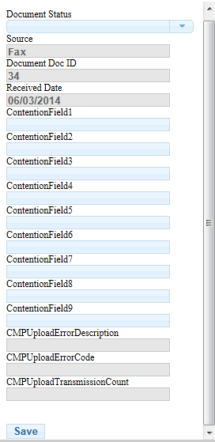
Workflow Page Document Level Processing
Document Status
Complete (same as icon)
Re-Scan
Split
Reject – Download Complete
Unidentifiable Mail
Grey shaded field cannot be accessed
Contention Fields to be updated by scanning vendor for info on 526s
After selection of Document Status, select Save, then select Complete icon to send to Authorization Queue

Slide 31
View Buttons and Tools
Image Navigation
Rotating Images
Zoom
Brightness and Contrast
Append Pages
(Not currently active)
Replace Content
(Not currently active)
Version Number and Toggle
(Not currently active)
Email a Document
(Not currently active)

Slide 32
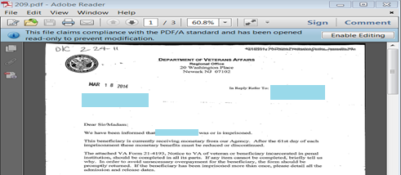
View Buttons and Tools
Save or Print a Document
Email from PDF

Slide 33
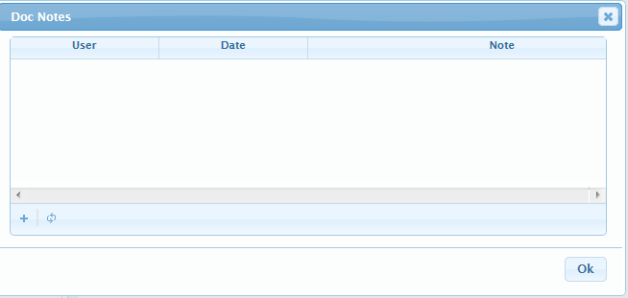
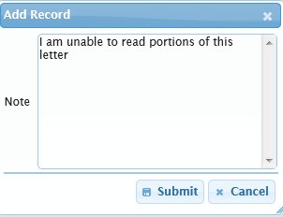
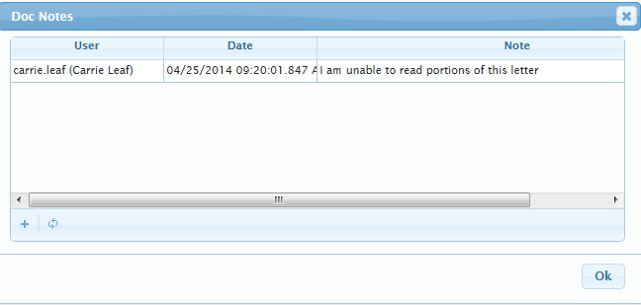
View Buttons and Tools
NOTES
Can be added to any document
Available for review by anyone with permission
Access the notes screen by clicking on ‘Notes’ icon
Add note by selecting the +
Icon turns yellow when note exists

Slide 34
Additional Information
Prior to upload to VBMS, ensure mail action has been performed:
Claims establishment (CEST)
Systems updating (CADD, POA, VACOLS)
Evidence updating (MAPD, VBMS)
Ensure an eFolder exists in VBMS before completing and uploading package

Slide 35
Misfiled and Misdirected Mail
Veteran Sends
Paper Claim
Postal Redirect
Claim Arrives at
Scan Vendor
2
1
3
Document is
sent to appropriate business line, e.g. PMC via e-mail
7
Claim Scanned and
Data Extracted
Business line works the non-comp claim
4
6
IPC receives misfiled or misdirected mail
IPC uses Download function in portal
5

Slide 36
Questions

