Slide 1
Effective Training Plans &
Certified Rehabilitation Counselor Continuing Education Request – Demo Based
Watch 'NMT: Effective Training Plans & CRCC Request' | Microsoft Stream
New Manager Training

Slide 2
Objectives
Explain the purpose of effective training plans
Demonstrate how to develop a local training plan
M28C.II.A.3.05 Training and Staff Development

Slide 3
Scope of Training
Supplement training
Prepare local VR&E Staff
Identify staff development needs
Fulfill VBA core annual technical training requirements
Plan and implement an appropriate staff development program
Provide periodic in-service trainings.
Guide the development of IDPs, when applicable.
Notes:
c. Scope of Training
(Change Date October 23, 2012)
In conjunction with the Office of Talent Management (OTM), VR&E Service provides training delivery systems through the Electronic Performance Support System (EPSS), Training Performance Support System (TPSS), and Talent Management System (TMS).
The scope of training at each VR&E Office is to supplement training provided by VR&E Service, and to adequately prepare local VR&E staff to successfully carry out daily tasks. VR&E Offices must identify staff development needs, fulfill both VA and Veterans Benefits Administration (VBA) core annual technical training requirements, plan and implement an appropriate staff development program to meet those needs, and provide periodic in-service training. Additionally, VR&E Offices should guide the development of Individual Development Plans (IDP), when applicable.

Slide 4
Local Training Plans – Staff Development
Training and Staff Development: Responsibilities
VR&E Officer | CO
Monitoring and reporting training and staff development activities | Reviewing national performance data
Reviewing local performance data | Identifying performance gaps
Identifying performance gaps | Identifying training needed to improve performance
Identifying local training needed to improve performance | Identifying available training courses/modules/materials
Identifying available training resources | Developing new training
Developing training plans | Providing training or training materials
Requesting assistance to obtain or develop training material | Reviewing training results
Requesting Certified Rehabilitation Counselor (CRC) credit from VR&E Service on behalf of staff members | Developing core training requirements for all VR&E positions
Promoting mentor relationships with less experienced VRCs, VSOC VRCs, and ECs
Providing new staff comprehensive training in a timely manner
Providing frequent refresher training to experienced staff
Allowing opportunities for staff members to attend professional training outside of the RO
Notifying VR&E Service of major training trends
Notes:
The VR&E Officer is responsible for staff development and training to include, but not limited to the following:
Monitoring and reporting training and staff development activities,
Reviewing local performance data,
Identifying performance gaps,
Identifying local training needed to improve performance,
Identifying available training resources,
Developing training plans,
Requesting assistance to obtain or develop training material,
Requesting Certified Rehabilitation Counselor (CRC) credit from VR&E Service on behalf of staff members,
Promoting mentor relationships with less experienced VRCs, VSOC VRCs, and ECs,
Providing new staff comprehensive training in a timely manner,
Providing frequent refresher training to experienced staff,
Allowing opportunities for staff members to attend professional training outside of the RO, and
Notifying VR&E Service of major training trends.
VR&E Service provides oversight of RO training plans and develops relevant centralized training products. VR&E Service is responsible for the following training initiatives:
Reviewing national performance data,
Identifying performance gaps,
Identifying training needed to improve performance,
Identifying available training courses/modules/materials,
Developing new training,
Providing training or training materials,
Reviewing training results, and
Developing core training requirements for all VR&E positions.

Slide 5
Systematic Technical Accuracy Review (STAR)/Quality Assurance (QA) Team Site Visit
Action Item #?: Develop and implement a formal training plan for VR&E staff.
Although training sessions are currently being conducted and the division is working toward completion of the national core training curriculum, this office does not have a formal training plan for the VR&E Division for FYxx. Also, a formal training plan was not developed for FYxx. Per 38 CFR 21.382 and M28C.II.A.3.06.i, the VR&E Officer is responsible for preparing a training plan for the development of staff as part of the station’s training plan at the beginning of each fiscal year.
Notes:
This is an example of the most common citation that is noted as an Action Item during a STAR/QA local site visit review. As mentioned in this slide and the previous slides, it is the VR&EOs responsibility to prepare a training plan for the development of staff as part of the stations training plan at the beginning of each fiscal year.

Slide 6
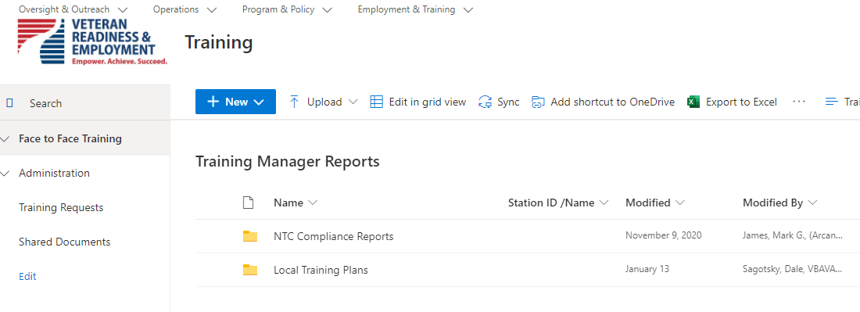
VR&E Local Training Plan
Must include:
  Training for each of the core areas and core technical training requirements
  Means through which training and development activities will be accomplished
  A review, at least yearly, of the training needs of each employee in the Division
  The frequency of in-service training meetings
  The estimated costs for travel related to training
Training Manager SharePoint
Notes:
i. Veteran Readiness and Employment Training Plan
(Change Date April 9, 2021)
The VR&E Officer prepares the local training plan at the beginning of each fiscal year for concurrence by the RO Director. Local training plans identify a list of local training topics and items to supplement the annual National Training Curriculum developed by VR&E Service. The plan must include training for each of the core areas and core technical training requirements. VR&E Officers must develop and implement local training that addresses performance gaps, changes in legislation, and other training needs. The local training plan must also include the means through which training and development activities will be accomplished, such as in-service training; training in conjunction with other VA, state and federal agencies; and other community resources. It also must include:
A review, at least yearly, of the training needs of each employee in the office,
Development of the means through which such training will be provided,
The frequency of in-service training meetings, and
The estimated costs for travel related to training.
Local training plans shall be uploaded to the VR&E Service Training Manager SharePoint page, under Local Training Plans in the specific Regional Office folder. Local Training Plans are due no later than the end of the 1st quarter of each fiscal year.

Slide 7
Core Areas
Evaluation and assessment
Psychological aspects of disabilities
Counseling theory and techniques
Medical aspects of disabilities
Personal and vocational adjustment
Occupational information
Placement processes and job development
Special considerations in rehabilitation for people with severe disabilities
Independent Living (IL) services
Resources for training and rehabilitation
Utilization of research findings and professional publications
Administration of rehabilitation and counseling services
Professional ethics
Rehabilitation philosophy and history
Notes:
b. Areas for Training and Development
(Change Date October 23, 2012)
The areas in which training and development activities may be provided to enhance staff skills include, but are not limited to the following:
Evaluation and assessment,
Psychological aspects of disabilities,
Counseling theory and techniques,
Medical aspects of disabilities,
Personal and vocational adjustment,
Occupational information,
Placement processes and job development,
Special considerations in rehabilitation for people with severe disabilities,
Independent Living (IL) services,
Resources for training and rehabilitation,
Utilization of research findings and professional publications,
Administration of rehabilitation and counseling services,
Professional ethics, or
Rehabilitation philosophy and history.

Slide 8
Core Technical Training Requirements
Experienced VR&E Officer, Assistant VR&E Officer and Supervisory VRC (GS 13/14): maximum of 40 hours
New VR&E Officer, Assistant VR&E Officer and Supervisory VRC (GS 13/14): maximum of 80 hours, which includes centralized VR&E New Manager Training
Experienced VRC (GS 11/12): maximum of 40 hours for CBTS and non-CBTS participants
New VRC (GS 9/11/12): maximum of 80 hours, which includes centralized VR&E New Counselor Training
Experienced Integrated Disability Evaluation System (IDES) Counselor (GS 11/12): maximum of 40 hours for CBTS and non-CBTS participants
New IDES Counselor (GS 9/11/12): maximum of 80 hours, which includes centralized VR&E New Counselor Training
Experienced VetSuccess on Campus (VSOC) Counselor (GS 11/12): maximum of 40 hours for CBTS and non-CBTS participants
New VSOC Counselor (GS 11/12): maximum of 80 hours, which includes centralized VR&E New Counselor Training
Experienced EC (GS 11/12): maximum of 40 hours
New EC (GS 9/11/12): maximum of 80 hours, which includes centralized VR&E Employment Services Training
Experienced Program Support Specialist (PSS) (GS 7/9/11): maximum of 18 hours
New PSS (GS 7/9/11): maximum of 24 hours
Notes:
Review the attached NTC Checklist. Most of these hourly requirements were mandated by VBA Letter 20-06-68 and these hourly requirements have been reported to be mutually agreed upon by VR&E Service, OFO, and the various Union representatives.
Please note: ED&T and VR&E Service are collaborating to develop a new ………

Slide 9
VR&E Training Plan – Means
  Means through which training and development activities will be accomplished
    Local in-service program or other on-site training
    Employ the services of consultants
    Write grants or make contracts with public and private agencies, including institutions of higher learning to conduct workshops and training activities
    Authorize individual training at institutions of higher learning and appropriate facilities
Notes:
Means through which training and development activities will be accomplished. This basically means: Which method or how will the training be delivered.
Training can be delivered by the following:
Local in-service program or other on-site training
Employ the services of consultants
Write grants or make contracts with public and private agencies, including institutions of higher learning to conduct workshops and training activities
Authorize individual training at institutions of higher learning and appropriate facilities
For example, many stations do the following:
work with DOL to provide training on state employment trends
Work with local colleges and universities to hear graduate presentations on multicultural counseling
Work with local SBA affiliates to learn about local business resources that can assist Veterans/Servicemembers
Please note: Most of the VR&E Service training is provided via TMS, EPSS, TPSS., Lync Meeting and Conference Calls.

Slide 10
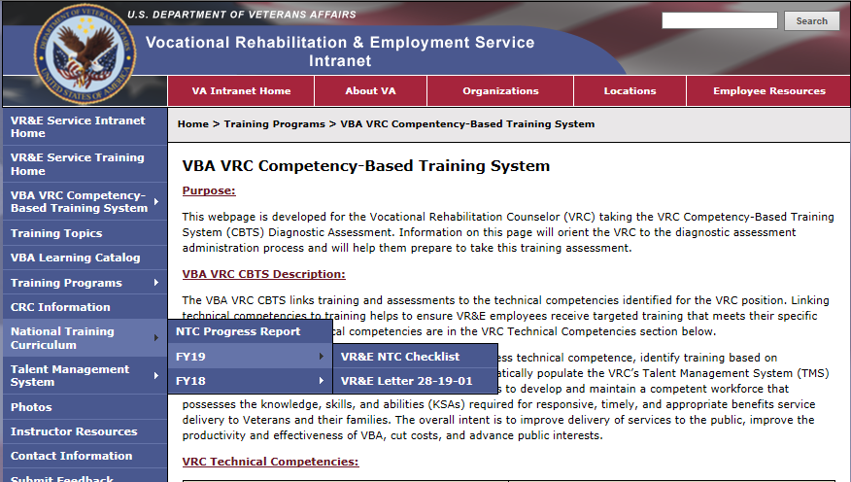
National Training Curriculum Checklist & VR&E Training Website
Notes:
The National Training Curriculum Checklist and Announcement Letter are housed on the VR&E Training Website (http://vretraining.vba.va.gov/Index.htm) and are also dispersed nationally via the VRE Corporate Mailbox. These items are usually posted within the first 15 days of the new FY.
These are tools to be used by VR&E Officers/Assistant VR&E Officers and Local Training Managers to aid in the development of local training plans.

Slide 11
Local Training Plan Template
Training in CTTR
Frequency and Duration
Delivery Method
Cost

Slide 12

Questions

Slide 13
Certified Rehabilitation Counselor Continuing Education Request – Demo Based
New Manager Training
Notes:
Show the following:
1. Training website where instructions are located. Go to vretraining.vba.va.gov/CRC.htm VR&E Training Website CRC Information
2. Show the TMS history report function/TMS Learning History Report Job Aid
Go to https://vba-media1.vbatraining.org/VBA_Learning_Catalog/EDT/Job_Aids/TMS-Learning-History-Report_Job-Aid.pdf
3. Provide the corporate mailbox where they will submit VAVBAWAS/CO/VRECEU
4. Show the Learning Catalog, Go to https://vba-tpi.vbatraining.org/lc/Default.aspx VBA Learning Catalog go to Curriculum, CRC Approved Items for additional CEs needed
5. Once VR&E Service provides certificates of completion, Go to https://crccertification.com CRCC and enter the approval numbers in the section for preapproved CEs.
Additionally, many TMS courses that are CRC approved have the accreditation attached for the course, so you can print out the certificates of completion using the following method.
Certified Rehabilitation Counselor (CRC) Continuing Education credit for this Item is approved. To receive your CRC Verification Form, go to the TMS “My History” Pod, Click “View All,” locate the training, click on “View Details” and click “Print Accreditation Certificate.” Submit the information on the Accreditation Certificate to your CRCC My Profile CE Report Portal.

Slide 14
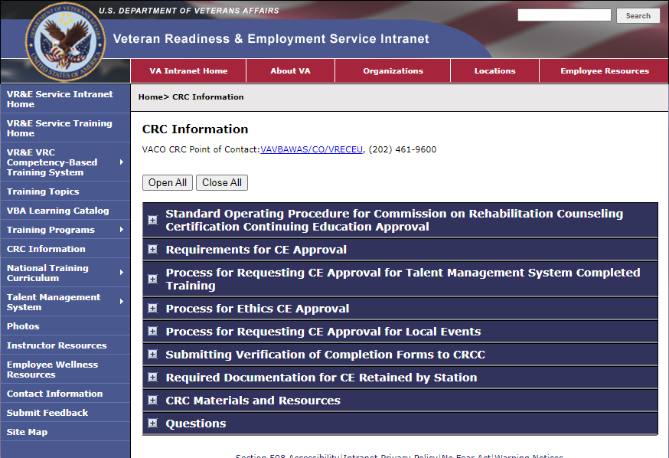
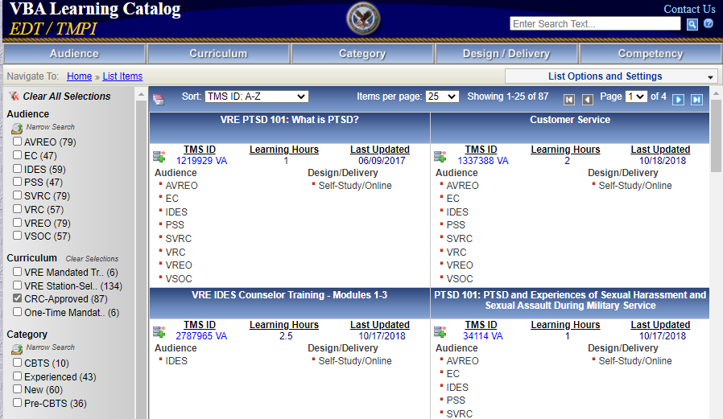
VR&E Training Website: VBA Learning Catalog
VBA Learning Catalog
Notes:
https://vba-tpi.vbatraining.org/lc/Default.aspx
You can view list items, add to list then open the TMS direct links which will launch the course

Slide 15
VR&E Training Website: CRC Information
VR&E CRC Information - VR&E Training (va.gov)
Notes:
vretraining.vba.va.gov/CRC.htm
From the CRC webpage of the VR&E Training Website, there are a number of menu options to select. If you navigate to the item called “Process for Requesting CE Approval for Talent Management System Completed Training” it outlines the instructions to submit a request for CRC CEs to the VR&E corporate mailbox for CRC, which is managed by myself and Mr. Lamoyd Figures. Here you can find the link to the VA 28-0521 form and a job aid for running a TMS Learning History Report.
28-0521 Form - http://vretraining.vba.va.gov/Documents/VA-Form_28-0521_2013.doc
TMS Learning History Report Job Aid - https://vba-media1.vbatraining.org/VBA_Learning_Catalog/EDT/Job_Aids/TMS-Learning-History-Report_Job-Aid.pdf

Slide 16
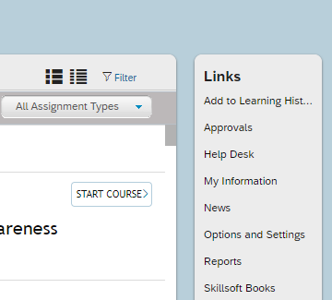
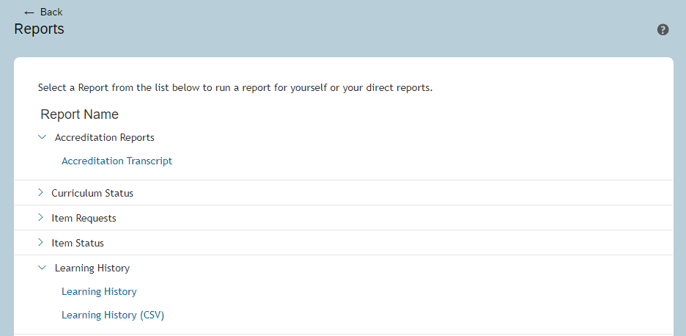
Talent Management System Reports
2
1
3
Notes:
Steps from your TMS learning page. Go to Reports.
If you click on Accreditation Transcript, you can run a report for all the items that have the CRCC Accreditation.

Slide 17
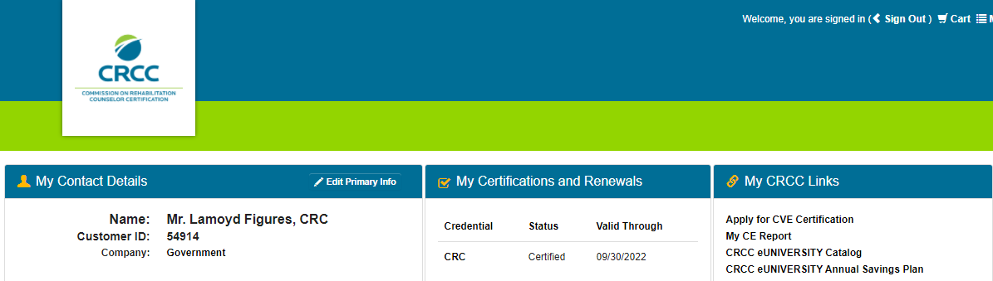
CRCC Website
1
2
Notes:
1. Log into CRCC Connect with your credentials
2. Click on My CE Report

Slide 18
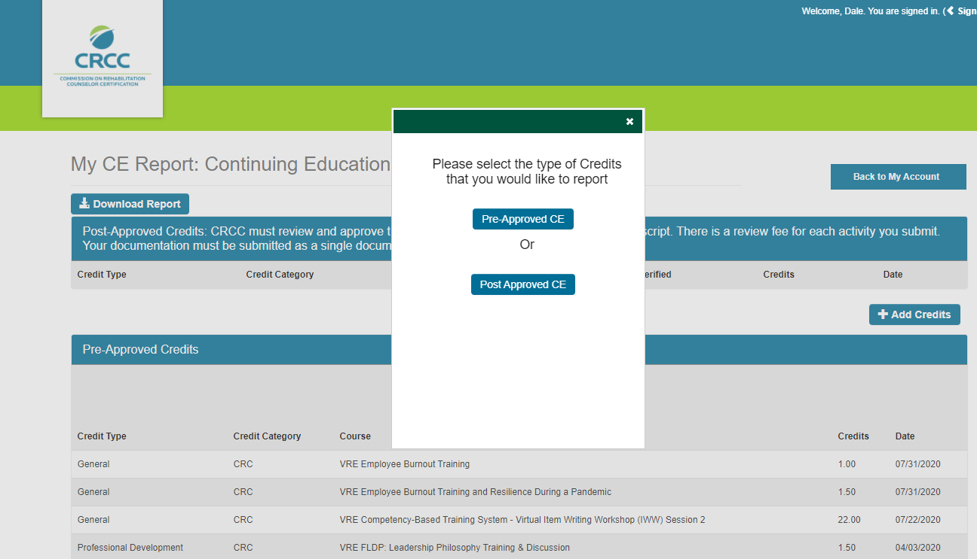
CRCC Website
3
2
Notes:
3. Choose Pre-Approved CE

Slide 19
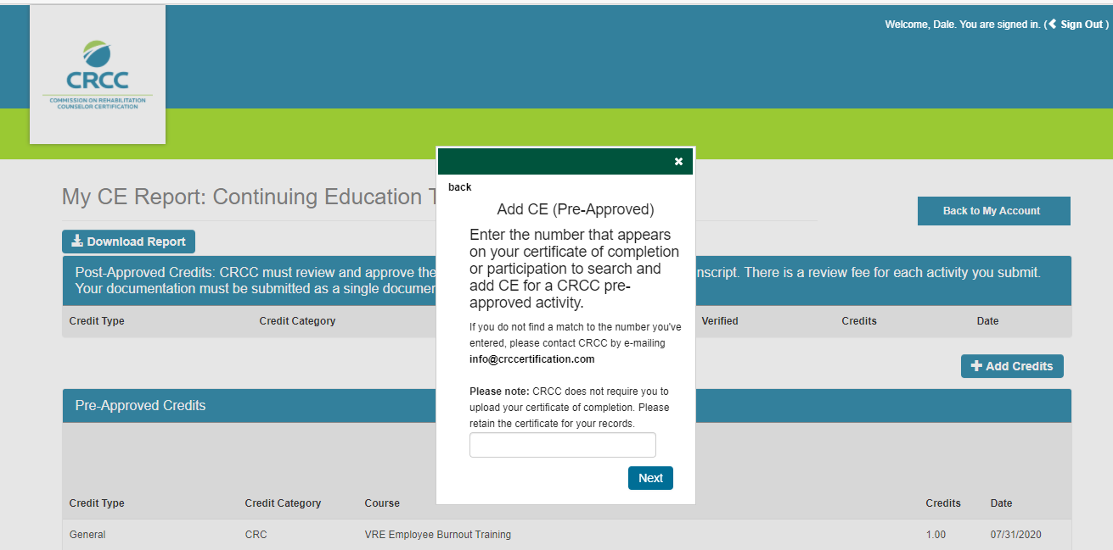
CRCC Website
4
Notes:
4. Enter the approval number from the certificate of completion you received. This number is on the PDF that VR&E Service sends you for that item. It is also in the Accreditation Module of TMS for that CRC approved item.

Slide 20
Questions

