Slide 1
800 Series Work Items
Compensation Service
September 2020

Slide 2
Purpose of Lesson
This lesson provides you with an introduction to 800 Series Work Items (WIs); what they are, where to find them, and the processing basics.
800 series work items are to prompt review for potential action and to assist in tracking, which leads to the correct status of benefits.
This knowledge is vital for processing follow-up actions related to VA Benefits correctly and efficiently.

Slide 3
Lesson Objectives
Describe what an 800 Series Work Item (WI) is
Locate 800 Series Work Items (WIs) in VBMS and SHARE
Explain the disposition of a WI after review
Identify when to use the “Potential Under/Overpayment” Special Issue

Slide 4
References
M21-1 III.ii.1.B.2.d, Placing Claims and 800 Series Work Items Under EP Control
M21-1 III.v.10.A, 800 Series Work Items and Cost-of-Living Adjustment (COLA)
M21-4 Appendix C, Index of Claim Attributes

Slide 5
800 Series Work Items
An 800 series work item is a system-generated message designed to assist Veterans Service Centers (VSCs) and pension management centers (PMCs) in identifying and tracking cases that require follow-up action.
Each 800 series work item has a descriptive claim label indicating the nature of the review required.
An 800 series work item may be generated as a result of maturation of a diary or other system triggers such as benefit details, returned payments, or data related to dependents.
Notes:
M21-1 III.v.10.A.1.a, M21-4 Appendix C.1.b (Claim Labels)

Slide 6
800 Series Work Items (cont.)
800 Series WIs are for tracking purposes only. Do not complete any development, rating, or award actions under an 800 series WI.
Exception: When necessary, certain actions can be taken in connection with review of an 800 series work item without a separate end product (EP) as provided in M21-1, Part III, Subpart v, 10.A.2.c (discussed below).
Note: Unlike End Products (EPs), 800 Series WIs only appear in the Corporate Database (accessed through VBMS and Share) and are not viewable in PIF Inquiry.
Notes:
III.v.10.A.1.a, III.v.10.A.2.b

Slide 7
Viewing 800 Series Work Items in VBMS
Notes:
III.v.10.A.1.c

Slide 8
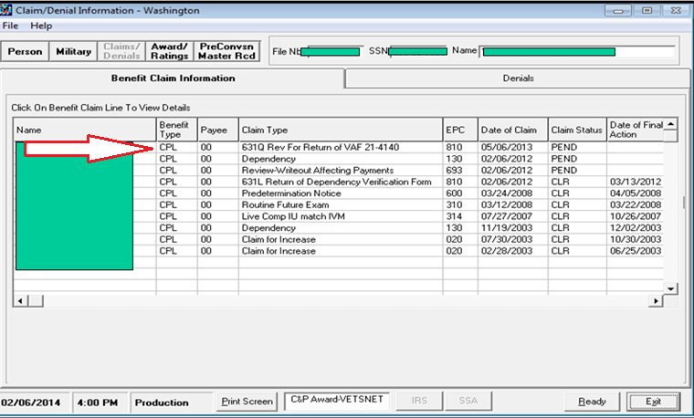
Viewing 800 Series Work Items in Share
Notes:
III.v.10.A.1.c

Slide 9
Types of 800 Series Work Items
810: Notice of Benefit Payment Transaction (810WI)
820: Explanation of Audit Message (820WI)
830: Miscellaneous (830WI)
840: Combat-Related Special Compensation (CRSC) / Concurrent Retirement and Disability Payments (CRDP) Audit Error Worksheets (AEW) (840WI)
850: Manual Payment Adjustments (e.g., annual COLA) (850WI)
Refer to M21-4 Appendix C.1.b, Index of Claim Labels for appropriate claim labels for Work Items.

Slide 10
Disposition of an 800 Series Work Item After Review
Once an 800 series work item has been reviewed, dispose of the work item as follows:
No action needed:
Cancel the 800 series WI using the reason “Message Received, No Action Necessary”
Additional Action Needed:
Clear the 800 Series WI using the reason “Message Received, Worked Under Proper EP”
Establish appropriate controlling EP and add “Potential Under/Overpayment” special issue if needed.
Notes:
III.v.10.A.2.c

Slide 11
Exceptions to Establishing a Controlling EP
In some cases, the required action does not require creation of an EP.
Examples include:
processing a first notice of death using the FNOD command in Share
reviewing a claims folder to confirm the accuracy of the results of a records-matching program, and
sending a questionnaire or letter due to failure of automatic issuance by the Hines Information Technology Center, such as described in M21-1, Part III, Subpart iii, 5.K.1.d.
Notes:
III.v.10.A.2.c

Slide 12
Date of Claim (DOC) for Controlling EPs
Use the date of the 800 Series WI as the DOC for the controlling EP.
Note: If no date is shown, use the date the RO initiated review of the work item.
Notes:
III.v.10.A.2.d (DOC), III.ii.1.B.2.d (review date)

Slide 13
When to Add Potential Under/Overpayment Special Issue
If an award adjustment associated with an 800 series work item could result in an overpayment or underpayment of benefits attach the Potential Under/Overpayment special issue to a contention of the controlling EP.
The special issue must remain in place until all actions involving an underpayment or overpayment are completed, to include simultaneous or subsequently received information involving an additional underpayment or overpayment action. This includes adding the special issue to any EP 600 associated with proposed adverse action arising from the 800 series work item.
Notes:
III.v.10.A.2.f

Slide 14
Review
Questions?

