Slide 1
Application Processing
September 2013
Ruth Comeau
Senior Program Manager
Notes:
The purpose of this training course is to identify and correctly perform steps for application processing. It will also briefly introduce you to BDN archiving and indexing.

Slide 2
Overview
Claim Development
Review the claim upon receipt
Basic Eligibility
Qualifying military service; qualifying SC disability
Date of Claim
Accuracy; established at CEST; CWINRS/M35
CER Folder Location
BFLD sequence for original and reopened claims
Disallowance
AutoGED processing
Data Generation & Tracking
End Products 095, 295, 719 and Corporate claim status
BDN Master Record Corrections
Notes:
Claim Development
Review the claim upon receipt
Basic Eligibility
Qualifying military service; qualifying SC disability
Date of Claim
Accuracy; established at CEST; CWINRS/M35
CER Folder Location
BFLD sequence for original and reopened claims
Disallowance
AutoGED processing
Data Generation & Tracking
End Products 095, 295, 719 and Corporate claim status
BDN Master Record Corrections

Slide 3
Overview - continued
Impact of CWINRS release 3.1 Indexing functionality on Ch31 Claims Processing
Impact of Archiving BDN Master Records on Ch31 Claims Processing
How do you know that a BDN MR has been archived?
What do you do when it has?
Using Share to locate Ch31 Information
Updating BDN with entitlement use when no subsistence allowance is paid
Notes:
Impact of CWINRS release 3.1 Indexing functionality on Ch31 Claims Processing
Impact of Archiving BDN Master Records on Ch31 Claims Processing
How do you know that a BDN MR has been archived?
What do you do when it has?
Using Share to locate Ch31 Information
Updating BDN with entitlement use when no subsistence allowance is paid

Slide 4
WIIFM?
VR&E Staff
Manager
Program Support Specialist/Rehab Tech
VRC/EC
Veteran
Timely and correct determination of period of basic eligibility and available entitlement for Ch31 program planning and completion
Notes:
Basic Eligibility is the keystone decision for a Service-member’s or Veteran’s access to Chapter 31 (Ch31) services. 38 United States Code 3102 and 3103 cover the provisions for establishing basic eligibility as well as the duration of eligibility.
A timely and correct response to a Veteran from Department of Veterans Affairs (VA) allows the individual access to Ch31 resources – at minimum, a thorough assessment along with information and guidance which he/she can use to make important decisions for employment or independent living.
Vocational Rehabilitation and Employment (VR&E) staff – using Information Technology systems, placing claims under control, processing correctly, generating data, and having correct basic eligibility information throughout, allow for sound workload management and provision of Ch31 services.

Slide 5
Application Processing
Claim Development
Notes:
Let’s begin with Claim Development.

Slide 6
Claim Development
Receiving and Processing Ch31 Applications
Mail Room delivery; VonApp download
Verify qualifying military service
Very qualifying service-connected disability
Verify record exists in correct station
CWINRS – BDN
Verify date of claim is on application
Notes:
Title page on Basic Claim Development Ste
Receiving and Processing Ch31 Applications
Mail Room delivery; VonApp download
Verify qualifying military service
Very qualifying service-connected disability
Verify record exists in correct station
CWINRS – BDN
Verify date of claim is on application
ps – overview page

Slide 7
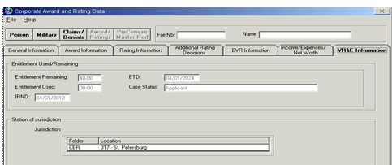
Additional Claim Development
Verify type of claim
Original (no CWINRS record; no BDN/Share record)
Reopened (previously Discontinued; previously Rehabilitated – EP 795)
Existing Ch36 claim in Applicant status
Know the outcome
Basic Eligibility Allowed
Basic Eligibility Disallowed
Notes:
Includes a screen snapshot of Share location of VR&E information

Slide 8
IT Systems Used in Basic Claim Development
BDN
BIRLS
Corporate WINRS
Share
VBMS
Virtual VA
VonApp
Notes:
The primary Information Technology (IT) systems used by VR&E staff are: Benefits Delivery Network (BDN), Beneficiary Identification and Records Locator System (BIRLS), Corporate WINRS, Share, Veterans Benefits Management System (VBMS), Virtual VA, and Veterans On-line Application (VonApp). Permissions and commands for using IT are processed through Common Security Employee Management (CSEM) – see your Information Resource Manager (IRM) or Information Security Officer (ISO) for more information about how to obtain access.

Slide 9
Basic Claim Development Steps
Before running AutoGED
Verify whether Original or Reopened claim
Use BDN MINQ command and M35 screen Get IRND from M33 screen
If BDN Ch31 MR found, it is a Reopened claim. If no record found, it is an Original claim.
May also use Share VR&E Information tab for Reopened claim
Verify qualifying military service
BIRLS, DD214 (VSC)
Use BDN BINQ command or SHARE.
Note EOD (entry onto active duty) date, RAD (release from active duty) date, and Character of Service.
Notes:
Reminder there are critical areas to verify before running AutoGED process.
Before running AutoGED:
Verify whether the claim is an Original – no BDN Master Record; or a Reopened – a BDN Master Record exists and information may be retrieved from the M33 and M35 screens, or from Share VR&E Information tab. If the Reopened claim is from a former Ch31 participant who was Rehabilitated, establish an EP 795 to control the count and timeliness until a determination is made that the prior rehabilitation declaration can be overturned.

Slide 10
Basic Claim Development Steps
Verify qualifying service-connected disability and obtain Initial Rating Notification Date (IRND)
SC compensation rating; Memo rating; NDAA
Use SHARE, Corporate Inquiries, Awards/Ratings, Compensation Ratings, and Memorandum Ratings
Other sources of IRND include
Virtual VA (rating decision and letter)
Claims folder
Veterans Service Center
Verify that CER folder is in your station
Verify whether Ch36 (Ed/Voc) exists
Verify date of claim
Notes:
Verify qualifying service-connected disability and obtain Initial Rating Notification Date (IRND)
SC compensation rating; Memo rating; NDAA
Use SHARE, Corporate Inquiries, Awards/Ratings, Compensation Ratings, and Memorandum Ratings
Other sources of IRND include
Virtual VA (rating decision and letter)
Claims folder
Veterans Service Center
Verify that CER folder is in your station
Verify whether Ch36 (Ed/Voc) exists
Verify date of claim

Slide 11
Date of Claim
Date of receipt of formal or informal claim
VA Facility (examples):
VBA Regional Office or out-based location including outreach location(s)
VHA facility or community-based outpatient clinic
Vet Center
National Cemetery Administration (NCA)
VonApp
Notes:
The Date of Claim follows the pending 095/295 and 719.
The Date of Claim is the equivalent of “Effective Date” in calculating Days to Entitlement when EP 719 is either cleared, or used in authorizing a Disallowance for no employment handicap or for failure to pursue. The Date of Claim on BDN M35 screen (effective date) must equal the Date of Claim in CWINRS History (effective date).

Slide 12
Claim Development – Verifying Qualifying Military Service
Notes:
Screen displays a BDN Ready Screen. Minimum entries are:
Command = BINQ
Password = 4 character BDN Ready Screen password
File Number = Veteran’s file number
Use BIRLS to verify qualifying military service. BIRLS may be accessed through BDN or Share.

Slide 13
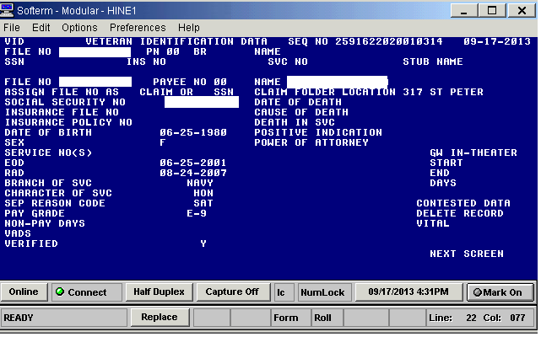
Claim Development – Verifying Qualifying Military Service
Notes:
Screen displays a BDN BIRLS Veteran Identification Data screen. No entries are allowed except in the Next Screen field.
View this screen to ensure that the following fields are correct:
Entry onto Active Duty (EOD)
Release from Active Duty (RAD)
Character of Service (Character of SVC)
Separation Reason Code (Sep Reason Code), and either –
VADS or Verified have a “Y” in the field.
NOTE: If any of these fields are missing, and the applicant is a Veteran, then a BIRLS update is required. Corporate WINRS AutoGED will stop processing when it encounters a field with incorrect or missing data.

Slide 14
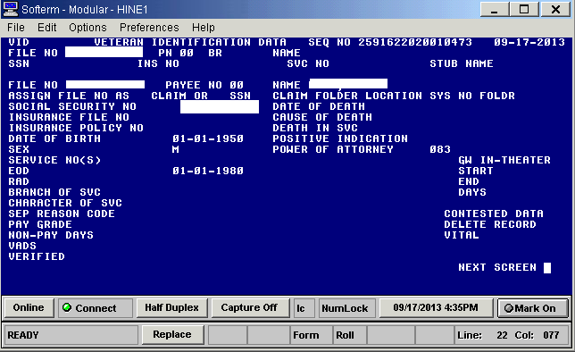
Claim Development – BIRLS record with minimal service entries for in-service Memo Rating or NDAA
Notes:
Screen displays a BDN BIRLS VID screen with minimum data for in-service Memo or National Defense Authorization Act (NDAA) AutoGED processing. The EOD field contains a valid date.
The BIRLS record must have enough data in it to confirm that the service-member has military service. If there is no BIRLS record or insufficient information in the record, AutoGED will stop and set the record to Disallowance. BIRLS update may be accomplished by Veterans Service Center.

Slide 15
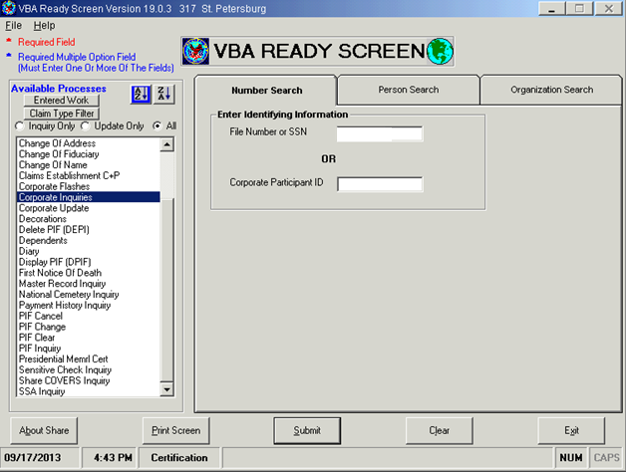
Claim Development – Using Share to verify qualifying service-connected disability IRND
Notes:
Screen displays a Share Ready Screen. Enter File Number and select Corporate Inquiries.
Use Share as primary resource to verify qualifying service connected disability rating. Select Corporate Inquiries and enter file number or Social Security Number (SSN). Two pieces of data are retrieved from Corporate Inquiries: Initial Rating Notification Date (from Claims/Denials Tab); and verification of service-connected disability rating at 10% or higher.
Step 1 – select Corporate Inquiries and enter Veteran’s file number.

Slide 16
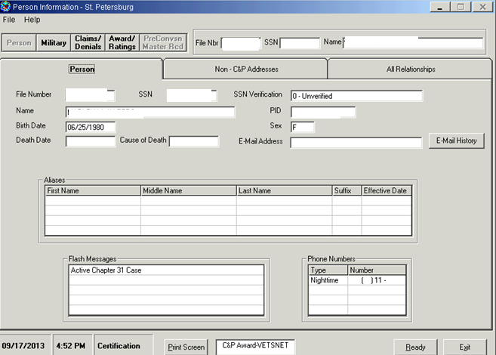
Claim Development – Using Share to verify qualifying service-connected disability IRND
Notes:
Screen displays Share Person Information screen.
Step 2 – Select Claims/Denials function.

Slide 17
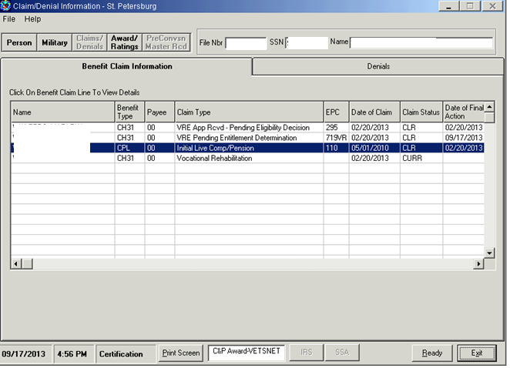
Qualifying service-connected disability IRND
Notes:
Screen displays Share Claim/Denial Information screen.
Step 3 – Highlight Initial Comp/Pension (note date of final action field).

Slide 18
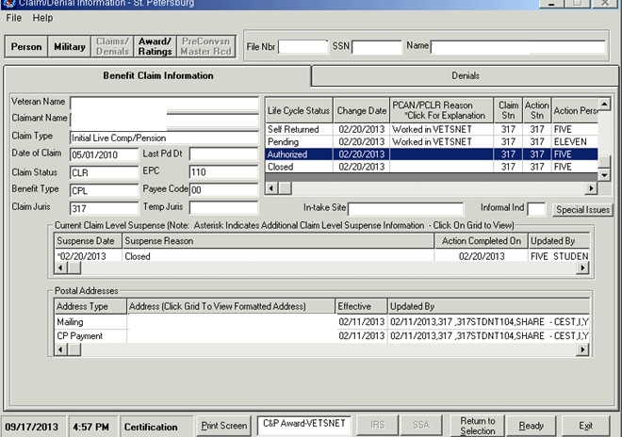
Qualifying Service-connected disability IRND
Notes:
Screen displays Claim/Denial Information screen with “Authorized” detail line highlighted to show date of authorization, which equals Initial Rating Notification Date.
Step 4 – for details on the date authorized, open Initial Comp/Pen line – date compensable (10% or higher) service-connected disability authorized is Initial Rating Notification Date.

Slide 19
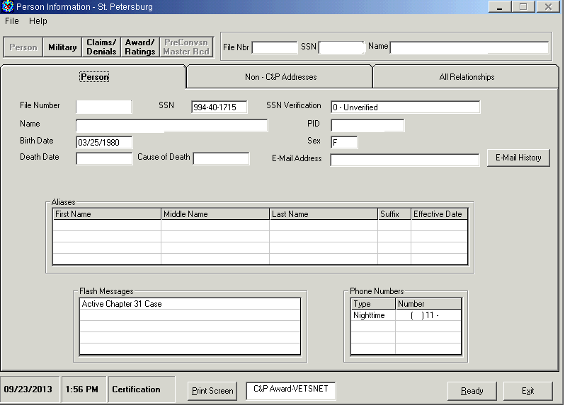
Claim Development – Using Share to verify qualifying service-connected disability rating
Notes:
Screen displays Share Person Information screen.
Step 5 – Select Award/Ratings function button in Veteran’s Share record.

Slide 20
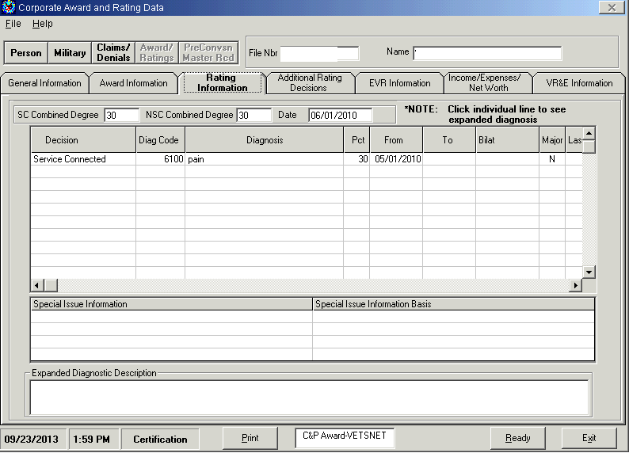
Claim Development – Using Share to verify qualifying service-connected disability rating
Notes:
Screen displays Share Corporate Award and Rating Data screen with the Rating Information tab highlighted, which displays the diagnostic code and percent of disability for service-connected disability condition.
Within Share Award/Ratings function, select Rating Information tab for diagnostic code and percentage of service-connected disability. Other tabs may be accessed for additional information if needed for claims processing.

Slide 21
Claim Development – Obtain Initial Rating Notification Date
Notes:
Screen displays a Veteran’s Virtual VA e-Folder with first notification letter line highlighted for selection.
Other sources of Initial Rating Notification Date – obtain Initial Rating Notification Date from Virtual VA. Open Veteran’s e-Folder, and locate Notification Letter for earliest claim (note: before using this date, verify that the letter specifies it is notification of compensable rating for Original/Initial claim of service-connected disability).

Slide 22
Initial Rating Notification Date
Notes:
Screen displays Share Claim/Denial Information Benefit Claim Information tab with “Closed” date corresponding to the same date of notification shown in the Veteran’s Virtual VA e-Folder.
Option B – Share view for corresponding Virtual VA example.
When basic development steps are complete, proceed with AutoGED processing.

Slide 23
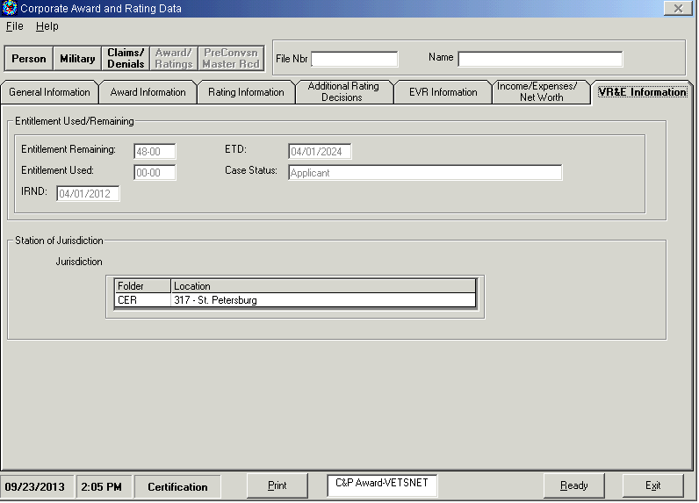
Initial Rating Notification Date – Reopened
Notes:
Screen displays Share Corporate Award and Rating Data VR&E Information tab. The following fields are populated in Share when AutoGED is used to process basic eligibility:
Entitlement Remaining; Entitlement Used; IRND; ETD (Eligibility Termination Date); Case Status; and Station of Jurisdiction of CER (Counseling Evaluation Rehabilitation) folder.
The Initial Rating Notification Date for Reopened Claims can be obtained from BDN M33 screen (use MINQ/M33) or from Share (use Corporate Inquiries – Award/Ratings function – VR&E Information tab).

Slide 24
Basic Development Step – CER folder location
Notes:
Screen displays BDN M35 screen (Ch31 Case Status and Employee Controls), highlighting the screen location of the CER Folder Location field.
Reopened claim – make sure the BDN CER folder location on the M35 screen is in the correct station before processing AutoGED.

Slide 25
Using EP 795 to Control Reapplication from Rehab
Refer to EP 795 training conducted on August 27, 2013 for procedures to establish EP 795 control
Do not start AutoGED before entitlement determination and overturning/removing prior rehab
Notes:
Claims received from prior Ch31 participants who entered Rehabilitated case status will be processed out-of-system, until a determination whether or not the prior Rehabilitation can be over-turned. Upon receipt of 28-1900, establish EP 795 with date of claim. Once a decision is made (allowed or disallowed), PCLR the 795. If the prior Rehabilitation is over-turned, proceed with AutoGED processing.

Slide 26
Application Processing
AutoGED Processing
Notes:
AutoGED Processing is next

Slide 27
AutoGED Processing – Original Claim
CWINRS AutoGED - Original
From CWINRS Navigator, click on GED PROCESSING button with AutoGED Processing showing in the drop-down list
Click on the ADD button on the right-hand side of the screen.
Enter File Number
Corporate environment will be checked to confirm claimant is a Veteran
If claimant is not a Veteran, a message will appear stating that there is no BIRLS record on file
Notes:
AutoGED is the primary tool to process Ch31 claims. NOTE: Corporate WINRS enhancement in February 2011 introduced a change to AutoGED. Prior to February 2011, AutoGED records were stored on a Regional Office server and could only be viewed by the Regional Office of jurisdiction. CWINRS Version (February 2011) introduced AutoGED to the Corporate Database and eliminated the ability to delete authorized GED records from the data base.

Slide 28
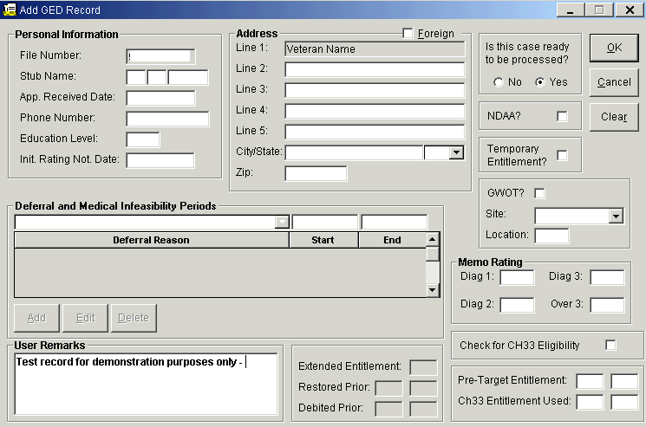
AutoGED Processing – Original Claim
Notes:
This is the Add GED Record screen in CWINRS. In addition to verifying that basic eligibility criteria are met with verified military service and one or more service connected disability conditions rated at 10% or higher; AutoGED will handle basic eligibility process when the Service-member/Veteran has a memorandum rating, or has applied under NDAA. AutoGED will also obtain Education benefit usage including Ch33 (enter a check-mark in the Ch33 Eligibility box).
Any errors or verification problems will be posted on the AutoGED record Processing Tab, and users are able to retry processing once the errors or problems are resolved.

Slide 29
AutoGED Processing – Original Claim
CWINRS AutoGED – Original Continued
Complete Form Entries
App Received Date – This must be accurate and taken as the date it was received in a VA facility
Education Level – Enter number of years with two digits.
Initial Rating Notification Date (IRND) or enter date of Memorandum Rating
Case ready to be processed?
Only say no if there is no Memo rating and then enter remark on the bottom
Is this an NDAA case? If yes, check the box
5555 will automatically appear in DIAG 1 field.
Refer to VR&E Circular 28-12-01 Procedures for Implementing the Provisions of Public Law 110-181, National Defense Authorization Act of 2008 as extended by Public Law 112-56, Vow to Hire Heroes Act.
Notes:
CWINRS AutoGED – Original Continued
Complete Form Entries
App Received Date – This must be accurate and taken as the date it was received in a VA facility
Education Level – Enter number of years with two digits.
Initial Rating Notification Date (IRND) or enter date of Memorandum Rating
Case ready to be processed?
Only say no if there is no Memo rating and then enter remark on the bottom
Is this an NDAA case? If yes, check the box
5555 will automatically appear in DIAG 1 field.
Refer to VR&E Circular 28-12-01 Procedures for Implementing the Provisions of Public Law 110-181, National Defense Authorization Act of 2008 as extended by Public Law 112-56, Vow to Hire Heroes Act.

Slide 30
AutoGED Processing – Original Claim
CWINRS AutoGED – Original Continued
Complete Form Entries continued
Is there temporary entitlement?
Do not check for re-opened application
The IRND will be on the M33 screen if claim is re-opened
If Veteran is a OEF/OIF/OND Veteran, then choose GWOT
These three fields will be attached to the EP which will give it the ability to track through End Products (EP)
Enter site – within the station
Enter Location – VOW, Initials of the Case Manager
Notes:
CWINRS AutoGED – Original Continued
Complete Form Entries continued
Is there temporary entitlement?
Do not check for re-opened application
The IRND will be on the M33 screen if claim is re-opened
If Veteran is a OEF/OIF/OND Veteran, then choose GWOT
These three fields will be attached to the EP which will give it the ability to track through End Products (EP)
Enter site – within the station
Enter Location – VOW, Initials of the Case Manager

Slide 31
AutoGED Processing – Reopened Claim
EP 795
If claimant is prior Ch31 participant who was Rehabilitated, establish an EP 795 and do not process in AutoGED until a determination to overturn Rehabilitation is documented. PCLR the 795 when entitlement determination is made.
Reopened
From CWINRS Navigator, click on GED PROCESSING button with AutoGED Processing showing in the drop-down list
Click on Single Record and enter file number
Highlight case and select Reopen
Enter date of claim, update any fields with outdated information
Process (errors or data validation issues will appear on Process Tab – correct and retry)
Notes:
EP 795
If claimant is prior Ch31 participant who was Rehabilitated, establish an EP 795 and do not process in AutoGED until a determination to overturn Rehabilitation is documented. PCLR the 795 when entitlement determination is made.
Reopened
From CWINRS Navigator, click on GED PROCESSING button with AutoGED Processing showing in the drop-down list
Click on Single Record and enter file number
Highlight case and select Reopen
Enter date of claim, update any fields with outdated information
Process (errors or data validation issues will appear on Process Tab – correct and retry)

Slide 32
Application Processing
Completed GED
Notes:
Next section is on Completed GED

Slide 33
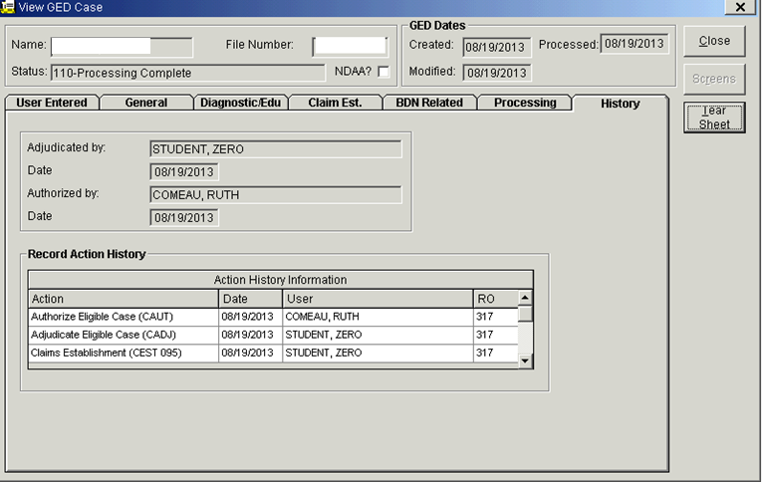
Completed GED
Notes:
Screen displays Corporate WINRS View GED Case screen.

Slide 34
Basic Claim Development Step – CER folder location
Notes:
An indicator that a CER folder location is incorrect is the appearance of “unknown” case manager numbers on a report such as Case Management Indicator. Check both the M35 screen and the BIRLS record (BINQ/Loc).

Slide 35
Basic Claim Development Step – CER folder location
Notes:
Screen displays BDN BIRLS Location screen.

Slide 36
CER Location
Create using BFLD (BIRLS Folder) Command
Original GED – BFLD after Authorization
Reopened GED – BFLD before Establishment
Notes:
The sequence of establishing a new, or updating an existing, CER folder location in BIRLS is essential for many data integrity issues.
If the claim is an Original (no Ch31 Master Record in BDN), perform the BFLD command AFTER authorizing the GED (update AutoGED Process Tab).
If the claim is a Reopened/Reapplication (Ch31 Master Record exists in BDN), perform the BFLD command BEFORE initiating the GED (update AutoGED Process Tab).
CER folder location allows CWINRS to accurately update the BDN Master Record with Date of Claim (i.e., the “effective” date) which is the beginning period for Days to Entitlement measure.
CER folder location allows BDN to refresh (when necessary) the CWINRS record.

Slide 37
Disallowance
Application Processing
Notes:
Disallowance processing in AutoGED is for no Basic Eligibility determination.

Slide 38
Disallowance – Basic Eligibility
AutoGED processes disallowance for Basic Eligibility
No qualifying military service
No qualifying service connected disability
Compensation; memo rating; NDAA
Processing Tab allows for corrections and re-try processing
Notes:
AutoGED processes basic eligibility Disallowance and creates a CWINRS and BDN record documenting that the claim was disallowed. If any basic eligibility criteria are missing or erroneous, AutoGED cannot validate the claim and will set it for disallowance. AutoGED Processing Tab allows VR&E user to retry processing after corrections to the record are made (may involve BIRLS update by Veterans Service Center), and to retry processing. If basic eligibility cannot be verified, the disallowance processing will be completed on the Processing tab.

Slide 39
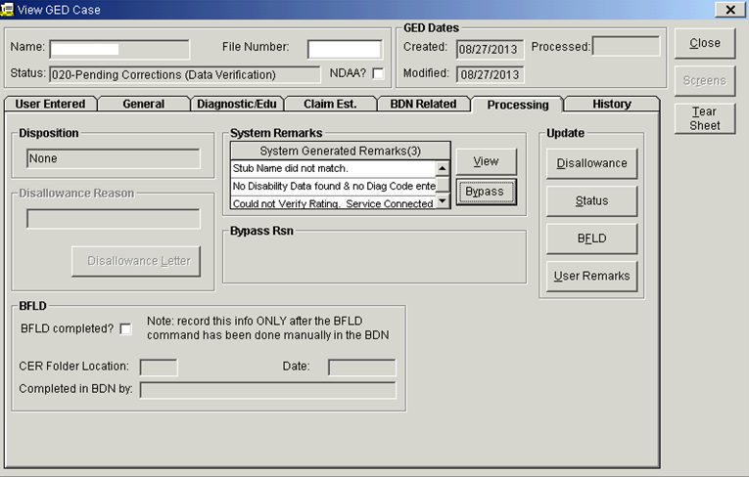
AutoGED Corrections on Processing Tab
Notes:
Slide displays Corporate WINRS View GED Case screen with Processing Tab displaying system generated remarks listing reasons for correction or Disallowance.
Examples of reasons for disallowance.

Slide 40
Data
Application Processing
Notes:
This next section is on Data—generation of data and locating it.

Slide 41
Data Generation
Performance measures
Reports
VOR 2.0
Pending Full Detail
Pending Control Time Detail
Pending Awaiting Authorization
Detail Cancelled EPs
Completed Detail
Completed Cycle Time
Detailed-Pending Message Work Items
PA&I: PIF Detail Report
CWINRS Intranet Reports
Notes:
Chapter 31 data is generated throughout claims processing:
EP 095/295 is generated in the Corporate claims environment (view in Share Corporate Inquiries; MAP-D) – and an EP is established in BDN) when AutoGED CEST status is complete;
EP 719 is generated in the Corporate claims environment and in BDN when AutoGED CAUT status is complete
EP 795 is manually established by VR&E employee in BDN when a reopened claim from Rehabilitated Ch31 participant is received.
NOTE: Veterans Service Center also establishes 095/295 in the Corporate claims environment for the purpose of processing Memorandum Rating Decisions.
Data sources/reports are available on the Performance Accuracy and Integrity (PA&I) web-site

Slide 42
Share Display of VR&E Data
Corporate Inquiries Module – Awards
SAM Award details (limited to SAM Beta participants)
Contains enrollment dates, benefit amount
VR&E Info tab (all Ch31 participants)
Contains Initial Rating Notification Date; Eligibility Termination Date; CER folder location; Case Status; Entitlement Used; Entitlement Remaining.
Will be available to Veterans through eBenefits log-on
BDN screens on Pre-Conversion tab (currently limited to archived records)
Payment History Module
Subsistence Allowance payments
Notes:
Corporate Inquiries Module – Awards
SAM Award details (limited to SAM Beta participants)
Contains enrollment dates, benefit amount
VR&E Info tab (all Ch31 participants)
Contains Initial Rating Notification Date; Eligibility Termination Date; CER folder location; Case Status; Entitlement Used; Entitlement Remaining.
Will be available to Veterans through eBenefits log-on
BDN screens on Pre-Conversion tab (currently limited to archived records)
Payment History Module
Subsistence Allowance payments

Slide 43
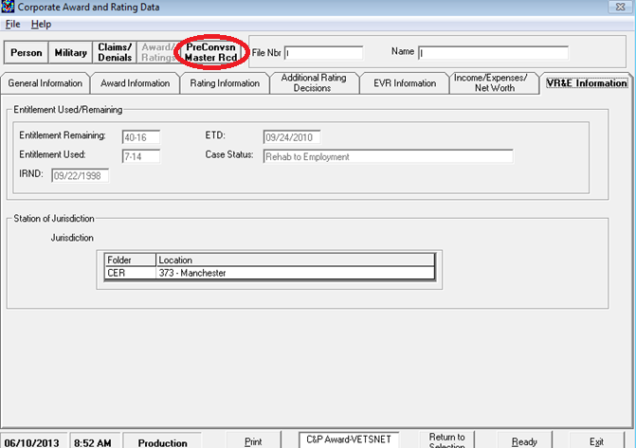
Share display of Ch31 eligibility/entitlement
Notes:
Screen displays Share Corporate Award and Rating Data VR&E Information tab with Entitlement Used and Remaining fields highlighted, as well as the Share tab containing Pre Conversion BDN Master Record screens highlighted.
Details on this slide to discuss pre-conversion location and VR&E Information

Slide 44
BDN Migration: Indexing/Archiving
Application Processing
Notes:
Next we have a brief overview about migrating off BDN, using indexing and archiving.

Slide 45
BDN Migration - Background
VR&E Service is migrating from BDN to the use of Corporate WINRS as a single system to:
Create Ch31 records
Manage Ch31 services
To pay subsistence allowance benefits
Corporate WINRS has been enhanced with:
Robust eligibility/entitlement module (AutoGED)
Fully functioning subsistence allowance module (SAM)
CWINRS release 3.1 and the ongoing BDN Archiving project are both driving the Ch31 transition from BDN to CWINRS.
Notes:
Corporate WINRS 3.1 version is scheduled for release between 9/28 and 10/19/13. When this release is deployed, VR&E users of BDN and Corporate WINRS will begin to encounter Indexed and Archived records.

Slide 46
BDN Migration – Archiving
What happens when a BDN record is archived?
BDN record is deleted
BDN data segments are stored in the Corporate data base for future use by CWINRS (AutoGED will access this data for reopened claims)
BDN screen series M32 – M38, M01 and M39 are stored in Share (Pre-Conversion Tab in Corporate Inquiries Module) for reference
Notes:
What happens when a BDN record is archived?
BDN record is deleted
BDN data segments are stored in the Corporate data base for future use by CWINRS (AutoGED will access this data for reopened claims)
BDN screen series M32 – M38, M01 and M39 are stored in Share (Pre-Conversion Tab in Corporate Inquiries Module) for reference

Slide 47
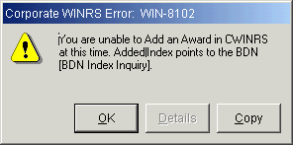
AutoGED - Indexing/Archiving Impact
CWINRS AutoGED – Index/Archiving Impact
No screen changes to AutoGED
All changes are to background processes to check or create Index record, synchronize entitlement, etc.
Warning messages displayed, processing stopped
Sample warning message below is displayed when you try to add an award in SAM when the Index points to BDN.
Notes:
Slide displays a Corporate WINRS screen snapshot displaying Error Message WIN-8102. The 8 Beta test sites where Corporate WINRS Subsistence Allowance Module (SAM) is currently in field test mode, will encounter this message when a Veteran’s Index is set to “B” (BDN). Notify VR&E that the Index needs to be re-set.

Slide 48
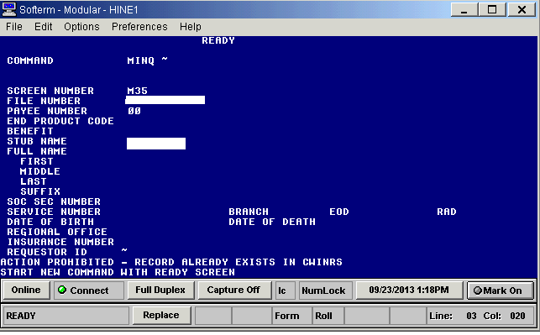
How to Identify an Indexed Record
BDN Ready screen will post the message displayed
Notes:
Screen displays the BDN error message located at bottom on Ready Screen when the Index is set to “V” (VetsNet or Corporate WINRS). The message reads: “Action prohibited – record already exists in CWINRS. Start new command with ready screen”). Notify VR&E to re-set the Index to B.
When a Ch31 record is Indexed to “V” (VetsNet/Corporate), the BDN Ready Screen will display this message when any of the following commands are entered:
MINQ, CEST, CADJ, CAUT, CADD, CORR, FIST FAUT.
In any instance where it is necessary for VR&E or Finance to access the BDN Master Record, submit a trouble ticket requesting that the Index be set to “B” (BDN).

Slide 49
Eligibility Entitlement
Application Processing
Notes:
Lastly, we will discuss eligibility entitlement.

Slide 50
Eligibility Entitlement Update (charging entitlement to Ch31)
Notes:
Screen displays BDN Chapter 31 Basic Eligibility Data – 431 screen for use in updating eligibility or entitlement.
Charging entitlement to a record where Veteran is attending at less than ½ time. When it is not possible to charge entitlement through subsistence allowance award processing, an eligibility/entitlement update GED is required to charge entitlement to the BDN Master Record (same functionality applies to SAM). Need award and enrollment certification just like with a BDN award for payment. Calculate number of months and days. Use BDN Eligibility/Entitlement Update functionality to process this GED type.
Enter “X” in the Elig/Entitlement update field. Enter mm-dd in the “Other” field. Validate or enter Initial Rating Notification Date if applicable. Proceed to 432 screen.
The provisions for computing and charging entitlement to Ch31 participants who are specifically barred from receiving subsistence allowance are:
CFR 21.79 “Determining Entitlement Usage under chapter 31” – 21.79-2 addresses participants such as IDES or others who are specifically barred from receiving subsistence allowance. CFR 21.310 – “Rate of Pursuit of a Rehabilitation Program” covers the Rate of Pursuit charged under different programs (note – since the publication date of the regulation, there have been changes to the rate of pursuit allowed for independent study). CFR 21.314, “Pursuit of Training Under Special Conditions” discusses the approval of pursuit at less than ½ time.

Slide 51
Eligibility Entitlement Update (charging entitlement to Ch31)
Notes:
Screen displays BDN Chapter 31 Basic Eligibility Data – 431 screen for use in updating eligibility or entitlement.
Proceed to 432 screen – recalculated creditable Ch31 entitlement occurs.

Slide 52
Eligibility Entitlement Update (charging entitlement to Ch31)
Notes:
Screen displays BDN Chapter 31 Basic Eligibility Data – 432 screen for use in updating eligibility or entitlement.
Enter a facility name or facility code in the “Facility Name” field. Enter applicable type of training (i.e., A=graduate; B=undergraduate). Enter course name. Enter amount of entitlement used (from 431 screen). Enter “OTH” in Benefit Type. Enter “S” or “U” (Satisfactory or Unsatisfactory). In Next Screen field, type GED. Authorize and sign the GED tear sheet. File in CER folder.

Slide 53
Questions
QUESTIONS

Slide 54
References
M28.PIV.A.2
VR&E Letter 28-13-21 (Revised)
“AutoGED Overview,” August 27, 2013 by Ruth Comeau
VR&E Knowledge Management Portal
VR&E Hotline Bulletin September 2012
“BDN Migration,” May 7, 2013 by Ruth Comeau
VR&E Job Support Tools Portal
Notes:
Here is a list of references that were used to create this training module. Please refer to these references if further clarification is needed. Please also note that the Manual reference above will soon be updated on the KMP so keep an eye out on it.

Slide 55
More Questions?
Email Field Liaisons
AREA | PRIMARY | ALTERNATE | E-MAIL
Eastern | Teri Nguyen | Veronica Brown | VAVBAWAS/CO/VRE/EA
Southern | Veronica Brown | Teri Nguyen | VAVBAWAS/CO/VRE/SA
Central | Aimee Speers | Marisa Liuzzi | VAVBAWAS/CO/VRE/CA
Western | Marisa Liuzzi | Aimee Speers | VAVBAWAS/CO/VRE/WA
CRC CEUs are available for this training, please submit CRC Request to the Corporate VR&E Mailbox Thanks for Your Participation!
Notes:
Conclusion
We encourage you to utilize your local resources, such as your colleagues and VR&E Officers to assist you with any questions regarding Application Processing. If further guidance is needed, VR&E Officers and Assistants will send all inquiries from the Regional Office staff to the Field Liaisons. A list of the VR&E Field Liaisons is referenced on this slide.
CRC CEU Credits are available for this training. Please remember to return to the TMS content screen and take the Feedback Survey. Your feedback regarding this training is greatly appreciated.
This concludes the presentation on Application Processing. We hope that this training has been beneficial in educating you. Thanks for participating in this Lync webcast and for your dedicated service to our Nation’s Veterans and Servicemembers.
Good bye!

