Slide 1
Introduction to IDES for Military Service Coordinators
Compensation Service
September 2016

Slide 2
Lesson Objectives
Identify principal concepts of the Integrated Disability Evaluation System (IDES) program
Identify the phases and stages within the Integrated Disability Evaluation System (IDES) program
Identify the role of VA within the Integrated Disability Evaluation System (IDES)
Identify Military Service Coordinator (MSC) responsibilities within the Integrated Disability Evaluation System (IDES)

Slide 3
References
Integrated Disability Evaluation System (IDES) Home Page, Integrated Disability Evaluation System (IDES) Procedures
M21-1, Part III, Subpart i, Chapter 2, Section D - Overview the Integrated Disability Evaluation System (IDES) and Initial Claims Development
M21-1, Part III, Subpart i, Chapter 2, Section E - Department of Veterans Affairs (VA) Responsibilities Based on Medical Evaluation Board (MEB) and Physical Evaluation Board (PEB) Outcomes

Slide 4
References
M21-1, Part III, Subpart i, Chapter 2, Section F - Special Situations Related to the Integrated Disability Evaluation System (IDES)
Department of Defense Manual DoDM 1332.18-V2

Slide 5
Background
IDES is a Service member-centered disability evaluation system that is a partnership between:
DoD – Determines whether wounded, ill, or injured Service members are fit for continued military service, and if unfit, appropriate benefits for participants who are separated or retired for a service-connected disability.
VA – Assigns disability evaluations for use by both departments in accordance with the VASRD.

Slide 6
Concepts
IDES has three principal concepts:
Single set of disability exam(s) conducted to VA standards that will be used by both Departments.
Single-source disability evaluation that is used to determine both military and VA disability benefits completed by VA that is binding in both departments.
Expeditious payment of VA benefits within 30 days of a member’s separation from service.

Slide 7
Goals
The goals of IDES are to:
Reduce the overall time it takes a participant to progress through the IDES process
Utilize a single examination process that meets the needs of VA and DoD
Increase the transparency of both the IDES and VA claims processes for wounded, ill, and injured participants and their families

Slide 8
Process Time
The IDES goal is to process:
Active duty Service member claims in 295 days
National Guard and Reserve member claims in 305 days

Slide 9
Process Improvement
IDES will be evaluated and improved based on the effectiveness of:
Single comprehensive physical examinations developed to meet the requirements of DoD and VA
Single disability evaluation that is used to determine both military and VA disability benefits
Rapid delivery of VA benefits
Participant, family member, and stakeholder satisfaction with the process

Slide 10
Program Overview
VA partnered with DoD to develop a Service member-centric disability evaluation system.
VA enters the disability evaluation at specific points in time to provide required services, such as physical examinations and disability ratings.
If IDES participants are found unfit for duty, VA will award benefits immediately after discharge on the basis of exams and rating completed in IDES.

Slide 11
IDES Phases
The Treatment Phase is a DoD process that occurs outside of the parameters of IDES. However, each IDES participant will complete the treatment phase before being referred into IDES.
The IDES process consists of the following phases (with each phase consisting of several stages):
Medical Evaluation Board (MEB) Phase
Physical Evaluation Board (PEB) Phase
Transition Phase
Reintegration Phase

Slide 12
IDES Phases

Slide 13
Treatment Phase

Slide 14
MEB Phase

Slide 15
MEB Stages
Referral
Claim Development
Medical Evaluation
MEB Stage

Slide 16
PEB Phase

Slide 17
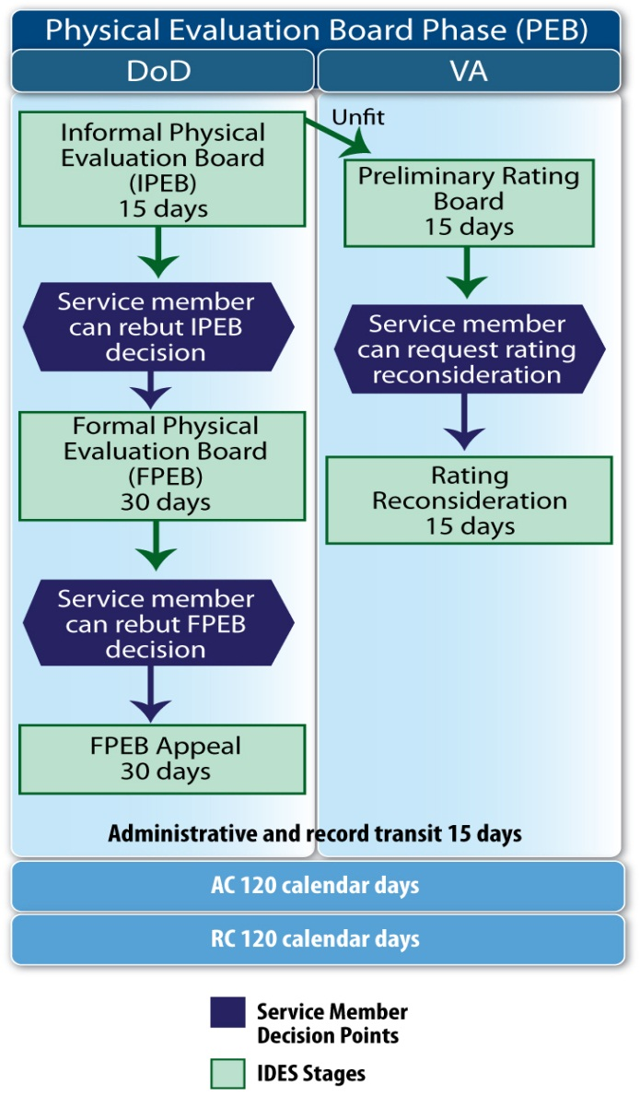
PEB Phase
The PEB Phase consists of the IPEB stage.
Depending on the outcome of the IPEB, the PEB phase may also include some (or all) of the following stages:
Proposed Rating Stage
Rating Reconsideration Stage
Formal Physical Evaluation Board (FPEB), and
FPEB Appeal

Slide 18
IPEB Stage
The IPEB Stage consists of the following steps:
The PEB Administration receives the IDES case file from the PEBLO and schedules an IPEB
The IPEB convenes and determines the participant’s fitness for duty
If the IPEB determines that the participant is unfit, the PEB will request a Proposed Rating from the VA Disability Rating Activity Site (DRAS); or, if the IPEB determines that the participant is fit, the fitness finding is forwarded to the PEBLO.

Slide 19
Proposed Rating Stage
The Proposed Rating Stage
begins when the Disability Rating Activity Site (DRAS) receives the PEB’s request for a proposed rating (after a participant is found unfit for duty), and
ends when the proposed rating and BEL are forwarded to the PEB

Slide 20
Post IPEB Actions
The PEB Administration returns the IPEB results to the PEBLO, which includes the proposed rating and the BEL (if the participant was found unfit).
The PEBLO informs the participant of the IPEB findings. The participant may request an interview with the MSC to receive an explanation of the proposed rating.
The participant will either accept the IPEB findings, request a formal PEB (FPEB), or request a rating reconsideration.
Once the PEB decision is final, the PEBLO will provide the MSC with a complete copy of the final PEB findings.

Slide 21
Transition Phase

Slide 22
Transition Phase
The Transition Phase begins once the participant has accepted the PEB findings and/or has exhausted all appeal/due process options.
The Transition Phase includes one of the following:
Assignment to a unit
Separation or Retirement Processing

Slide 23
Reintegration Phase

Slide 24
Reintegration Phase
The Reintegration Phase consists of the following:
Return to Duty
VA Benefits Notification (Final Rating) Stage
*Veterans have appellate rights

Slide 25
VA’s Role in IDES
VA organizations and applications that support IDES:
Office of Field Operations (OFO)
Office of Transition, Employment and Economic Impact (OTEEI)
Compensation Service
Veterans Tracking Application (VTA)

Slide 26
Office of Field Operations (OFO)
OFO assigns project manager(s) who communicate and coordinate with ROs, district offices, IDES sites, and OTEEI to:
Provide adequate staffing to IDES sites
Develop a description of duties for an MSC under the IDES program
Develop a standardized grade structure for all IDES MSCs

Slide 27
Office of Transition, Employment and Economic Impact
OTEEI assigns a supervisor and program manager(s) to communicate and coordinate with DoD, VACO, VHA, ROs, IDES sites, and OFO.
Responsibilities include:
Develop IDES policy and procedures for VBA
Communicate IDES policy and procedural changes to VBA field employees
Act as liaison to the Office of the Secretary VA and Under Secretary for Benefits
Attend regularly scheduled stakeholder meetings arranged by the IDES Support Team and DoD

Slide 28
Office of Transition, Employment and Economic Impact
OTEEI responsibilities (continued):
Provide on-site assessment and training at IDES sites
Function as business owner for IDES module of VTA
Develop and provide training on VTA, to include VTA Operational Reports
Evaluate IDES operations into at local ROs as part of the site visit protocol process

Slide 29
Compensation Service
Compensation Service provides support for the IDES program. Compensation Service responsibilities include:
Develop and provide initial IDES training for new MSCs
Post training documents online to sustain training of existing MSCs
Support and monitor VBA contract examination process used to support IDES
Update IDES procedures in the M21-1

Slide 30
Veterans Tracking Application (VTA)
VTA is a web-based application used to track IDES participants as they proceed through the program.
VTA is accessed through the Veterans Information Portal (VIP).
Users must have access to VIP prior to requesting access to VTA.
The user’s supervisor and ISO must approve requests for access.

Slide 31
MSC Responsibilities
During the IDES process, MSC responsibilities include:
Referral Package Review
Initial Interview
Claims Control
Claims Development
Claims Tracking
Exit Interview

Slide 32
Referral Package Review
Before the initial interview, the MSC will review the referral package for completeness.
Complete STRs
VA Form 21-0819
Service Department Memorandum of Complete and Currents STRs

Slide 33
Initial Interview
The MSC should conduct the initial interview in a positive and professional manner for the following reasons:
The MSC is the participant’s direct link to VA information
The initial interview may be the first time the participant has encountered a VA employee
This experience may determine the participant's overall impression of VA as an agency

Slide 34
Claims Control
The MSC has the responsibility for reviewing, controlling, and processing all incoming IDES claims and mail:
Claims Establishment (CEST)
Establish, build, or request claims files
Control of Veterans Records System (COVERS)
Veterans Benefits Management System (VBMS)
Proper mail routing

Slide 35
Claims Development
Claims development for non-IDES claims is usually the responsibility of a VSR at the RO.
In the claims development stage of the IDES claims process, the MSC develops the claim.

Slide 36
Claims Tracking
The MSC is responsible for tracking the claim during the IDES process. The following applications are used for tracking purposes:
VBMS
tracked items
claim level suspense reasons
suspense dates
notes
SHARE Participant Profile Flash
VTA reports
Nexus or MyCore Reports

Slide 37
Exit Interview
The MSC conducts an exit interview to:
Notify the participant that VA will close the pending claim if he/she is on active duty and found fit for duty
Notify the participant that VA will make a final decision on the claim, if VA has not done so already, if he/she is not on active duty and found fit for duty
Explain the VA proposed rating and benefits estimate if found unfit for duty

Slide 38
Review

Slide 39
Questions

