Slide 1
Processing Mitigating Circumstances for Post-9/11 GI Bill Claims

Slide 2
Overview of Today’s Training
Processing Mitigating Circumstances for Post-9/11 GI Bill Claims
The purpose of this lesson is to provide the Veterans Claims Examiner (VCE) with the knowledge to process changes in enrollments involving Mitigating Circumstances (MITCs), occurring on or after November 15, 2015, in the Long Term Solutions (LTS).

Slide 3
Lesson Objectives
At the end of this lesson, you will be able to:
Using available references, identify acceptable reasons for adjustments to enrollments, including Mitigating Circumstances (MITCs), with 80% accuracy on the assessment.
Using available references, identify the steps for processing MITCs in the Long Term Solutions (LTS), with 80% accuracy on the assessment.
Using available references, identify how to generate Long Term Solutions (LTS) Notification Letters, with 80% accuracy on the assessment.

Slide 4
Terminology

Slide 5
Mitigating Circumstances (MITCs)
Mitigating circumstances (MITCs) are circumstances beyond the claimant's control that prevent the continuous pursuit of a program of education.

Slide 6
Acceptable Mitigating Circumstances
Examples of acceptable MITCs include:
An illness or injury afflicting the student during the enrollment period An illness or death in the student's immediate family An unavoidable change in the student's conditions of employment An unavoidable geographical transfer resulting from the student's employment | Immediate family or financial obligations requiring suspension of training to obtain employment Discontinuance of the class by the school Unanticipated active military service, including active duty for training Unanticipated difficulties with child care arrangements the student has made for the period during which he or she is attending classes

Slide 7
Drop Period
The drop period is a reasonably brief period of time, at the beginning of a term, officially designated by a school for dropping one or more classes without penalty.
The school's last day to drop a class will be the end of the drop period, providing it does not exceed 30 days from the first day of the term.

Slide 8
Punitive Grades
A punitive grade (Passing or Failing) is a grade assigned for pursuit of a class that is used in determining overall progress toward completion of the school's requirements for graduation.
Unlike a non-punitive grade, the punitive grade imposes a penalty toward graduation, such as an adverse effect on the student's GPA.
Examples of punitive grade examples are: A, B, C, D, F.

Slide 9
Non-Punitive Grades
A non-punitive grade is a grade not used when determining progress for fulfillment of requirements for graduation.
Such a grade neither yields credit toward the school's requirements for graduation nor affects a student’s GPA.
The non-punitive grade causes the class to become the equivalent of an audited class for the purpose of advancement toward graduation.
Non-punitive grade examples are W, WF, WP, Incomplete.

Slide 10
VA Form 22-1999B & 22-1999 (AM1999)
Changes to enrollments may be submitted as a Notice of Change in Student Status (VA Form 22-1999B) or an Amended Enrollment Certification (VA Form 22-1999).
Corrections to enrollment information such as changes to term dates, tuition updates or any change that is effective at the beginning of the enrollment period would be reported on an VA Form 22-1999.
Changes that involve hours enrolled including; increases, reductions and terminations are reported on a VA Form 22-1999B.

Slide 11
Comprehension Check
What is the difference between punitive and non-punitive grades?

Slide 12
Adjustments to Enrollments & MITCs

Slide 13
Adjustments to Enrollments
The law prohibits payment of VA benefits for a class from which a student withdraws and receives a grade that will not be used in computing requirements for graduation and/or be factored into the student’s Grade Point Average (GPA).
Exceptions
Benefits may still be paid if the student can establish that the failure to complete the class(es) was due to:
The student being ordered to active duty, or
A withdrawal during the "drop" period, or
Punitive grades, or
MITCs

Slide 14
Adjustments to Enrollments (Continued)
The purpose of the original legislation creating these rules was to minimize the abuse of VA educational assistance programs by certain students who were using the non-punitive grading and liberal withdrawal policies of some schools to receive VA benefits for several terms without achieving progress toward program completion.

Slide 15
Comprehension Check
Question:
If a student withdraws from a class, benefits may still be paid if the student can establish that the failure to complete the class was due to what exceptions?
What are some examples of acceptable MITCs?

Slide 16
Six Credit Hour Exclusion (6X) - Defined
VA automatically issues a one-time grant of MITCs for up to 6 credit hours for the first instance of a reduction or termination which is after the drop period, and before the end of the term, for which a non-punitive grade is assigned.
This exclusion is called the Six Credit Hour Exclusion (6X) and can only be made one time for a claimant across the various VA education programs.

Slide 17
Six Credit Hour Exclusion (6X)
The Six Credit Hour Exclusion does not apply in the following situations:
Student completes a class and receives a non-punitive grade; or
Has not yet been awarded benefits for the dropped class(es).
When called to active duty
School cancelation/closure or
Other adjudication determination where it should not be applied.

Slide 18
Six Credit Hour Exclusion (6X) - Application
If more than 6 credit hours are dropped in the first instance, the additional hours will be subject to the MITCs rules.
VA will automatically cover the first 6 credits and will consider whether or not acceptable MITCs apply to the remaining credits.

Slide 19
Comprehension Check
Question:
How often can a student qualify for the Six Credit Hour Exclusion (6X)?

Slide 20
Protected Unprotected Hours
Protected hours = Payable
Unprotected hours = Not Payable
Terminations and reductions are considered “Protected” when they occur:
Before the end of the drop-period (30 day max.)
After the drop period with non-punitive grades and acceptable MITCs are received
After the drop period with non-punitive grades and the 6-credit exclusion covers dropped classes
Anytime a punitive grade is assigned

Slide 21
Effective Dates of Terminations
If the withdrawal is from all classes before the end of the institution's drop period:
Benefits are paid through the last day of attendance.
If the withdrawal is from all classes after the end of the institution's drop period and punitive grades are assigned for the classes or acceptable MITCs are available:
Benefits are paid through the last day of attendance.

Slide 22
Effective Dates of Terminations (Continued)
If the withdrawal is from all classes after the institution's drop period, with non-punitive grades assigned, and no acceptable MITCs are found:
Benefits are terminated effective the first date of the enrollment period.
If the 6X is available and only covers part of the drop:
Pay 6 credit hours through the last date of attendance, and
Reduce any remaining hours effective the first date of the term.

Slide 23
Effective Dates of Terminations (Continued)
If an individual completes a class but at the end of the term, semester, or quarter receives a non-punitive grade for the class and acceptable MITCs are not found:
Terminate benefits from the first date of the enrollment period.
Note: The 6-credit exclusion is not a factor in such cases and should not be applied.

Slide 24
Comprehension Check
Questions:
When are benefits terminated if a student withdraws from all classes before the end of the institution's drop period?
When are benefits terminated if a student withdraws from all classes after the institution's drop period, with non-punitive grades assigned, and no acceptable MITCs are found?

Slide 25
Effective Dates of Reductions
When a student reduces hours enrolled by withdrawing from fewer than all classes on or before the first day of the term, reduce payments effective the first date of the term.

Slide 26
Effective Dates of Reductions (Continued)
A reduction occurs when the student reduces hours enrolled by withdrawing from fewer than all classes under one of the following “protected” conditions:
The reduction is during the drop period, (30 day max.);
A punitive grade is assigned for the class from which the student withdraws; or
MITCs are received and accepted, the 6-credit exclusion applies to all hours, or the training is discontinued as the result of being ordered to active duty
Payments are reduced effective the end of the month or end of the term whichever occurs first.

Slide 27
Effective Dates of Reductions (Continued)
Reductions with non-punitive grades occurring after the institution’s drop period that are “unprotected” will be adjusted effective the first day of the term. All payments associated with those hours are not payable.
Chapter 33 “protected” reductions are effective and payable through the end of the month of the change.
VA cannot pay benefits when a claimant is no longer attending an enrollment period.

Slide 28
Comprehension Check
Questions:
When a student reduces hours enrolled by withdrawing from fewer than all classes on or before the first day of the term, payments are reduced effective when?
If a student reduces their hours enrolled by withdrawing from fewer than all classes and MITCs are received and approved, payments would be reduced effective when?

Slide 29
Changes to Enrollment (VA Forms 22-1999 & 1999B)
In most cases, a VCE should not need to enter information manually.
If there is missing, conflicting, or illogical information, develop with the SCO or ELR as appropriate.
Anytime “Other” is used as the reason for an adjustment and is not fully explained in the remarks, develop with the SCO for clarification and place all development documents in the TIMS folder.

Slide 30
Terminations and IT Systems
Terminations that are “protected” will be paid up to and through the last day of attendance.
BDN processing requires the use of a No Pay Date which is the day after the last date of attendance.
LTS does not use a No-Pay date, therefore you will enter the effective date received on the Notice of Change in Student Status (VA-Form 22-1999b).
If pre-populated via the VA-ONCE Inbox, verify that the date matches the date on the form in TIMS.
Do not process enrollments or changes without reviewing either the 1999 or 1999B in TIMS.

Slide 31
Terminations in LTS
Termination or complete withdrawal reported effective before or on the first day of the term must be processed as an Amendment in the LTS. Note this is not a correction.
LTS will require the user to enter the first day of the term as the effective date. Be sure to ALWAYS check the “Student did not attend” box. Otherwise the system will incorrectly pay for that first day.
All other changes effective on or before the first day of the term are processed as a Correction to the original enrollment period.

Slide 32
VA-Once
Changes submitted electronically through VA-ONCE will populate the correct check box(es) for an “Amendment or Correction” in LTS.
Based on the information submitted online or entered by the user for reductions or withdrawals after drop/add with non-punitive grades assigned (or completing a term with non-punitive grades), LTS will generate the appropriate letter to the claimant:
Developing for MITCs (MITCs)
Granting MITCs, or
Disallowing MITCs

Slide 33
Amendment Correction
Source of Change: | Applicable Functionality:
IF there’s a change (reduction or termination) after the first day of the term. | THEN the “Amendment” button is checked
IF MITCs are received after Authorization of the Amended Award | THEN the “Correction” button is checked

Slide 34
Demonstration - Amendment vs. Correction

Slide 35
Comprehension Check
Question:
When processing protected terminations in LTS, which form will provide you with the Effective Date?

Slide 36
Processing MITCs in the LTS

Slide 37
Notification Letters
LTS generated letters have been developed to provide proper notification.
LTS generates the following MITC letters:
MITCs Required – MITC-1 letter
MITCs Received and Not Acceptable – MITC-2 letter
MITCs Received and Acceptable – MITC-3 letter
Six-Credit Hour Exclusion – MITC-4 letter

Slide 38
Mitigating Circumstances are Required (MITC-1)

Slide 39
Generating an MITC-1 Letter
The MITC-1 Letter informs the claimant that an overpayment has been created due to an “unprotected” change in enrollment and that VA is requesting information as to the cause of the change in enrollment status.
To generate a MITC-1 letter:
Check the following box:
Mitigating Circumstance are Required
Ensure that the following boxes are NOT selected:
Mitigating Circumstance are Provided
Mitigating Circumstance are Acceptable

Slide 40
Generating an MITC-1 Letter (Continued)
Check the “MITCs are Required” box if an “unprotected” change in enrollment results in the creation of an overpayment for the following reasons:
A reduction/termination occurred after the school’s drop/add period with non-punitive grades, or
Non-punitive grades were assigned at the end of the term
This will automatically allow for the application of the 6-Credit Hour Exclusion if it is available.
NOTE: The 6-credit hour exclusion will not be available if used on another education benefit outside of the LTS and indicated on the claimant’s Biography page or if the exclusion was applied to an adjustment that occurred on an earlier.

Slide 41
Generating an MITC-1 Letter: Do Not Apply 6X
Also check the “Do Not Apply 6X” box when:
An Enrollment Certification (VA form 22-1999) and a Notice of Change in Student Status (VA form 22- 1999b) are received for an Unprotected reduction/termination for a term for which benefits have not yet been paid, and for which we have not received MITCs. In this case, both the VA form 22-1999 and VA form 22-1999b should be entered under the same Work Product.
A Notice of Change in Student Status (VA form 22-1999b) is received indicating completion of the term with non-punitive grades for which we have not received MITCs.

Slide 42
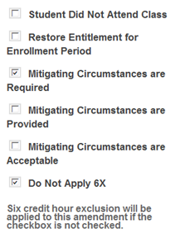
Demonstration - Generating an MITC-1 Letter: Do Not Apply 6X

Slide 43
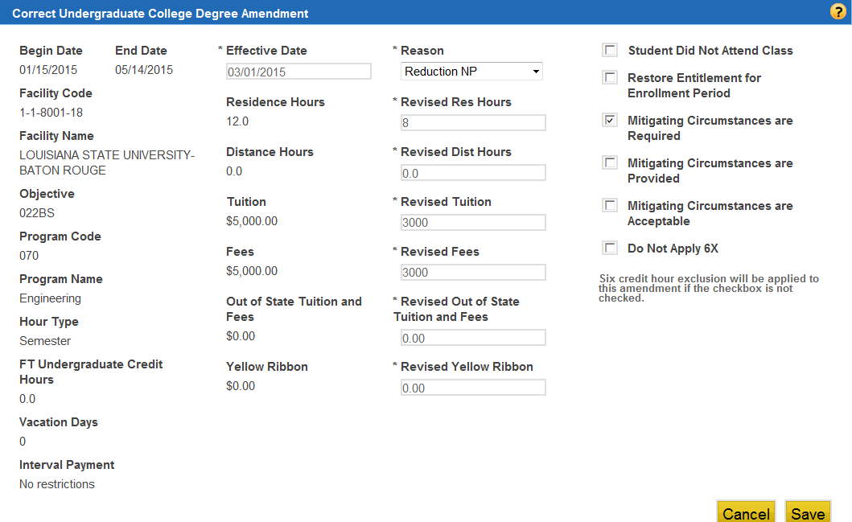
Generating an MITC-1 Letter - Scenario 1
Scenario 1:
Reduction after Drop/Add received for 6 hours or less and the 6-credit hour exclusion is not available.
1
Check MITCs Required
Click Save
2

Slide 44
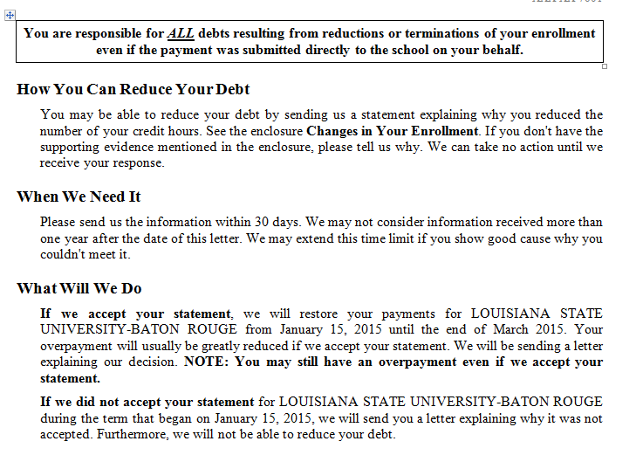
Generating an MITC-1 Letter: Scenario 1

Slide 45
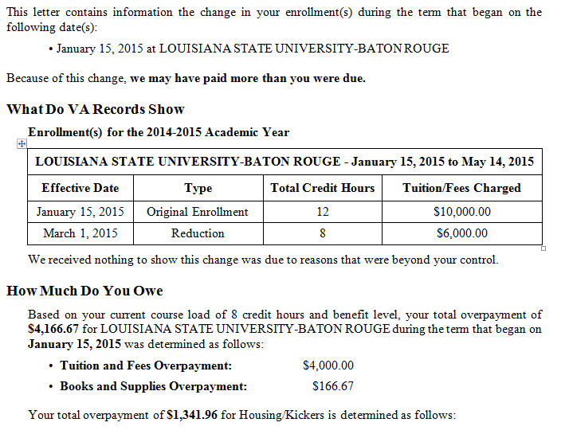
Generating a MITC-1 Letter: Scenario 1 (Continued)
Processing Mitigating Circumstances for Post-9/11 GI Bill Claims

Slide 46
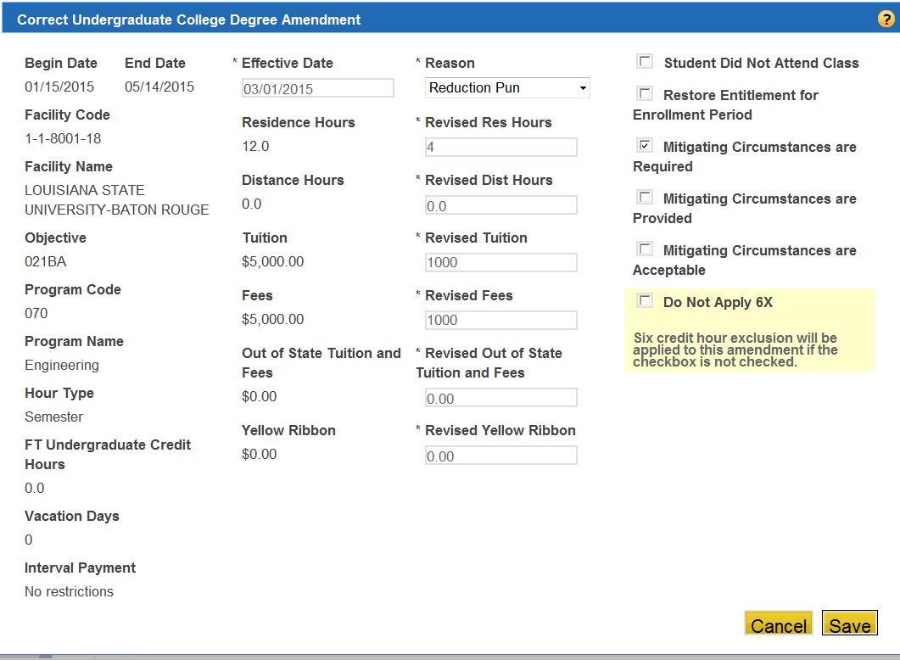
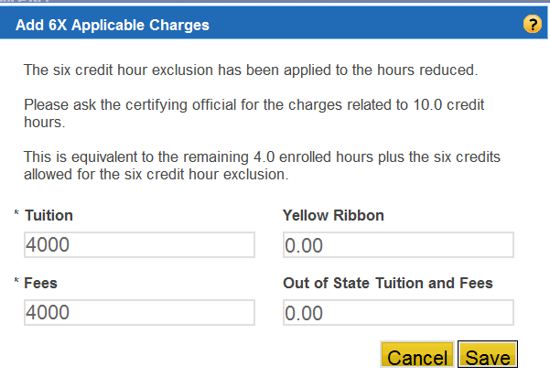
Generating an MITC-1 Letter: Scenario 2
Scenario 2:
Reduction is more than 6 hours and 6x is available.
Updated T&Fs for remaining hours must be entered.
6X placeholder values

Slide 47
Scenario 2 - 6X Applicable Charges (6X Placeholders)
The school’s notification of the change in enrollment will include the charges for the remaining hours after the reduction or termination.
When a change occurs that results in the application of 6X, yet 6X doesn’t cover all of the dropped classes, the VCE must obtain “placeholder” charges by calling the school to request the tuition and fee charges for the most expensive classes covered by the exclusion and the remaining enrolled hours.

Slide 48
Scenario 2 - 6X Applicable Charges (6X Placeholders) (Continued)
The 6X placeholder is the total number of hours an individual is enrolled after the amendment, plus 6 hours.
Click “Add” button to populate 6X Applicable charges screen.
The LTS will not allow Work Products to be authorized without inputting the additional values.

Slide 49
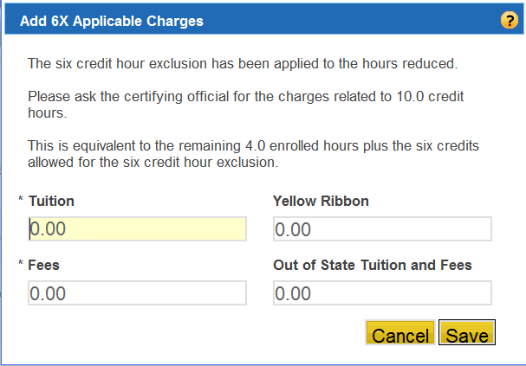
Scenario 2 - 6X Applicable Charges (6X Placeholders) (Continued)
6X Applicable Charges:
The actual charges that represent the sum of the six credit hours (allowed by 6X) and hours enrolled after the amendment.
(VCE must verify amount if not indicated.)
Insert values & Click the “Save” button.

Slide 50
Scenario 2 - 6X Applicable Charges (6X Placeholders) - Examples
6X Applicable Charges:
Example A: Claimant was enrolled in 12 hours, then reduced to 4 hours. VCE will add the total amounts charged for 10 credit hours. (6 protected + 4 remaining hours)
Example B: Claimant was enrolled in 12 hours then terminated. VCE will input the total amounts charged for 6 credit hours. (6 protected + 0 remaining hours)

Slide 51
MITC-1 Letter: Scenario 2 (6X Placeholders)
Excluding the “6X Applicable Charges” placeholders may result in erroneous debts. VCE must verify values due to system defect that allows automation to bypass without inserting values.
Without placeholder values
With placeholder values

Slide 52
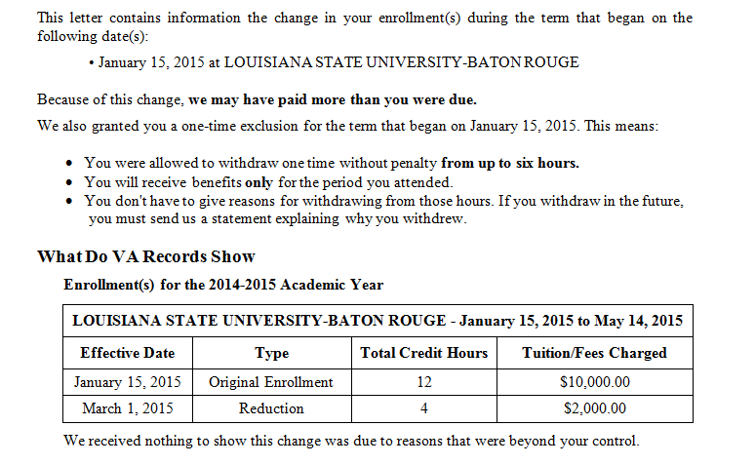
MITC-1 Letter: Scenario 2

Slide 53
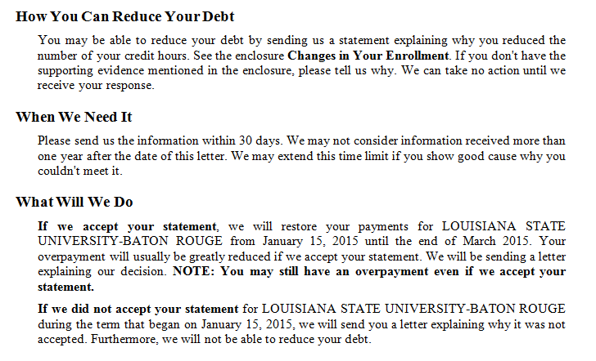
MITC-1 Letter: Scenario 2 (Continued)

Slide 54
MITC-1 Limitations
Due to known formatting and language issues when multiple amendments are processed or reductions are received out of order, VCEs must review and edit all MITC-1 letters, as needed, and include VA Form 4138.
All Work Products should be authorized prior to amending the letter, and all modified LTS letters must be captured into TIMS.

Slide 55
MITC-1 Automation
All MITC-1 letters will require the VCE to review the amendment modal and insert 6X placeholder values when applicable.
The following banner message will display:
“MITIGATING CIRCUMSTANCES 1 LETTER PRODUCED”
Automation will be set to off ramp all MITC letters until functionality has been corrected.

Slide 56
Comprehension Check
Question:
When is the MITC-1 Letter utilized?

Slide 57
MITCs Received but Not Accepted Letter (MITC-2)

Slide 58
Generating an MITC-2 Letter
When necessary, MITCs are requested from the claimant. If received, claims processors must determine if they are acceptable or unacceptable.

Slide 59
MITCs “Are Provided” Box
Check the “MITCs are Provided” box if MITCs are:
Required, and
Have been received
With the change in enrollment or
After development, and
They are not acceptable
If MITC’s are received pursuant to development, do not remove the existing checks in the “Mitigating Circumstances are Required” and “Do Not Apply 6X” boxes, if applicable.

Slide 60
Generating an MITC-2 Letter: Received After Development
Click the “Correction” button to navigate to the Amendment modal.

Slide 61
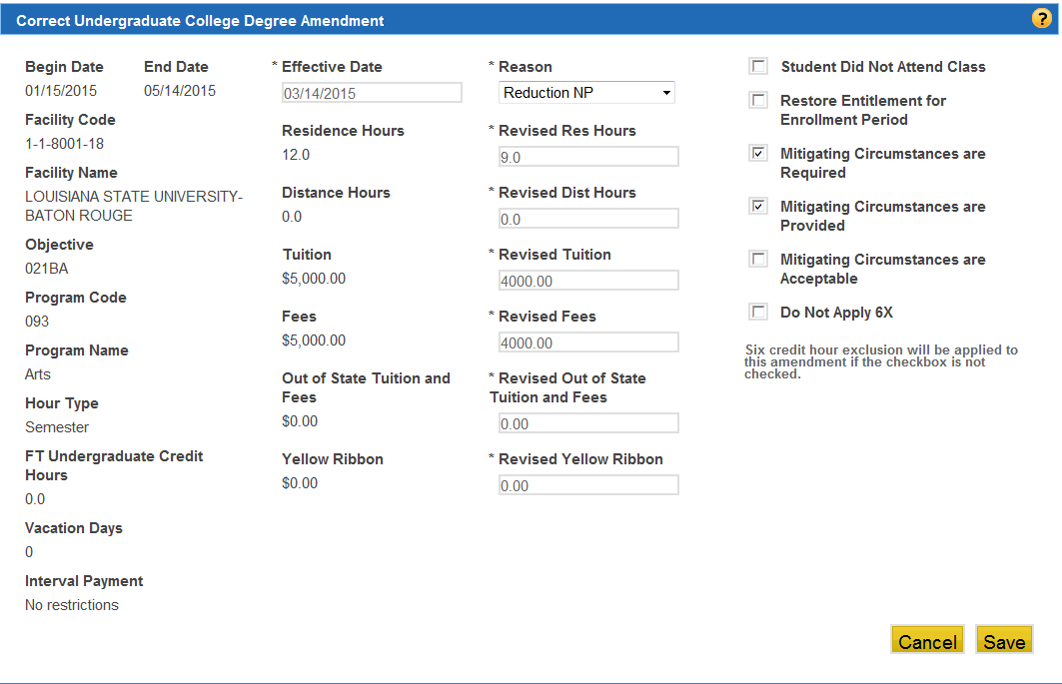
Generating an MITC-2 Letter
Check both the “Required” & “Provided” boxes if received together (or check “Provided” if received after development) and
click the “Save” button.

Slide 62
Generating an MITC-2 Letter (Continued)
Results:
Updated to reflect “Required & Provided”
Click the “Next” button to navigate to the Letters Page.

Slide 63
Generating a MITC-2 Letter (Continued)
Results:
Check the appropriate reason for why the MITCs are not acceptable, and click the “Next” button to navigate to the WP summary page. If the reason is not listed, select the ‘Free text option’. (This field is limited to 1,024 characters.)

Slide 64
Generating a MITC-2 Letter (Continued)
Results: Net Awards will indicate $0 payment and $0 debt for the term.

Slide 65
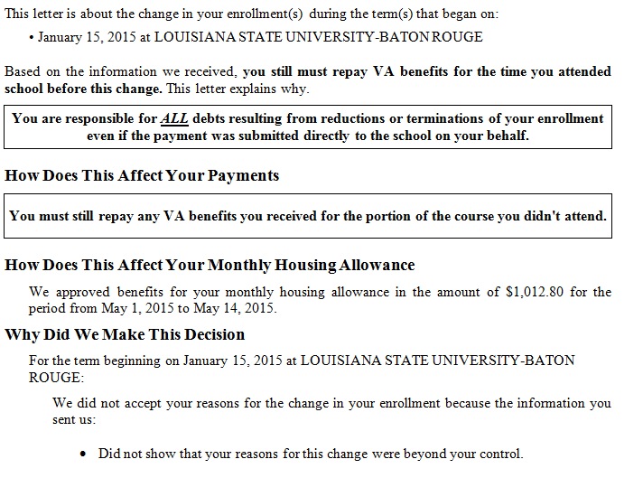
MITC-2 Letter

Slide 66
MITC-2 – Automation
All MITC-2 letters will be off ramped in order to select a reason for not accepting MITCs.
The following banner message will display:
“MITIGATING CIRCUMSTANCES 2 LETTER PRODUCED”
All Work Products should be authorized prior to amending the letter.

Slide 67
Comprehension Check
Question:
When is the MITC-2 Letter utilized?

Slide 68
Mitigating Circumstances Received and Accepted Letter (MITC-3)

Slide 69
Generating an MITC-3 Letter
The MITC-3 letter informs the claimant he/she withdrew from a period enrollment and the mitigating circumstance submitted was acceptable. Therefore, VA will not ask the claimant to repay benefits for the time attended school prior to the reduction/withdrawal.
Note: The claimant will still have to repay any VA benefits received for the portion of the class not attended.

Slide 70
Mitigating Circumstances “Are Acceptable” Box
Check the “Mitigating Circumstances are Acceptable” box if MITCs are:
Required, and
Have been received
With the change in enrollment or
After development, and
They are acceptable
If MITC’s are received pursuant to development, do not remove the existing checks in the “Mitigating Circumstances are Required” and “Do Not Apply 6X” boxes, if applicable.

Slide 71
Generating an MITC-3 Letter
To generate a MITC-3 Letter the follow checkboxes must be selected:
Mitigating Circumstance are Required check box AND
Mitigating Circumstances are Provided check box AND
Mitigating Circumstances are Acceptable check box
Note: The Restore Entitlement for Entitlement Period box will NOT be selected unless the withdrawal was due to a qualifying activation, order to a new duty station, or increase in work as required by law.

Slide 72
Generating a MITC-3 Letter: Received After Development
Click the “Correction” button.

Slide 73
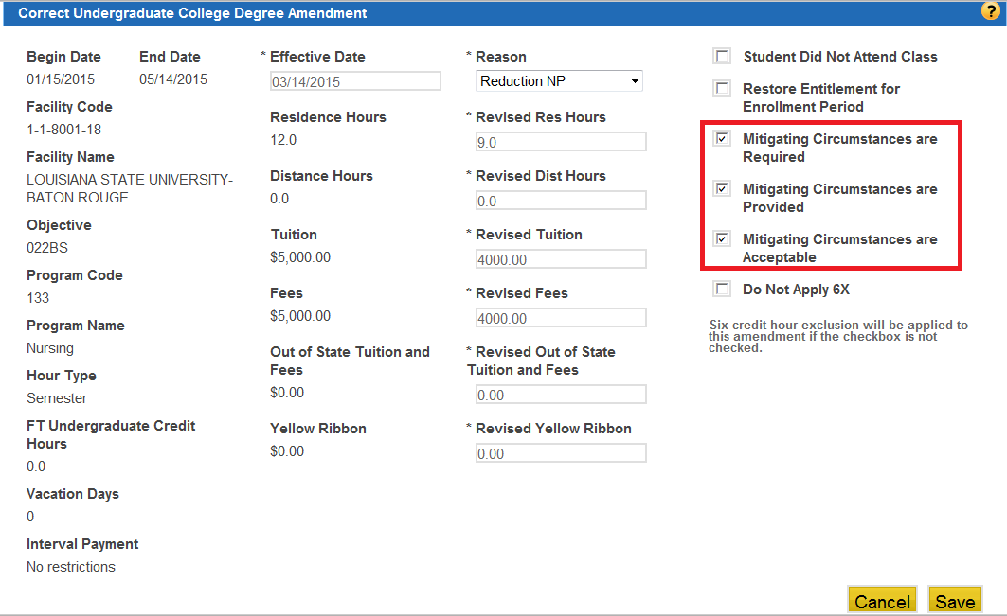
Generating an MITC-3 Letter
Used 6X
Check the “Required,” “Provided,” and “Acceptable” boxes if received together (or check “Provided” and “Acceptable” if received after development) and click the “Save” button.

Slide 74
Generating a MITC-3 Letter (Continued)

Slide 75
Generating an MITC-3 Letter (Continued)
Select one of the 3 Acceptable MITC Reasons or select the “Free text option” to manually type a reason.

Slide 76
Generating an MITC-3 Letter (Continued)
Results:
Work Product indicating a Request for MITCs with LTS Generated Debt amount.
Work Product indicating Acceptable MITCs. LTS reinstated payment to student effective first day of term until reduction date.

Slide 77
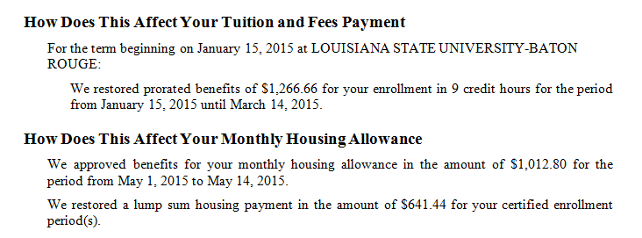
Generating an MITC-3 Letter (Continued)
Suppress the generated MITC-3 Accepted letter.
Indicating Tuition and Fees Payment restored.

Slide 78
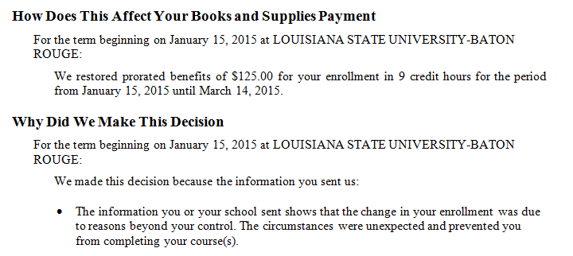
Generating an MITC-3 Letter (Continued)
Indicating Books and Supplies Payment restored.

Slide 79
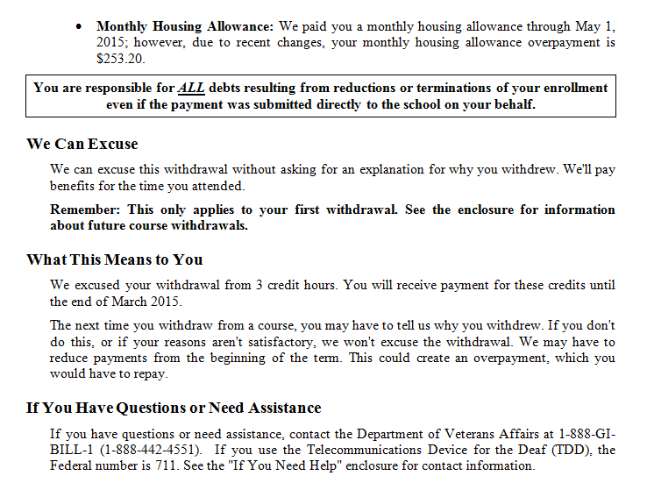
Generating an MITC-3 Letter (Continued)

Slide 80
MITC-3 Letter – Limitations Collection Code
LTS does not automatically collect debts from restored benefit payments when a claimant submits acceptable MITCs before the 30 day due process period.
When acceptable MITCs are received and accepted within the 30 day due process period, you must update collection the code indicator in BDN to allow offset prior to authorization.

Slide 81
MITC-3 Letter – Automation
All MITC-3 letters will be off ramped, requiring VCEs to review.
The following banner message will display:
“MITIGATING CIRCUMSTANCES 3 LETTER PRODUCED”
Note: All Work Products should be authorized prior to amending the letter.

Slide 82
Six Credit Hours Exclusion (6X) Granted for Withdrawal/Termination (MITC-4)

Slide 83
Generating an MITC-4 Letter
When an amendment is added to a term and MITCs are required, LTS will automatically apply 6X if it is available.

Slide 84
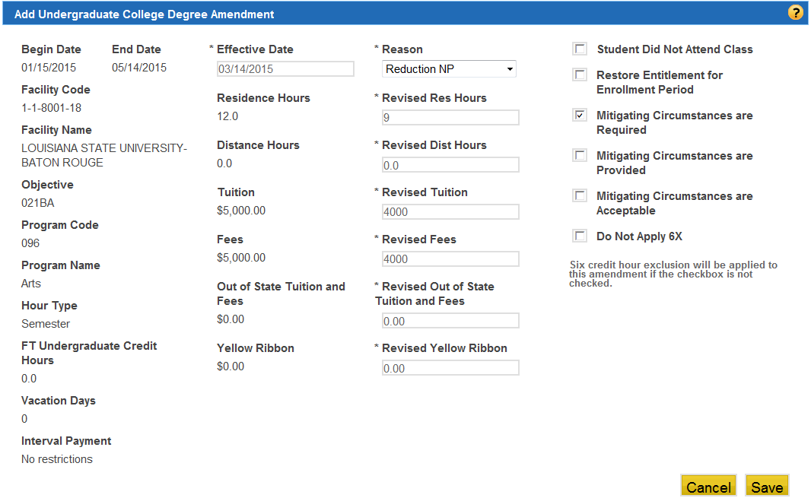
Generating an MITC-4 Letter (Continued)
6x needs to be available to grant the 6x.
Check the BIO screen or enrollment screen to check availability.
In the amendment module select Mitigating Circumstances are Required.
3
Important
1
2

Slide 85
Generating an MITC-4 Letter (Continued)
Important
Letter Page Will Display:

Slide 86
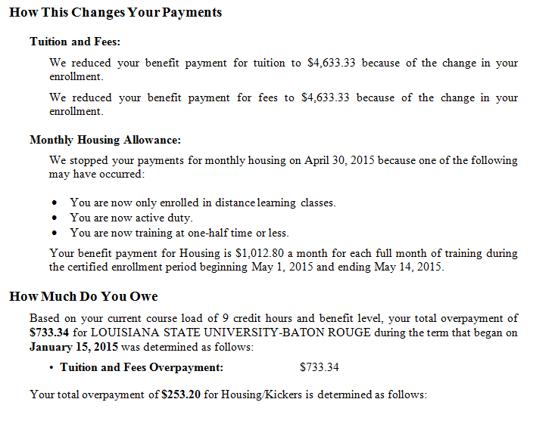
Generating an MITC-4 Letter (Continued)

Slide 87
Generating an MITC-4 Letter (Continued)

Slide 88
MITC-4 Limitations
Increases or reductions prior to the use of 6X will generate the MITC-4 without the proper debts. The letter will be blank in the sections that states “You Owe.” VCEs will need to review and update with appropriate information.
Power of Attorney (POA) will not display on MITC-4 letters, VCEs will need to add this information.

Slide 89
MITC-4 Automation
All MITC-4 letters will be off ramped and require the VCEs to review and update the letter to include missing information (debts and POAs).
The following banner message will display:
“MITIGATING CIRCUMSTANCES 4 LETTER PRODUCED”

Slide 90
Mitigating Circumstances - Scenarios

Slide 91
Summary
You have completed the Processing Mitigating Circumstances for Post 9/11 GI Bill Claims lesson. You should be able to:
Using available references, identify acceptable reasons for adjustments to enrollments, including Mitigating Circumstances (MITCs), with 80% accuracy on the assessment.
Using available references, identify the steps for processing MITCs in the Long Term Solutions (LTS), with 80% accuracy on the assessment.
Using available references, identify how to generate Long Term Solutions (LTS) Notification Letters, with 80% accuracy on the assessment.

Slide 92
Questions?
What questions do you have?

Slide 93
TMS Assessment and Survey
The assessment and survey have been assigned to you in TMS.
The assessment is comprised of multiple choice questions.
The questions are based on the information presented in this lesson.
The assessment should take you approximately 30 minutes.
Be sure to complete both the assessment and the survey in TMS to receive credit for this training.

