Slide 1
Introduction to First Notice of Death (FNOD)
Compensation Service
July 2020

Slide 2
Objectives
Identify an acceptable Veteran Notice of Death (NOD)
Describe the appropriate FNOD notification
Explain the steps to process a FNOD

Slide 3
References
M21-1, Part III, Subpart ii, 8 First Notice of Death (FNOD) Processing

Slide 4
Purpose of Veteran FNOD Processing
FNOD processing establishes or updates a Veteran’s Beneficiary Identification and Records Locator Subsystem (BIRLS) record with the date of the Veteran’s death. It also automatically:
clears and takes end product (EP) credit on any pending issues for compensation and pension benefits for live Veterans and apportionees that the Department of Veterans Affairs (VA) has not already authorized,
discontinues any benefits being paid, and
terminates the power of attorney (POA) of record.
Note: The FNOD process will discontinue an award as of the first day of the month of death (MOD).
Notes:
III.ii.8.A.1.a

Slide 5
Criteria for an Acceptable Veteran FNOD
A FNOD is acceptable if it:
furnishes sufficient information about the Veteran to allow a definite identification of the Veteran’s record
identifies the source of the report of the death.
Exception: If the FNOD is a returned check indicating that the Veteran is deceased, identification of the source of the report of death is not necessary.
There is no requirement that a NOD be in writing or originate with the next of kin.
Notes:
III.ii.8.A.1.b

Slide 6
Criteria for an Acceptable Veteran NOD (cont.)
Examples:
Notice of a Veteran’s death from the Compensation and Pension Record Interchange (CAPRI) is considered an acceptable NOD.
A NOD may originate with a funeral home or other third party.
A report of contact based on a telephone call is an acceptable NOD if the report clearly identifies the Veteran and the caller.
Any claim for burial and/or death benefits.
You can also use a search engine to locate an obituary or do a SSA Inquiry, and upload the evidence to VBMS.
Notes:
III.ii.8.A.1.b

Slide 7
Notice Requirements Associated With Veteran FNOD Processing
In most cases, VA must issue notice of proposed adverse action (due process) to a beneficiary before reducing or discontinuing his/her benefits. The discontinuation of benefits based on receipt of an acceptable NOD is one of the exceptions to this rule.
Although notice of proposed adverse action is not required, contemporaneous notice of the action taken is required if the NOD was obtained:
by way of telephone or personal interview
from an Insurance Service Public Contact Representative, or
through computer matching with another Federal agency, such as the Social Security Administration (SSA).
Notes:
III.ii.8.A.1.d

Slide 8
Notice Requirements Associated With Veteran FNOD Processing (cont.)
An automatic generation and mailing of a contemporaneous notice is sent to the Veteran’s last known address (as it exists in the corporate record), when
there was a running award of Veteran's benefits, and
a spouse is of record on the Veteran's award at the time of the FNOD entry, and
a user selects a Next of Kin letter on the MONTH OF DEATH screen.
If the award has been suspended by the SSA Death Master File notification, a user-generated letter must be sent by the claims processor.
Notes:
III.ii.8.A.1.d

Slide 9
Notifying a Deceased Veteran’s Estate of Benefits to Which Survivors and Others May Be Entitled
When a VA employee processes the NOD and the Veteran has a running award, the employee is presented with the default option of sending a Next of Kin letter on the MONTH OF DEATH screen. If the employee proceeds with this selection, the Hines Information Technology Center (ITC) generates and mails a letter to the Veteran’s estate containing information about survivor benefits to which the Veteran’s survivors and others may be entitled. These benefits include
burial benefits
Survivors Pension
Dependency and Indemnity Compensation (DIC)
accrued, and
educational benefits under 38 U.S.C. Chapter 35.
Notes:
III.ii.8.A.1.e

Slide 10
Benefits Paid to Surviving Spouses Through the FNOD Process
After FNOD processing, the following automated benefits can be awarded to eligible surviving spouses based on information contained in the corporate record:
burial allowance, and
DIC.
The month of death (MOD) payment is also awarded to eligible surviving spouses after a VA employee completes the MONTH OF DEATH screen that automatically appears after FNOD processing is completed.
Note: An automatically generated letter informs the surviving spouse if the burial allowance, DIC, and/or MOD payment are awarded.
Notes:
III.ii.8.A.1.h

Slide 11
Issuing a Presidential Memorial Certificate (PMC) During a FNOD
The Department of Veterans Affairs (VA) may issue a Presidential Memorial Certificate (PMC) to eligible persons to honor the memory and service of
Veterans who received an honorable or general under honorable conditions discharge, and
service members who died while on active military service.

Slide 12
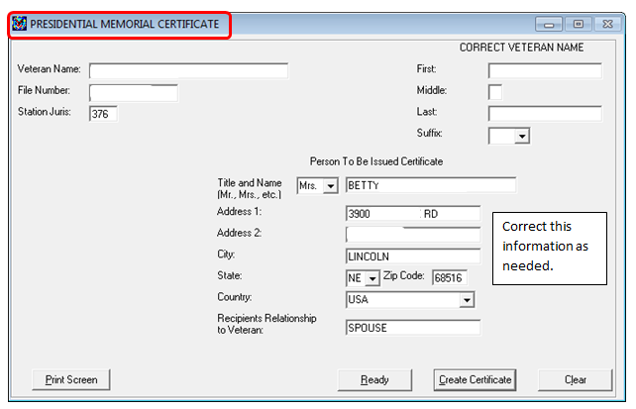
Issuing a PMC During a FNOD
The screen to process a PMC will automatically appear during the FNOD process after the Date of Death and Cause of Death have been entered and updated in SHARE.

Slide 13
Processing a FNOD
Utilize the Manual reference
M21-1 Part III, Subpart ii, 8.B.2.a Veteran FNOD Processing Steps to Include Working With the MOD and Presidential Memorial Certificate Screens,
and follow along as the instructor either demonstrates processing a FNOD or goes over the instructions.

Slide 14
Questions?

