Slide 1
Compensation Service
March 2018
Defense Personnel Records Information Retrieval System

Slide 2
Lesson Objectives
Understand what records are available through DPRIS Web and what must continue to be ordered through PIES
Understand your role and responsibilities as a DPRIS Web User
Become a registered user of DPRIS Web
Become familiar with DPRIS Web Site
2

Slide 3
References
DPRIS Web User Guide:
https://www.dpris.dod.mil/downloads/dpris_user_guide.pdf
3

Slide 4
DPRIS Web Advantages
Through a single secure internet sign-on, allows access to OMPF images contained in some of the Services’ repositories
On average, images are received in less than 48 hours
Many images are received within minutes
4

Slide 5
DPRIS Advantages (cont.)
Provides a standard index of all images contained in each of the Services’ OMPF Systems
Includes a Follow-up Message capability. This enables the user to gain additional information directly from the Services’
action officer (except Army).

Slide 6
VA-Services Interface
Without DPRIS Web
Navy
Marine Corps
Army
Air Force
VA

Slide 7
VA-Services Interface
With DPRIS Web
Navy
Marine Corps
Army
Air Force
DPRIS Web
VA

Slide 8
DPRIS Web Standard OMPF
Document Indexing Scheme

Slide 9
Personnel Records
Available Through DPRIS Web
The Veteran’s OMPF should be available through DPRIS Web if his/her service obligation ended on or after the following dates:
  Army: October 1, 2002*
  Navy: January 1, 1995
  Marine Corp: January 1, 1999
  Air Force: October 1, 2004
There are no Coast Guard records available in DPRIS Web.
*Note: For Army service obligations that ended between October 1, 1994, and September 30, 2002, user should make the DPRIS request as indicated per M21-1 III.iii.2.I.4.a.

Slide 10
VARO/DPRIS Access Organization
Roles and Responsibilities
Communicate with: Managers and DPRIS Web staff via User Assistance Forms
Initiate DPRIS Web requests for military personnel records information
Initiate requests for approved DPRIS Web Standard Reports

Slide 11
Roles & Responsibilities (cont.)
Initiate secure DPRIS Web follow-up messages
Manage own personal DPRIS Web user account information
Access DPRIS Web Information, Help Website Modules, and submit automated User Requests Assistance Forms

Slide 12
Compensation Service
The Registration Process

Slide 13
DPRIS Website
https://www.dpris.dod.mil

Slide 14
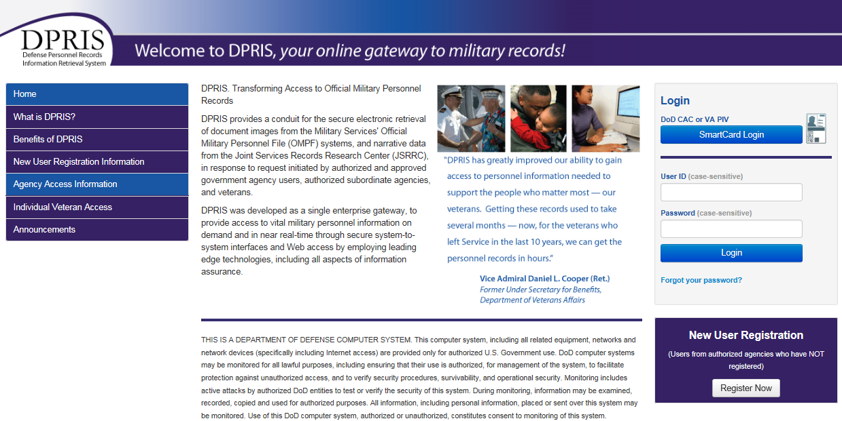
Home Page

Slide 15
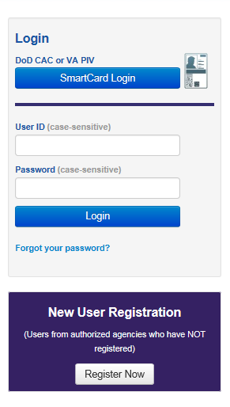
New User Registration

Slide 16
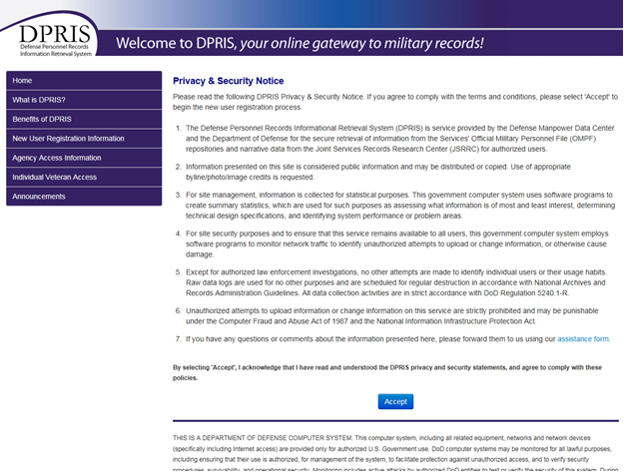
Privacy and Security Statement

Slide 17
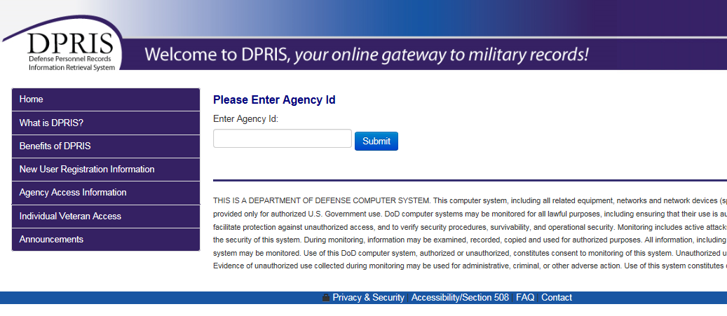
Agency ID Code

Slide 18
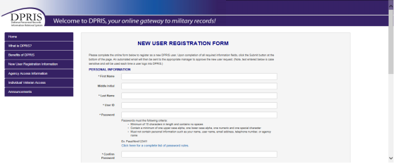
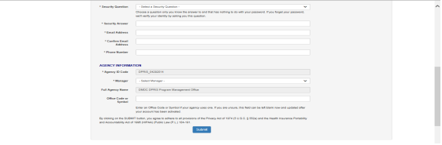
User Registration Form

Slide 19
Compensation Service
User ID and
Strong passwords

Slide 20
User ID
VBA has determined that VARO shall use their VA email address as their DPRIS User ID
First.LastName@va.gov
or
First.LastName1@va.gov

Slide 21
Strong Passwords
Must Have
Must Not Have
Minimum of 15 characters
Minimum of one upper case alpha character
Minimum of one lower case alpha character
Minimum of one numeric character
Minimum of one special character: ! @ # $ % & * ( ) - _ = , . ; : ’ ”
A space...Example: US Gov
Consecutive characters: Example: 123, abc, 654, yxw
Duplicate characters: 11, ee, TT, $$, Aa, 55,$$
Any character used more than 2 times
Alabama

Slide 22
More About Passwords
May not be changed more than once within a 24 hour period
A new password must be different from the last 10 you created
You will be locked out of the system after three consecutive incorrect password entries
Passwords are case sensitive
(Tip: Do not create your password with the “CAPS LOCK” on)

Slide 23
More About Passwords (cont.)
Do not record your password in writing
Do not share your password or accept another user’s password
Do not use something anyone can guess such as names of your spouse, pets, children, or words found in a dictionary

Slide 24
If You Forget Your Password
You will get a message when you have unsuccessfully entered a password and are about to get locked out.
If you get locked out of DPRIS, you must go to your Manager.
Before you get locked out, click on FORGOT PASSWORD on the DPRIS Home Page.
You will be prompted to enter your User ID and email address.

Slide 25
If You Forget Your Password
(cont.)
If both are entered correctly you will be asked your secret question.
  (You selected your secret question when you initially registered.)
You will be sent an email with your password.
The first time you login you must change your password to a new password.
You must create a new password following the password rules.

Slide 26
VARO Agency Identification Code (AIC)
The AIC code will be provided to you by your manager or coach.

Slide 27
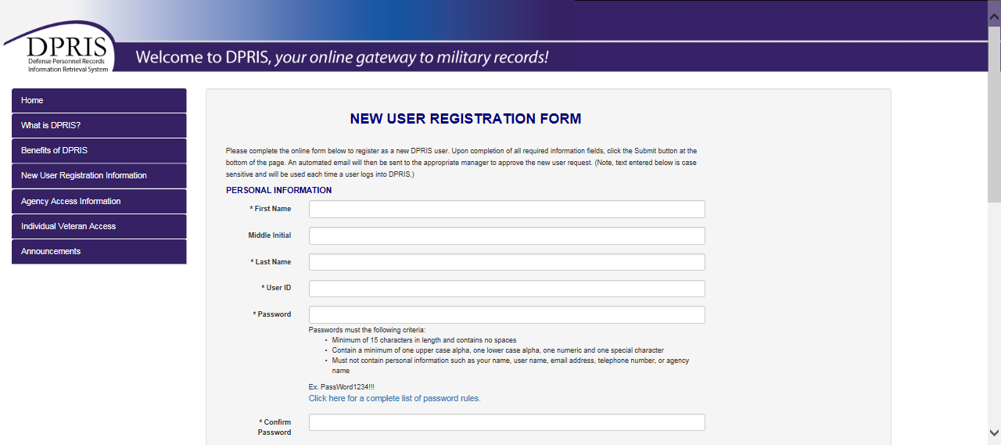
Completing the User Registration Form

Slide 28
Compensation Service
Using DPRIS Web

Slide 29
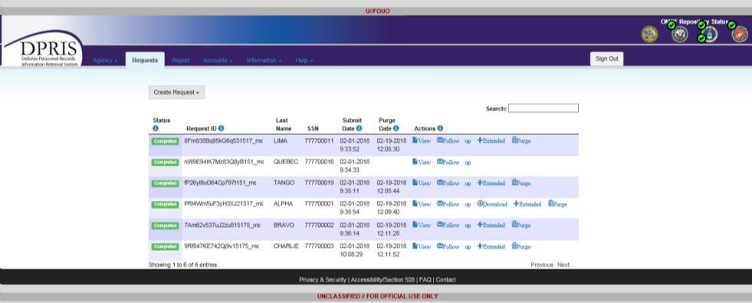
Default Screen after Login

Slide 30
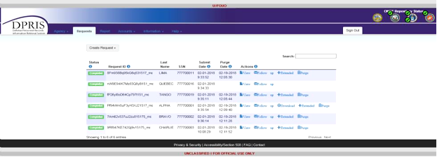
Viewing Requests

Slide 31
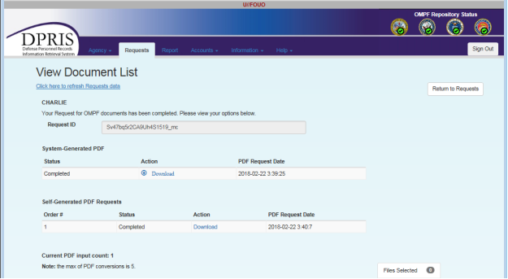
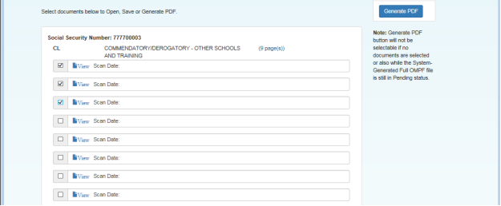
Viewing Responses

Slide 32
Compensation Service
Creating OMPF
and
JSRRC Requests

Slide 33
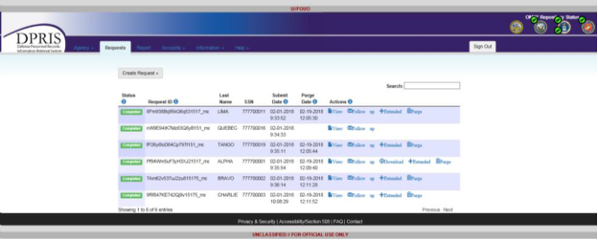
Create Request

Slide 34
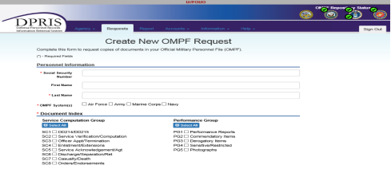
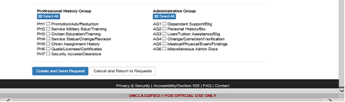
OMPF Request

Slide 35
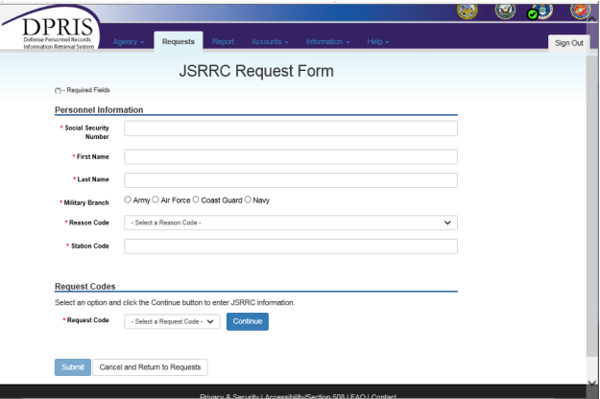
JSRRC Request

Slide 36
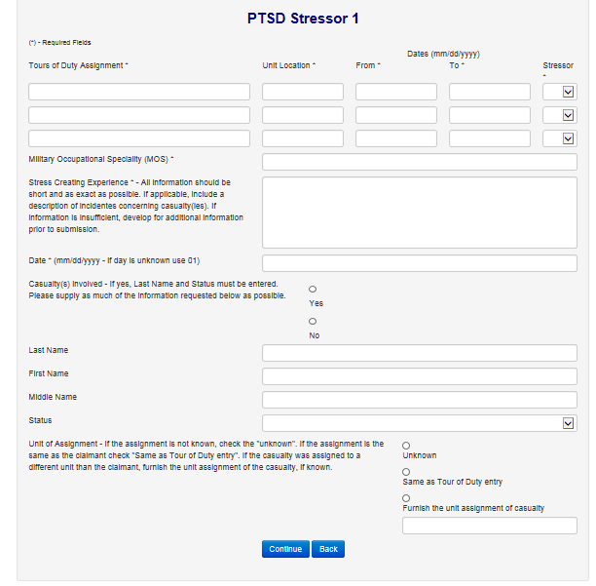
PTSD Stressor Form

Slide 37
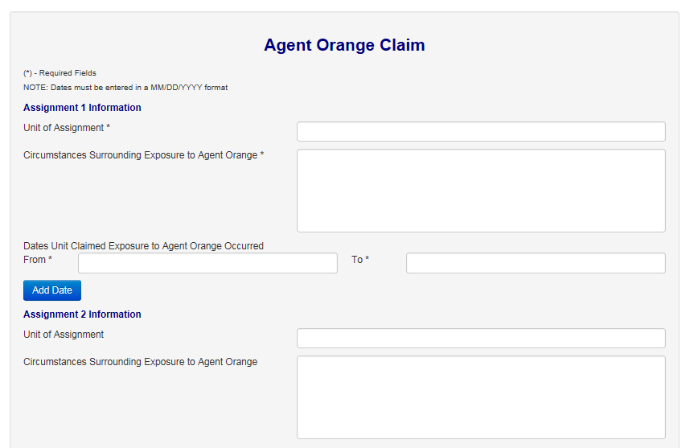
Agent Orange Form

Slide 38
Compensation Service
DPRIS Web Reports

Slide 39
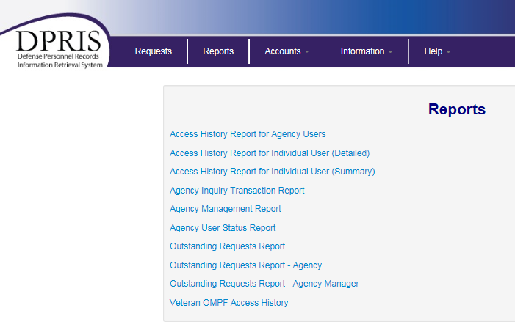
Viewing User Reports

Slide 40
Compensation Service
Account Management

Slide 41
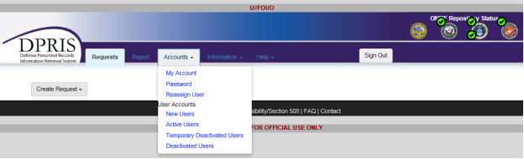
Account Management

Slide 42
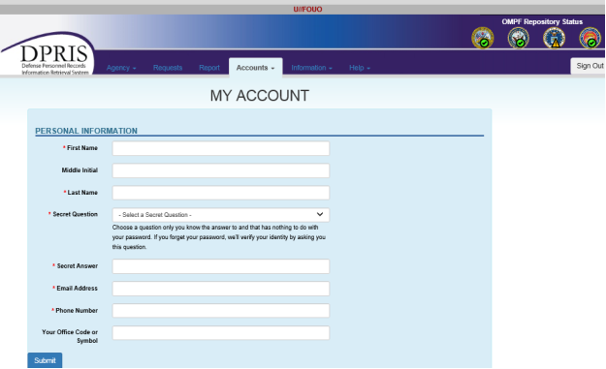
My Account Option

Slide 43
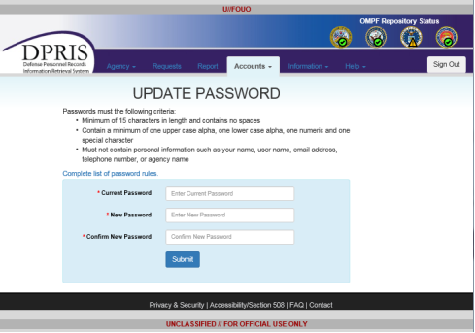
Password Option

Slide 44
Compensation Service
Information Page

Slide 45
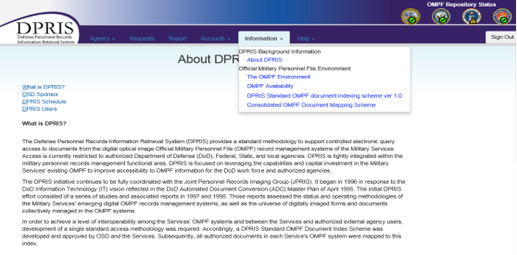
Information Page

Slide 46
Compensation Service
DPRIS WEB HELP

Slide 47
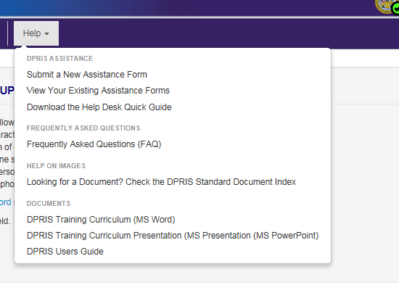
Help Page

Slide 48
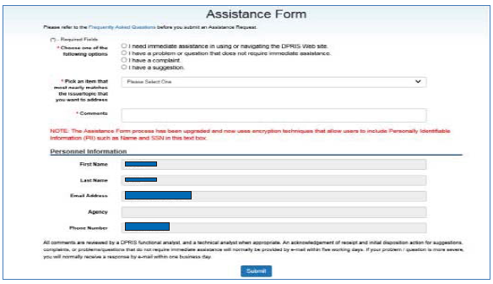
Assistance Form

Slide 49
VBA Central Office Contact
VAVBAWAS/CO/PIES

Slide 50
Review
Review

