Slide 1
Date of Claim
Compensation Service
February 2016

Slide 2
Lesson Objective
Determine the VA Date of Claim (DOC)

Slide 3
References
38 CFR 3.1 (r), Definitions, Date of Receipt
38 CFR 3.155, How to File a Clam
M21-1 Part III,ii,2,B, Claims for Disability Compensation
M21-1 Part III.i.2.A, Introduction to Pre-Discharged Claims
M21-1 Part III.i.4.C, Date Stamp for Claims Submitted Electronically

Slide 4
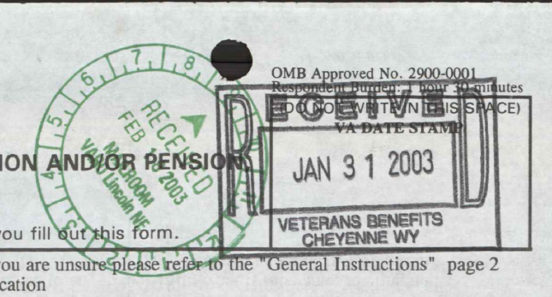
Date of Receipt Stamp
The Date of Receipt is when information or evidence was first received by the Department of Veterans Affairs.
VA requires that each document that is submitted, MUST receive a stamp with the date-of-receipt.
Note: There might be several dates, make sure to locate and use the earliest possible one.

Slide 5
Date of Receipt Stamp, cont’d
Date stamps can be from any VA entity, including but not limited to:
Regional Office (RO), or
Pension Management Center (PMC), or
Veterans Affairs Medical Center (VAMC), or
Records Management Center (RMC), or
VA Claims Intake Center, or
VONAPP Direct Connect (VDC) forms received through eBenefits

Slide 6
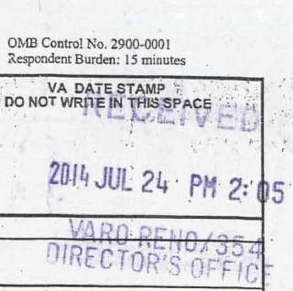
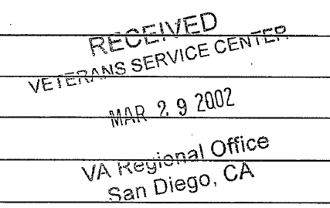
Examples of VA Date of Receipt Stamps

Slide 7
eBenefits
VA Date Of Claim – 11/18/15
VA Date Of Claim – 09/03/2014

Slide 8
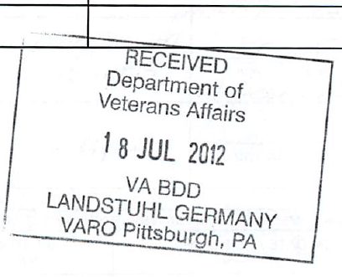
BDD & Quick Start Claims
A Pre-Discharge claim is a claim accepted from a service member who is still on active duty.
BDD and Quick Start dates of claim are the first day after the service member is discharged.

Slide 9
Practical Exercise

Slide 10
Questions

