Slide 1
Compensation Service
February 2016
SHARE-SSA/FOLQ

Slide 2
Objectives
Recognize what the SHARE-SSA/Federal On-Line Query (FOLQ) program is and who has access to it
Perform the inquiry function of the SHARE-SSA/FOLQ program
Apply the information from each SHARE-SSA/FOLQ response screen in order to perform job-related tasks
Interpret SHARE-SSA/FOLQ messages

Slide 3
References
M21-1, Part III, Subpart iii, 3.A.3 – Obtaining Information Through Federal On-Line Query (FOLQ)
M21-1, Part III, Subpart iii, 3.A.4 – VA Requests for Verification of SSA Monthly Payments
SHARE User Guide
SSA Federal On-Line Query (FOLQ) System User Guide

Slide 4
What is Federal On-Line Query (FOLQ)?
Read-only, person-specific, real-time query developed by the Social Security Administration (SSA)
Data provided:
Verification of Social Security numbers (SSNs)
Title II, Retirement, Survivors, and Disability Insurance data
Title XVI, Supplemental Security Income (SSI) data
A limited payment history file

Slide 5
Accessing FOLQ
SSA Inquiry command in SHARE
Information provided
Vital information (SSN, address, and/or date of birth & death)
SSA benefit information
Unearned income history
SSI information

Slide 6
Accessing FOLQ
Authorized access – VSRs, Insurance Specialists & Technicians, and their supervisors
Restrictions for users:
SSA data is 3rd party information (due process necessary for any adverse action based on this info)
SSA data is under the restrictions of the Privacy Act
Data use is for the purpose of verifying information in order to process claims
All users must sign a Certificate of Understanding annually
Security – VBA has an audit system which runs behind the transactions being processed

Slide 7
SSA Inquiry Command
Allows VA to access information provided by SSA through FOLQ
Monthly SSA benefits paid to a Veteran, Veteran’s spouse/surviving spouse, Veteran’s surviving children, Veteran’s parents
User must provide
Name
SSN
Date of birth
VA file number
Reason for inquiry

Slide 8
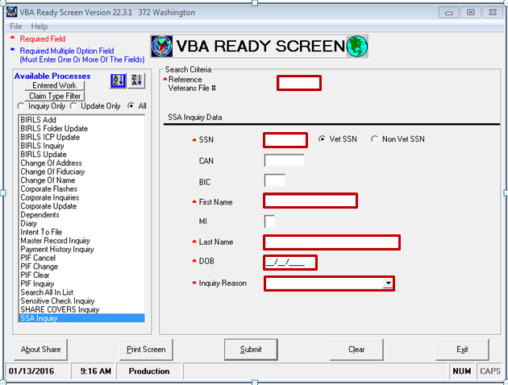
SHARE – SSA Inquiry
The SSA Inquiry command in SHARE allows users to input necessary information in order to verify:
Benefits
Date of death
Personal information
Social Security Number

Slide 9
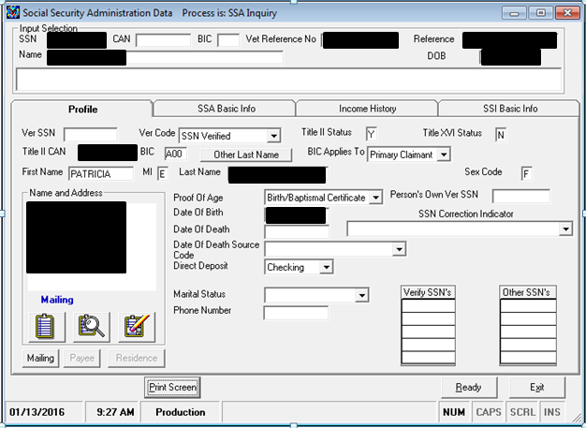
Response Screen – Profile
The first screen displayed after a successful SSA inquiry
Displays Veteran (and dependents) personal information
Unsuccessful inquiries will result in an SSA message. See FOLQ User Guide

Slide 10
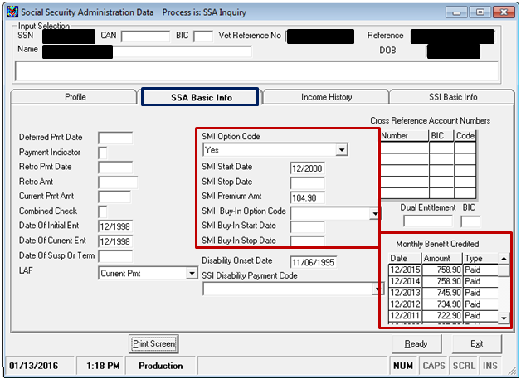
Response Screen – SSA Basic Info
SMI fields – Supplemental Medical Insurance – part B (SMIB), deducted from monthly SSA benefits
The beneficiary is not paying “out of pocket” for SMIB if the SMI Buy-In Option Code is one of the following:
Pd by Private Party
Pd by 3rd Party
Pd by State
Pd by Civil Service

Slide 11
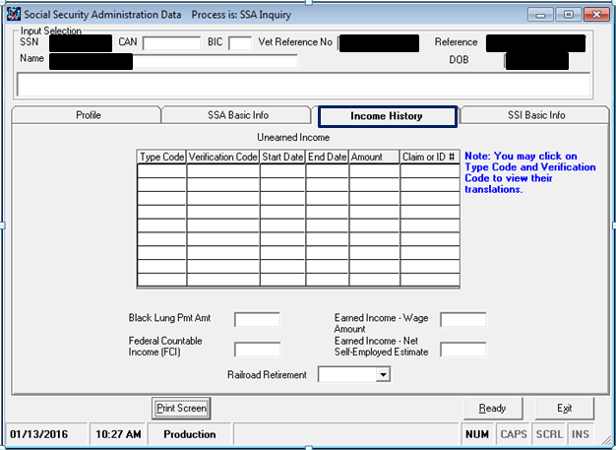
Response Screen – Income History
Displays information about veteran's income type, amount, start & end dates, Federal Countable Income (FCI), and earned amount.
Current month’s amount of unearned income after all exclusions
Other potential earned income entitlements

Slide 12
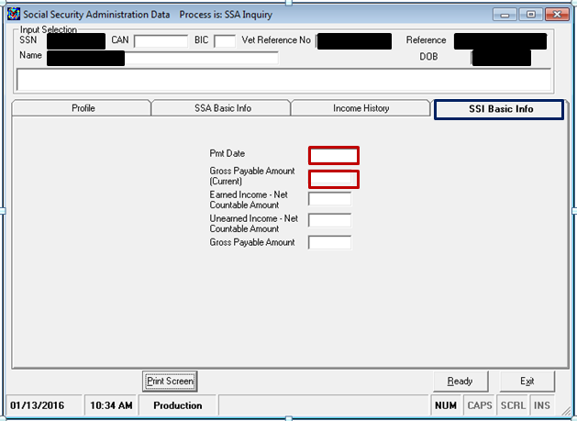
Response Screen – SSI Basic Info
This screen will show if the beneficiary is receiving SSI benefits. SSI benefits do not affect NSC Pension, as this benefit is public assistance. These are unearned incomes and gross payable amounts.

Slide 13
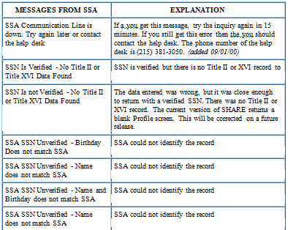
Messages from SSA (FOLQ User Guide)

Slide 14
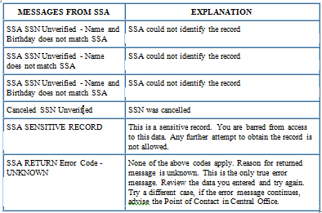
Messages from SSA (FOLQ User Guide)

Slide 15
Summary
VA employees requiring the information to perform job duties may access the SHARE-SSA/FOLQ system
SHARE-SSA/FOLQ information may be accessed by using the “SSA Inquiry” function in SHARE
Information found on the SHARE-SSA/FOLQ response screens is applied to job-related tasks – SHARE User Guide & FOLQ User Guide provide explanations of each screen
SHARE-SSA/FOLQ messages from SSA can be found in the FOLQ User Guide

Slide 16
Practical Exercise

Slide 17
Review of Practical Exercise

