Slide 1

Invoice Payment Processing System
Introduction, Logging In & Troubleshooting
Briefed by:
VR&E Service
Updated: August 12, 2019
Notes:
Hello and welcome to the e-Invoicing and e-Authorizations training also known as the Invoice Payment Processing or IPPS Training. My name is Lamoyd Figures, VR&E Service Training Specialist and assisting me with training today are Dale Sagotsky, VR&E Service Training Specialist, Alison Rosen, VR&E Service Senior Program Analyst, Sharon Hirsch, VR&E Service Policy Analyst, and Shelly Sawyer, Enterprise Support Section Supervisor of Financial Operation Service. The IPPS application is one of the many VR&E Service Modernization initiatives and we are excited to deploy this application. IPPS will reduce the administrative time, becoming a force multiplier by allowing VRCs/CMs with more time to provide direct services to Veterans/SMs.
Today’s training will include several modules that consist of virtual instructor-led components with actual IPPS demonstrations.
You will receive the specific names of the facilities to place on the authorizations, more information on the IPPS Pilot Check-in Calls, and the IPPS User Guide prior to September 3, 2019. The IPPS User Guide will serve as a vital resource for you when you are processing and/or certifying awards, adding users, viewing reports and any other IPPS functions that you maybe performing based upon your user-specific role, which we will discuss later in this training.
So without further adieu, lets go over our training objectives for the first training module.

Slide 2

Learning Objectives
After this training you will be able to:
Describe the intent and purpose of e-Invoicing and e-Authorizations A.K.A Invoice Payment Processing System (IPPS)
Describe the steps taken to access IPPS
Describe the steps to begin “troubleshooting” solutions
Notes:
After this training you will be able to:
Describe the intent and purpose of e-Invoicing and e-Authorizations (IPPS)
Describe and obtain the steps to access IPPS
Describe the steps to begin “troubleshooting” solutions

Slide 3

Invoice Payment Processing System (IPPS)
IPPS is an electronic invoicing platform which will enable vendors to receive electronic authorizations from and submit electronic invoices directly to VR&E.
Once implemented, this capability will standardize and streamline the invoice payment process, and significantly reduce the amount of time needed to receive, process, and pay vendors.
Projected Savings:
90% savings in payment processing time by implementing IPPS.
Notes:
IPPS is an electronic invoicing platform which will enable vendors to receive electronic authorizations from and submit electronic invoices directly to VR&E.
Once implemented, this capability will standardize and streamline the invoice payment process, and significantly reduce the amount of time needed to receive, process, and pay vendors.
Projected Savings:
90% savings in payment processing time by implementing IPPS.

Slide 4

IPPS Workflow (At-A-Glance)
IPPS
VRC creates Authorization in IPPS
IPPS sends Authorization to Tungsten
Vendor/Facility
Vendor locates created Authorization in Tungsten
Vendor creates Invoice
Tungsten sends Invoice to IPPS for certification and payment
IPPS
VRC reviews Invoice
VRC approves and certifies for payment
Note: School Certifying Official certifies training hours in VA-ONCE (nothing changes with this process)
Vendor is notified via email
Notes:
So, who creates the authorization? The VRC creates an authorization in IPPS, which replaces the use of the 28-1905 in CWINRS. Tungsten receives the authorization and notifies the Vendor via email that there is a pending invoice authorization. As a reminder, the Tungsten Network enables VR&E and its Vendor/Facility to submit, process and approve invoices online. Vendors or Facilities can use their Tungsten Accounting System to submit invoices electronically to VR&E. Therefore the invoice is then created in the Tungsten Network by the Vendor/Facility based on the authorization and sent back to IPPS for the VRC to certify and pay via IPPS.
Let’s take a look further at accessing IPPS.
IPPS is a web-based system that recognizes your credentials if you’re logged into your government computer with your Personal Identity Verification (PIV) card. A separate user name or password is not required.

Slide 5
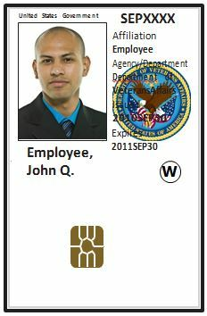
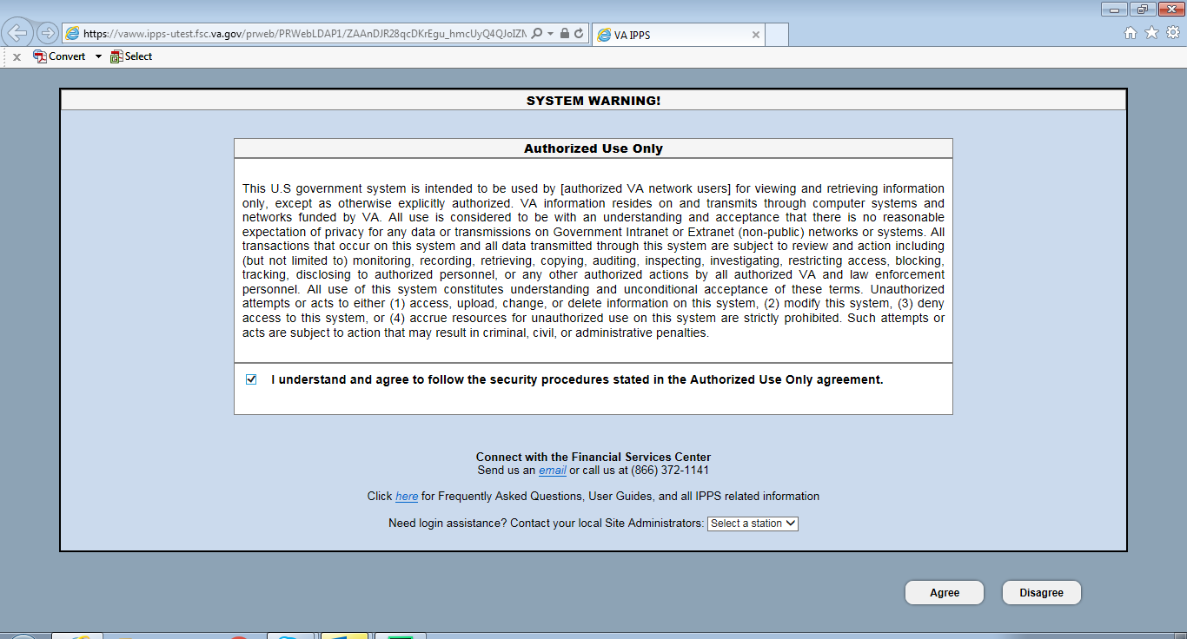
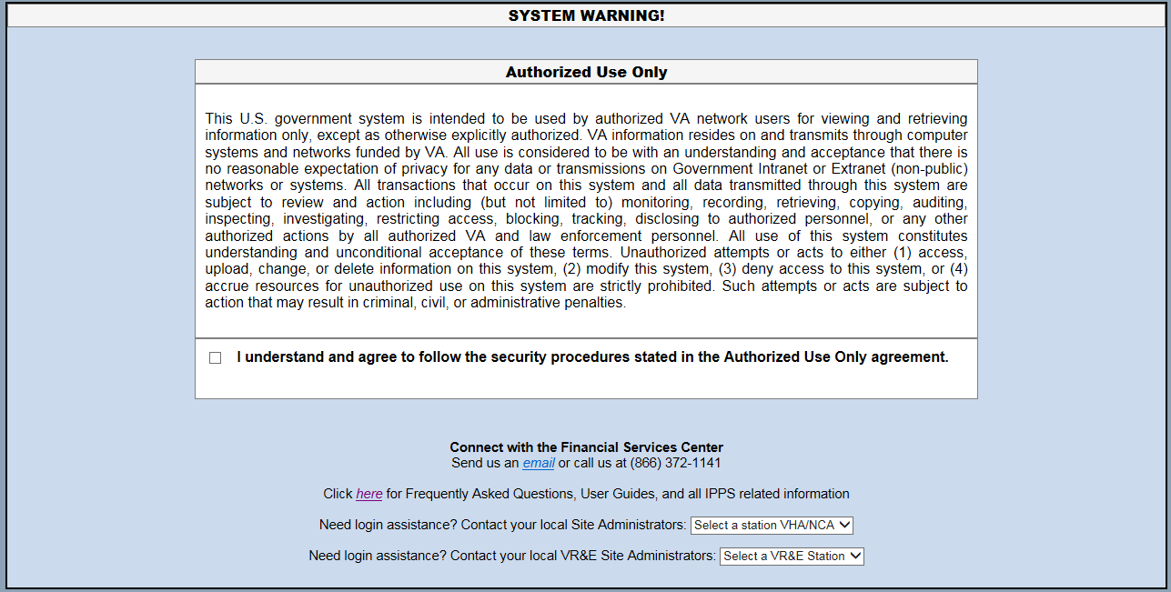
Log In
1
Log in using your PIV card
2
Go to https://vaww.ipps.fsc.va.gov/
3
Click the checkbox at the bottom of the window and select “Agree”
Notes:
To log into IPPS:
Log into your government computer using your PIV card.
Go to https://vaww.ipps.fsc.va.gov/ .
a. An Authorized Use Only warning displays verifying that you understand the security procedures stated above .
NOTE: If you receive a message saying you are using an unsupported browser, we will address this error in the Troubleshooting Turning Compatibility Settings Off section.
b. Click the checkbox at the bottom of the window and select Agree.
Please note: Access is granted with a provisional 90-day activity window. If you do not log into IPPS within a 90-day period, your access to the application is removed and you won’t be able to log in. To regain access, see Error! Reference source not found.
After a few seconds, the IPPS application displays. The interface appears differently based on your role.

Slide 6
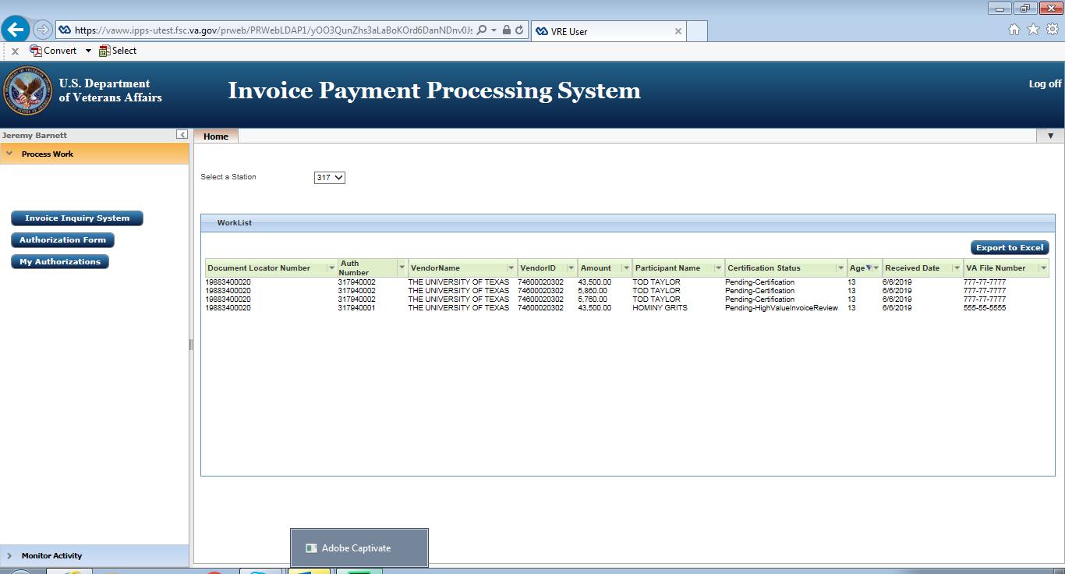
Screen Components (General)
1. Title Bar
2. Navigation Bar
3. Workspace
Notes:
After a few seconds of logging in successfully, the IPPS application displays. The interface appears differently based on your role.
When you log into the system, your screen will typically display several components.
The contents of each screen component depend upon the role you are assigned as indicated earlier, we will provide a brief overview of the various roles in an upcoming slide. The screenshot displayed on the slide is for a VR&E Supervisor.
No matter what screen or role that you are assigned, upon logging in your screen will have the following general graphic user interface or layout:
Title Bar
Navigation Bar
Workspace
Now that we have displayed the general graphic user interface, let’s move on to the proper way to exit out of IPPS.

Slide 7
Exiting
1
Notes:
Exiting IPPS
1. To log off the IPPS application and prevent a possible error, click Log Off at the top right-hand side of the screen.
Note, if you don’t log off the application, the old session may be stored in cache so that it produces an error when you try to log in again. To fix this error, see Error When Logging In

Slide 8
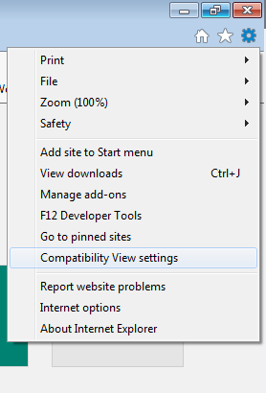
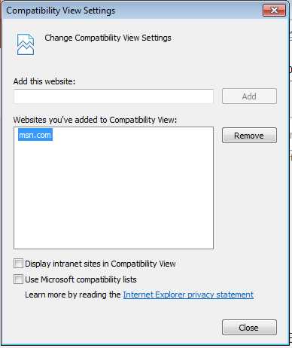
Troubleshooting
Unsupported Browser Error Message (Log In)
Turn Compatibility Setting Off
1
Select the “Tools Widget”
Select any websites and click “Remove”
3
2
Select the “Compatibility View Settings”
4
Clear all checkboxes
5
Select “Close” to automatically refresh IPPS and load the entry screen
Notes:
Now we will discuss some troubleshooting steps for those who may experience issues logging in and/or exiting IPPS.
It is important to mention that IPPS is compatible with Internet Explorer 11 (IE 11) and your compatibility settings should be blank Note, IPPS is not compatible with not Google Chrome, Mozilla, Fire Fox or iOS for Apple computers. If your compatibility settings are turned on, you’ll receive an error message saying you are using an unsupported browser.
Let’s walkthrough the steps of turning your Internet Explorer 11 compatibility settings off.
To turn compatibility settings off:
From Internet Explorer, go to the tools widget.
Select Compatibility View Settings and the Compatibility View Settings window displays.
If any websites are listed in the Compatibility View area, select them and click Remove.
If any checkboxes are checked, clear them.
Select Close to refresh IPPS and load the entry screen.

Slide 9
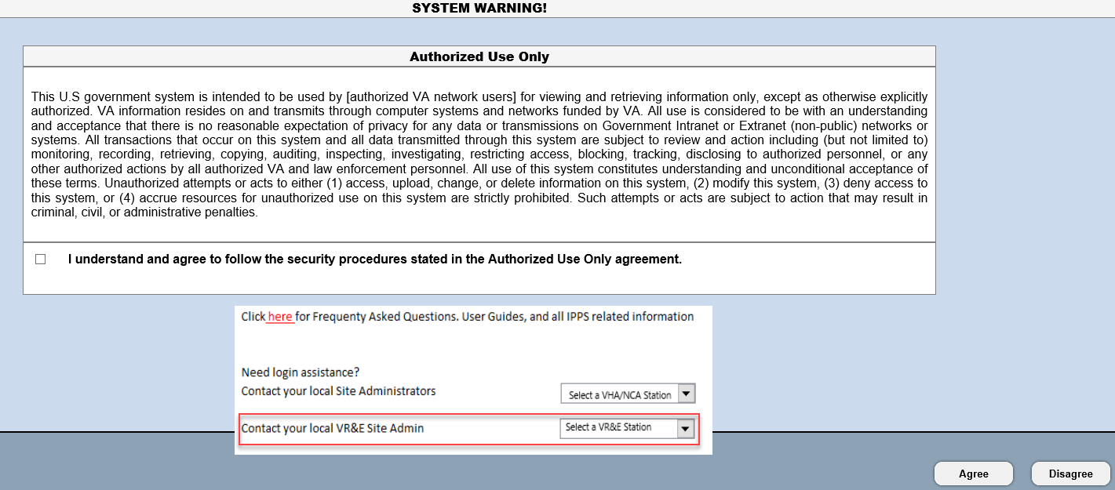
Troubleshooting
User or Access Issues
Contact your Site Administrator
1
Go to https://vaww.ipps.fsc.va.gov/
2
Go to the “Contact your local VR&E Site Admin” and click the drop-down.
3
Find your station and a list of site admins is displayed
Notes:
If you are trying to access the IPPS application and you continue to experience log-in errors or issues, as indicated by the “You do not have access to this application” you will need to contact your local IPPS site administrator.
To find out who your local IPPS administrator is:
Go to https://vaww.ipps.fsc.va.gov/ and an Authorized Use warning displays.
Select your station from the dropdown list under Contact your local VR&E Site Admin.
A list of site administrators displays for your station.
3. Find your Station’s Site Administrator and use the contact information to notify them for assistance.
Note: All users should know that access is granted with a provisional 90-day activity window. If you do not log into IPPS within a 90-day period, your account is deactivated. To reactive the account, please contact your Site Administrator.

Slide 10
Pilot Support
For VR&E IPPS support, please attend or contact the following:
IPPS Pilot Users Check In Calls
Fridays at 2:00 PM ET
Starting September 6th
Invitations to Pilot Users provided
E-mail: vafscenterprisesupport@va.gov
Telephone: 866-372-1141
Notes:
If you should experience any issues or have any questions during the IPPS Pilot, please attend the upcoming IPPS Check-In Calls that will be held on September 6th and every Friday at 2:00 pm ET. Note further information regarding these weekly support calls will be released prior to September 3rd.
You may also contact IPPS Pilot Support by email, using the email address indicated on the slide or by calling the telephone number indicated on the slide as a second inquiry method. Using one of these methods will ensure your inquiry or comment is routed to the appropriate personnel.

Slide 11
Invoice Payment Processing System
User Roles
Briefed by:
VR&E Service
Updated: August 12, 2019
Notes:
Now let’s take a dive into the IPPS User Roles. As mentioned earlier, your assigned role determines your functionality or ability to access and process certain IPPS features. We will discuss the specific roles in depth in the upcoming slides. Let’s state our objectives.

Slide 12
Learning Objectives
After this training you will be able to:
Identify the various roles in IPPS
Identify the functions associated with each role in IPPS
Notes:
After this training you will be able to:
Identify the various roles in IPPS
Identify the functions associated with each role in IPPS

Slide 13
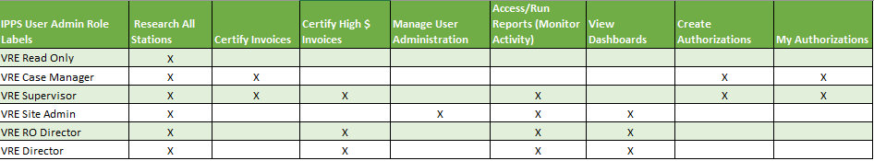
VR&E Roles in the IPPS Application
IPPS User Role Matrix
A user can only be assigned one role at a time.
Notes:
Now let’s discuss the various VR&E specific roles in the IPPS application. This is an overview of the various roles and the associated specific functions that can be performed in IPPS. This portion of the training, will simply provide just a brief overview of the roles.
Note: A user can only be assigned one role at a time.
VRE Read Only (Support Services Division and all other IPPS Users)
VRE Read Only has access to the following functionality:
Research using the Invoice Inquiry System (IIS)
Note, the IIS enables IPPS users to search for the status and details of invoices based on specific search criteria. The search is restrictive to the station(s) you are assigned access to. We will discuss the IIS research capabilities later in this training.
2. Case Manager
The Case Manager is responsible for creating an authorization for services to a Service Provider on behalf of a Participant. Though a Case Manager can recommend approval for high dollar invoices, these invoices must be routed to the Supervisor for recommendation or final approval.
A Case Manager has access to the following functionality:
Research using the Invoice Inquiry System
Create an Authorization Form
View or cancel their own authorizations - My Authorizations
Certify Low Dollar Invoices
3. Supervisor
The Supervisor can create an authorization for services to a Service Provider on behalf of a Participant. Though a Supervisor can recommend approval for high dollar invoices, these invoices must be routed to another Supervisor or RO Director for recommendation or final approval.
A Supervisor has access to the following functionality:
Research using the Invoice Inquiry System
Create an Authorization Form
Access and run reports - My Authorizations
Certify Low Dollar Invoices
Certify High Dollar Invoices
4. VRE Regional Office (RO) Director
The main function of RO Director in IPPS is to certify high dollar/cost invoices. The RO Director has access to:
Research using the Invoice Inquiry System
Certify high dollar/cost invoices - High Dollar Invoices
Access Dashboard – Invoice Inquiry System
5. Director
The main function of the Director in IPPS is to certify high dollar invoices. The Director has access to:
Research using the Invoice Inquiry System
Certify high dollar invoices - High Dollar Invoices
Access Dashboard – Invoice Inquiry System
6. Site Administrator
The function of the Site Administrator (Site Admin) is to manage users. If you lose access, want to change roles, or require reassignment of authorizations when a case manager is out of the office for an extended period of time, like for a vacation, the Site Administrator is the point of contact.
Site Admins have access to:
Change roles, assign stations, reactivate or delete users – User Administration
Research using the Invoice Inquiry System
Access Dashboard – Invoice Inquiry System

Slide 14
Invoice Payment Processing System
Functionality: Authorizations
Briefed by:
VR&E Service
Updated: August 12, 2019
Notes:
The Authorization form is created in IPPS so that Service Providers can invoice for services rendered.

Slide 15
Learning Objective(s)
After this training you will be able to:
Provide instructions on how to create an authorization
Notes:
After this training you will be able to:
Provide instructions on how to create an authorization

Slide 16
VR&E Roles in the IPPS Application
Authorization Roles
A user can only be assigned one role at a time.
Notes:
Now let’s discuss the various VR&E specific roles in the IPPS application as it relates to the authorization function.
Users who have this functionality are the Case Manager and VRE Supervisor.
1. Case Manager
The Case Manager is responsible for creating an authorization for services to a Service Provider on behalf of a Participant.
Though a Case Manager can recommend approval for high cost invoices, these invoices must be routed to the Supervisor for recommendation or final approval.
2. Supervisor
The Supervisor can create an authorization for services to a Service Provider on behalf of a Participant. Though a Supervisor can recommend approval for high dollar invoices, these invoices must be routed to another Supervisor or RO Director for recommendation or final approval.

Slide 17
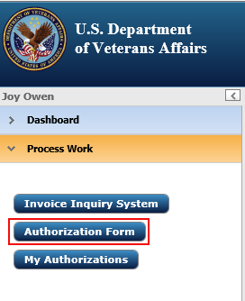
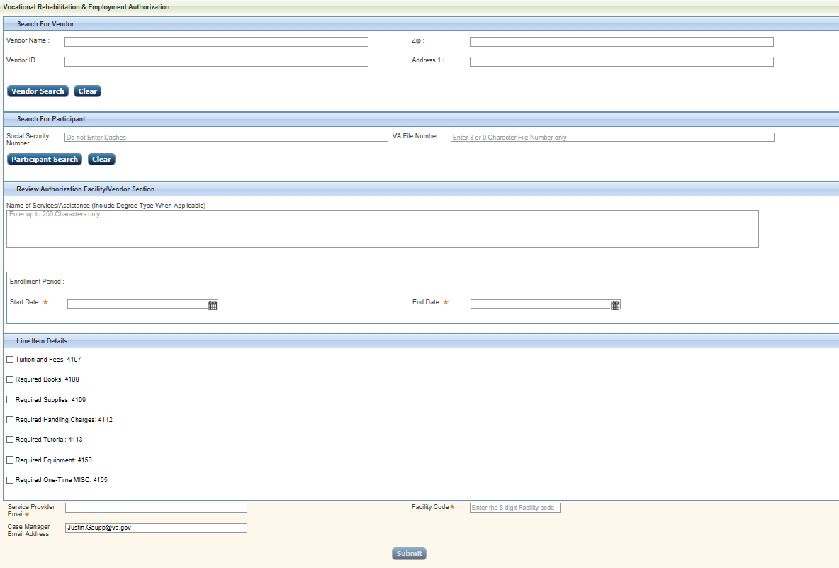
Create an Authorization
1
To create an authorization, select the “Authorization Form” button
Authorization Form
Notes:
To create an authorization, select the Authorization Form button.
Note: The level of your access determines the selections available in the navigation bar.
Upon clicking, the Authorization Form button, the Authorization form displays.

Slide 18
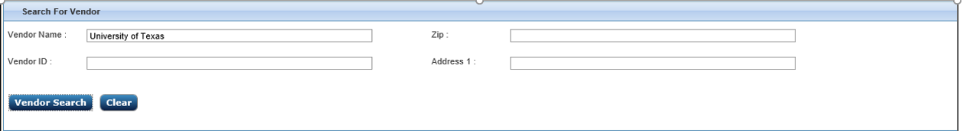
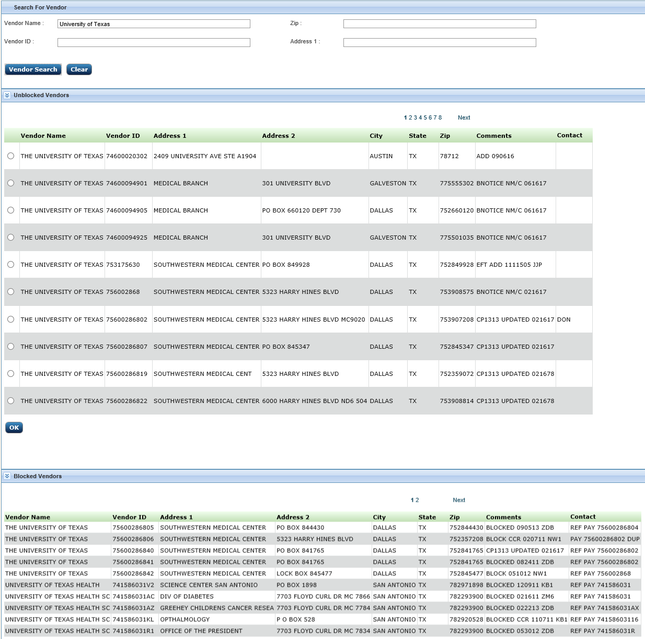
Search for a Vendor/Facility
2
Enter one or more fields in the “Search For Vendor” Form
3
Click “Vendor Search”
Notes:
Now let’s identify the steps needed to search for a vendor.
This search area is used to locate the service provider that will receive an authorization to provide services to a Participant. You can search for a vendor based on:
Vendor Name
Vendor ID, which is the same as the Vendor’s Tax ID
Vendor Zip Code
Vendor Address
To complete a vendor search:
Enter one or more fields, and
Click Vendor Search.

Slide 19
Search for a Vendor/Facility cont’d
Double Chevron Icons
Unblocked Vendors
Blocked Vendors
Notes:
The search returns blocked and unblocked vendors. Expand or minimize each section by clicking the double chevrons to the left of the column. Information in the comments section of blocked vendors may point you to the correct unblocked vendor. You can only perform authorizations on unblocked vendors.

Slide 20
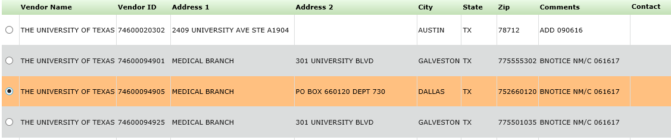

Search for a Vendor/Facility
4
To authorize services for a vendor, click the radio button next to it
5
Click “OK”
6
Vendor details are populated in the “Selected Vendor Details” field
Notes:
4. From Unblocked Vendors, click the radio button next to the vendor you are authorizing services to.
5. Click OK.
6. Vendor details are populated in the Selected Vendor Details area.
Note, a Vendor must be selected to submit the authorization; otherwise an error message displays on the screen. If you can not find the vendor you are searching for contact VAFSCEnterpriseSupport@va.gov

Slide 21
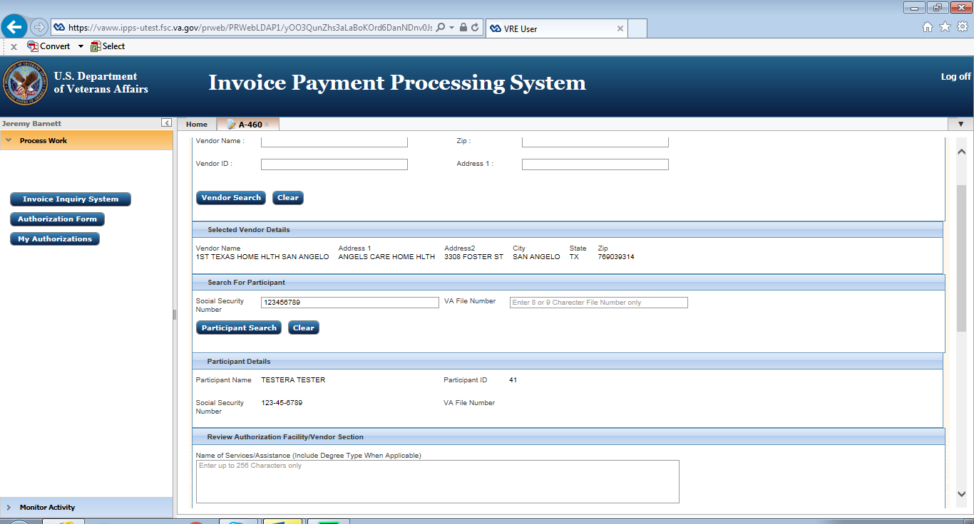
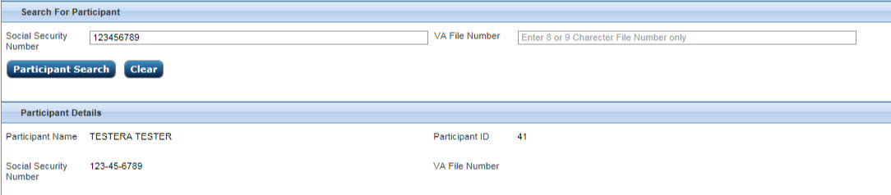
Search for Participant
1
On the Search for Participant pod, enter the Participant’s Social Security Number and/or VA File Number
2
Click “Participant Search”
3
Verify the Participant’s information in the “Participant Details” field
Notes:
After selecting the correct vendor/facility, you must search for the correct participant, which in this case is the Veteran/SM. So this search is used to locate the Veteran/SM that will receive the services by the Vendor that you just selected in the previous steps.
You can search for a participant based on the social security number (with no dashes or spaces or the VA File Number (with no special characters).
Enter one or more of these fields and click Participant Search.
The Participants information is displayed in the Participant Details section, verify this information.
Note: A participant must be selected to submit the authorization; otherwise an error message displays on the screen.

Slide 22
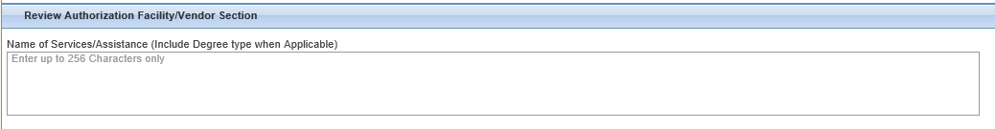
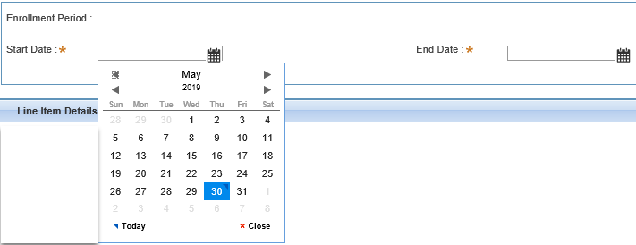

Review Authorization Facility/Vendor
1
In the “Review Authorization Facility/Vendor Section”, enter the Name of Services/Assistance field
2
In the “Review Authorization Facility/Vendor Section”, click the calendar icon to the right to enter the Start/End Date of the Authorization
Select the dates of the Enrollment Period on this calendar
Note: The End Date cannot be more than one year from the Start Date
Notes:
After searching and selecting a facility and participant, you must review the authorization. This section provides further information on the vendor or facility. The following fields are provided in this area:
Name of Services/Assistance
Facility/Vendor Enrollment Period
Enter information into the Name of Services/Assistance field as required. This includes degree type when applicable.
Then use the calendar icon to the right of the Start Date/End Date to select the enrollment period.
Note: The End Date can not be more that one year from the Start Date on the authorization.

Slide 23
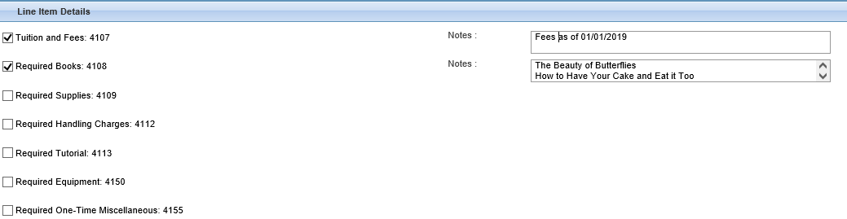
Line Item Details
1
Click the checkbox next to the Line Item(s) that are being funded (authorized)
2
Optional Notes field displays to the right of all checked Line Item(s) for additional specificities, such as dollar limits or specific books or supplies
Notes:
The next section on the Authorization page is the Line Item Details section. The Line Item Details are the approved goods/services that VBA is funding. Note: In order to submit the Authorization Form, at least one line item must be selected, if not an error message will appear on the screen.
To select the approved goods/services that VBA is funding do the following:
Click the checkbox next to the Line Item(s) that are being funded.
Line Item(s) listed in IPPS are the following:
Tuition and Fees
Required Books
Required Supplies
Required Handling Charges
Required Tutorial
Required Equipment
Required One-Time Misc
An Optional Notes field displays to the right of all checked line items for additional specificities, such as limiting a dollar amount on supplies.

Slide 24
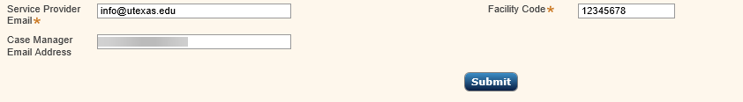
Authorization Fields
1
Provide the Service Provider/Vendor Email Address
2
Provide the Case Manager Email Address
3
4
Click “Submit”
Provide the Facility Code
Notes:
The fields at the bottom of the authorization form include:
Service Provider Email – the email address for the Service Provider point of contact (POC). Upon selecting Submit, the email address entered here receives the New Authorization Notification email from IPPS.
Case Manager Email Address – the authorizing case manager. The Case Manager Email Address field is auto-populated. The field is still editable to allow for an alternative VA POC.
Facility Code – 8-digit code assigned to the facility (What if you cant find this?) You can use CWINRS to find the Facility Codes and enter them here in IPPS or you can locate the Facility Code by looking at the printed or generated 28-1905. In a future instance, hopefully the Facility Codes will be automatically imported from Web Enable Approval Management System or WEAMS. In the interim, we encourage users/stations to create a local spreadsheet that lists the facility codes for the services providers.
Enter information into all required fields marked with an asterisk and click the Submit button.

Slide 25
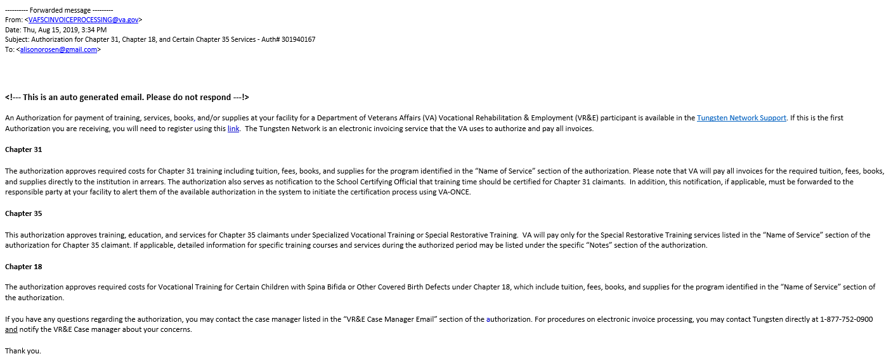
Auto-generated Email
Notes:
Upon completing the required fields at the bottom of the Authorization Form and clicking the Submit button, the authorization is created and the following email is generated and sent to the Service Provider/Vendor.
Note, only a Case Manager or Supervisor can submit an authorization and if any required fields have not been filled, you will receive an error message. If you receive an error message, click OK, then make appropriate corrections, and click the Submit button again.

Slide 26
Invoice Payment Processing System
Functionality: My Authorizations
Briefed by:
VR&E Service
Updated: August 12, 2019
Notes:
Now let’s move to the My Authorizations function. This function allows you to view the details surrounding the authorizations that you have created. It also allows the option to cancel an authorization after it has been submitted.

Slide 27
Learning Objectives
After this training you will be able to:
Access the My Authorizations Module
Cancel an Authorization
View a PDF of an Authorization
Notes:
After this training you will be able to:
Access the My Authorizations Module
Cancel an Authorization
View a PDF of an Authorization

Slide 28
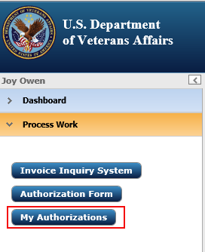
My Authorizations
1
Click “Process Work” from the Navigation Menu
2
Click the “My Authorizations” button
3
A list of your Authorizations is displayed in the Workspace entitled My Authorizations Report
Notes:
Now let’s go over the steps of how to view your authorizations:
Click Process Work from the Navigation Menu.
Click My Authorizations from the left navigation bar.
A list of your Authorizations is displayed in the workspace entitled My Authorizations Report.

Slide 29
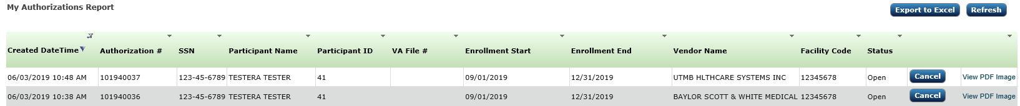
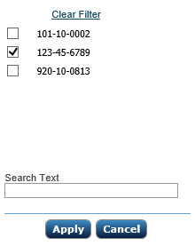
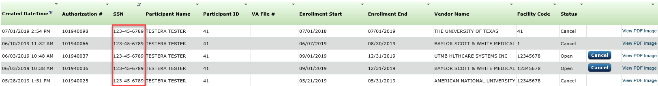
Filtering Authorizations
1
Select the dropdown arrow for the column you want to filter
2
In the list option window, select the checkbox option you want to filter by
3
4
Click “Apply”
Only authorizations containing that option displays
Notes:
Now let’s discuss how you can filter your authorizations in the My Authorizations Report workspace.
To filter authorizations:
From My Authorizations Report, select the dropdown arrow for the column you want to filter by. A list of information displays specific to that column.
In this example, we are filtering social security numbers. Select the option you want to filter by.
Click Apply.
Only authorizations containing that option will display.

Slide 30
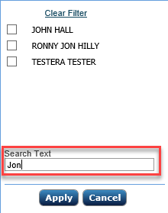
Searching the Authorization Report
1
Select the dropdown arrow for the column you want to filter
4
2
Enter the text you want to search for in the “Search Text” field
Click “Clear Filter” to clear the filter and return to the Authorizations Report
3
Click “Apply”
Notes:
Searching throughout the Authorization Report is very similar to filtering,
Except after you select the dropdown arrow for the column that you want to search and the dropdown list displays.
Enter the text you want to search for in the Search Text field.
Click Apply and the report is filtered by your search text.
Note, if you are in a filter and you want to cancel the filter, you can clear the filter and return to the complete list of authorizations by clicking Clear Filter.

Slide 31
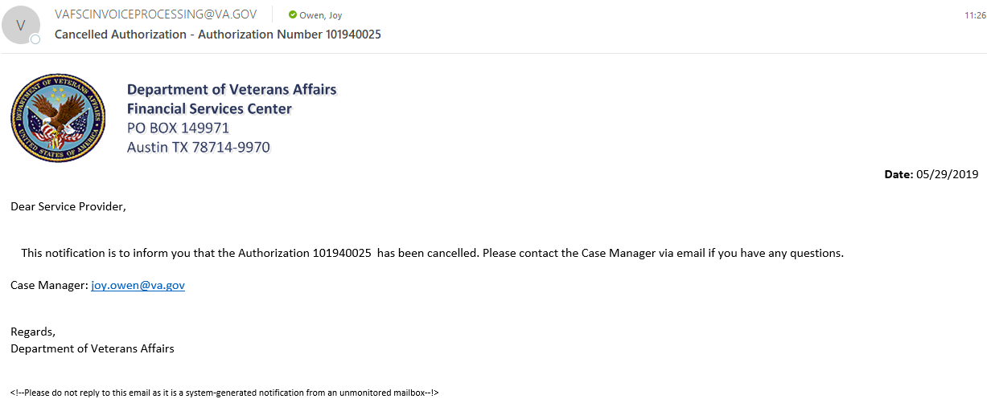
Cancelling an Authorization
1
Locate the Authorization and click the “Cancel” button
2
Authorization row turns orange and the status is changed to “Cancel”
3
An auto-generated email is sent to the Service Provider/Vendor
Notes:
Now let’s discuss canceling an authorization invoice. From the My Authorizations Workspace, the Supervisor and Case Manager roles are the only roles that can cancel authorizations and remember, you can only cancel your own authorizations.
In order to cancel your authorization:
Find the Authorization that you would like to cancel and click the Cancel button.
You will then see that the authorization row will turn orange and the Status changes from Open to Cancel.
In addition to the status changing to Cancel, an auto-generated email will be sent to the Service Provider.

Slide 32
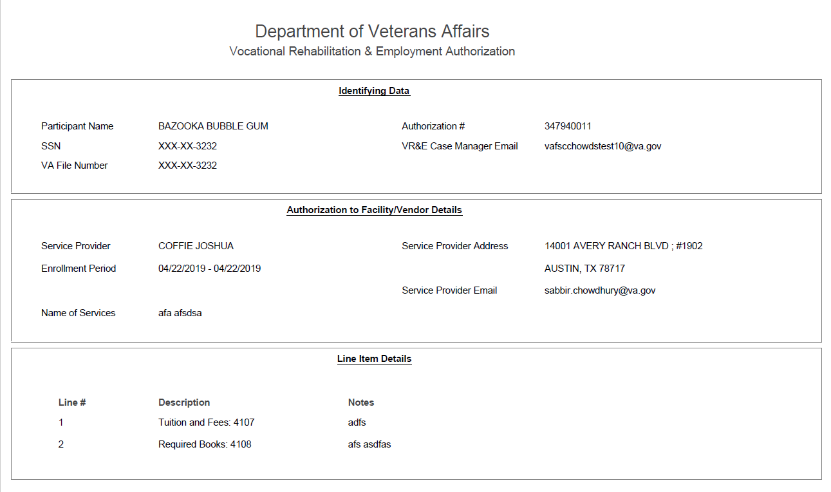
Viewing a PDF of an Authorization
Locate the Authorization to view and then click “View PDF Image” (hyperlink)
1
2
The PDF displays in a separate window
Notes:
Now after you create an authorization and you would like to view it. In order to view a PDF of an authorization you must:
1. Complete steps in My Authorizations to open the My Authorizations Report. These steps were described on the previous slides in this section.
a. Click the View PDF Image link for the PDF you want to view from the My Authorizations Report workspace.
2. The PDF displays in a separate window.

Slide 33
Refreshing the Screen
Click the “Refresh” button to update the screen contents
1
Notes:
If the Refresh button displays, you can click it to update the screen contents to be the most current.

Slide 34
Invoice Payment Processing System
Functionality: Certifying Invoices
Briefed by:
VR&E Service
Updated: August 12, 2019
Notes:
Now we will cover how to certify invoices. Certification occurs when the facility/service provider creates the invoice and we are notified via email or by looking in our work list that an invoice is ready to process. Let’s start off by identifying our objectives.

Slide 35
Learning Objectives
After this training you will be able to:
Identify the User Roles that can certify invoices
Certify a Low Dollar Invoice
Certify a High Dollar Invoice
Notes:
After this training you will be able to:
Identify the User Roles that can certify invoices
Certify a Low Dollar Invoice
Certify a High Dollar Invoice

Slide 36
VR&E Roles in the IPPS Application
IPPS User Role Matrix
A user can only be assigned one role at a time.
Notes:
Now let’s discuss the various VR&E specific roles in the IPPS application as it relates to certifying invoices. This is an overview of the various roles and the associated specific functions that are performed in the certification of invoices.
The roles that can certify invoices include:
Case Manager – low dollar invoices
Supervisor – low dollar invoices and high dollar invoices
The roles that can approve invoices include:
Supervisor – low dollar invoices and high dollar invoices
RO Director and Director – high dollar invoices

Slide 37
Invoice Certification Routes
Low Dollar Invoices
High Dollar Invoices
Invoice
Approved
Invoice is Paid
Refuse
Back to Service Provider
Invoice
Recommend Approval
Supervisor
Refuse
Back to Service Provider
Approved
Recommend Approval
Invoice is Paid
RO Director
Return to Reviewer
Refuse
Back to Original Reviewer
Back to Service Provider
Notes:
Certification routes the invoice one of several ways:
If the invoice certification is recommended for approval, it goes to the next higher role in the process for approval.
If the invoice certification is not recommended for approval, it goes back to the reviewer.
If approval is given for the invoice certification, the invoice is paid.
If refusal is given for the invoice certification, the invoice is not processed and the vendor/service provider is notified via email.
The amount of the invoice determines the approval path it must take, and which selections are seen by the approver (either approve/refuse or recommend approve/refuse).
For instance, for a Low Dollar Invoice, the CM receives and approves the invoice and the invoice is paid. If the CM refuses the invoice, the invoice is then routed back to the service provider with an explanation.
For a High Dollar Invoice, the CM receives and approves an invoice, but since it is above the dollar threshold, the CM has to recommend approval of the invoice. The high dollar invoice then goes to the Supervisor, who then will either Approve; Recommend Approval if it is above the Supervisor’s dollar threshold; Refuse the invoice and send it back to the service provider; or Return to Reviewer to send the invoice to the original reviewer.
These are just two examples of the routes that certification invoices may take. We will discuss the Dollar Thresholds on the next slide.

Slide 38
Dollar Thresholds
IPPS Low Dollar Thresholds
IPPS Role | Thresholds for Books | Thresholds for Supplies | Thresholds for Tuition Payments
Case Manager | ≤$5,000 | ≤$5,000 | ≤$25,000
Supervisor | <$5,000 | <$5,000 | <$25,000
IPPS High Dollar Thresholds
IPPS Role | Thresholds for Books | Thresholds for Supplies | Thresholds for Tuition Payments
Supervisor | ≥$5,000 but ≤ $10,000 | ≥$5,000 but ≤ $10,000 | ≥$25,000 but ≤ $50,000
RO Director | >$10,000 but ≤ $15,000 | >$10,000 but ≤ $15,000 | >$50,000 but ≤ $100,000
VR&E Service Director | >$15,000 | >$15,000 | >$100,000
Notes:
The amount of the subtotal per Budget Object Code (BOC) determines the approval path for tuition, books and supplies. It also determines which selections are seen by the approver (either approve/refuse or recommend approve/refuse).
Each invoice works its way upward through the system. When a user submits an invoice for approval, the system looks at two things:
Has the threshold for the invoice line item been met or exceeded?
Which role is next in the line for approval?
Low Dollar invoices do not require as many approval levels as high-dollar invoices.
The slide indicates the dollar thresholds for the two types of invoices to give you an idea of the approvals required:
Let’s give a couple examples:
Example 1: If an invoice comes in for books that exceeds $15,000, the Supervisor can recommend approval, then the RO Director can recommend approval, but the Director has the final approval.
Example 2: If an invoice comes in for books for $6,000, the Supervisor provides the final approval and does not go to the next level.
Please note the high cost memo is different from the IPPS Dollar Thresholds. The High Cost Memo is completed during plan development and relates to the total cost of tuition, books, fees and supplies per calendar year when cost exceed $25,000. Please continue to follow guidance in M28R.IV.C.1.04.b.3.

Slide 39
Invoice Payment Processing System
Functionality: Low Dollar Invoices
Briefed by:
VR&E Service
Updated: August 12, 2019
Notes:
As a reminder, only the Case Manager or Supervisor approves low dollar invoices. To process a low-dollar invoice, complete steps in the next sections.

Slide 40

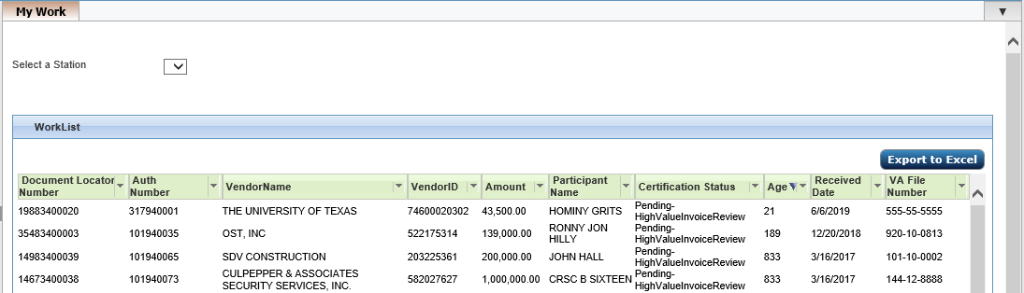
Opening an Invoice
1
Log into IPPS (discussed earlier) and the “My Work” tab displays in the Workspace
2
Select the station
3
Double-click on the invoice you want to process
Notes:
To process low dollar invoices:
1. Log into IPPS.
The Case Manager or Supervisor My Work tab displays.
2. If you have access to multiple stations, select the station for which you are processing invoices.
3. Double-click on the invoice you want to process.

Slide 41
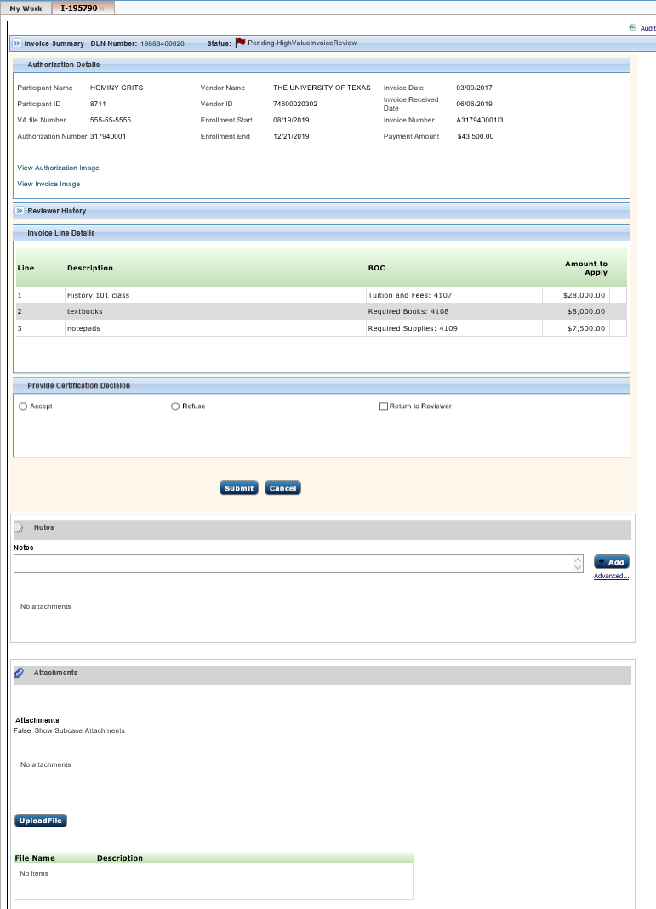
Certification Screen
1
Audit Link
3
Authorization Details
2
Invoice Summary
4
Invoice Line Details
5
Provide Certification Decision
6
Notes and Attachments
Notes:
Upon double clicking the invoice that you would like to certify, the Certification Details screen displays. The invoice image opens in a separate window.
Let’s provide a quick overview of the parts of the Certification Screen.
Parts of the Certification screen include:
Audit Link – Provides a history of the invoice.
Invoice Summary – Contains metadata submitted from IPPS. This includes: the DLN Number - The unique ID of every invoice in IPPS status of the invoice.
Authorization Details – This area displays pre-populated fields from the invoice and authorization. There are also links to open the Authorization and Invoice images.
Invoice Line Details – This area displays items that are brought in from Tungsten, a dropdown list for their Budget Object Code (BOC), and the amount for each line item.
Provide Certification Decision – This area allows you to Accept or Refuse the invoice (or return it to the reviewer).
Notes and Attachments – These areas allow for additional notes or attachments to be filed with the invoice. See also Notes and Attachments.

Slide 42
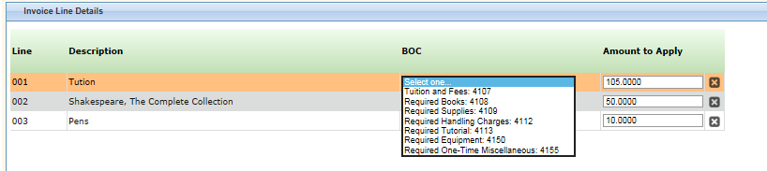
Accepting an Invoice
Ensure a BOC is selected for each line item and that the amounts are correct in the “Amount to Apply” field for each item. Note: You can select a list of possible BOC entries and update the Amounts to Apply as needed
1
1a
You can also delete a line item by selecting the “X” to the right of the Amount to Apply field
Notes:
If the invoice is within the threshold for approval, the certifying official sees the Accept/Refuse radio buttons on the certification screen.
If the books or supplies subtotal amounts are <=$5000 (or tuition <= $25,000), no approvals are needed after certification.
To accept a low dollar invoice, complete the following steps:
From the open invoice screen, ensure that a Budget Object Code (BOC) is selected for each line item and that the amounts are correct for each item. Select from a list of possible entries for the BOC and update amounts to apply as needed directly into the Amount to Apply field.
1a. You can also delete a line item by selecting the “X” to the right of the Amount to Apply field.

Slide 43
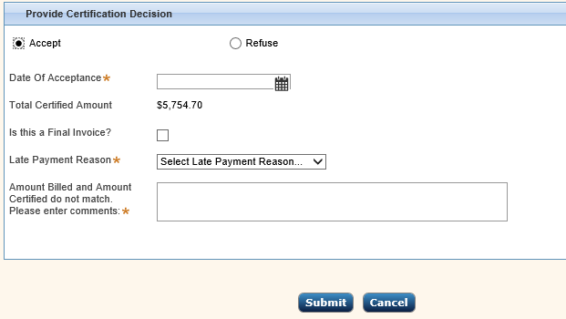
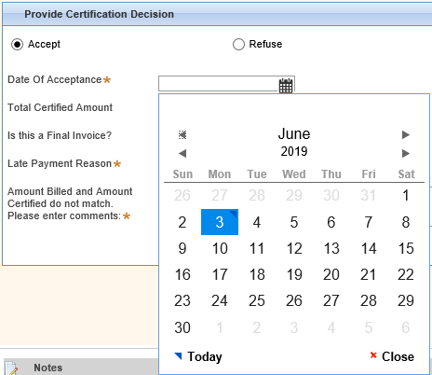
Accepting an Invoice cont’d
2
Select Accept in the Provide Certification Decision
3
Enter all mandatory fields,
Such as the Date of Acceptance by clicking on the calendar icon
Verify the “Total Certified Amount”
If final invoice and no further processing, select the checkbox next to “Is this the Final Invoice?”
Click “Submit”
Notes:
2. Now after entering the BOC and certifying or adjusting the amounts on the Invoice Line Details Select Accept in Provide Certification Decision.
Depending on the condition of the invoice, additional fields may display. If it’s late or if amounts mismatch and so on, you are asked to provide further information. This will be discussed further on the next slide.
3. Enter all mandatory fields,
Such as the Date of Acceptance by clicking on the calendar icon.
Verify the “Total Certified Amount”.
If final invoice and no further processing will be done, select the checkbox next to “Is this the Final Invoice?” This prevents the vendor from sending another invoice under the same authorization.

Slide 44

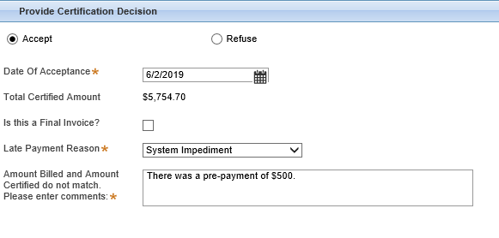
Additional Mandatory Fields
3
(d) If displayed, enter a “Late Payment Reason” from the dropdown list
(e) If displayed, enter the required notes in the “Amount Billed and Amount Certified do not match" field and click “Submit”
(f) Go to “My Authorizations and the authorization shows a “Final” status
Notes:
These are some of the additional mandatory fields based on the condition of the invoice.
If the Late Payment Reason field is indicated with an asterisk (see screenshot), enter a late payment reason from the dropdown list. This field will be displayed if you certify the invoice beyond the 30 days upon receipt.
If the Amount Billed and Amount Certified do not match field is indicated with an asterisk *(see screenshot), enter comments in the text entry field.
Click the submit button. Once submitted, you may go to My Authorizations and the authorization shows a status of Final.

Slide 45
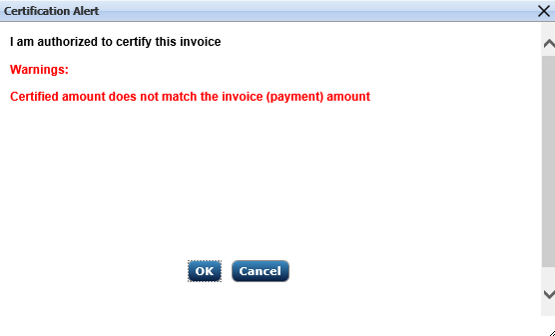
Accepting an Invoice cont’d
4
Select OK, to verify the authorization of the invoice
Note: If overriding an error, a warning message displays in the Certification Alert Authorization Window
Notes:
After entering all mandatory fields and clicking the Submit button, you will be asked to verify that you are authorized to certify the invoice as shown by the screen capture.
Note, if you are overriding an error, the error displays in the this authorization window. For instance if you have updated the Amount to Apply, therefore changing the Total Amount to Certify you will receive a warning on this screen.
Once you verify that you are authorized to certify the invoice by clicking the OK button, the system processes the payment and it is no longer displayed in your work list.
As an important reminder as the certifying official for the invoices you are the last reviewer of the invoice before payment is made. Please, please ensure that invoice is correct. It is your responsibility to do your due diligence to verify the dollar amounts that you are approval.

Slide 46
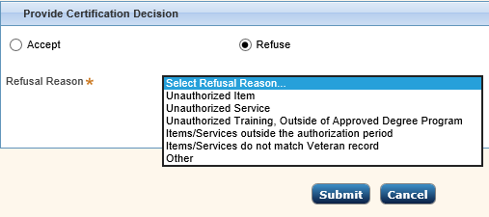
Refusing an Invoice
1
Select the “Refuse” radio button from the Provide Certification Decision pod
2
Select the appropriate refusal reason from the drop down
Notes:
Now let’s discuss the steps to refuse an invoice.
From the open invoice screen, Provide Certification Decision Pod, select the Refuse radio button.
Notice an additional field displays, where you can select the Refusal Reason.

Slide 47
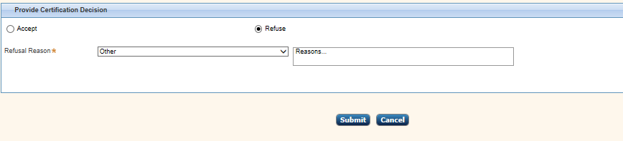
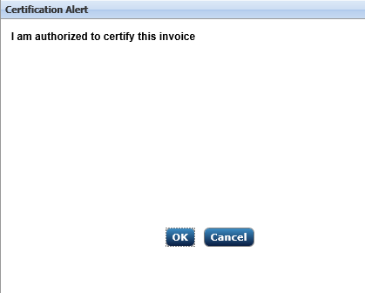
Refusing an Invoice cont’d
3
Note, if you select Other, enter the additional reasons in the Reasons text field.
Click “Submit”
4
Click “OK” on the Certification Alert window. The rejected invoice is archived and goes back to the vendor. system processes the refused invoice
Notes:
If you select Other for the Refusal Reason, you are asked for further information. Enter the other reason in the Reasons text field and select the Submit button.
Upon clicking Submit, you will be asked if you are authorized to certify the invoices. Click OK and then the system will reject the invoice and an auto generated email will be sent to the vendor that created it.

Slide 48
Invoice Payment Processing System
Functionality: High Dollar Invoices
Briefed by:
VR&E Service
Updated: August 12, 2019
Notes:
Now that we have covered how to process Low Dollar Invoices, let’s move into discussing processing High Dollar Invoices. Only the Supervisor, the VR&E Services Director and the RO Director can certify high-dollar invoices. To approve a high-dollar invoice, these specific roles must complete the steps in the upcoming sections.

Slide 49
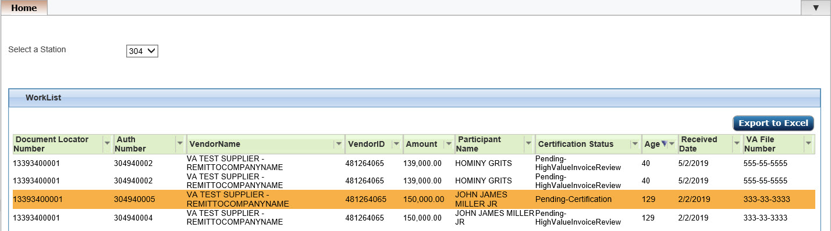
Opening an Invoice
1
Log into IPPS (discussed earlier) and the Home tab displays in the Workspace
2
Select the station
Certification Status Header:
Pending High Value Invoice Review status
3
Double-click on the invoice you want to process
Notes:
To process low dollar invoices:
Log into IPPS.
The Supervisor or Director/RO Director home tab displays.
2. If you have access to multiple stations, select the station for which you are processing invoices. Note, the Certification Status for high dollar invoices shows as “Pending-High Value Invoice Review”.
3. Double-click on the invoice you want to process.

Slide 50
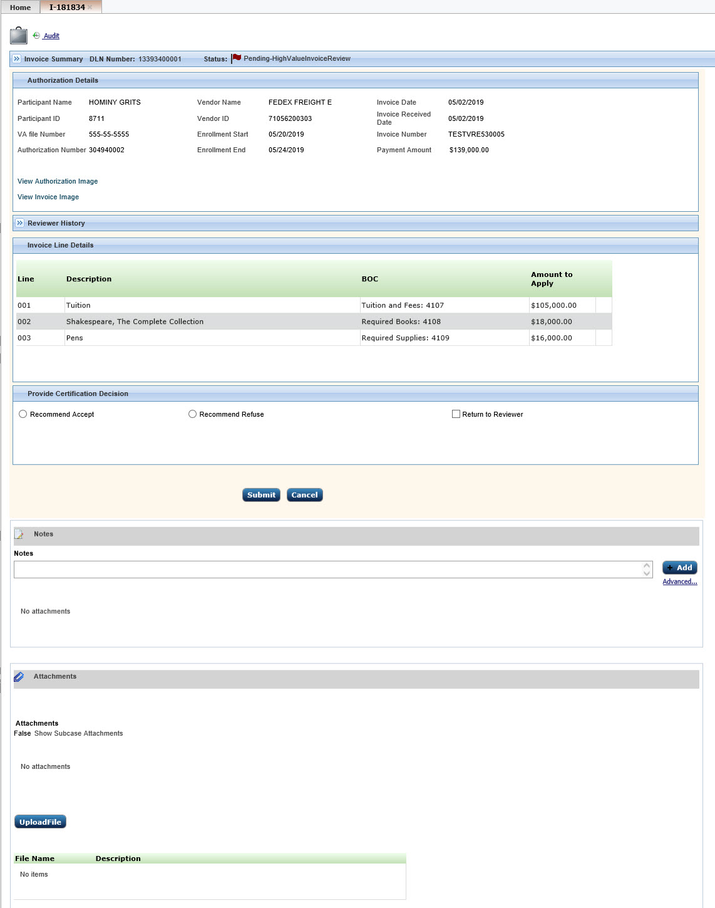

Certification Screen
1
Audit Link
4
2
Invoice Summary
5
3
Invoice Line Details
Authorization Details
6
Provide Certification Decision
7
Notes and Attachments
Notes:
Upon double clicking the invoice that you would like to invoice, the certification details screen displays. The invoice image opens in a separate window.
Let’s provide a quick overview of the parts of the Certification Screen.
Parts of the Certification screen include:
Audit Link – Provides a history of the invoice
Invoice Summary – Contains invoice information submitted by the vendor.
Authorization Details – This area displays pre-populated data.
Reviewer History – This area displays actions taken by previous reviewers.
Invoice Line Details – This area displays items that are being invoiced, their Budget Object Code (BOC), and the amount for each line item.
Provide Certification Decision – This area allows you to Accept or Refuse the invoice.
Notes and Attachments – These areas allow for additional notes or attachments to be filed with the invoice. We will be discussing this section later on this training.

Slide 51
Role Specific Certification Actions (High Dollar)
VR&E Supervisor
Accept
Recommend Accept
Return to Reviewer
Refuse
RO Director
Accept
Return to Reviewer
Recommend Accept
Refuse
VR&E Service Director
Accept
Return to Reviewer
Refuse
If you are the final approver or if this is the original review when in Pending-Certification Status
If you are the final approver or if this is the original review when in Pending-Certification Status
Archives the invoice and sends a reason for refusal notification to the vendor
Recommendation for approval must always be routed directly to the Director role
Recommendation for approval must always be routed directly to the RO Director role
Return to Reviewer must always be returned to the original invoice reviewer. Invoice status is Pending-High Value Invoice Review
Return to Reviewer must always be returned to the original invoice reviewer. Invoice status is Pending-High Value Invoice Review
Return to Reviewer must always be returned to the original invoice reviewer
Notes:
Now let’s discuss the role specific certification actions for high dollar invoices at-a-glance. To process an invoice with a value over the threshold for an approving official which can include the Supervisor, RO Director and/or VR&E Service Director, the invoice must first be recommended for acceptance which sends the invoice upward in the approval chain. If the next approving official does not have authority to approve the dollar amount, they recommend acceptance as well until the invoice finally ends up on the desk of the approving official that does have authority over this amount.
For instance, a VRC accepts an high dollar invoice that needs to be certified and it is forwarded to the VR&E Supervisor to review. The VR&E Supervisor reviews this certification invoice and due to cost, the Supervisor has to recommend acceptance of the certification invoice. The certification invoice then goes to the RO Director for review. After review, the RO Director is prompted to Accept the invoice because it is indicated that he is final approval official based on the dollar threshold amounts.
Note, for the amounts each role can certify up to, please refer to the Dollar Threshold slide.

Slide 52
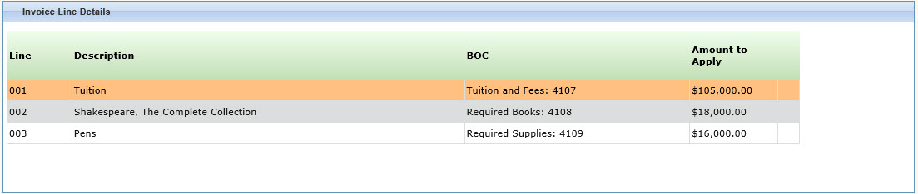
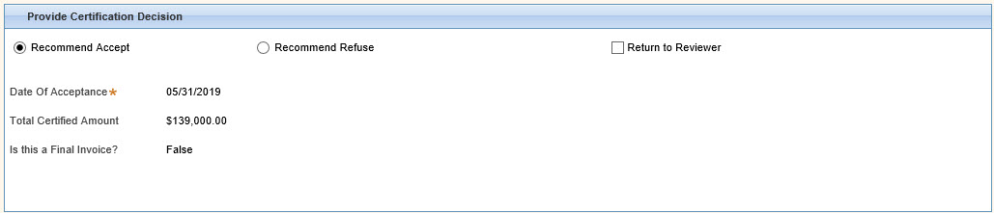
Recommend Accept
1
Review the invoice and ensure the Invoice Line Details are correct
2
Select “Recommend Accept” in Provide Certification Decision section and review the additional information
3
Select “Submit”
Notes:
If an invoice is out of the approving official’s threshold for acceptance, the “Recommend Accept” radio button displays. To recommend a high dollar invoice for approval, the Supervisor and (potentially) the RO Director complete the following steps:
Review the invoice and ensure the Invoice Line details are correct.
Select Recommend Accept in Provide Certification Decision section and information displays.
Review the additional approval information that is displayed, and if there are no changes click Submit.
Note, if changes are required, select Return to Reviewer

Slide 53
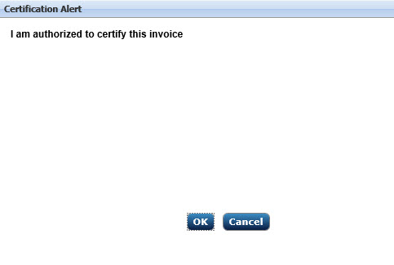
Recommend Accept
4
Click “OK”
Notes:
Upon clicking the Submit button, you are greeted with the Certification Alert window, confirming you are authorized to certify the invoice.
Click OK
The system processes the invoice and routes it to the next higher role in the system. The invoice no longer displays in your work list.

Slide 54
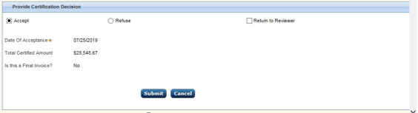
Accepting the Invoice
1
Click “Accept” and “Submit”
2
Click “OK”
Notes:
If the invoice is within the threshold for approval, the RO Director sees the Accept/Refuse radio buttons on the certification screen.
1. Click Accept to accept the invoice and then Submit.
You are asked to confirm you are authorized to certify the invoice.
2. Click OK.
The system processes the invoice. It no longer displays in your work list.

Slide 55
Refusing the Invoice
1
Select the “Refuse” radio button. Select a reason from the dropdown
2
Note, if you select “Other”, provide further information.
3
Click “Submit”
Notes:
Refusing the Invoice. To refuse a high dollar invoice, complete the following steps:
1. From the open invoice screen, select the Refuse radio button in the Provide Certification Decision section.
Note an additional field displays.
2. Select a reason from the dropdown list for refusing the invoice. If you select Other, you are asked for further information. Enter the other reason in the Reasons text field.
3. Click Submit.
The system archives the refused invoice, returns it to the vendor and it no longer displays in your work list.

Slide 56
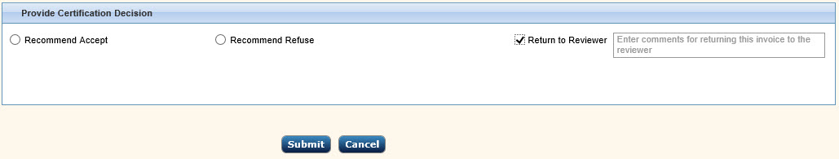
Return to Reviewer
1
On the Certification Screen, select “Return to Reviewer”
2
An additional text field displays, enter the reason the invoice is being returned
3
4
Click “Submit”
Click “OK”
Notes:
If the next level approver feels the invoice needs to be adjusted by the initial reviewer, he/she must complete the following steps:
1. From the certification screen, select Return to Reviewer in Provide Certification Decision.
An additional text field displays for comments.
2. Enter the reason the invoice is being returned in the text field.
3. Click Submit.
You are asked if you are authorized to certify the invoice.
4. Click OK.
The system archives the invoice and routes it to the original reviewer. It no longer displays in your work list.

Slide 57
Invoice Payment Processing System
User Administration: Site Administrator Role
Briefed by:
VR&E Service
Updated: August 12, 2019
Notes:
Now we will discuss the primary roles and functions of the Site Administrator.

Slide 58
Learning Objectives
After this training you will be able to:
Add Users
Reassign Authorizations
Change Roles
Assign Stations
Reactivate Disabled Users
Delete Users
Notes:
After this training you will be able to:
Add Users
Reassign Authorizations
Change Roles
Assign stations
Reactivate Disabled Users
Delete Users

Slide 59
VR&E Roles in the IPPS Application
IPPS User Role Matrix
A user can only be assigned one role at a time.
Notes:
Now let’s discuss the various VR&E specific roles in the IPPS application as it relates to certifying invoices. This is an overview of the various roles and the associated specific functions that are performed in user administration by the Site Admin.
User Administration is only available for the Site Administrator role. In this role, you can:
Add a new user
Reassign authorizations
Change roles
Assign stations
Reactivate disabled users
Delete users
In addition, as you can see by slide, the Site Administrator will have access to research all stations (read-only mode), access/run reports and view dashboards. We will delve into these functions in the upcoming slides.

Slide 60
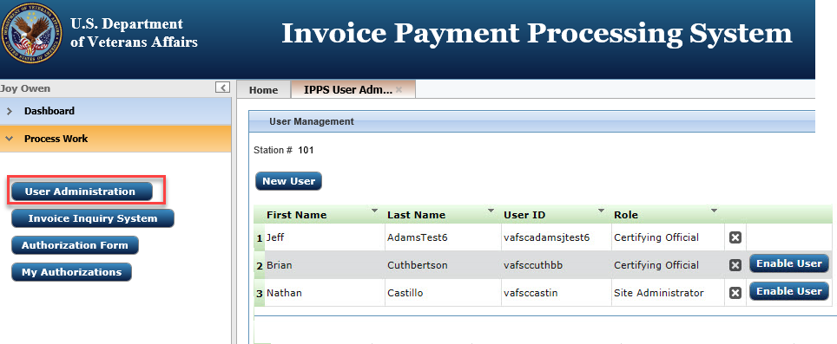
User Administration Screen
1
Click “User Administration” from the Navigation Pane
Notes:
To get to the User Management screen, click User Administration from the left navigation pane.
The User Management screen displays.

Slide 61
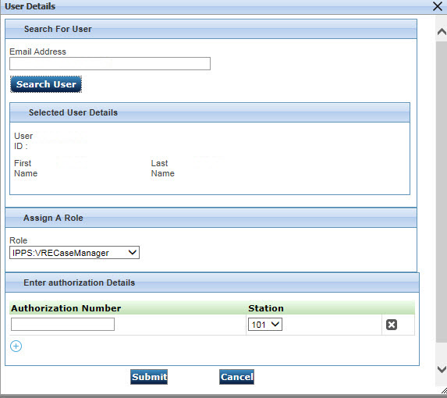
Adding Users
1
Click “New User”
2
Enter the user’s VA email address
3
Click “Search User”
Notes:
To add a new user:
1. From the User Management screen, click New User. The User Details window displays.
2. Enter the user’s VA email address in the address field. Note: Anyone with a va.gov address can be added, please use your discretion.
3. Click Search User.
Data is retrieved from the VA’s global address listing (GAL). This populates the user’s name and user ID fields. In addition, any authorizations assigned to the user is displayed.

Slide 62
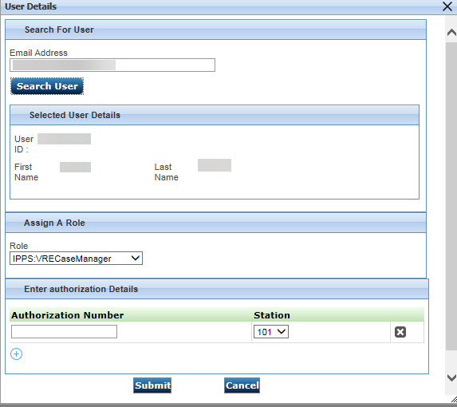

Adding Users cont’d
4
Confirm the User’s details
5
Select the User’s role in the dropdown
6
Click “Submit”
Notes:
4. Confirm the user’s details are correct such as the Email Address, User ID, First Name and Last Name.
5. Select the role the user is to perform from the dropdown menu in the Role field. Here you can Assign a Role and Adding or Reassigning Authorizations.
6. Select Submit to complete the entry.
Note, if a user already exists in the system, an error message is shown.

Slide 63
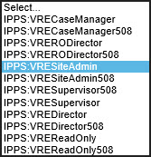
Assigning a Role
1
Select the User’s role in the dropdown
Notes:
To assign a role to a user:
Select the role the user is to perform from the dropdown menu in the Assign a Role field.
If a user has transferred from a different VA station, they must be deleted from their previous station and added by their new site admin to their correct User ID.

Slide 64
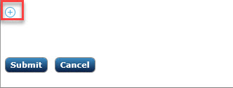
Adding or Reassigning Authorization
1
Select the “Plus Sign”
Notes:
Now let’s discuss how to add or reassign an authorization. To add or reassign an authorization you must complete the following steps:
From the bottom of the User Details screen, select the Plus Sign.

Slide 65
Adding or Reassigning Authorization cont’d
1
Authorization Field
2
Select the Station number from the dropdown list
3
4
Enter the Authorization Number
Click “Submit”
Notes:
After clicking the Plus Sign,
An orange Authorization Number field is populated with a new line. Note this field is optional unless you are reassigning an authorization to a user.
To reassign, complete the following steps: Select a Station number from the Station dropdown list.
Enter the Authorization Number in the blank field to the right of the Station Number.
Select Submit to complete the entry.

Slide 66
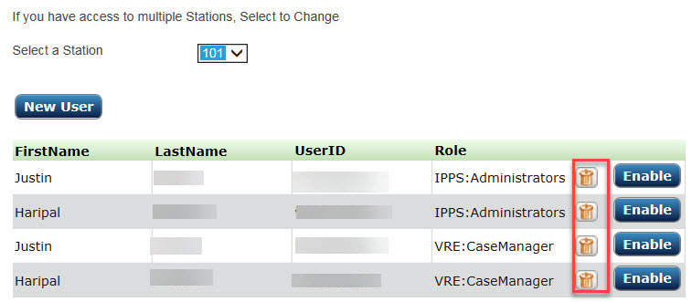

Removing a User
1
Click the “Trashcan” Icon next to the user you want to remove
2
Click “Yes” and the user is deleted from the list
Notes:
Before starting the Removing a User section, please note that if a user has transferred from a different VA station, they must be deleted from their previous station and added by their new site admin to their correct User ID.
In order to remove a user from the IPPS user list, complete the following steps:
From the User Management screen, click the Trashcan icon next to the user you want to remove.
You are then asked to confirm the deletion, select Yes and the user is deleted from the list.

Slide 67

Reactivating a User
1
Click Enable button
Please provide a OK screenshot for the this window.
Notes:
If a user has not logged into IPPS in the last 90 days, that user no longer has access to the system and needs to be reactivated. Also, when you view the user in User Management, the Enable button is no longer grayed out, but is active.
For the user to regain system access do the following:
From the User Management screen, click the Enable button next to the user you want to enable. You are asked to confirm.
Click OK and the user is now able to access IPPS.

Slide 68


Deleting User – Assigned Authorizations
1
Double click the user’s name
2
3
Click the “X” to remove the user
Click “Submit”
Notes:
To delete authorizations for a user:
Double click the user’s name from the IPPS User Administration screen and User Details window displays.
Click the “X” to the right of the authorization you want to remove from the user. The Authorization is deleted from the window.
Select Submit and your changes are saved.

Slide 69
Invoice Payment Processing System
Reports: Dashboard
Briefed by:
VR&E Service
Updated: August 12, 2019
Notes:
Now we will discuss the features of the Dashboards, Monitoring Activity and Action buttons.

Slide 70
Learning Objectives
After this training you will be able to:
Access the Dashboard
Access the Monitor Activity Reports
Review Action Buttons
Exporting to Excel
Notes:
After this training you will be able to:
Access the Dashboard
Access the Monitor Activity Reports
Review Action Buttons
Exporting to Excel

Slide 71


Dashboard
1
Select “Dashboard”
Hover over the images to show additional information
Notes:
The dashboard provides you with the status of payment processing in the system. The dashboard functions have been assigned to the following roles: Site Admin, RO Director and VR&E Service Director. There are three categories displayed:
Invoices Pending Certification Over 14 Days
Invoices Pending Certification Greater Than or Equal to 30 Days
All Pending Invoices
To view the Dashboard, select Dashboard from the left navigation panel. The charts display as shown on the slide.
As a note, you can hover over the images to show the percentage of invoices in that category.

Slide 72


Dashboard – Chart Actions
1
Select Show Data
2
Click an entry, to drill-down into further details
Notes:
To show chart data, complete the following steps:
Select Show Data from the Chart Actions dropdown.
The fields associated with the chart are displayed.
Click an entry in the first column to drill-down further into details.

Slide 73

Dashboard – Chart Actions cont’d
3
Click an entry, to drill-down into further details
Notes:
Click the Action button to Refresh, Edit report, Save, Summarize, List, Print, Export (PDF or Excel).

Slide 74

Monitor Activity
1
2
Click “Monitor Activity” on the left navigation pane.
Double-click the specific report to export the report
Notes:
Monitoring activity is a function that can be performed by the following:
Supervisor
Director
Service Director and
Site Administrator
The Monitor Activity section of IPPS, like the Dashboard, allows you to pull data to monitor the health of your station’s invoice processing.
1. To use this option, click Monitor Activity from the left navigation pane.
A report list displays.
Reports available include:
All Pending Invoices
Invoice Paid Over Thresholds
Invoices Pending Certification Over 30 Days
Invoices Pending Certification Over 14 Days
Invoices Refused by Certifying Official
Throughput in the Past Week by Work Type (Not working yet)
2. Double-click the specific report. The report will be shown in a separate window.

Slide 75
Action Buttons
Selection | Action
Refresh | Refreshes data on the screen
Edit Report | Takes you to an editor that allows you to customize search results
Save as | Allows you to save the report in another format
Summarize | Shows a summary of report data. You can also edit what the summary displays.
List | Converts the report from a summary to a list
Print | Allows you to print the report
Export to PDF | Allows you to export to PDF
Export to Excel | Allows you to export to Excel
Help | Provides context-sensitive help
Notes:
Since we have utilized the Actions button for the last two functions, lets delve deeper into some of the actual actions of this button. When you see the Actions button displayed, it allows you to conduct further report manipulation. Some of the features include those on the screen.

Slide 76

Exporting to Excel
1
Click the “Export to Excel” Button
2
Click “Open” to view or “Save” to save the document
Notes:
Another feature that you may see is the Export to Excel button.
You can export data to Excel whenever the Export to Excel button displays on a page. Upon clicking the Export to Excel button, you are asked if you want to open or save ExportData.xls .
Click Open to view the document or Save to save the document to your computer.

Slide 77
Conclusion and Pilot Support
For VR&E IPPS support, please attend or contact the following:
IPPS Pilot Users Check In Calls
Fridays at 2:00 PM ET
Starting September 6th
More details to come…
E-mail: vafscenterprisesupport@va.gov
Telephone: 866-372-1141
Notes:
This concludes our training today. We appreciate your participation in the pilot and we look forward to your feedback and supporting you as needed throughout this pilot. As a reminder, you will receive the specific names of the facilities to place on the authorizations, more information on the IPPS Pilot Check-in Calls, and the IPPS User Guide prior to September 3, 2019. The IPPS User Guide will serve as a vital resource for you when you are processing and/or certifying awards, adding users, viewing reports and any other IPPS functions that you maybe performing based upon your user-specific role, which we will discuss later in this training.
As another reminder, before we part, if you should experience any issues or have any questions during the IPPS Pilot, please do not hesitate to contact IPPS Pilot Support by email, using the email address indicated on the slide or by calling the telephone number indicated on the slide. Using one of these methods will ensure your inquiry or comment is routed to the appropriate personnel.
Again thanks for attending this training and have a good day.

