Slide 1
Title is name of content
Accounts Receivable
Administrative & Loan Accounting Center (ALAC)
Paul Jiang, Supervisory Accountant
July 23, 2024
Notes:
Say your welcome and what’s below:
Please place questions in the chat and our facilitator will read them.
We will address them as time permits.
If we run out of time, we will place the answer under the FAQ section on the Virtual SSD SharePoint and OFM will notify you when we do so.

Slide 2
Learning Objectives
  Given this training, the learner will explain the Bill To Collect (Accounts Receivable (A/R)) process, with 80% accuracy.
  Given this training, the learner will identify the A/R Roles and Responsibilities with 80% accuracy.
  Given this training, the learner will identify the different types of Billing Documents/Uses, with 80% accuracy.
  Given this training, the learner will analyze Debt Management with 80% accuracy
  Given this training, the learner will identify the A/R Power BI Report with 80% accuracy.
Notes:
Adult Learning Principles: As you develop instructional strategies for your training, be sure you incorporate principles of adult learning into your learning activities, such as:
Adults are self-directed and expect to take responsibility for decisions
Adults need to know why they need to learn something
Adults need to learn experientially
Adults approach learning as problem-solving
Adults learn best when the topic is of immediate value
Strategies such as case studies, role playing, simulations, and self-evaluation are most useful when teaching adults. Highly recommend not just talking at them. Make it as fun as possible with the limited time.

Slide 3
Accounts Receivable
VA will review receivables for completeness, accuracy, and supportability monthly.
BME
BPI BTE
Vendor Debt
Employee Travel Debt
Employee Payroll Debt
Jury Fees

Slide 4
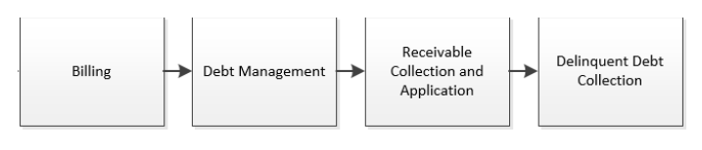
Overview of Bill To Collect
Billing – The billing phase includes activities associated with establishing, amending, approving, and generating
receivables due from non-government sources and determining billing requirements.
Debt Management – The debt management phase includes activities associated with monitoring and updating accounts receivable (A/R) based on dispute, waiver, compromise, and repayment plan processes and decisions as well as managing debt collection.
Receivable Collection and Application – The receivable collection and application phase includes
activities associated with receiving and processing collections, matching the collection activity to the receivable, and
researching unapplied collections.
Delinquent Debt Collection – The delinquent debt collection phase includes activities associated
with processing collections and completing agency actions on uncollectible accounts to include
generating dunning notices; assessing interest, penalty, and administrative charges; establishing
payroll or vendor payment offsets; writing-off debt; and referring debt to Treasury for cross-servicing
A/R Reporting – The A/R reporting phase includes activities associated with supporting the delivery
of the VBA quarterly Treasury Report on Receivables (TROR).

Slide 5
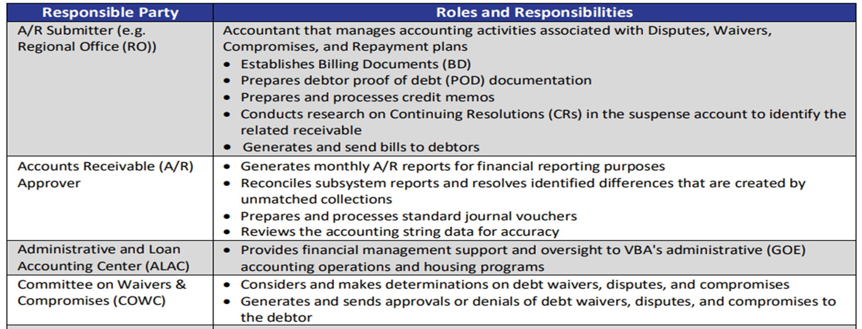
iFAMS Roles and Responsibilities

Slide 6
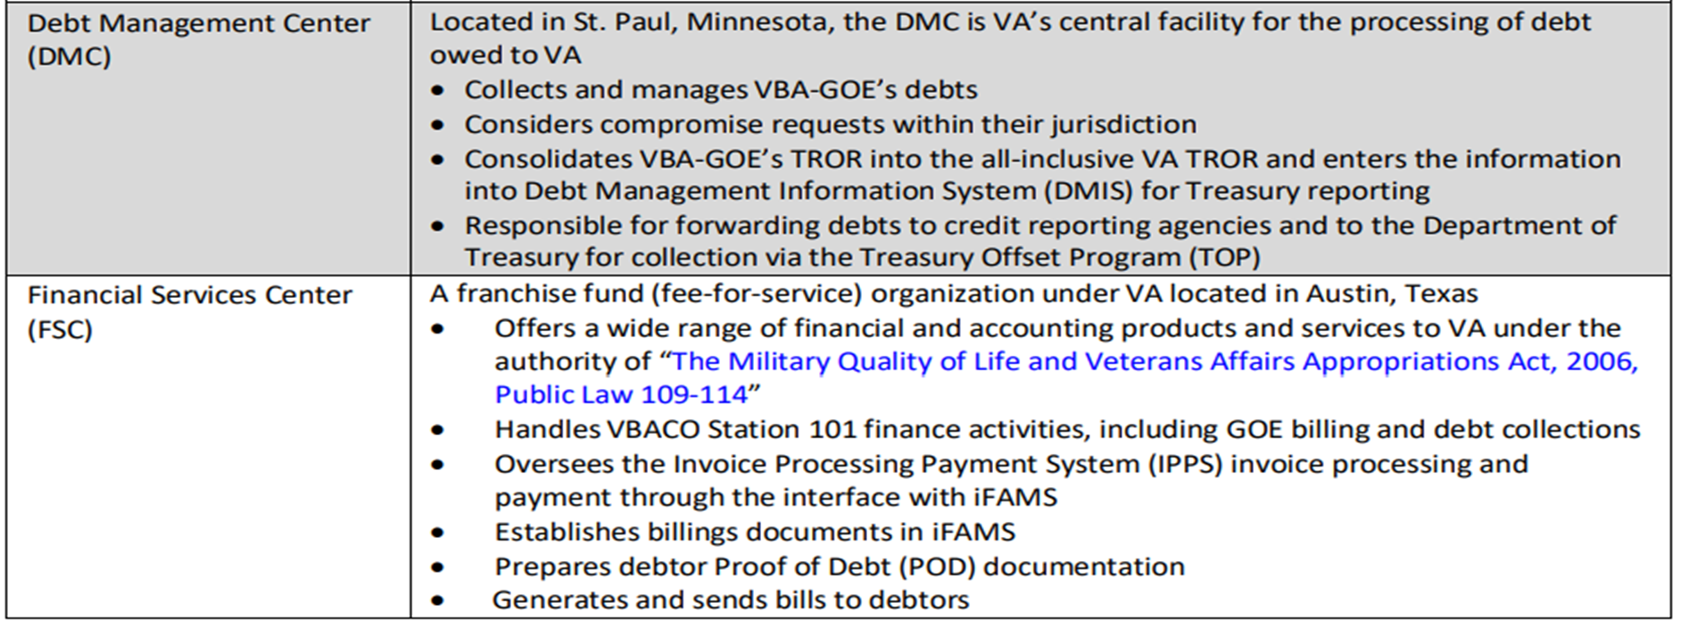
iFAMS Roles and Responsibilities

Slide 7
What is a Billing Document?
Billing Documents (BD) are used to record a Bill of Collection for materials furnished, services rendered and erroneous payments of vendors, employees, veterans, etc.
A billing document (BME, BTE, BPI) should be recorded when:
  An overpayment has occurred.
  An erroneous payment has been issued.
  Employees on extended LWOP whose insurance premiums are paid by the government.

Slide 8
iFAMS BD Types
VA GOE debts are maintained in the Integrated Financial and Acquisition Management System (iFAMS). By selecting Accounts Receivable under the Transaction Category, you may process the following BD types:
Vendor Debt
  Debts owed by vendors for overpayment of merchandise received/services rendered.
  Erroneous payments to the wrong vendor.
Employee Travel Debt
  Debts owed by employees for travel overpayments.

Slide 9
iFAMS BD Types
Employee Payroll Debt
  Debts owed by employees for advance payments caused by FEHB LWOP not processed by DFAS.
  Payroll debts of separated employees after final salary is processed by DFAS.
Jury Fees
Debts owed by employees for jury fees. VA employees are compensated by the federal government while performing jury service and may not be paid a jury fee.
  Jury Fees must be paid to the Station’s Agent Cashier for transfer of funds to the Treasury.

Slide 10

Knowledge Check #1
VA GOE Debts are maintained in which of the following systems?
iFAMS (Integrated Financial and Acquisition Management System)
CAATS (Centralized Admin Accounting Transactions System)
CARS (Centralized Accounts Receivable System)
FAS (VETSNET Finance and Accounting System)

Slide 11
Knowledge Check #1 Answer
VA GOE Debts are maintained in which of the following systems?
iFAMS (Integrated Financial and Acquisition Management System)
CAATS (Centralized Admin Accounting Transactions System)
CARS (Centralized Accounts Receivable System)
FAS (VETSNET Finance and Accounting System)

Slide 12
iFAMS Document Types
These documents are used to manually establish an A/R in iFAMS.
  BME – Billing Document – Manual
  BTE – Billing Document – Travel Advance
This document is established from an HR-PAS Payroll file.
  BPI – Billing Document – HR-PAS Payroll Billing Interface

Slide 13
iFAMS Document Types
BME
  Recording an overpayment of a vendor or employee.
  Employee submitted for payroll offset. Bills for damages will not reference payment.
  Advances or bill creation outside of bill cycle for agreements.
  Revenue Receivables involving non-federal leasing activity, miscellaneous revenue collection, and/or seller agreement activity.

Slide 14
iFAMS Document Types
BTE
  Travel Billing Document (BTE) references a travel payment and bills for over payment. Can reference the following TCI (TDY travel Advance), TNE (Manual Travel Advance), or TNI (PCS Travel Advance).
BPI
  Bill created with Payroll Interface (HR-PAS). Employees on leave without pay (LWOP) have a BPI created to cover the amount paid for Federal Employee Health Benefits (FEHB) during the pay period. When employee returns to work, a payroll collection (CPI) is created to pay outstanding receivables.
  If employee leaves VA, BPI is converted from employee receivable type to Non-Federal receivable type (BME).
  To cancel a BPI, make request through customer support portal.

Slide 15
Knowledge Check #2
Which document type is used to create manual billing documents in iFAMS?
BMX
BPI
BME
BNE

Slide 16
Knowledge Check #2 Answer
Which document type is used to create manual billing documents in iFAMS?
BMX
BPI
BME
BNE

Slide 17
Knowledge Check #3
Which document type is automated for billing documents in iFAMS?
BTE
BPI
BME
BTT

Slide 18
Knowledge Check #3 Answer
Which document type is automated for billing documents in iFAMS?
BTE
BPI
BME
None of the Above

Slide 19
Debt Management
  The VA is required to ensure each debtor is provided a demand letter, known as the NOI, explaining the required time for response or payment and notifying the debtor of the subsequent procedures if they believe the debt is in error, wish to request a waiver or compromise, or do not have the ability to repay all or part of the debt.
  A NOI Letter and dunning notice are automatically generated when a BD is established in iFAMS once proof of debt (POD) has been established. POD is required to be included in the NOI issued to the debtor.
  There are due process rights and procedures that may vary according to the type of debt.

Slide 20
Receivable Collection and Application
Collections paid via Pay.gov, FedDebt, and Fedwire automatically interface and match to the corresponding BD in iFAMS.
Automated collections do not require manual invention if the match is successful in iFAMS. If a payment is unable to match to the corresponding BD or is rejected due to an error, iFAMS automatically creates a CMZ document and records the cash receipt to the appropriate suspense account.
The CMZ document needs to be reviewed and reclassified in iFAMS.

Slide 21
Delinquent Debt Collection
  Debts become delinquent 30 days after the debtor is mailed a NOI and has not made a payment (either partial or in full); requested dispute, waiver, or compromise, or has defaulted on an agreed-upon payment plan.
  Interest, penalty, and administrative charges (IPA) are assessed on delinquent debts. IPA assessments are automatically applied to delinquent debts in iFAMS monthly. IPA assessments are determined systematically for all BDs (regardless if the BD was system generated via an interface or manually established) based on the receivable type and the applicable Accounts Receivable Options (AROP) for each receivable type and doc type in iFAMS.
  Interest is assessed on the first day of delinquency and is effective retroactive to the bill date. The interest rate applied automatically by iFAMS to the debt is the Treasury’s Current Value of Funds Rate. Penalties are assessed 120 days after the bill date (90 days delinquent) and accrue back to when the debt first became delinquent.

Slide 22
Delinquent Debt Collection
  DMC coordinates updates to the fees assessed with the VA’s Office of Financial Policy. Fee updates are made periodically and automatically in iFAMS by the FSC and/or System Administrators.
  Dunning notices are generated automatically in iFAMS and attached as PDF documents to the BD.
  DMC is responsible for sending the dunning notices to all debtors.

Slide 23
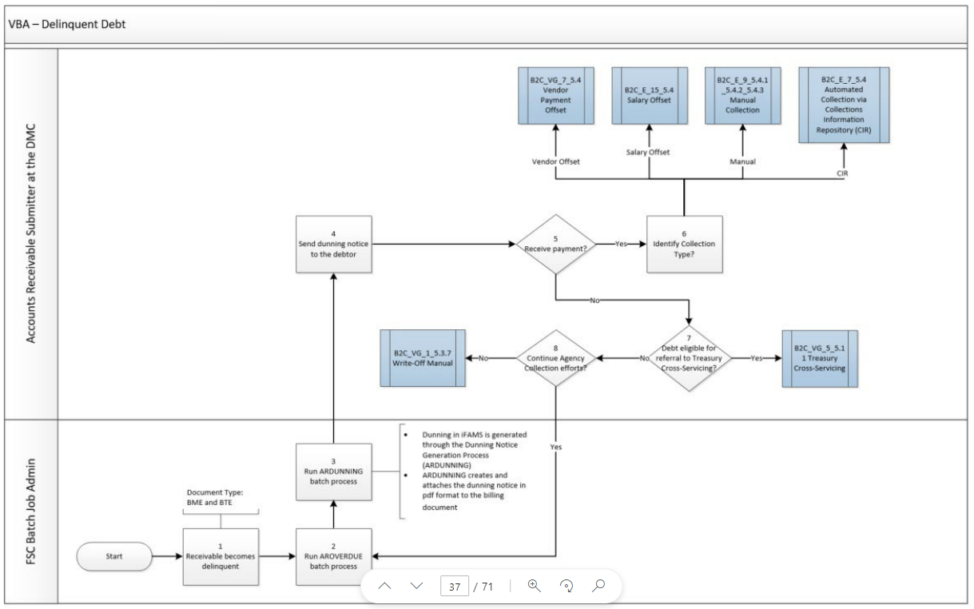
Delinquent Debt Collection Process

Slide 24
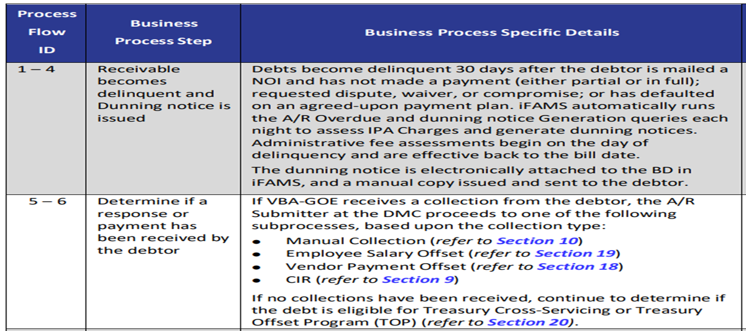
Delinquent Debt Collection Process Steps

Slide 25
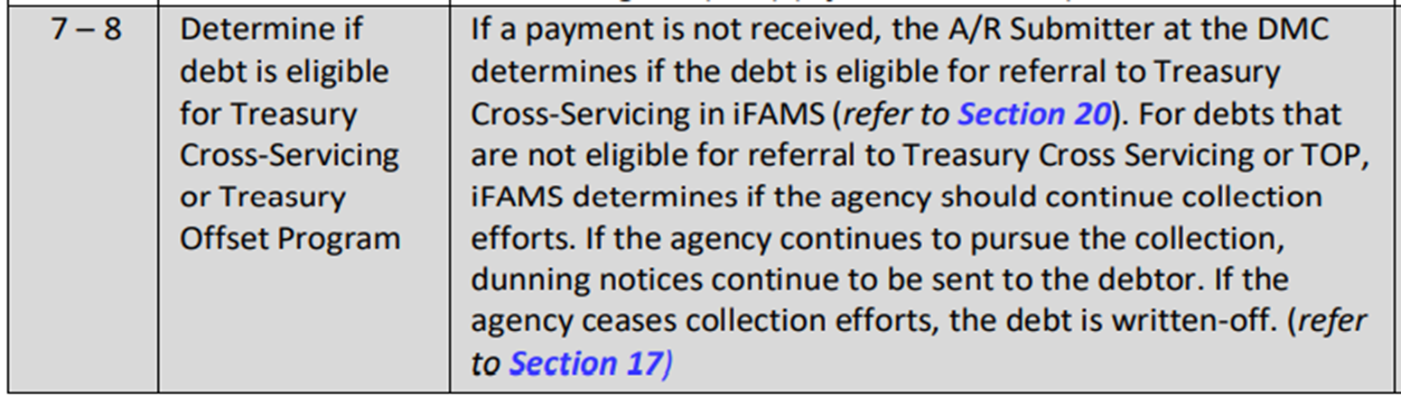
Delinquent Debt Collection Process Steps
VBA Office of Financial Management Intranet - VBA_B2C_SOP.pdf - Normal (sharepoint.com)

Slide 26
Knowledge Check #4
How many days do debts become delinquent after the debtor is mailed a NOI and has not made a payment (either partial or in full); requested dispute, waiver, or compromise, or has defaulted on an agreed-upon payment plan?
31 days
45 days
60 days
30 days

Slide 27
Knowledge Check #4 Answer
How many days do debts become delinquent after the debtor is mailed a NOI and has not made a payment (either partial or in full); requested dispute, waiver, or compromise, or has defaulted on an agreed-upon payment plan?
31 days
45 days
60 days
30 days

Slide 28
Debt Waiver Process
The Committee on Waivers and Compromises (COWC) considers debts for waivers.
If waiver is denied debt collection resumes per due process requirements.

Slide 29
Debt Write-Off
VA will terminate collection activity only when all available collection efforts have been exhausted, and the debt is determined to be uncollectible.
Debt must meet write-off eligibility requirements to be written-off.
A Write-Off Cash Receipt (CWE) document is created and linked to the original BD. To classify the debt appropriately, a reason for a write-off must be recorded in iFAMS.
A corresponding Financial Adjustment Standard Voucher (SSV) must be processed to alleviate any general ledger out of balances.
The CWE is automatically routed through various levels of approval in iFAMS, based on the CWE amount.

Slide 30
Debt Write-Off Process
Debt Write-Off Approval Authority
$1,000 and below | SSD Chief
Greater than $1,000 but less than $40,000 | VBA Chief Financial Officer/Designee
Greater than $40,000 but less than $100,000 | Deputy Assistant Secretary for Finance/Designee
$100,000 and over | Department of Justice (DOJ)
SSD Finance reviews debts that are delinquent, prepares the request, and follows the submission process thresholds as notated above.
Requests are submitted to OFM via Salesforce FIRE ticket for approval.

Slide 31
iFAMS Receivables BI Report
  The E-AR01 Receivables Report can be accessed in PowerBI Reporting by selecting the FMBT Restricted Standard App.
  This replaces the F842 and F853 report previously in FMS.
  Report allows users to monitor bills by aging category, VA organization, debtor and amount to prioritize collection of outstanding amounts.
  Station should review this report regularly to determine whether all billing documents are valid and have the appropriate document type (i.e., BPI vs BME).

Slide 32
iFAMS Receivables BI Report
  When monitoring this report, special attention should be paid to the established date, the last date of collection, and the employee status.
  Review reports for BPIs that have an EX-employee vendor code.
  Verify if these employees are no longer employed.
  Convert the BPIs to a manual BME.
  This allows DMC to start the Cross-Servicing collection process.

Slide 33
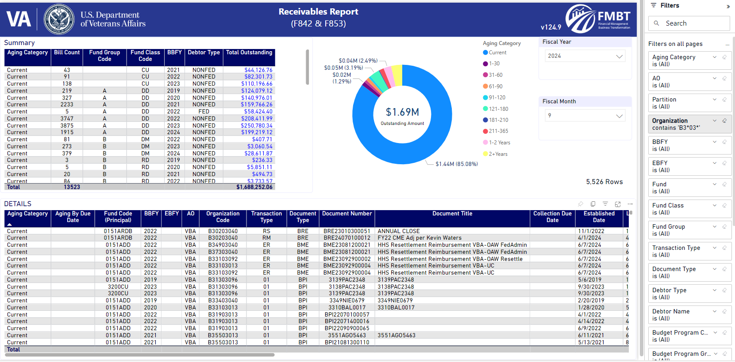
E-AR01 Receivables Report Example

Slide 34
Knowledge Check #5
If a write-off is submitted for $25,000, who has the approval authority?
SSD Chief
Department of Justice
Deputy Assistant Secretary
VBA Chief Financial Officer

Slide 35
Knowledge Check #5 Answer
If a write off is submitted for $25,000, who has the approval authority?
SSD Chief
Department of Justice
Deputy Assistant Secretary
VBA Chief Financial Officer

Slide 36
Summary
Understand the Bill to Collect process
Understand the Roles and Responsibilities
Identify the different types of billing documents and their uses
Understand Debt Management

Slide 37
Resources

Slide 38
Resources
VA Financial Policies & Procedures Volume XII, Chapter 9 – Interest, Administrative Costs, and Penalty Charges
  Chapter 09 - Interest, Administrative Costs, and Penalty Charges - Financial Policy Documents (va.gov)
VA Financial Policies & Procedures Volume XII, Debt Management Policies
  http://www.va.gov/finance/policy/pubs/volumeXII.asp
M24-3, Chapter 01 - Debt Management Overview
  M24-3 Chapter 01 Debt Management Overview (va.gov)

Slide 39
Resources cont’d
M24-3, Chapter 02 - Station Debt Procedures
  M24-3 Chapter 02 Station Debt (va.gov)
M24-3, Chapter 03 - Fiduciary Misuse Debt Processes
  M24-3 Chapter 03 Fiduciary Misuse Debt (va.gov)
M24-5, Chapter 01 - Internal Controls
  M24-5 Chapter 01 Internal Controls Assessment and Reviews Part 01 to 03 (va.gov)

Slide 40
Resources cont’d
Termination of Collection Action and Close Out of Debt
  Chapter 01 - VA Debt Collection Standards - Financial Policy Documents
GOE Bill to Collect SOP
  VBA Office of Financial Management Intranet - VBA_B2C_SOP.pdf - Normal (sharepoint.com)
AR01 Receivables Demonstration Video
  FMBT BI Report Demonstrations 20230419 Meeting Recording.mp4 (sharepoint.com)

Slide 41
Resources cont’d
iFAMS Self-Service (CRM Ticket)
  Self Service Portal (va.gov)
iFAMS User Guides and Resources (B2C)
  iFAMS User Guides and Resources - Bill to Collect B2C - All Documents (sharepoint.com)
ALAC Salesforce
  Home | Salesforce

Slide 42
Points of Contact
Leadership Team:
Charles Kemp, Supervisory Accountant, charles.kemp2@va.gov, 512-981-4610
Brent Kamphues, Supervisory Accountant, brent.kamphues@va.gov, 512-981-4607
Paul Jiang, Supervisory Accountant, paul.jiang@va.gov, 512-981-4608
Christy Castillo, Technical Accountant, christy.castillo@va.gov, 512-981-4641
Accounting Team (submit Salesforce ticket):
Home | Salesforce

Slide 43

Questions

Slide 44

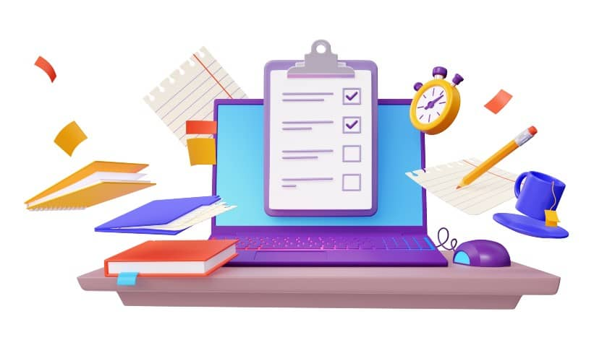
TMS Number
The assessment for this training is available
  5 questions
  80% to pass
  Open book
  Unlimited times
Please complete before the end of the day
Training TMS Number: 4661916
Notes:
The assessment for this training is available in TMS.
5 questions
80% to pass
Open book, can use training materials
Can take as many times as you like.
Please complete before the end of the day.
The TMS Item # is XXXXXXXXXX.
A recording of this training along with the slide deck presentation will be available shortly and placed in TMS as well as the Virtual SSD Training Symposium Website.
.

