Slide 1
VETERANS HEALTH ADMINISTRATION
Veterans Benefits Administration Briefing
March 14, 2024

Slide 2
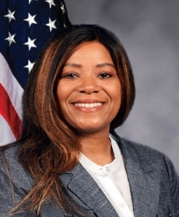
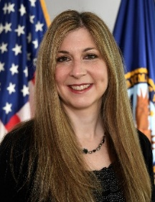
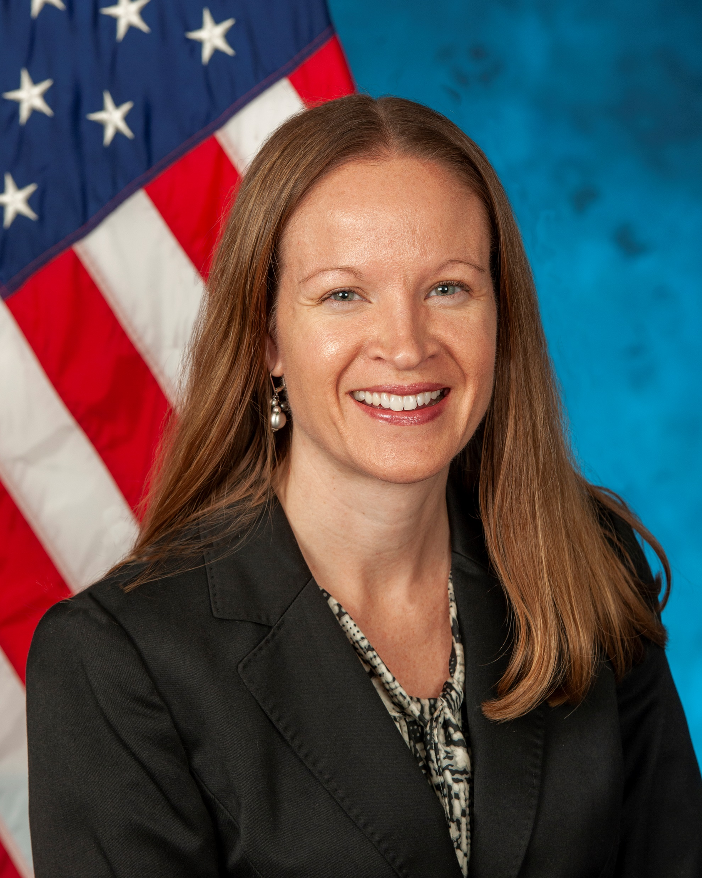


Today’s Presenters
Alita Harmon, LCSW
National Program Coordinator
National Social Work Program
Andrea M. Berkheimer, LCSW
Facility Based Project Assistant
National Social Work Program
Jaime Halaszynski, LCSW
Facility Based Project Assistant
National Social Work Program
2
Notes:
Bios:
Alita R. Harmon is a Licensed Clinical Social Worker, working in the profession for nearly 28 years. Alita is currently on special assignment as a National Program Coordinator assigned to the National Social Work PACT Staffing program. Prior to this appointment in January of 2022, Alita’s primary area of responsibility was with the Department of Veterans Affairs as the Outpatient Medical Programs Supervisor for Social Work Service, responsible for the provision of supervision and clinical consultation to VA PACT Social Workers in outpatient primary care clinics across the Gulf Coast Veterans Health Care System.
Alita is a member of the VACO-Social Work Leadership Council Knowledge and Data Management Committee and serves as the Co-Secretary for this committee.
Andrea M. Berkheimer is a Licensed Clinical Social Worker, working in the profession for 24 years. Andrea is a Facility Based Project Assistant for the National Social Work PACT Staffing program. Andrea’s primary area of responsibility is with the Department of Veterans Affairs as the Medical Social Work Supervisor, at the James E. Van Zandt Medical Center in Altoona, Pennsylvania. Andrea is responsible for the provision of supervision and clinical consultation to the VA PACT Social Workers, the VA Home Based Primary Care Social Workers, the Inpatient/Community Living Center Social Worker, the VA Community Nursing Home Coordinator and the Visual Impairment Services Team Coordinator.
Andrea is a member of the VACO Social Work Leadership Council Professional and Leadership Development Committee.
Jaime Halaszynski has been a clinical social worker at the VA for sixteen years and is the Assistant Chief of Social Work at Butler VA, is a Facility Based Project Assistant for the National Social Work in Patient Aligned Care Teams Staffing Program and is the Lead of the National Social Work Elder Justice Clinical Implementation Team. Jaime enjoys helping Veterans age with dignity and supporting the professional development of staff and students.

Slide 3

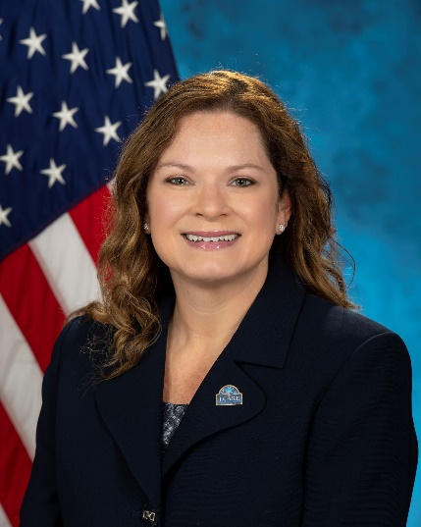
Welcome
Jennifer Koget, MS, LCSW, BCD
National Director of Social Work, Fisher House & Family Hospitality and Intimate Partner Violence Assistance Programs
3

Slide 4
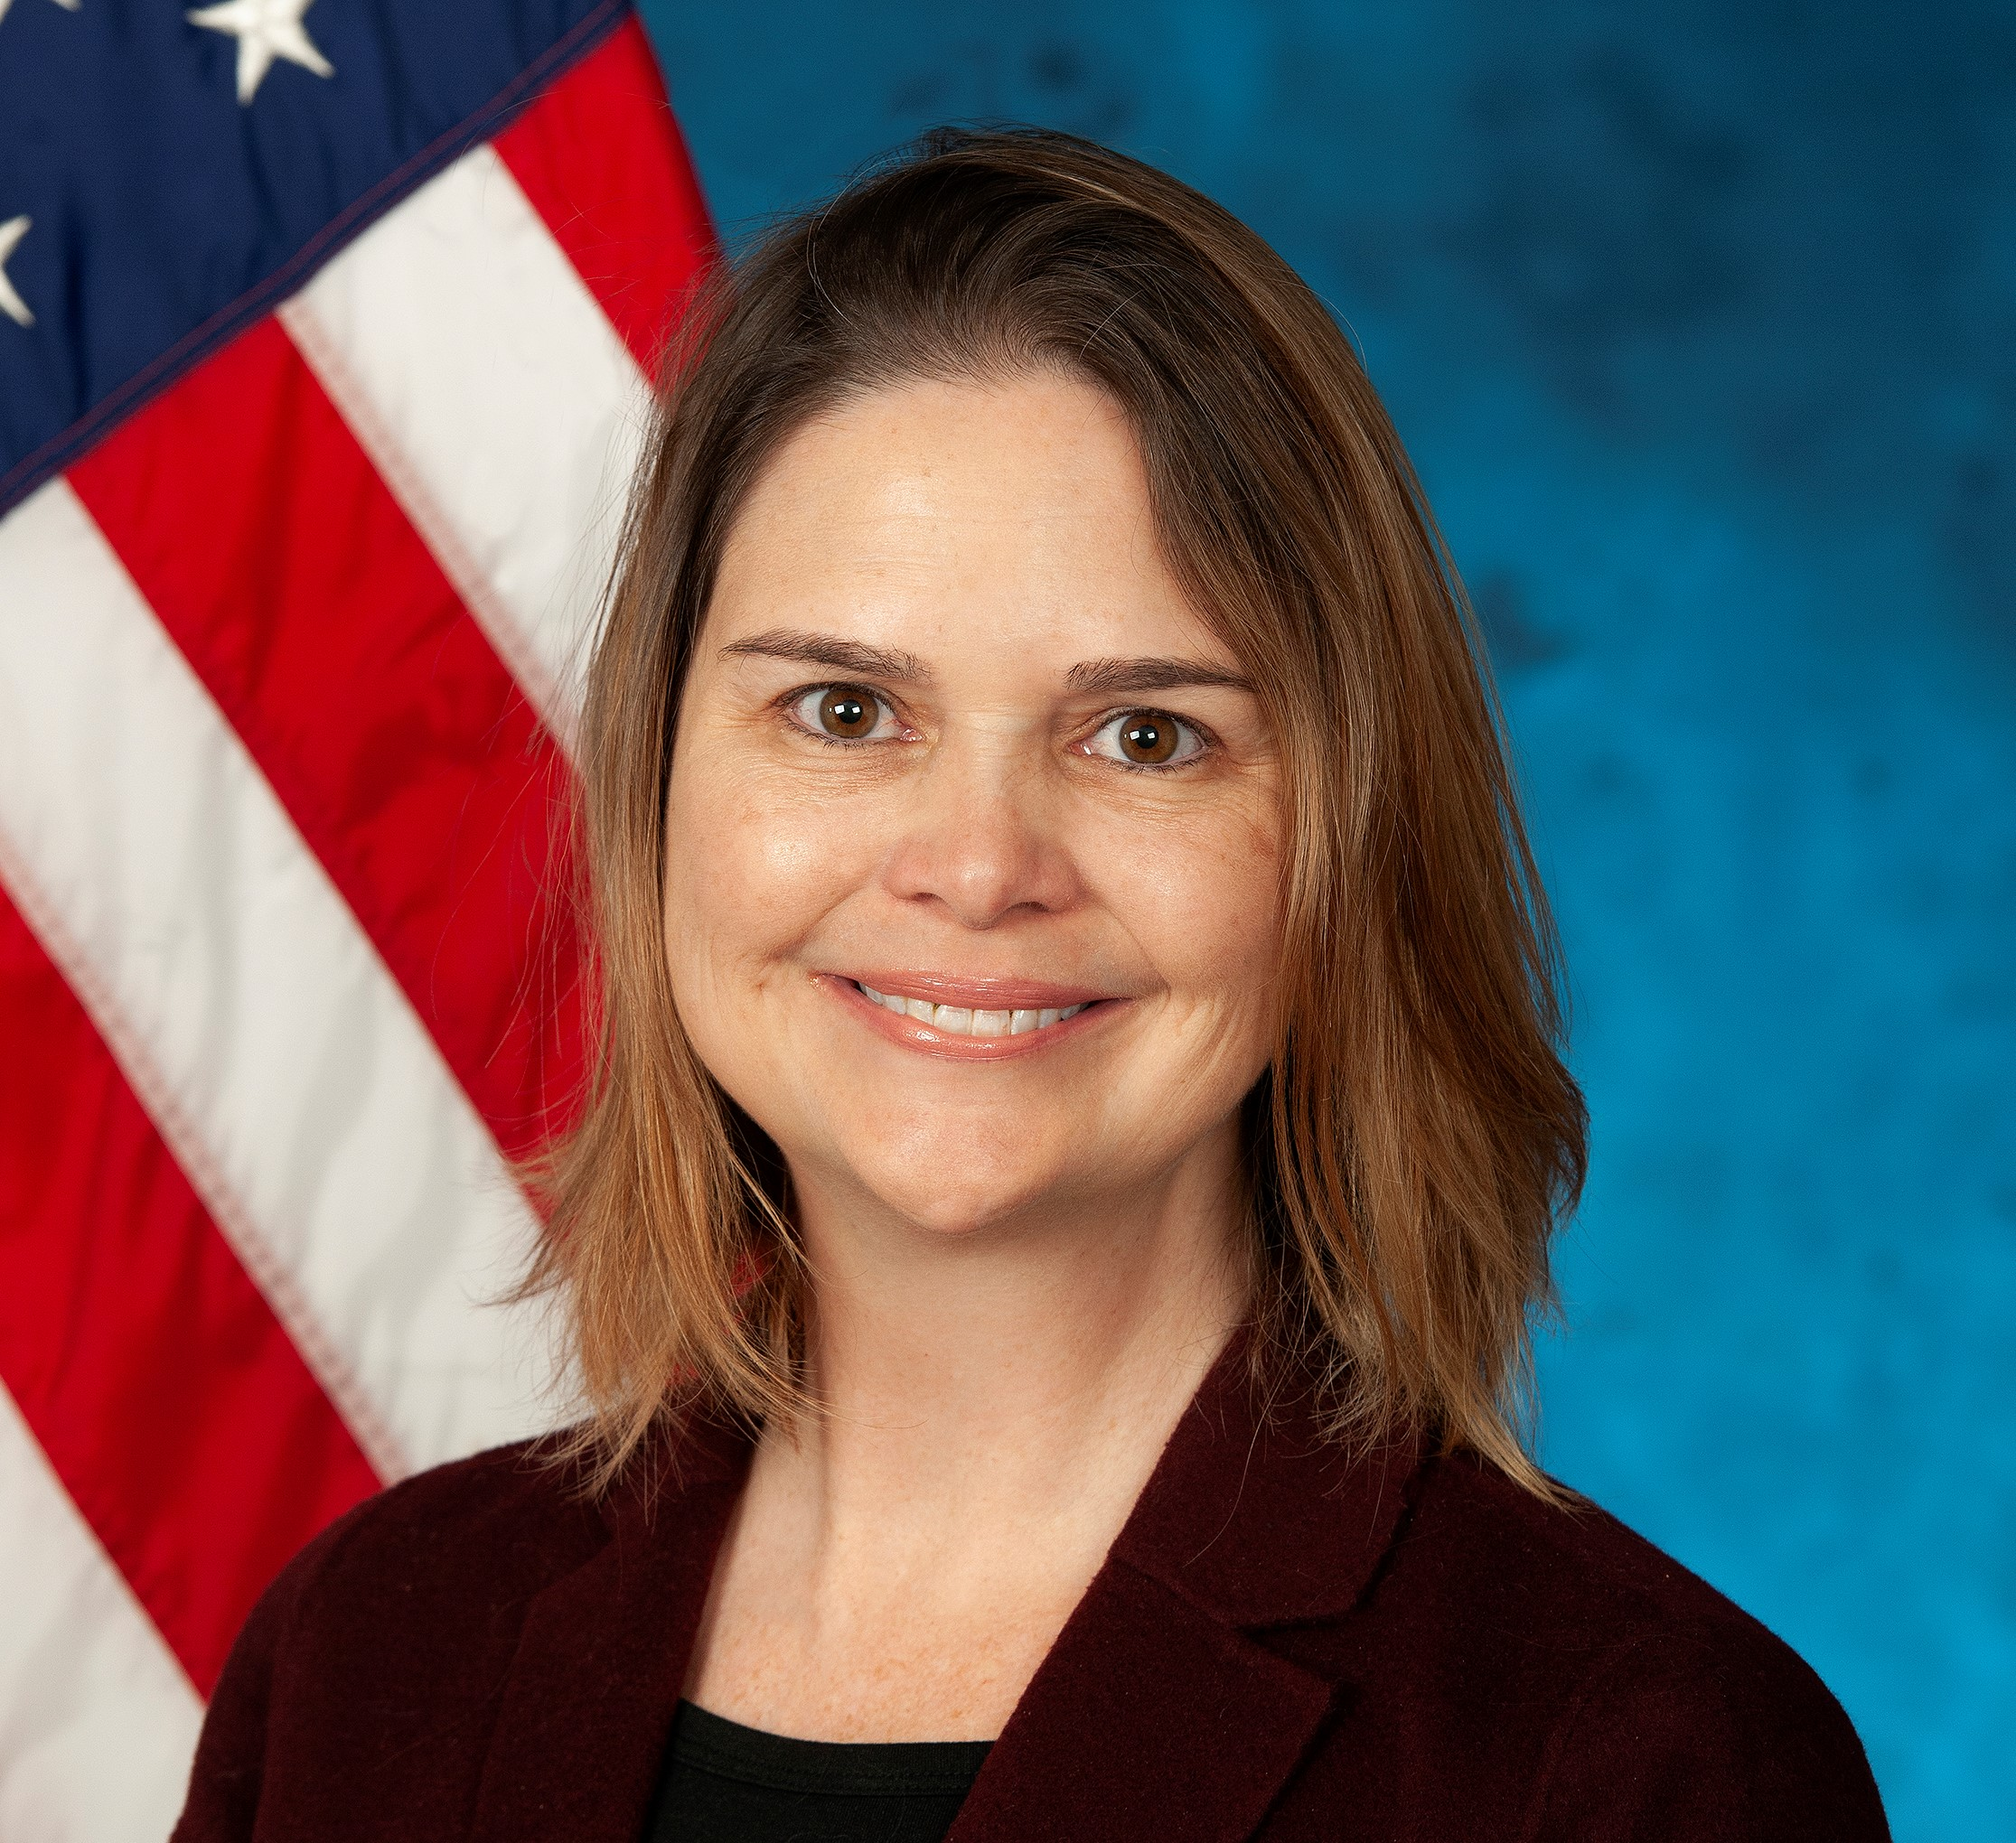
Welcome
Jennifer Silva, LCSW-S
National Program Manager,
National Social Work Program
4

Slide 5

Department of Veterans Affairs
Mission statement:
“To fulfill President Lincoln’s promise to care for those who have served in our nation’s military and for their families, caregivers, and survivors”
5

Slide 6

Veterans Health Administration
Veterans Health Administration (VHA): largest integrated health care network in the United States with 1,321 health care facilities, including 172 medical centers, serving 9 million enrolled Veterans each year
6

Slide 7
Enrolling in VA Health Care
By Phone: Veterans can complete applications for enrollment by calling 1-877-222-VETS (8387) Monday through Friday between 8 a.m. and 8 p.m. ET; VA staff members will collect the needed information and process application for an enrollment determination
Online: Veterans can fill out the application online at www.va.gov/health care/apply/application/introduction and electronically submit it to VA for processing; VA will search for supporting documentation through its electronic information systems and contact the Veteran if unable to verify military service
By Mail: The application form can be downloaded from www.va.gov/health-care/how-to-apply/
  Mail the completed and signed form to:
  Health Eligibility Center, Enrollment Eligibility Division
  2957 Clairmont Road NE, Suite 200
  Atlanta, GA 30329-1647
In Person: Apply at any VA health care facility
7

Slide 8
VA Health Care
Enrollment process
Veterans are given the opportunity to select the VA Health Care System or Community Based Outpatient Clinic (CBOC) where they prefer to be seen
Many Veterans qualify for enrollment and cost-free health care services based on a compensable service-connected condition or other qualifying factors but do not need to be service connected to be seen
Certain Veterans will be asked to complete a financial assessment at the time of enrollment to determine eligibility for cost-free medical care, medications and/or travel benefits
  Assessment is based on the previous year’s gross household income of the Veteran, spouse, and dependents
For more information, visit www.va.gov/health-care/about-va-health-benefits/cost-of-care/, call 1-877-222- VETS (8387) Monday through Friday between 8 a.m. and 8 p.m. ET or contact the Enrollment Coordinator at local VA medical facility.
8
Notes:
Veteran’s spouse and dependents cannot receive health care

Slide 9
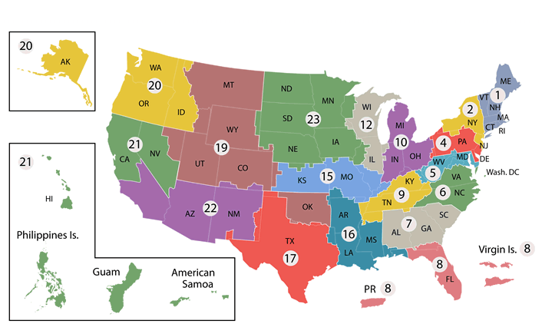
Delivery of Care
Veterans Integrated Services Networks: 18 regional systems of care working together to meet local health care needs and access to care
9

Slide 10

Delivery of Care
Health Care System: Several medical centers and clinics work together to offer services to area Veterans as a Health Care System to provide more efficient care
VA medical centers: Provide a wide range of services including traditional hospital-based services such as surgery, critical care, mental health, orthopedics, pharmacy, radiology and physical therapy
VA has advanced Telehealth Services that include home, clinic and hospital visits
  Remote visits with a specialist can occur at a local, regional or national level
10

Slide 11

Delivery of Care Continued
Community-Based Outpatient Clinic (CBOC)
To make access to health care easier, VHA utilizes CBOCs across the country
  Provides the most common outpatient services, including health and wellness visits, without needing to visit a larger medical center
  VHA continues to expand the network of CBOCs to include more rural locations
Services offered vary depending on VA medical center, area of the country and rurality
Social Workers assist with care coordination
Use the Facility Locator to find a local VA medical center
11

Slide 12

Rural Veterans
Unique considerations for the 2.7 million Veterans who are enrolled in VHA care who live in a rural area
Congress passed legislation in 2006 that established the VHA Office of Rural Health through targeted research, programs, and new models of care
Improves the health and well-being of rural Veterans by increasing access to care and services
  Rural Promising Practices: field tested innovative projects
  Enterprise-Wide Initiatives: expand access to sites that serve rural Veterans
12

Slide 13

VA Community Care
Veterans can access and receive Community Care covered by the VA when the closest VA does not offer a needed service or is too far to travel
Authorized and set up by the local VA medical center
Full array of medical, mental health and specialty care including alternative medicine and homecare
Each VA works with a contracted third-party administrator (TPA) for their region and that TPA’s Care Coordination Network of providers
13

Slide 14
VA Health Care and Medicare
VA does not recommend Veterans cancel or decline coverage in Medicare (or other health insurance programs including Medicaid) solely because they are enrolled in VA Health Care
Enrolling in both VA and Medicare can provide Veterans flexibility
  Veterans enrolled in both programs have access to community physicians (under Medicare Part A or B)
  Can obtain prescription drugs not on the VA formulary if prescribed by community physicians and filled at their local retail pharmacies (under Medicare Part D)
Enrollment in VA Health Care is not considered creditable coverage for Medicare Part B; Veterans with VA Health Care still need to pay a Medicare Part B premium for Medicare’s outpatient coverage
Enrollment in VA Health Care is considered creditable coverage for Medicare Part D purposes
Only Veterans can enroll in VA Health Care; dependents and family members do not receive credible coverage under the Veteran’s enrollment
14

Slide 15

Emergent and Urgent Care
During a medical emergency, Veterans should immediately seek care at the nearest medical facility or call 911; emergent and urgent care is available
Variations exist in VA Emergency Department services, including:
Social Work staffing and availability
Response to crises including intimate partner violence, sexual assault and psychiatric emergencies
Long term care and skilled nursing facility placement ability
Transportation resources
Capacity evaluations and cognitive issues
Post-emergency department discharge follow up
15

Slide 16

Inpatient Care
Depending on size and complexity of VA facility:
Some sites have inpatient acute care services that include:
  Medical
  Surgical
  Mental Health
  Dialysis
  Acute Care
There are also specialized care units that include:
  Intensive Care
  Transplant Care
  Spinal Cord Injuries/Disorders Centers
  Traumatic Brain Injury Units
  PolyTrauma Centers
Some VA systems rely on coordination with community hospitals for services
16

Slide 17
Nursing Home Care
Community Living Centers (CLC) are VA skilled nursing facilities, often referred to as nursing homes
Veterans receive help with activities of daily living (ADL) and 24-hour skilled nursing and medical care, including rehabilitative services and hospice/palliative care for end of life
Veterans may be admitted for short or long-term stays
There are over 100 CLCs across the country
Community Nursing Homes are non-VA nursing homes that the VA contracts with in many parts of the country
State Veterans Homes are state-owned and managed centers that provide full-time care for Veterans and sometimes non-Veteran spouses and Gold Star parents
17

Slide 18
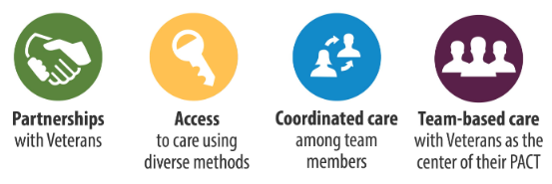
Outpatient Care
Patient Aligned Care Team (PACT)
Veterans are assigned to a PACT team that uses a team-based approach to care, with an emphasis on prevention and health promotion
Team members oversee transitions in care to specialists, other levels of care, community care and arrange for community resources
Every Veteran enrolled in PACT is assigned a Social Worker
18

Slide 19
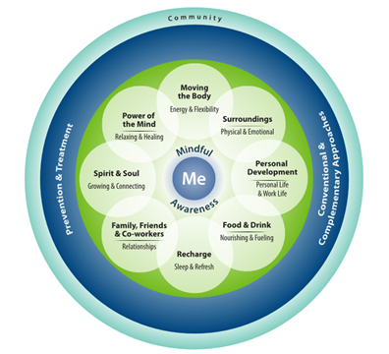




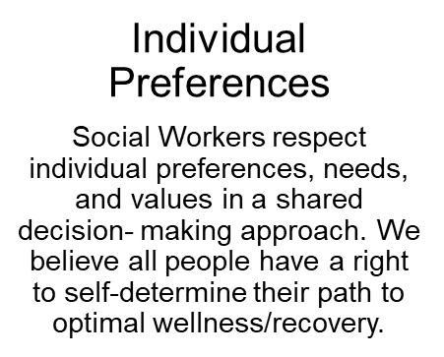
Guiding Principles of Social Work Practice
19
Notes:
The mission of VA Social Workers is to assist Veterans, their families and caregivers in resolving Social Drivers/Determinants of Health (SDOH) challenges to health and well-being
Social Work is woven into the fabric of VA health care, providing services in all clinical programs across the continuum of care

Slide 20

Social Drivers of Health (SDOH)
“The social drivers/determinants of health are the non-medical factors that influence health outcomes. They are the conditions in which people are born, grow, work, live and age and the wider set of forces and systems shaping the conditions of daily life.”
- World Health Organization(2022)
20

Slide 21
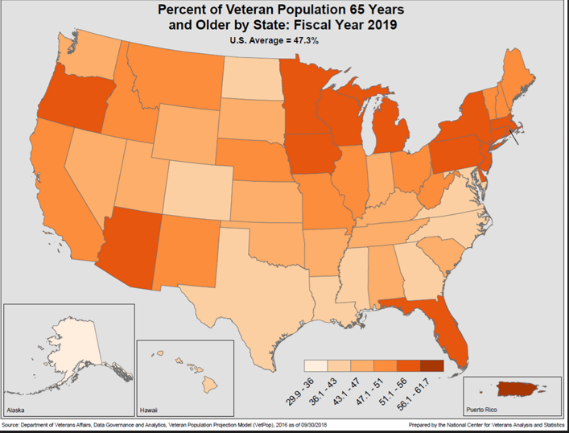
Veteran Population is Aging
National Center for Veterans Analysis and Statistics
21

Slide 22
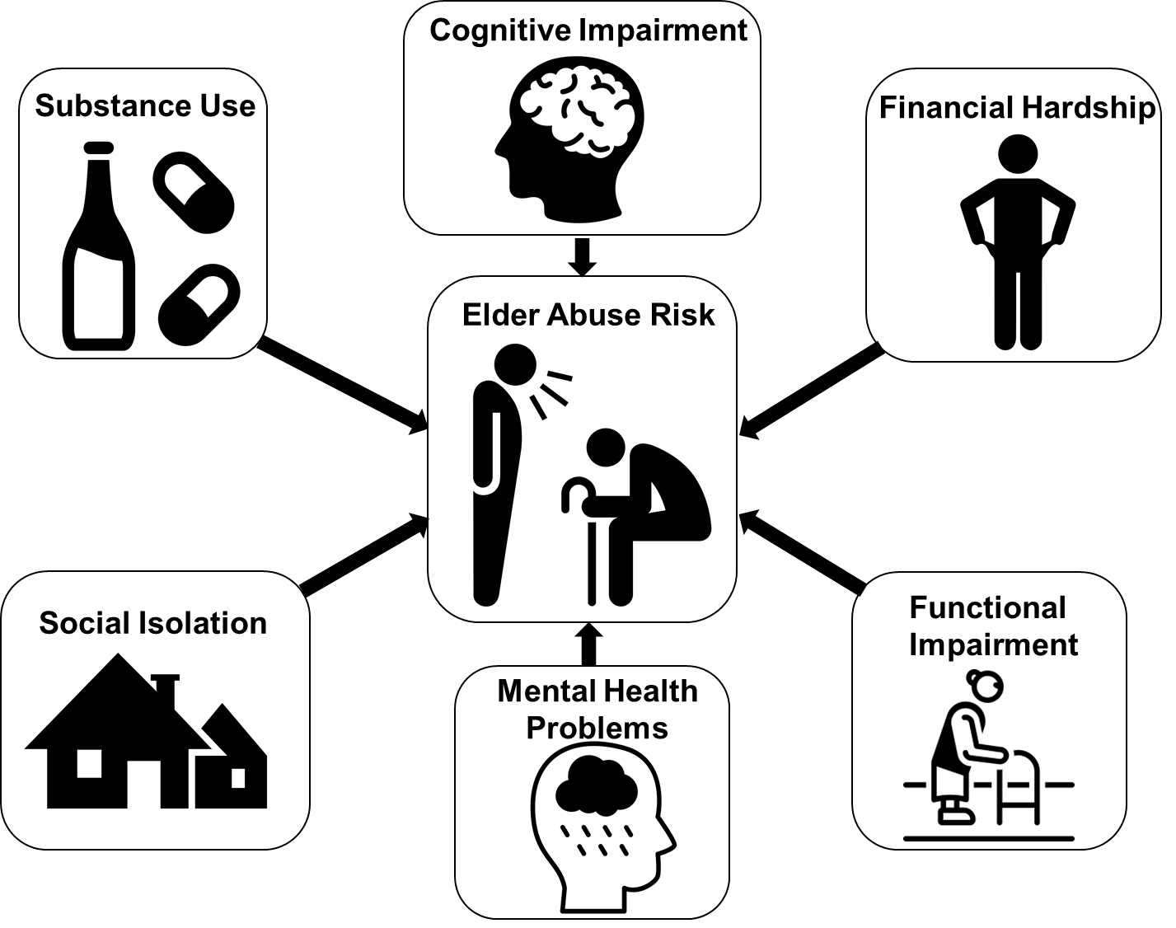
Veterans Have High Prevalence of Risk Factors
Makaroun LK, Taylor L, Rosen T. JAGS 2018
22

Slide 23

Social Workers
Critical Roles
Educate and refer Veterans to VA and community resources
Coordinate multiple appointments, facilitate access to care and support discharge planning
Evaluate psychological status, including elder mistreatment and neglect, suicidal and homicidal safety, intimate partner violence
Assist in psychosocial aspects of pain relief, coping and chronic disease self-management
23

Slide 24
Critical Roles of Social Workers
Outreach and Assessment
Reach out proactively to Veterans with high risk factors
  Over age 65; have chronic illness and multiple medical conditions; live alone; have recent life events such as job loss or death of a loved one; have substance use disorder or a mental health disorder
Provide comprehensive assessment, treatment planning and intervention for social drivers of health impacting the Veteran
Assess impact on Veteran’s ability and desire to engage in treatment recommendations by the interprofessional team
24

Slide 25
Critical Role of Social Workers
Assist Veterans
In understanding caregiver stressors and provide caregiver specific referrals
Facilitate and participate in goals of care conversations and advance care planning through completion of Advance Directives and living wills
Provide supportive counseling, conduct groups and other evidence-based practices
Incorporate inclusive care principles to promote collaborative, patient-centered decision making
25

Slide 26
VHA Directive on Abuse and Neglect
VHA Directive 1199(2) Reporting Cases of Abuse and Neglect establishes policy for the reporting of abuse and neglect cases as stipulated by state statue for all VA medical facilities
All professionals are required to adhere to federal and state laws that govern the reporting of suspected cases of abuse and neglect
Must promptly document in the electronic health record all pertinent information, including:
  Required report was filed timely with the appropriate agency, include copy of report
  Examination and treatment for conditions caused by abuse or neglect were offered to Veterans
Ensure that a referral is made to VA Social Work for each report
Social Workers are responsible for initiating a thorough assessment and identifying psychosocial risk factors requiring intervention
Social Workers have a duty to:
  Facilitate referrals for clinical assessment, treatment and care
  Maintain a list of VA and community resources that provide or arrange for evaluation and care
26

Slide 27

Guardianship
Veterans who await court appointment of a legal guardian are arguably the most vulnerable cohort of Veterans served by VHA and include those who are cognitively impaired, lack decision-making ability, have no Durable Power of Attorney for Health Care and do not have family or community resources
VA facilities experience significant delays in discharging Veterans in need of a legal guardian to the appropriate level of care
Guardianship remains under the purview of state law and practices, procedures and rule of law vary widely from state to state
27

Slide 28
Questions?
For questions about the content of this presentation, please reach out to the National Social Work Program at VHASWVACOPACTStaff@va.gov
For assistance connecting a Veteran to care, please reach out to your local VA Medical Center and ask to speak to the Social Work Chief or Executive
28

