Slide 1
Defense Personnel Records Information Retrieval System (DPRIS)

Slide 2
Lesson Objectives
Learn how to register and access DPRIS
Know what information is available from DPRIS
Learn the steps to submit a DPRIS request

Slide 3
Defense Personnel Records Information
Retrieval System (DPRIS)
What is DPRIS?
The Defense Personnel Records Information Retrieval System (DPRIS) is an electronic gateway. This gateway allows authorized users to access the Services' Official Military Personnel File (OMPF) and Joint Services Records Research Center (JSRRC) repositories online in a secure and efficient manner.

Slide 4
DPRIS
The following DoD information systems can be accessed using DPRIS, coordinated through the Joint Service Record Research Center (JSRRC):
Army
    The interactive Personnel Electronic Records Management System (iPERMS)
  Navy
    Electronic Military Personnel Records System (EMPRS)
  Marine Corps
    Optical Digital Imaging Records Management System (ODI-RMS)
  Air Force
    Automated Records Management System (ARMS)

Slide 5
Information Not Available in DPRIS
The information below must be obtained through DoD or other federal agencies directly, as DPRIS does not provide the following:
Non-service related benefit processing development
Title 10 benefit (Chapter 1606 & 1607) eligibility and kicker information
Service information or records for:
  Coast Guard,
  Public Health Service, or
  National Oceanographic Health Administration

Slide 6
Using DPRIS
When first accessing DPRIS, the VCE must:
  Register and be approved, then
  Logon
  Create a requests
  View completed requests
  Capture information returned into TIMS

Slide 7
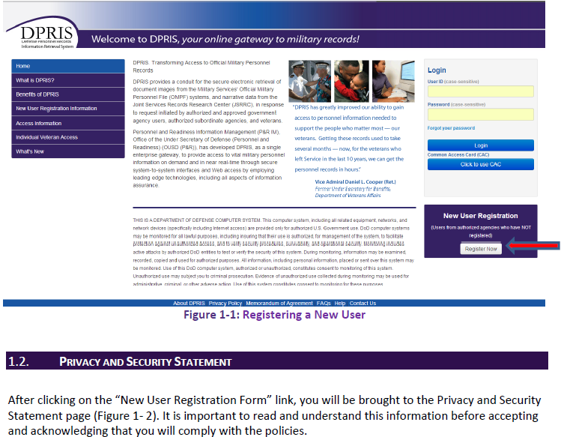
DPRIS - Register
Notes:
To register for DPRIS, view the DPRIS Registration Guide with the users. Have the users create a User ID = VA email address and provide the Agency ID/Agency Code provided by the station. Access will be available after approval. Print user guide as a job aid and discuss with users.

Slide 8
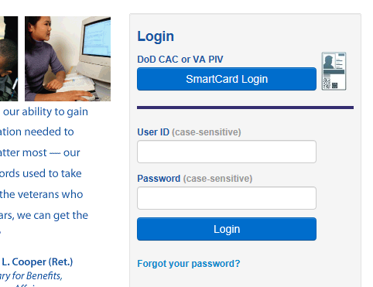
DPRIS - Login
To login to DPRIS, use your User ID and Password or with a VA PIV card. Access must be approved.

Slide 9
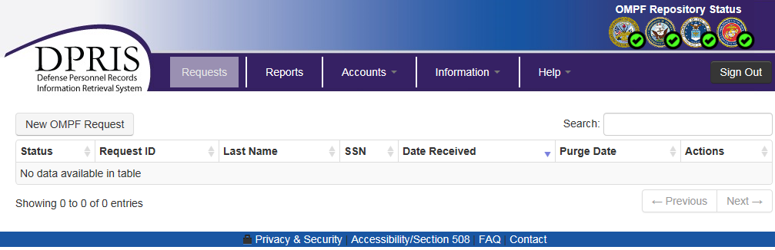
DPRIS - Create a Request
Click on the New OMPF Request button to start a new request

Slide 10
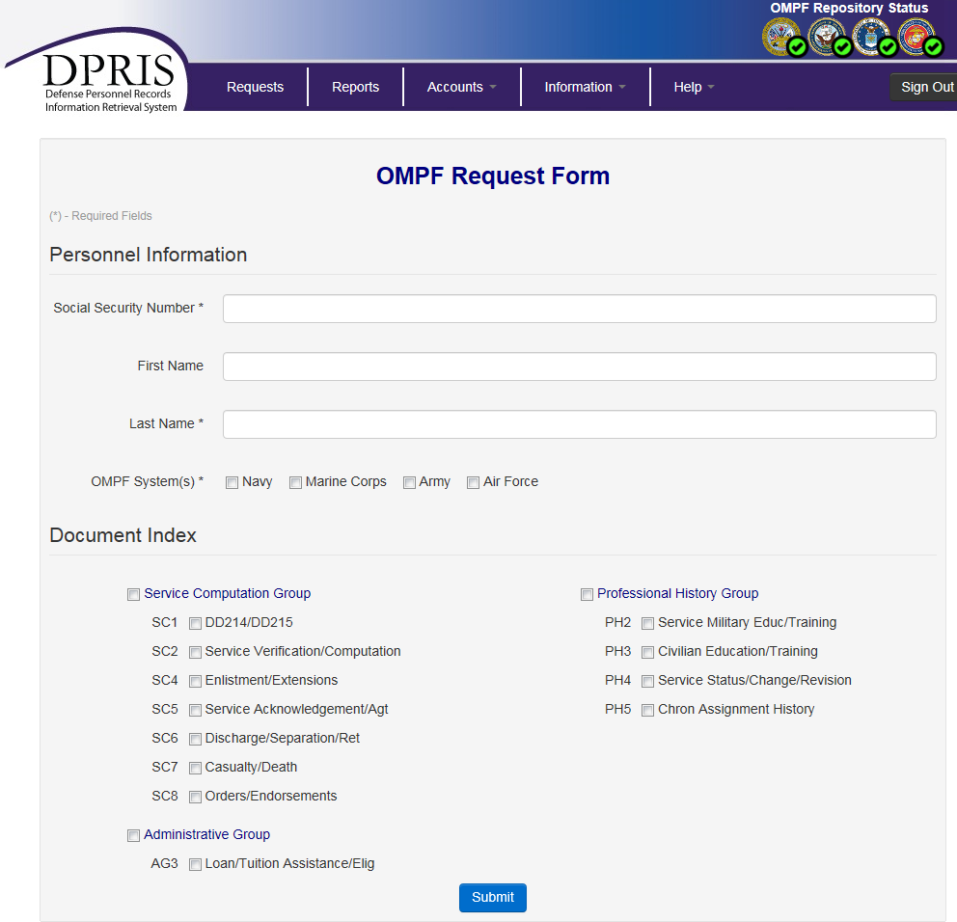
DPRIS - OMPF Request Form
Complete OMPF Request Form as follows:
Include the SSN and last name (required fields)
Check the appropriate box for service department(s) OMPF system
Systems includes reserve and guard service documents too
Check all groups for best searching results. (see example on next slide)
Documents can be misfiled
Press “Submit” button

Slide 11
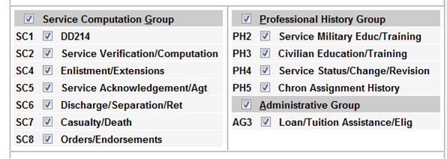
DPRIS – Information Requested
VCEs must request all available information in DPRIS
  Select all options (groups) and submit request
  Suspend claim until notified by DPRIS that the request is completed or 24 hours whichever comes first, before attempting any additional development

Slide 12
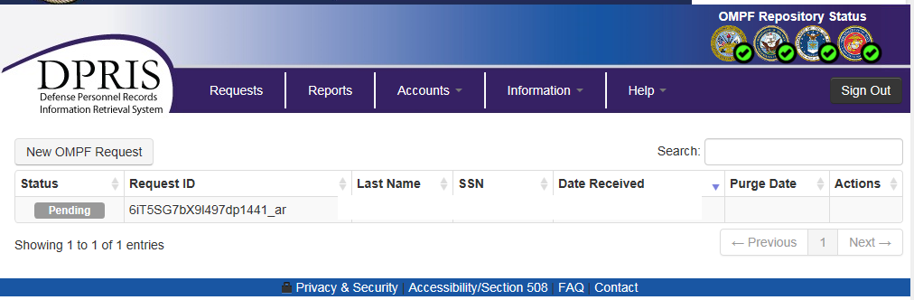
DPRIS - OMPF Request Pending
Once a request is submitted the Pending status and the request information will appear on the DPRIS home page.

Slide 13
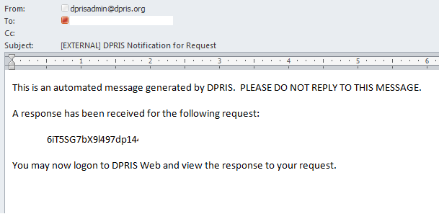
DPRIS - Email Notification
An automated email will be sent when requested documents are available. Usually within an hour.

Slide 14
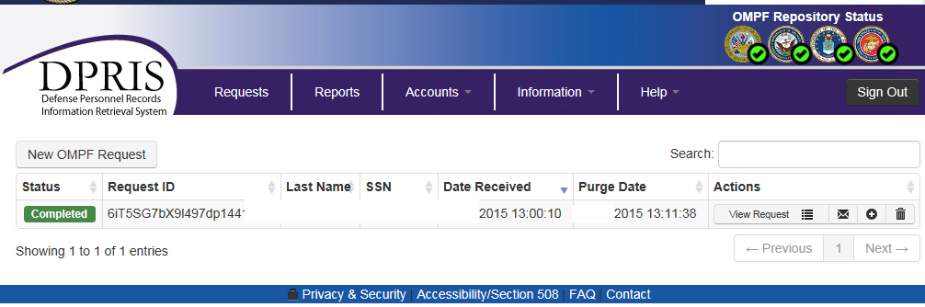
DPRIS - View a Request
Click View Request under Actions column

Slide 15
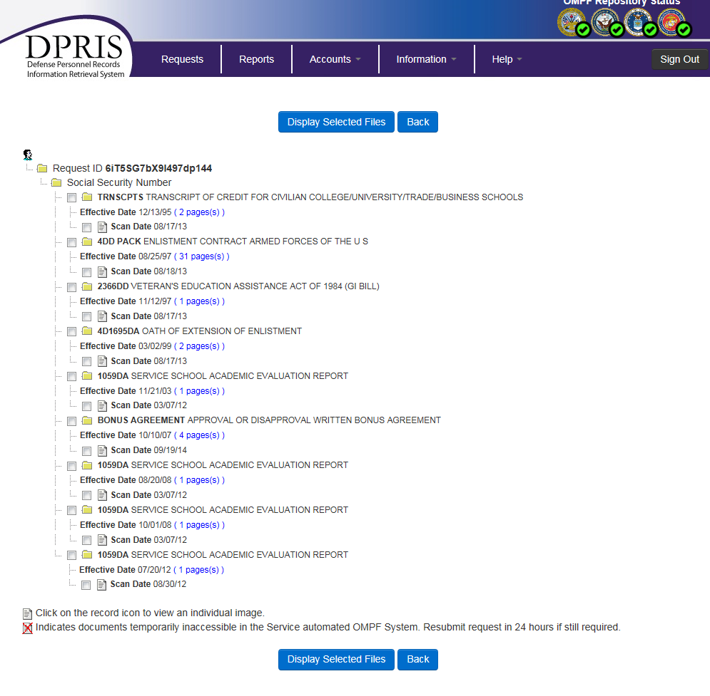
DPRIS - View Documents & Print to TIMS
Select all boxes associated with documents to view and print into TIMS

Slide 16
Questions
16
Notes:
16

