Slide 1
Web Enabled Approval Management System
(WEAMS)
Notes:
DESIGN NOTES TO THE INSTRUCTOR:
Introduction Slide
Add lesson title as appropriate to the training on this slide.
These slides can be used for ILT (Instructor-Led Training) or IWT (Instructor-guided Web-based Training). If you have any questions about developing or delivering training, contact ED&T.
NOTES:
ENSURE TRAINING SUPPORTS VA MISSION AND VALUES.
ENSURE THAT ALL TRAINING YOU DELIVER IS COMPLIANT WITH SECTION 508 OF THE REHABILITATION ACT OF 1973 (29 U.S.C. § 794d). FOR GENERAL INFORMATION ABOUT SECTION 508, PLEASE VISIT http://www.section508.va.gov/
Do not use inaccurate, incomplete, outdated, biased, offensive or otherwise inappropriate graphics/cartoons, materials, jokes, videos , or other files anywhere in your training!
IF IT IS NOT CLEAR THAT THE AGENCY HAS ENDORSED YOUR PRESENTATION’S CONTENT, AT THE BOTTOM OF THIS SLIDE ONLY ADD A FOOTER IN 10 POINT FONT THAT ‘This presentation contains pre-decisional information.’

Slide 2
Overview of Today’s Training
Web Enabled Approval Management System (WEAMS)
  The purpose of this lesson is to provide information and practice on the WEAMS software used to process educational benefits.
  This lesson includes demonstrations, comprehension checks, and exercises that provide opportunities for the student to practice the knowledge and skills presented in the lesson.

Slide 3
Icebreaker Activity
Answer this question:
  What does the term “Approval Management” mean to you?

Slide 4
Lesson Objectives
After you have completed the WEAMS lesson, you should be able to:
  Using available references, define the purpose of WEAMS
  Using available resources and the WEAMS program, perform basic WEAMS functions, including accessing the program, logging in, and basic search functions
  Using the WEAMS website, perform advanced WEAMS functionality, including advanced, facility code, and school verification searches
  Using the WEAMS website, identify approval information and an organization’s Yellow Ribbon participation

Slide 5
WEAMS Overview
For VBA personnel and other interested parties, WEAMS provides:
  General information about organizations offering training
  A database to enter approval and other information
  A system to view approval information
  Approval information to determine an institution’s eligibility to provide VA-approved training

Slide 6
VA/VBA Use of WEAMS
WEAMS is VA’s official repository for information about approved programs. This important information is used to determine the appropriate payment in the processing of educational claim benefits.
Not Important

Slide 7
Comprehension Check
Question:
For VA/VBA purposes, what is WEAMS?

Slide 8
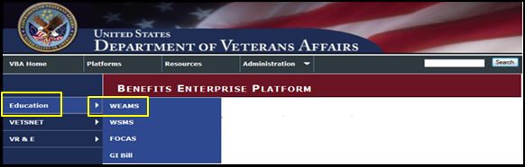
WEAMS - Access
WEAMS access:
  Access the portal:
http://webapps.vba.va.gov/vbaapps/security/home.html
  Select “Education”
  Select “WEAMS”

Slide 9
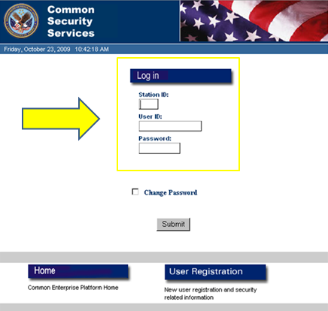
WEAMS - Login
On the login screen, “Enter”:
  Station ID
  User ID
  WEAMS Password (CSS Login)
Select “Submit”

Slide 10

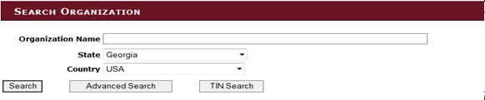
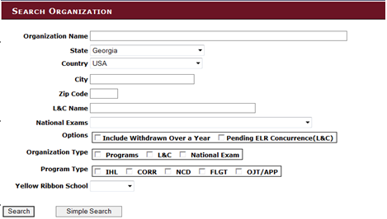
WEAMS - Main Page
Search Options
Facility Code Search
Simple Search Name and State
Advanced Search

Slide 11
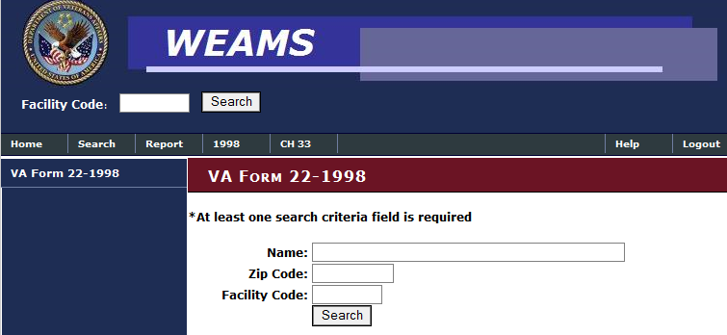
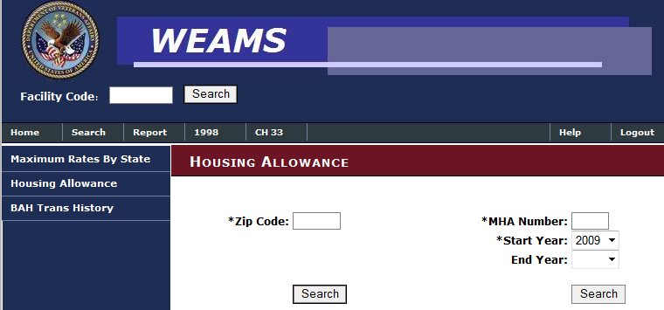
WEAMS - Main Page
Search Options (Continued)
VA Form 22-1998 Search
Housing Allowance Search

Slide 12
Practice Exercise
WEAMS Login/Search
Practice accessing WEAMS by doing the following:
Log into the program
Perform the following searches:
  Facility Code Search
  Simple Search Name and State
  Advanced Search
  VA Form 22-1998 Search
  Housing Allowance Search

Slide 13
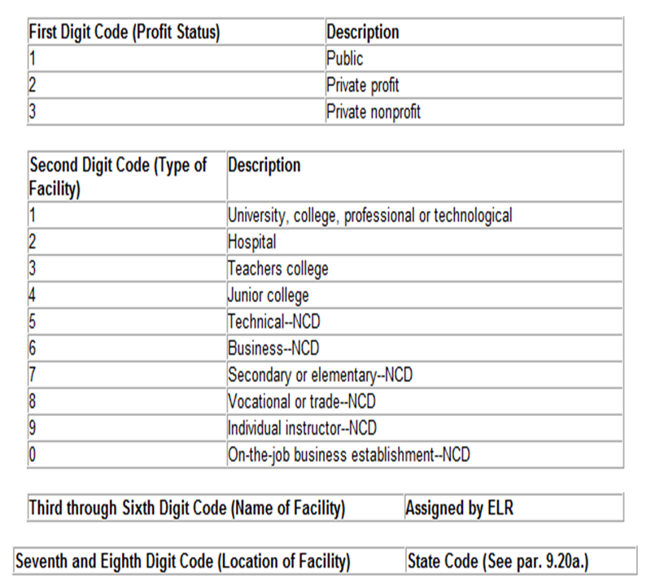
Facility Code
Education Liaison Representative (ELR) assigns the institution’s 8-character alphanumeric facility code.
This code has 8 digits in 4 parts:
  Profit status
  Type of training facility
  Name
  Location

Slide 14
Facility Code - First Digit
The first digit of the facility code determines if the facility is public, private for-profit, or private not-for-profit:
Important
First Digit Code (Profit Status) | Description
1 | Public tax supported facility
2 | Private for-profit facility
3 | Private not-for-profit facility
Not Important

Slide 15
Facility Code - Second Digit
The second digit of the facility codes are as follows:
IHL Code | Description
1 | Highest level programs baccalaureate or graduate degrees
2 | Accredited hospital (medical residency or clinical programs)
3 | Teachers college (rarely used)
4 | Highest level programs are associate’s degrees
Non-IHL Code | Description
5 - 8 | Non-degree certificate (NCD) and all other schools including high schools, technical non-degree schools, etc.
9 | Assigned for VR&E only for evaluation services
0 | Job training establishments (JTE), i.e., apprenticeship or other on-the-job training
Important
Not Important

Slide 16
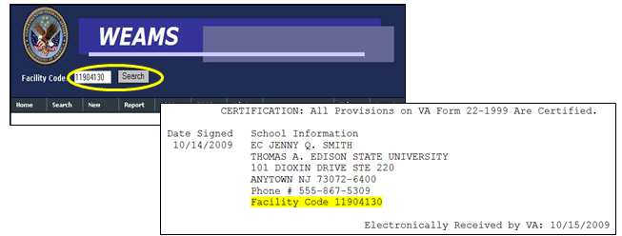
Facility Code Search
School approval information can be located by searching the 8 character alphanumeric facility code shown on VA Form 22-1999 in TIMS.

Slide 17
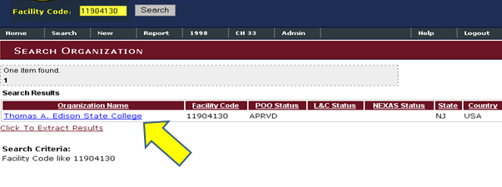
Organization’s Name Hyperlink
When conducting a search, the organization’s name will appear as a hyperlink. Select the hyperlink to view specific approval information.

Slide 18
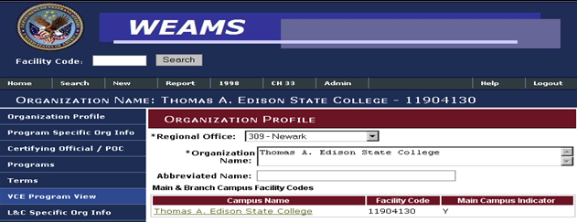
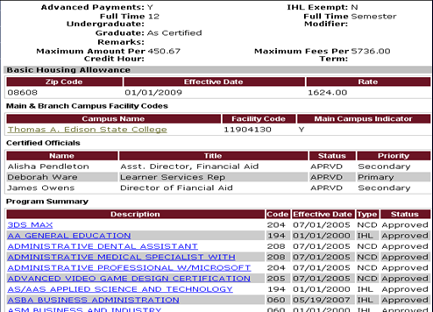
VCE Program View
On the organization profile screen, select the “VCE Program View” menu to verify school information such as:
Number of hours required for full time undergraduate
Full time modifier
Number of hours or “As Certified” for full time graduate
List of approved programs

Slide 19
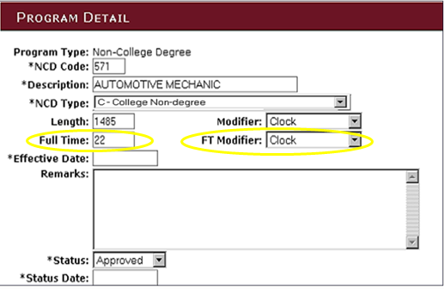
VCE Program View - Program Detail
Check the Full Time Hours and the Full Time Modifier (Clock Hours) for the NCD Automotive Mechanic Program.
Not Important

Slide 20
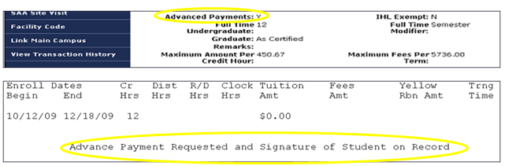
WEAMS - Review of Information
If the Enrollment Certification indicates that Advance Payment is requested, you must verify if the school participates in the Advance Payment program.

Slide 21
Yellow Ribbon Processing
RPOs must verify if a school is a Yellow Ribbon program participant before processing an enrollment certification containing Yellow Ribbon amounts.
If the school is not a Yellow Ribbon participant, do the following:
  Process the certification without the Yellow Ribbon Program benefits.
  Send a letter to both the school and individual indicating that the school is not a Yellow Program participant.

Slide 22
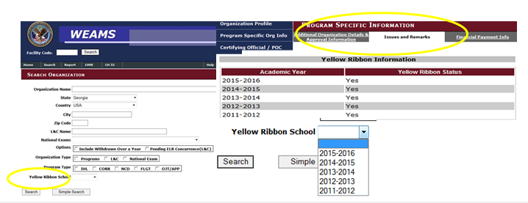
Yellow Ribbon Verification
Verify Yellow Ribbon participation in the following ways:
  Program Specific Org Info > Issues and Remarks tab
  Advanced Search > Yellow Ribbon School Year

Slide 23
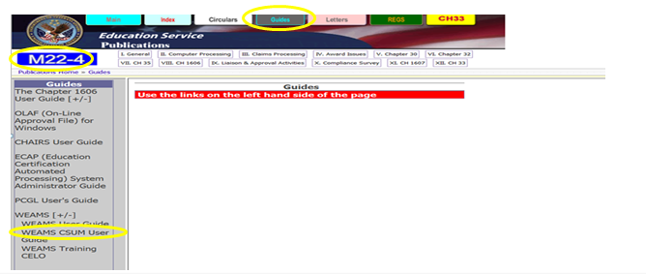
WEAMS User Guide
The WEAMS User Guide can be accessed via the WEAMS-22-4, Guides Tab by selecting WEAMS or @:
http://vbaw.vba.va.gov/bl/22/ref/guides/index.html

Slide 24
Comprehension Check
Question:
If a school does not participate in the Yellow Ribbon program, what process is the RPO required to follow?

Slide 25
Summary
You have completed the WEAMS training. You should be able to:
  Using available references, define the purpose of WEAMS
  Using available resources and the WEAMS program, perform basic WEAMS functions, including accessing the program, logging in, and basic search functions
  Using the WEAMS website, perform advanced WEAMS functionality, including advanced, facility code, and school verification searches
  Using the WEAMS website, identify approval information and an organization’s Yellow Ribbon participation

Slide 26
Questions?

Slide 27
TMS Assessment and Survey
The assessment and survey have been assigned to you in TMS
The assessment is comprised of multiple choice questions
The questions are based on the information you learned today
The assessment should take approximately 30 minutes
Be sure to complete both the assessment and the survey in TMS to receive credit for this training.

