Slide 1
For TMS Training Credit
To obtain training credit in TMS, there is no need to review these slides at this time – immediately close this box by using your mouse to select the “X” in the upper right-hand corner; select “Return to Content Structure” button; and, select the next link (Video) to view the audio recording of the Quality Call along with the Quality Call Bulletin
  These slides are included here only in case you want to use them later for training purposes or reference
    These are the exact same slides that are shown in the audio recording

Slide 2
Compensation Service
Quality Call
August 2021

Slide 3
Welcome to the August 2021 Compensation Service Quality Call
Bonnie Kirby
Senior Quality Review Specialist
Quality Review Team, Quality Assurance

Slide 4
Agenda
What’s New in M21-1?
  M21-1 Reorganization Project
New Presumptive Conditions Due to Particulate Matter Exposure
Specially Adapted Housing Reminder
VBMS-A Award Effective Dates and Incorrect Payment Displays
(July 26-27, 2021)

Slide 5
M21-1 Reorganization Effort Updates
Dustin Z. Williams
Lead Program Analyst
Procedures Maintenance

Slide 6
M21-1 Reorganization Effort
Procedures Maintenance has partially completed the third of six planned phases of M21-1 content reorganization.
  July 15, 2021 – Released new M21-1, Part VII, Dependency, comprised of select content previously located in M21-1, Parts III and IV.
  July 29, 2021 - Released new M21-1, Part VIII, Special Compensation Issues, comprised of select content previously located in M21-1, Parts III and IV, and all content previously located in M21-1, Part VI (now reserved to accommodate content yet to be reorganized).

Slide 7
M21-1 Reorganization Effort (Cont.)
The entirety of M21-1 content reorganization is expected to be completed by September 30, 2021. Still to come are releases of numerous new parts on progressive delivery dates, as outlined in the table below.
Content | Proposed Release Date
Part X, Benefits Administration and Oversight | August 19, 2021
Part IX, Pension, Survivors’ Pension, and Parent’s Dependency and Indemnity Compensation (DIC) | September 1, 2021
Part VI, The Authorization Process | September 1, 2021
Part V, The Rating Process | September 15, 2021
Part IV, Examinations | September 15, 2021
Part III, The Development Process | September 30, 2021
Part I, Claimants’ Rights and Claims Processing Centers and Programs | September 30, 2021

Slide 8
M21-1 Reorganization Effort
Compensation Service will continue to provide updates on M21-1 reorganization using previously discussed media, including
the M21-1, Adjudication Procedures Manual, FY21 Reorganization Guide
the Compensation Pension Knowledge Management Portal (CPKM) landing page under the Breaking News header
Compensation Service Bulletins, and
Compensation Service Calendar updates, normally occurring on Fridays, identifying M21-1 content published during the week.

Slide 9
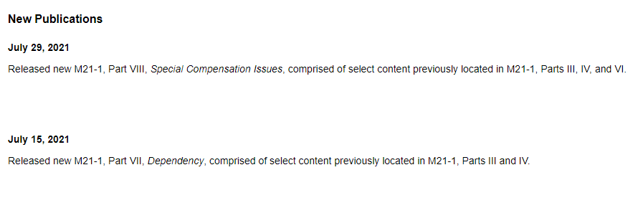
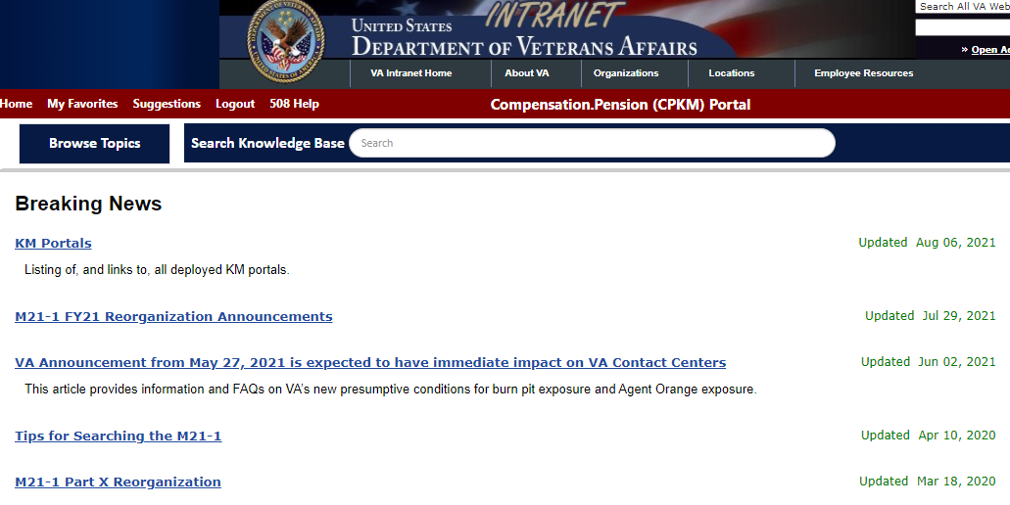
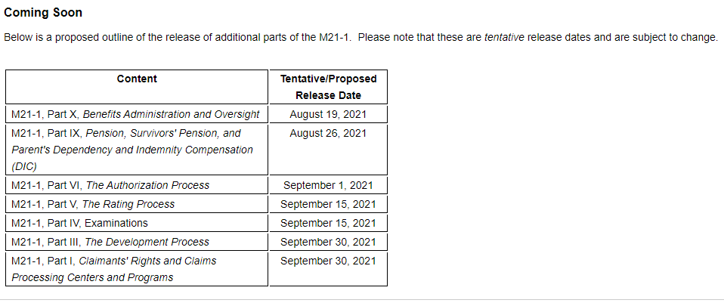
Reorganization Resource Reminders –
CPKM Breaking News Article

Slide 10
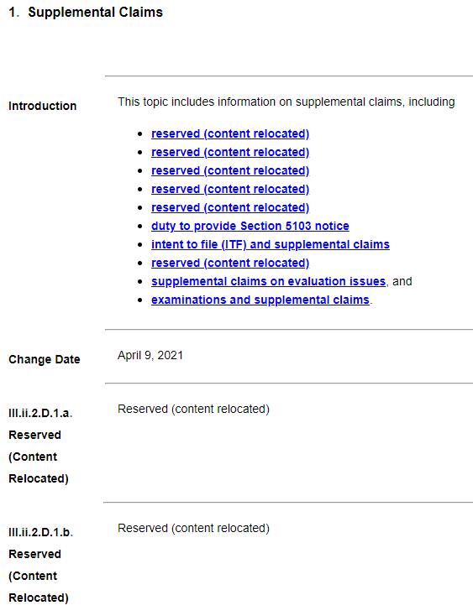
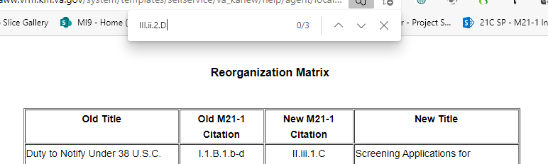
Reorganization Resource Reminders –
M21-1 FY21 Reorganization Guide (and Matrix)
Example: Former coverage of supplemental claims in M21-1 III.ii.2.D.

Slide 11
New Presumptive Conditions due to Particulate Matter Exposure
Abigail J. Werner
Management and Program Analyst
Legislative Staff, Policy and Procedures

Slide 12
New Presumptive Conditions
On August 5, 2021, an interim final rule (IFR) was published in the Federal Register to amend 38 C.F.R. § 3.159 and add 38 C.F.R. § 3.320.
  The IFR establishes a presumption of service connection based on exposure to fine, particulate matter and the manifestation of chronic asthma, rhinitis and sinusitis, to include rhinosinusitis.
  Exposure to particulate matter may be conceded with qualifying service, which means a period of active military, naval, or air service in the Southwest Asia theater of operations on or after August 2, 1990, or in Afghanistan, Syria, Djibouti or Uzbekistan on or after September 19, 2001, during the Persian Gulf War.

Slide 13
New Presumptive Conditions Cont.
There is no minimum time limit for the length of military deployment.
The condition(s) may manifest to any degree of disability (i.e., non-compensable conditions qualify).
The condition(s) must manifest within 10 years of separation from the last period of military service.

Slide 14
New Presumptive Conditions Cont.
To ensure the new presumptive conditions are properly addressed in the claim process, the relevant training course must be self-assigned and completed.
Additional information may be found in M21-1, VIII.ii.2.A-C and in VBA letter 20-21-12, Presumptive Service Connection for Respiratory Conditions Due to Exposure to Particulate Matter.
The full version of the IFR is available to review on Federal Register’s website.

Slide 15
M21-1 Updates
Added three new sections pertaining to exposure to fine, particulate matter (38 CFR 3.320) in Part VIII, Subpart ii, Chapter 2
  VIII.ii.2.A – General Information on Claims Based on Particulate Matter Exposure
  VIII.ii.2.B – Developing Claims Based on Particulate Matter Exposure
  VIII.ii.2.C – Rating Claims Based on Particulate Matter Exposure
Manual guidance should be applied in concert with the principles of 38 CFR 3.320 and VBA letter 20-21-12, Presumptive Service Connection for Respiratory Conditions Due to Exposure to Particulate Matter.

Slide 16
Specially Adapted Housing (SAH) Eligibility Reminder
Bonnie Kirby

Slide 17
Specially Adapted Housing (SAH) Eligibility
PL 116-154 amended the blindness criteria for entitlement to SAH
  Permanent bilateral (BL) blindness 20/200 or less in the better eye with the use of a correcting lens
  Not necessarily total
  Effective August 8, 2020
M21-1 XIII.i.2.B.1.c

Slide 18
Specially Adapted Housing (SAH) Eligibility
Cite 38 U.S.C. 2101 as the authority for grants on this basis until regulation (38 CFR 3.809) updated
Reminder:
  SAH may be granted when Special Home Adaptation (SHA) has previously been granted.
  SHA may not be granted if SAH has previously been granted.
38 CFR 3.809 and 3.809a
M21-1 XIII.i.2.B.1.d

Slide 19
VBMS-A Award Effective Dates and Incorrect Payment Displays (July 26-27, 2021)
Isabelle Brisendine
Consultant
Authorization & Non-Rating Team, Quality Assurance

Slide 20
VBMS-A Awards
July 26-27, 2021
VBMS-A awards generated July 26-27, 2021, may have errors
  Incorrect effective dates and rates
  Not all awards generated were incorrect
OFO issued reports to ROs July 30, 2021, for review and correction
VSRs must ensure rates/dates are correct upon promulgation of awards

Slide 21
* Present a Topic
* Suggestions
* Next Quality Call
Bonnie Kirby

Slide 22
Would You Like to Present a Topic?
We are offering opportunities for RO SMEs to present topics during Compensation Service Quality Call recording sessions
  Peer-to-Peer communication is optimum
If YOU are interested in presenting a topic in a future Quality Call
  Talk to your Coach or other RO management team member
  If okay, have management send your name and topic to
    VAVBAWAS/CO/InternalQRS

Slide 23
Do You Have Suggestions for Topics?
If you have topic suggestions for a future Quality Call, please email the Quality Call Lead (Bonnie Kirby) at VAVBAWAS/CO/InternalQRS
  In your email, please include
    Cc to your Coach or other RO management
    Name of topic
    Intended audience (VSR Pre or Post, RVSR, AQRS, RQRS, etc.)
    Applicable 38 CFR and/ or M21-1 references
Quality Call Bulletins can be found on the STAR Home Page on the Compensation Service Intranet site, TMS, and VBA Learning Catalog
Audio recordings of the Quality Calls with separate copies of the PowerPoint slides can be found in both TMS and the VBA Learning Catalog

Slide 24

When is the Next Quality Call?
Compensation Service Quality Calls are recorded monthly, except September
  First Quality Call of FY22 scheduled to be recorded the week of October 11th

